Slide 1

Deliveron consulting services
Installing and Configuring Team Foundation Server 2008

Slide 2
About Mike Douglas
Solution Consultant at Deliveron Consulting Services MikeDouglas@Deliveron.com
Previously Lead Developer at FCSAmerica
Team Foundation Server
2nd OTSUG Presentation
2 Open source projects
http://TeamDeploy.CodePlex.com
http://TFSBuildLight.CodePlex.com
http://www.CodeSmartNotHard.com
Team System and TFS Jumpstart

Slide 3
Team System and TFS Jumpstart
2 Week Engagement
Assessment
Installation
Configuration
Knowledge Transfer / Training
Advanced Customization

Slide 4
Agenda
About Team System
Installation
Configuration
Top 5 “Gotchas”
Changes in Team System 2010

Slide 5
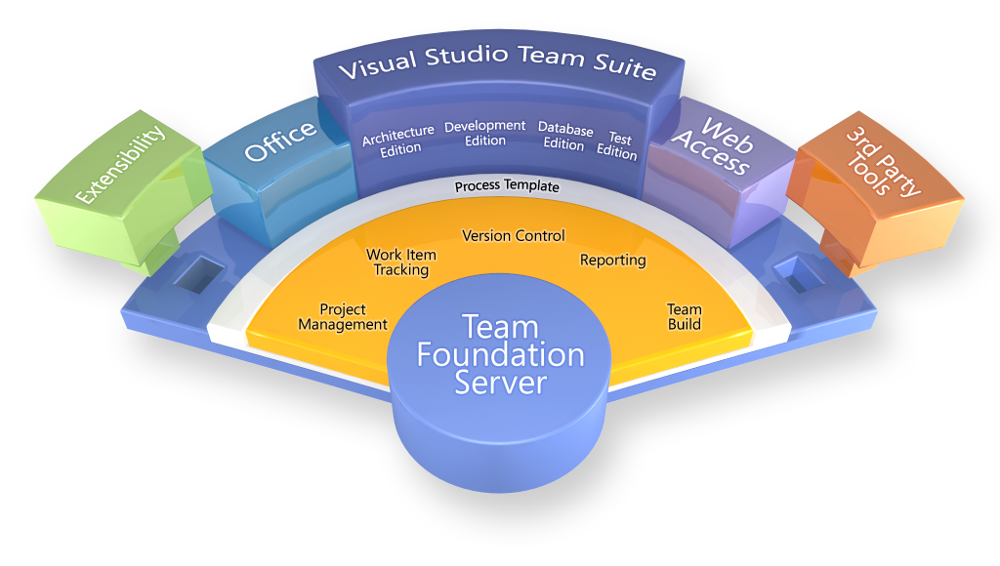
Team System Components

Slide 6
Editions of Team Foundation Server
Standard
Server license cost
Users are required to have a CAL to access*
Workgroup
Limited to 5 users
Included with MSDN Premium
Same features as Standard

Slide 7
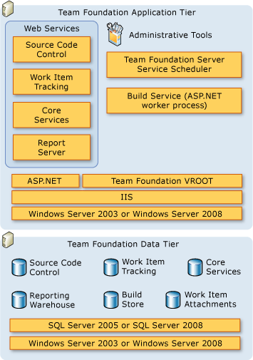
TFS Logical Architecture

Slide 8
TFS Physical Architecture
Simple Topology (under 100 users)
Moderate Topology (under 1000 users)
Complex Topology (2000 users)
Unsupported Topologies

Slide 9
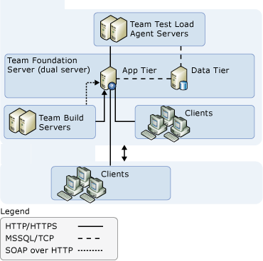
TFS Physical Architecture

Slide 10
Unsupported Topologies
Domain with NT 4 authentication modes such as W2K mixed-mode.
NLDB clustering for application tier
Splitting TFS web services across multiple servers
Multiple TFS instances on same computer
Databases can not be stored on separate computers
Windows Server 2003 Web Edition

Slide 11
User Accounts
2 Main Accounts required
TFS Setup – User for installation. Updates must also be done with the same user
TFS Service – User for service accounts (can be some for other services)
Domain Environment
Must use domain accounts
No Active Directory / Workgroup environment
Can use local accounts

Slide 12
Server Pre-Installation
Best Practice Analyzer (and Demo)
Use the TFS Installation Guide
System Health Check
Pre-Installation Demo

Slide 13
Server Installation Order
W2K3 or W2K8 (TFS Server must be 32bit)
WSS 3.0 SP 1 (Required if W2K8)
SQL Server 2005 or 2008 (Standard or Higher)
TFS (Integrated Installation if SQL Server 2008)
Team Foundation Build
Team Explorer
Team System Web Access SP1
TFS SP1 and VS2008 SP1
TFS Admin 1.4
Install SQL Server 2008 SP1

Slide 14
Client Installation
Visual Studio 2008 (Standard or higher)
VSTS 2008 Database Edition GDR R2 (Included with Dev Edition)
Team Explorer
VS 2008 SP1
Power Tools – Must Have Download

Slide 15
Configuration
Groups and Permissions
Connecting to TFS
Workspaces
Alerts
Source Control Settings

Slide 16
Groups and Permissions
Must maintain permissions in 3 places
TFS
SharePoint
Reporting Services
TFS Admin Tool
Managing Permissions Demo

Slide 17
Connecting To TFS
Team Explorer First Look
Workspaces
Mapping server path to local path. Similar to Working Directory in VSS.
Server keeps track of workspace by Username + Machine name (really uses SID).
Connect to TFS / Workspaces Demo

Slide 18
Alerts
Email notifications for actions such as
Build Failures (success also)
Work Items assigned to “me”
Check Ins
Included options are limited
Power Tools provides a lot more options
Alerts Demo

Slide 19
Source Control Settings
Structure
Branching Guidelines
Multiple Check-out
Force Get Latest
Check-In Policies
Source Control Settings Demo

Slide 20
TFS Urls
Team System Web Access
http://tfsserver:8090
Each Team Project SharePoint Portal
http://tfsserver/sites/myproject
TFS Reports
http://tfsserver/reports

Slide 21
Administration
Administration CHM
http://tinyurl.com/tfs2k8adminguide
Backups
Add TFS Databases to normal SQL Server backup schedule
Reporting Services Encryption Key

Slide 22
Installation Troubleshooting
Do not trust the error on the display dialog. Always go to the log to determine the real error message.
Log files (C:\Documents and Settings\<user>\Local Settings\Temp)
VSMsiLogxxxx.txt - Detailed installation steps of MSI and where it failed.
dd_error_vstf_at_90.txt - Lists the error message for each installation attempt.
dd_install_vstf_at_90.txt - Detailed steps of the installation steps.

Slide 23
Mike’s Top 5 Gotchas
5. If installing WSS 3 SP1, do advanced install and apply domain user
4. If using Sql Server 2008 you must do a integrated install with service pack one.
3. Don’t Install TFS Data Tier on Dev Database Servers
2. Need to Install SP1 After Team Explorer is installed
1. A Company doesn’t use the Deliveron TFS Jumpstart to implement TFS

Slide 24
Changes in TFS 2010
Pre-reqs
Server OS – W2K3 SP3, W2K8 SP2, W2K8 R2
64 bit – 32bit and 64bit versions
SQL Server – SQL Server 2008sp1 or SQL Server 2010
SharePoint – WSS 3.0 SP2, WSS 4, MOSS 2007 SP2, MOSS 2010

Slide 25
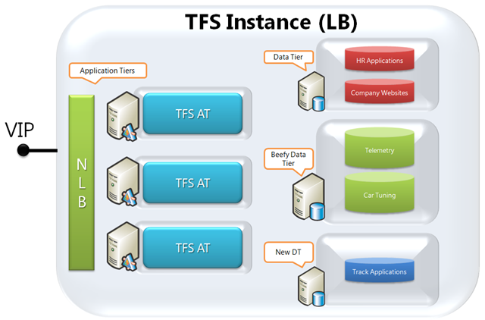
Changes in TFS 2010 (cont)
Application Tier NLB
SQL Server scale out
Sharepoint and Reports are optional
Kerberos support
Setup and Configuration are separate

Slide 26
Links
Mike Douglas’ Blog on TFS, CSLA.NET, and Code Generation http://www.codesmartnothard.com/
Brian Harry’s Post on TFS 2010 Config, Install http://blogs.msdn.com/bharry/archive/2009/04/30/tfs-2010-admin-operations-setup-improvements.aspx
Team Foundation Installation Guide for Visual Studio Team System 2008 http://www.microsoft.com/downloads/details.aspx?FamilyID=FF12844F-398C-4FE9-8B0D-9E84181D9923&displaylang=en

