Slide 1
Installing Visual Studio 2010 and connecting Team Foundation Server
http://phase2.com/TFS

Slide 2
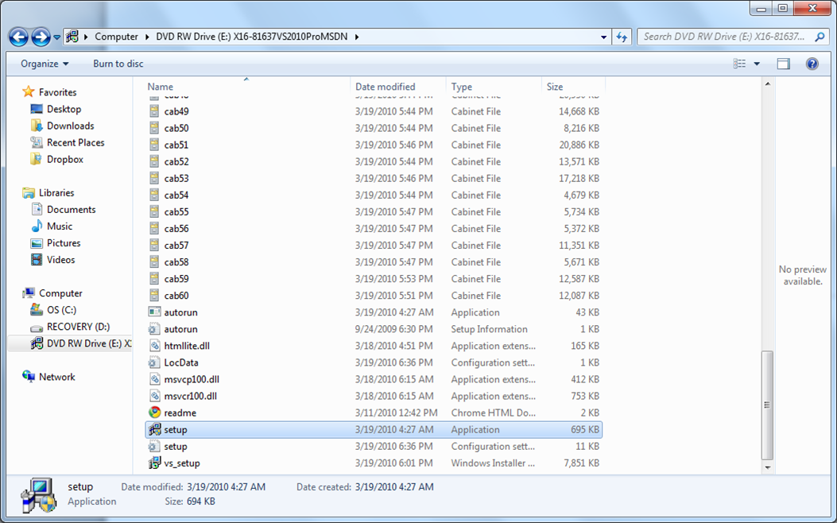
After downloading or inserting disc, select setup.exe

Slide 3
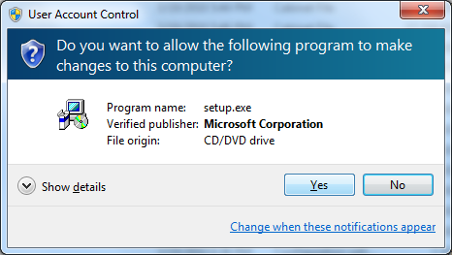
Choose yes

Slide 4
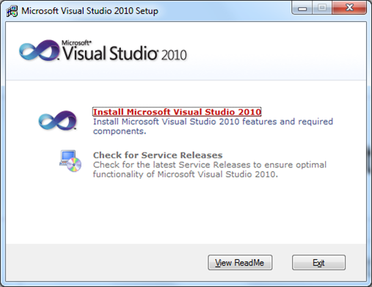
We recommend checking for the latest service release, but its not neccesary

Slide 5
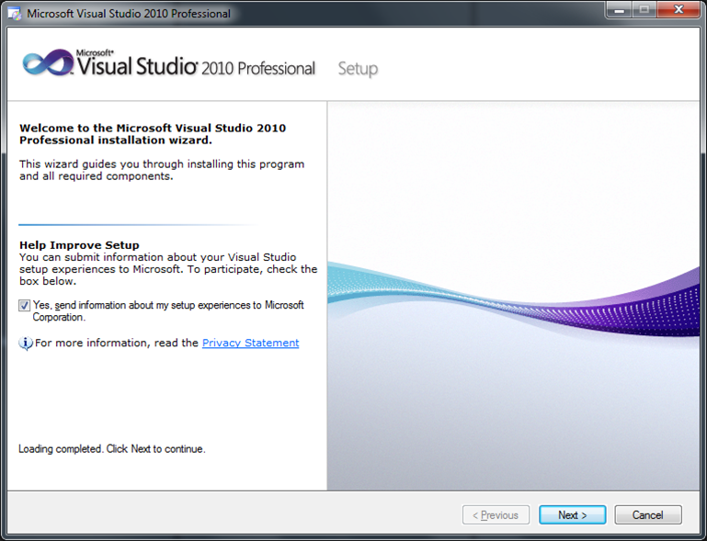
Choose Next to start the setup wizard

Slide 6
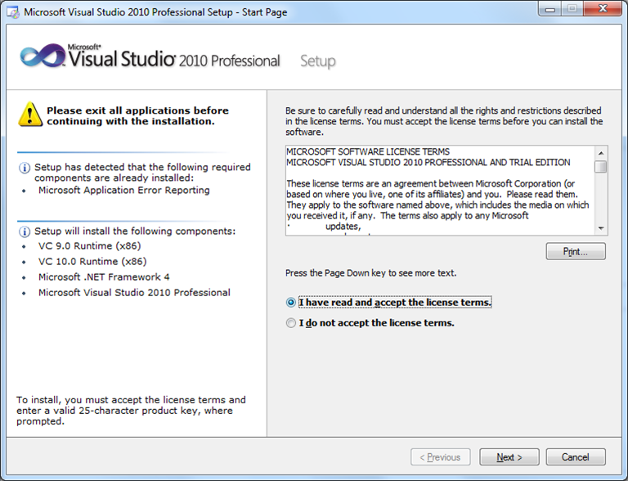
Choose I have read and accept.

Slide 7
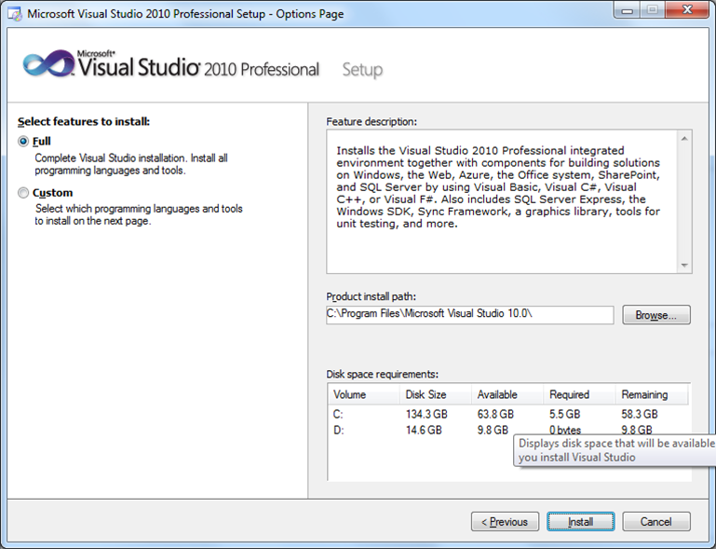
Unless you are certain that you only need certain sections of the program
Choose full install.

Slide 8
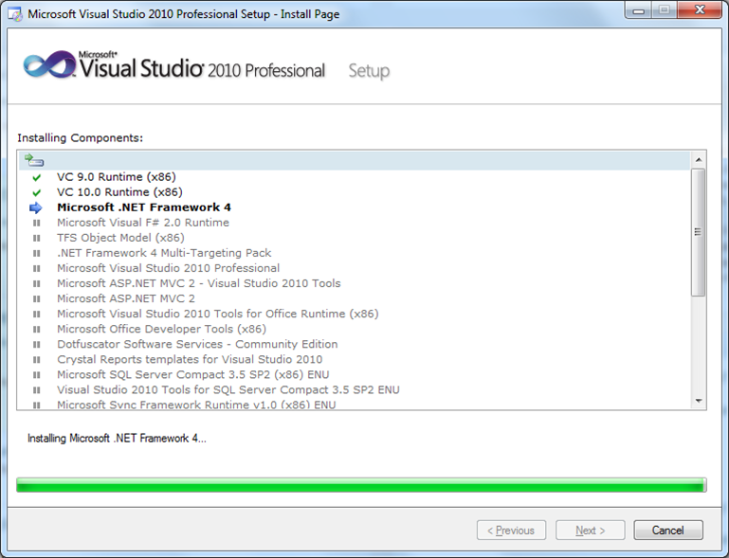
If you don’t have the .NET framework
Installed, this process can take a while.

Slide 9
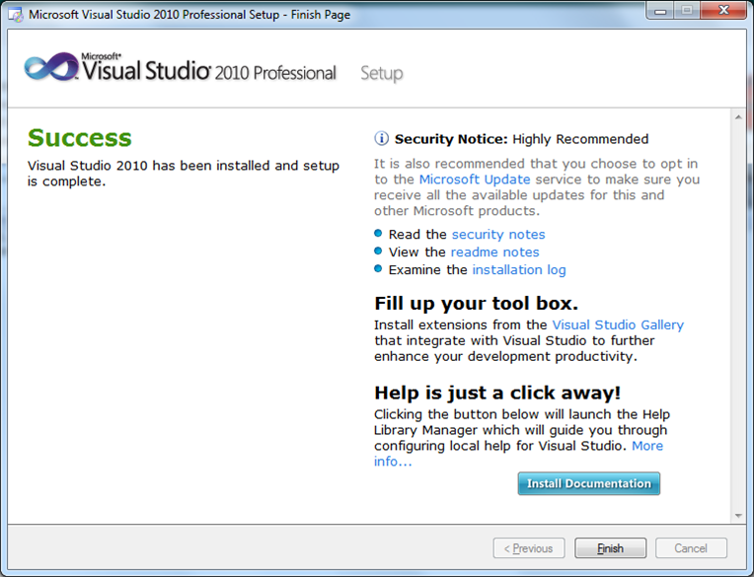

Slide 10
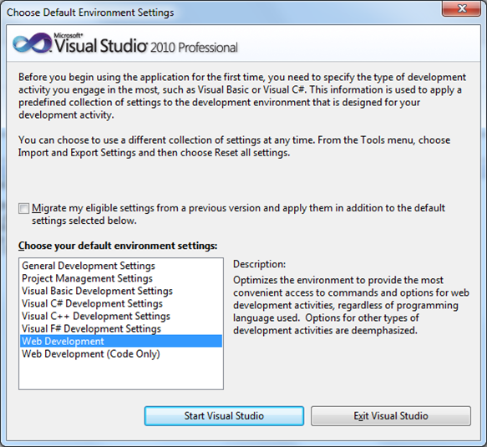
Select your typical workflow (this can be changed later)

Slide 11
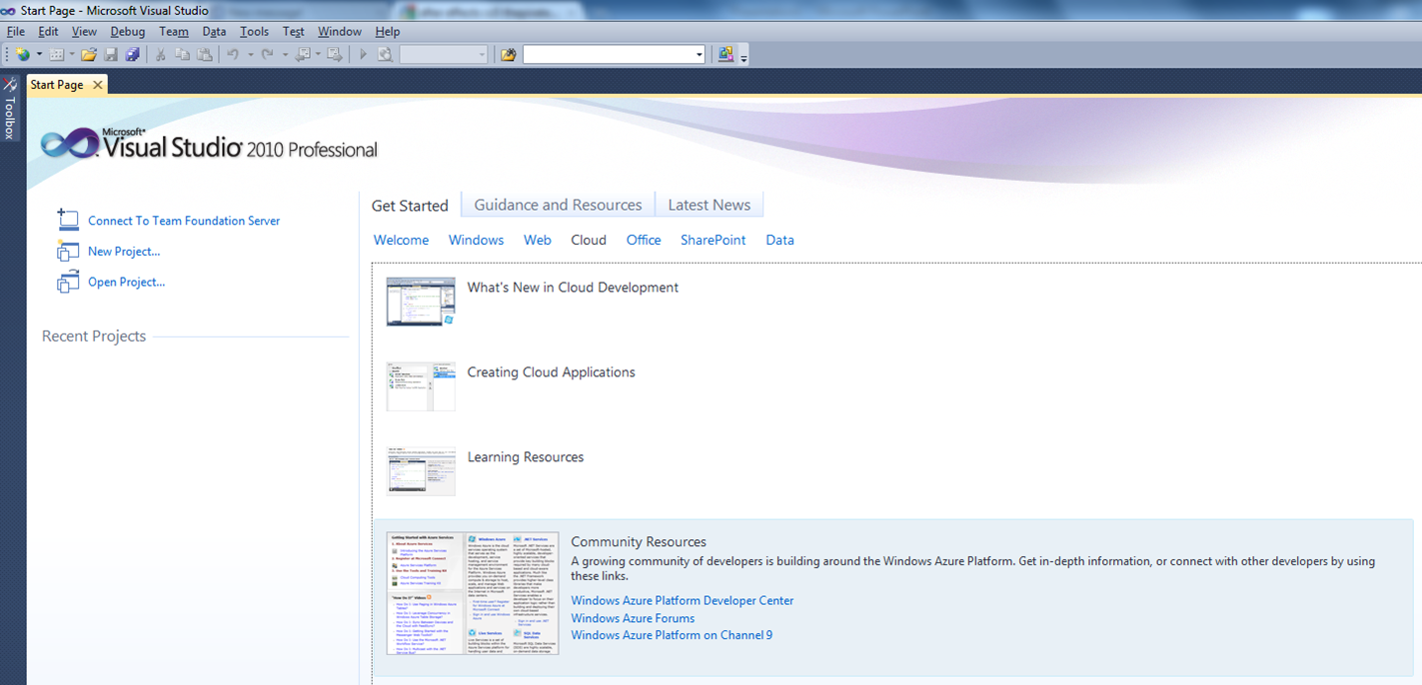
Choose “Connect to Team Foundation Server” (if you have a server setup, if not,
We can help phase2.com/TFS or call 800-550-2739)

Slide 12
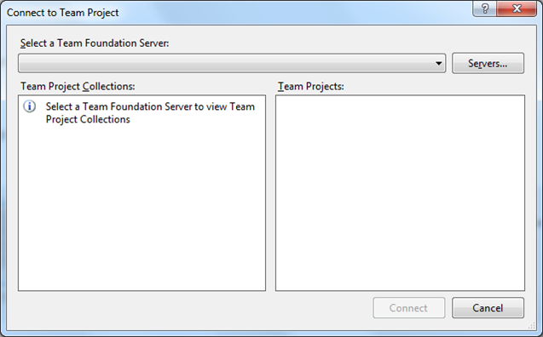
Click Servers

Slide 13
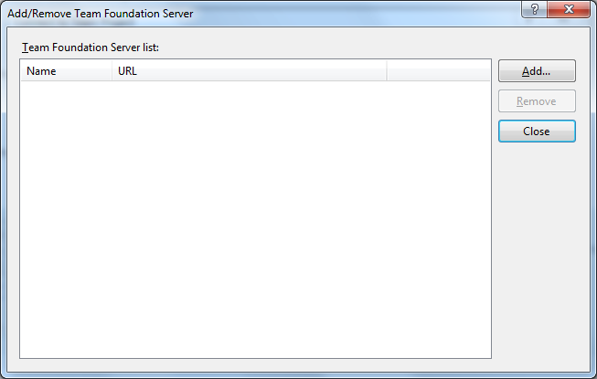
Choose add

Slide 14
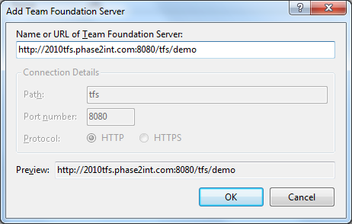
Enter the URL to your TFS server.
If your connecting via SSL, choose the HTTPS protocol.

Slide 15
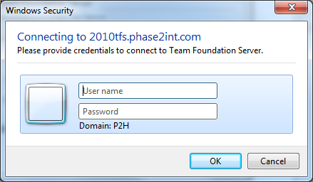
Enter your authentic an details.

Slide 16
Need any help?
Let us know at phase2.com/contact

