Slide 1
Project Management with TFS 2013
Hossein Sarshar
Senior Software Engineer
Saman Salamat Pajoh

Slide 2





Where is the problem?
Source Control
.....
.....
New Task
Project Management
Bug Tracker
Saman Salamat Pajouh
.....
.....

Slide 3



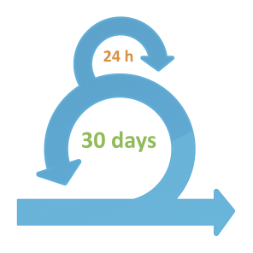






Offered solution:
Project Management
Saman Salamat Pajouh
Version Control
Project Management
Work Item Tracking (Bug, Task, Feature, …)
Feedback Management
Team Management
Reporting

Slide 4
What is Team Foundation Service?
Full Application Lifecycle Management Suite
from: http://goo.gl/NPhsf7
Web • Client • Server • Cloud • SharePoint • Java • iOS
Visual Studio • Team Explorer Everywhere
Scrum • CMMI • Agile
Team Foundation Service
Planning
SCM
Work Item Tracking
Continuous Delivery (Azure)
Build Automation
Feedback Management

Slide 5


Project management options
Scrum
Agile
CMMI
Agile Scrum
General Agile
A Waterfall Model

Slide 6
Why we should avoid waterfall?
Source: Forrester/Dr. Dobb's Global Developer Technographics Survey 2009

Slide 7
How waterfall works
Requirements
Design
Verification
Implementation
Maintenance

Slide 8
HOW AGILE Scrum WORKs
Test
Check-in
Code
24 hours
Update the Task
“Sprint 0”
Scrum
Product Vision
Product Backlog
Sprint Review
2 – 4 weeks
Backlog Grooming
Sprint Retrospective
Potentially Shippable* Product
Sprint Backlog
Sprint Planning
from: http://goo.gl/NPhsf7

Slide 9
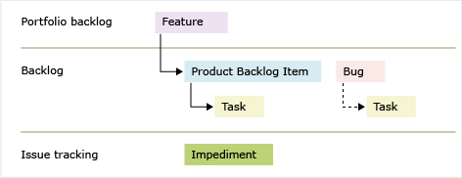
What tFS offers for project management
Working Item tracking (tracking tasks, processes, bugs, feedbacks, …).
Feature: is a top level entity in scrum hierarchy and defines a very big goal which consists of some product backlog items, tasks, bug and ….

Slide 10
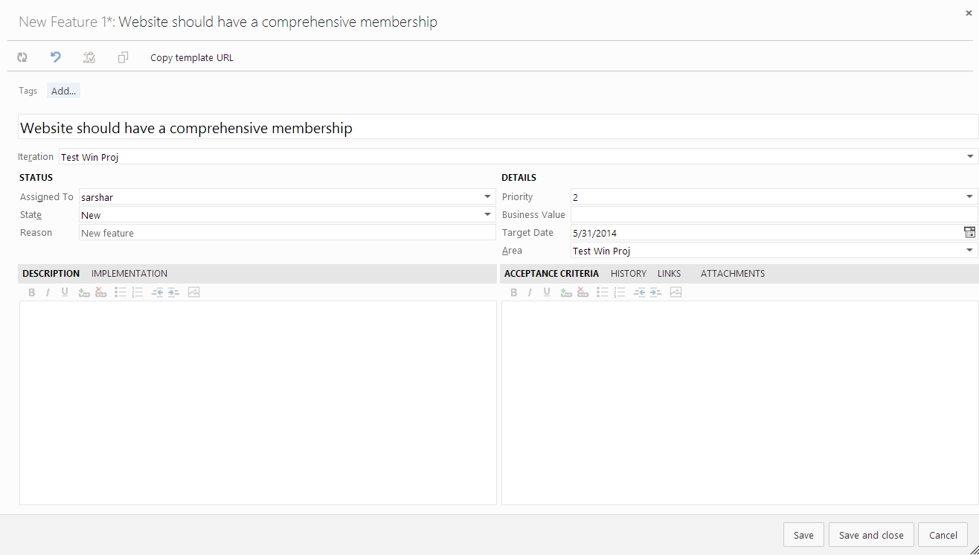
Feature fields

Slide 11
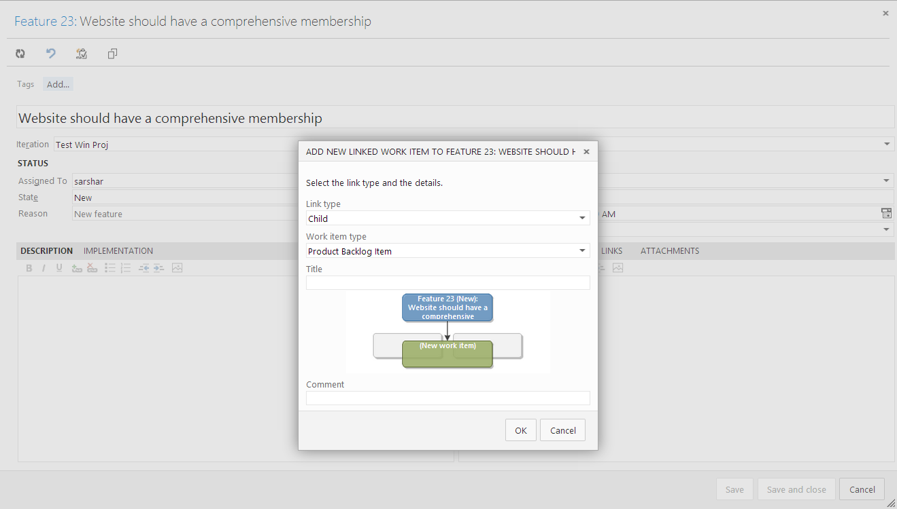
Product Backlog Item
Product Backlog Item: When you define a product backlog item, you want to focus on the value that your customers will receive and avoid descriptions of how your team will develop the feature.

Slide 12
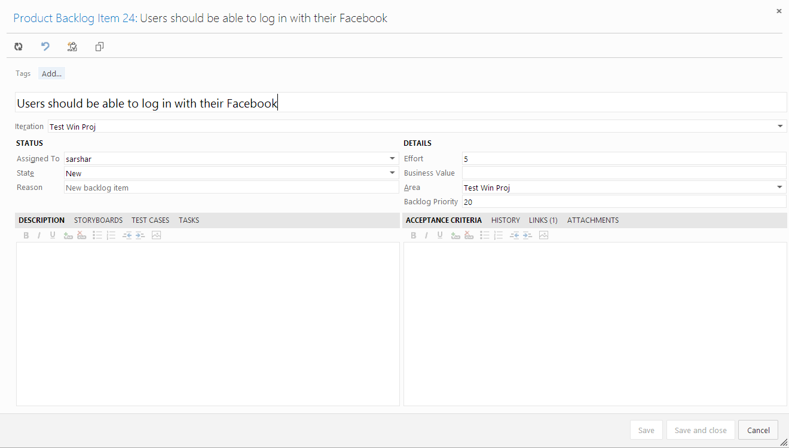
PBI fields

Slide 13
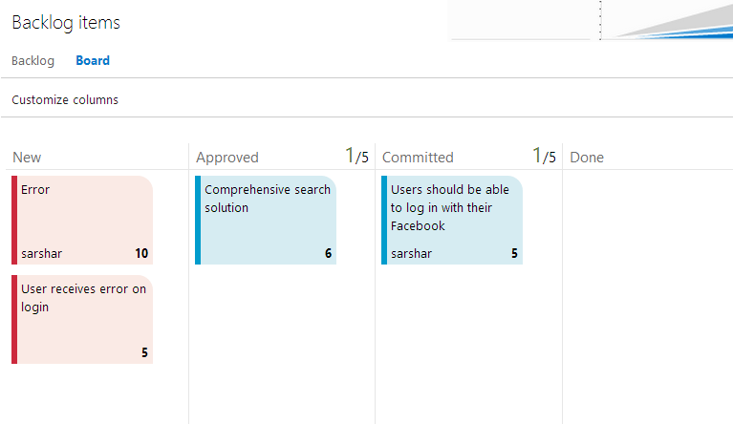
PBI Kanban board
The product owner creates a PBI in the New state with the default reason, New backlog item.
The product owner moves a PBI to Approved after it is sufficiently described and ready for the team to estimate the level of effort. Most of the time, items near the top of the Product Backlog are in the Approved state, while items toward the middle and bottom are in a New state.
The team updates the status to Committed when they decide to complete the work during the sprint.
A PBI is moved to the Done state when the team has completed all its associated tasks and the product owner agrees that the PBI has been implemented according to the Acceptance Criteria.

Slide 14
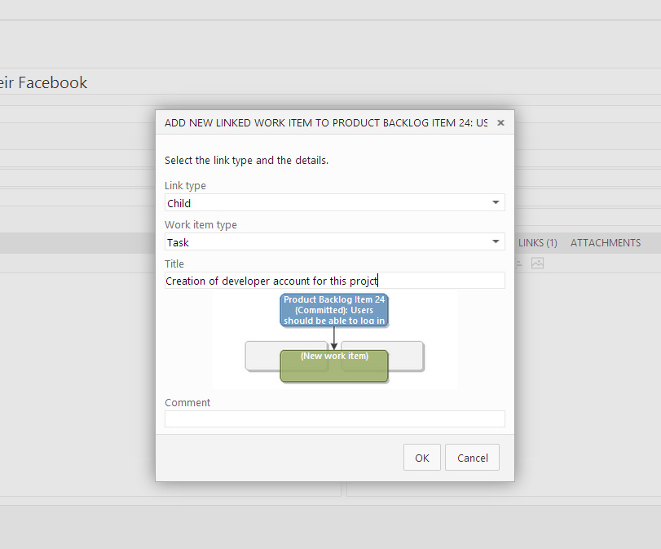
Assigning tasks to PBI
Using Scrum, teams forecast work and define tasks at the start of each sprint, and each team member performs a subset of those tasks. Tasks can include development, testing, and other kinds of work. For example, a developer can define tasks to implement PBIs, and a tester can define tasks to write and run test cases.

Slide 15
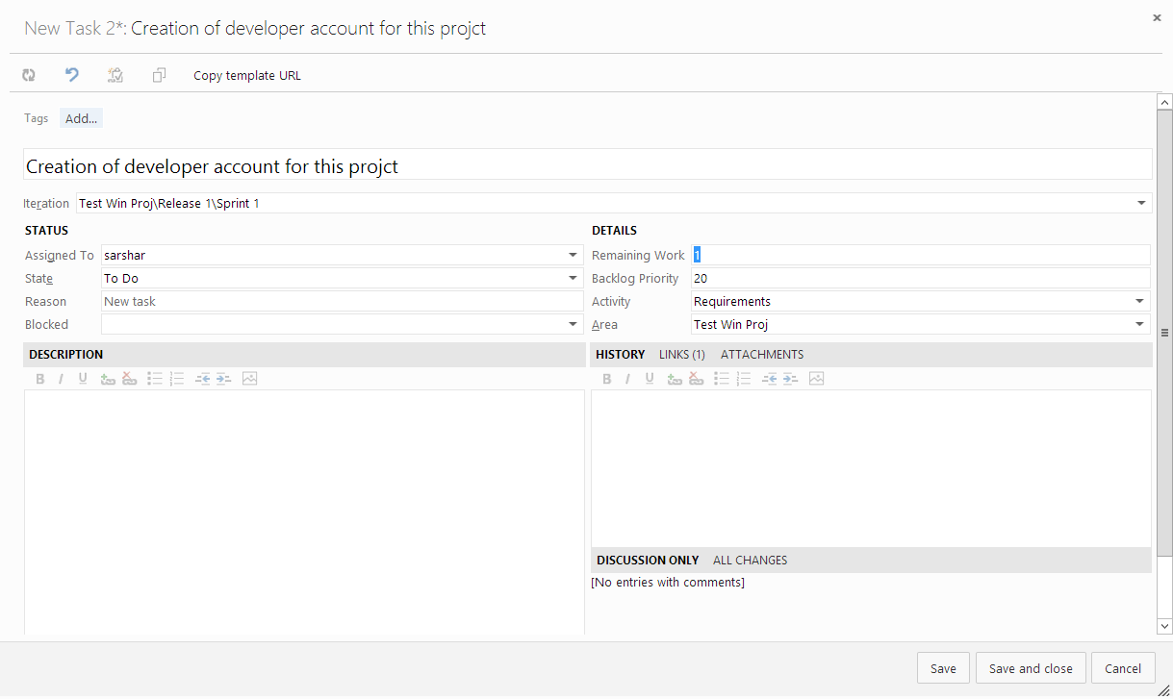
Task fields
Remaining work: This section should be updated repeatedly by developers!
After DONE status, this field turns to disabled.

Slide 16
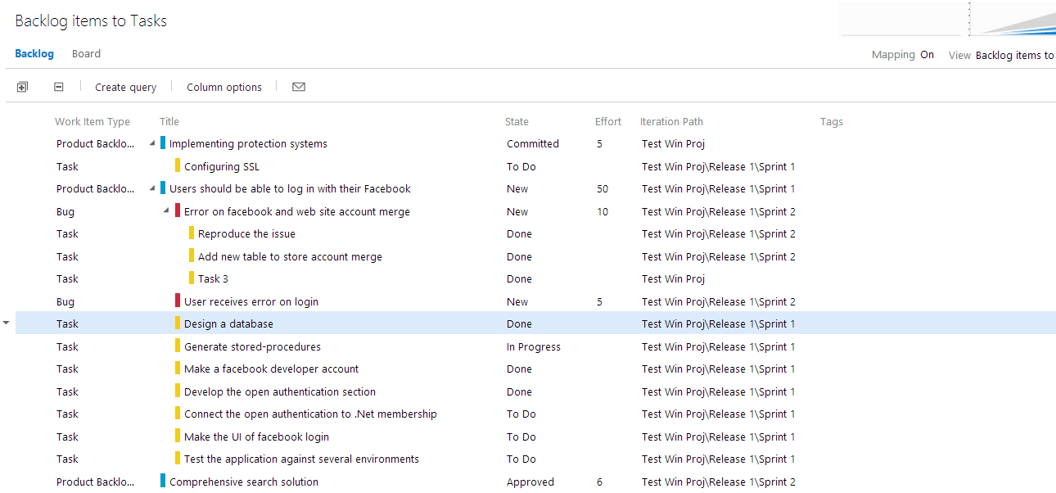
Backlog items to tasks

Slide 17
Sprint in scrum
Each sprint is a 2-4 weeks. Scrum team assign a suitable amount of work to each sprint at the start point of the sprint in sprint planning session.
Sprints | Work Items
Sprint 2
Sprint 3
Sprint 4
Sprint ….
Product Backlog
Task
Task
Task
Bug
Task
Task
Task
Task
Bug
Task
Sprint planning
Task
Task
Bug
Bug
Sprint Backlog

Slide 18
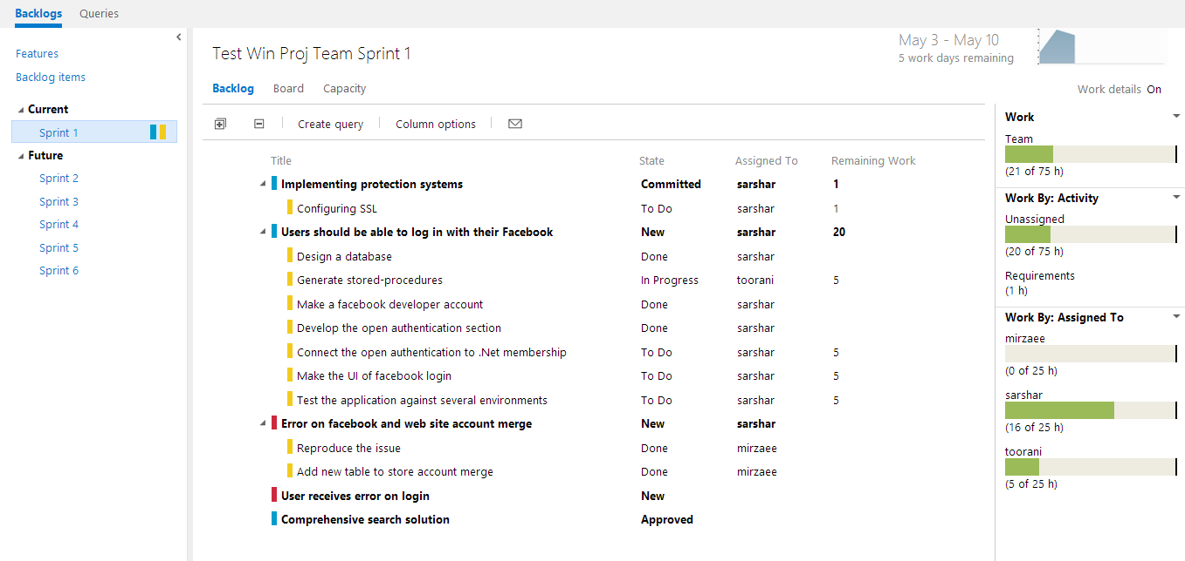
Sprint in TFS

Slide 19
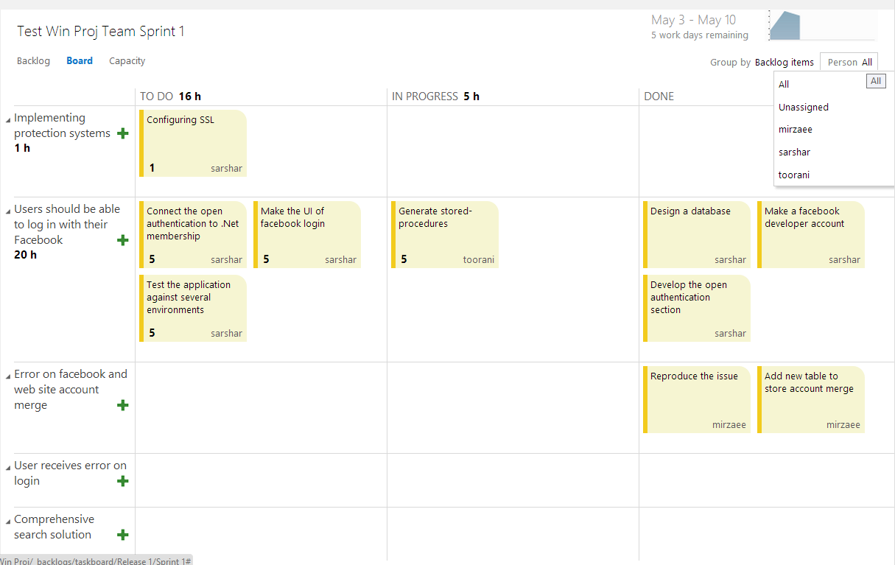
Sprint Kanban board

Slide 20
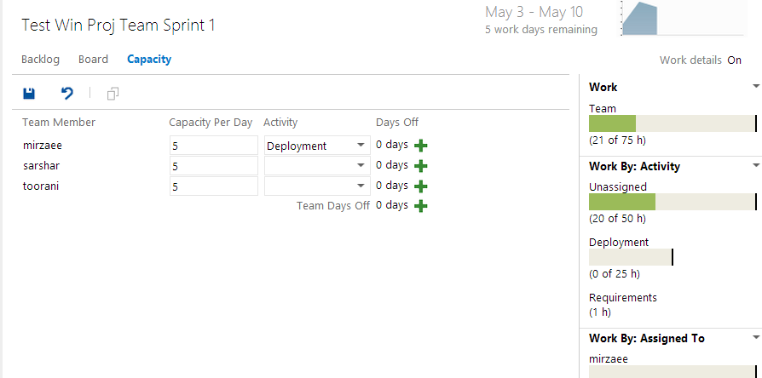
Managing sprint members

Slide 21
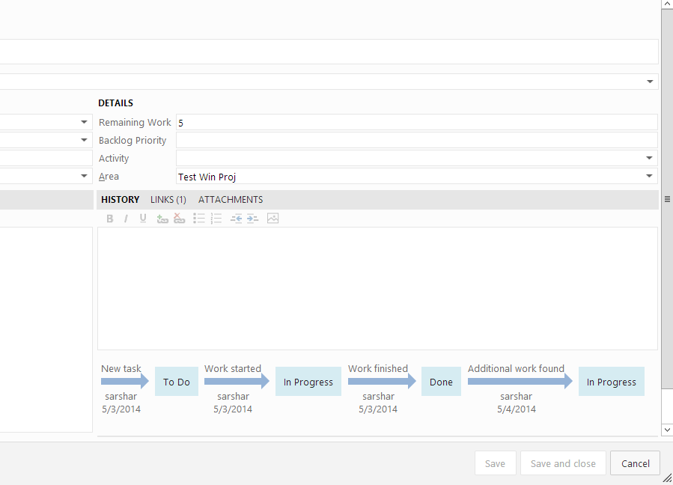
Tracking an item

Slide 22
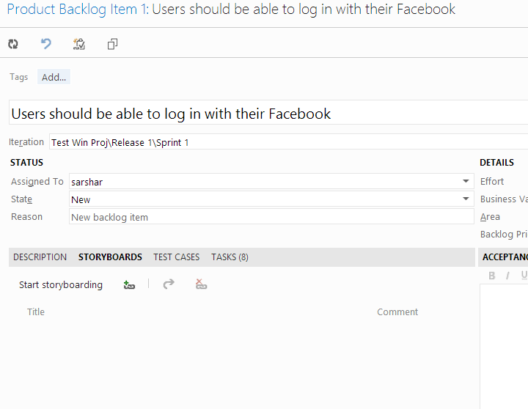
Assign storyboard to PBI

Slide 23
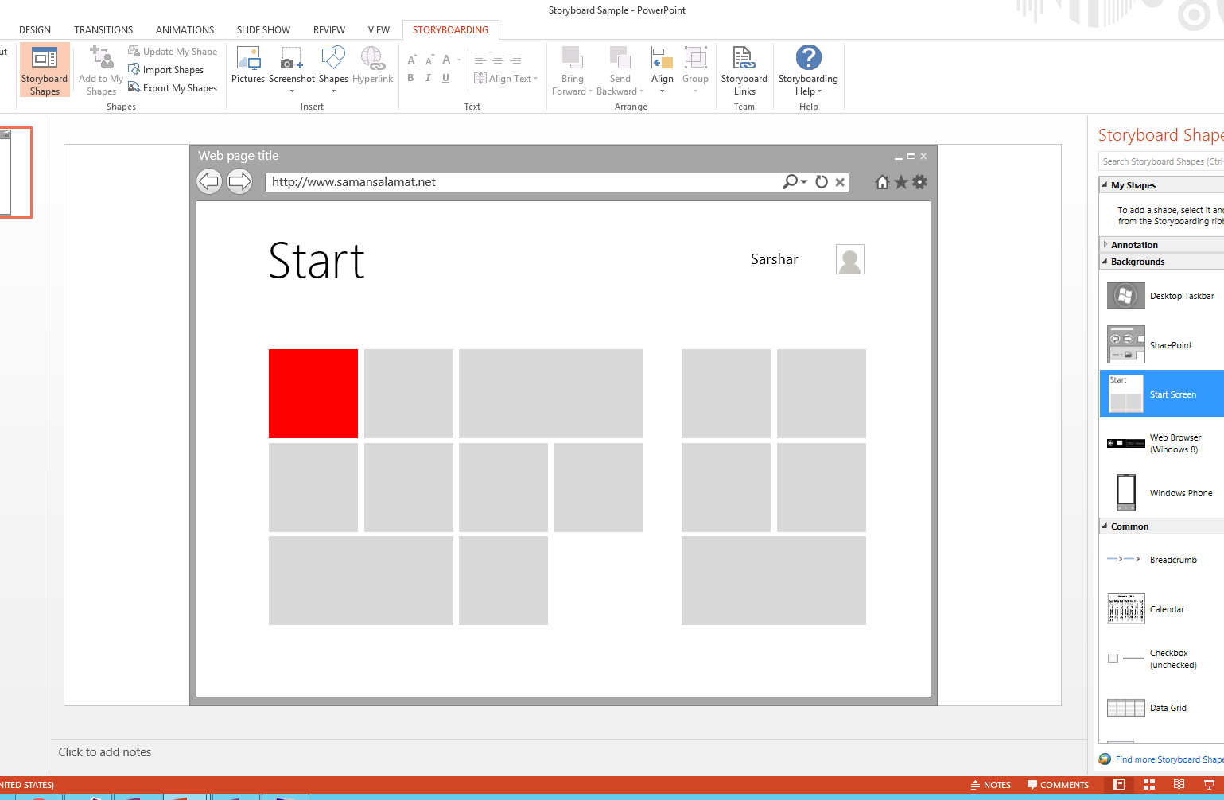

Slide 24
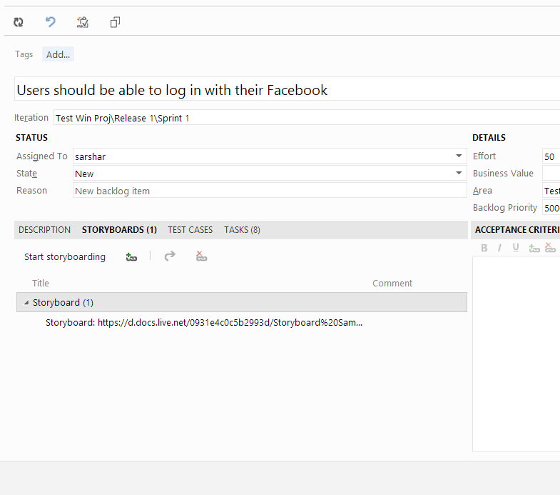

Slide 25
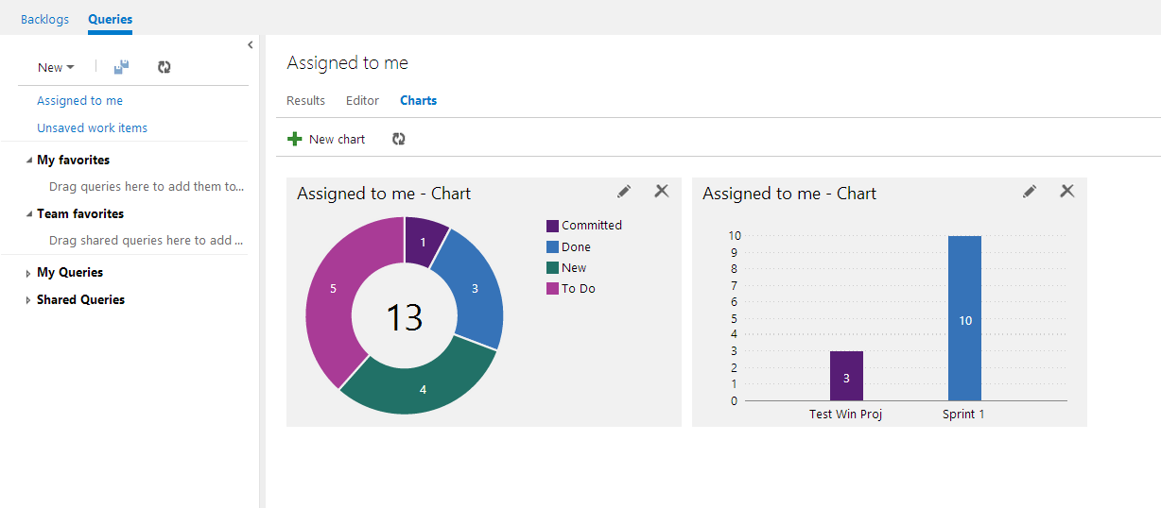
Reporting - charts

Slide 26
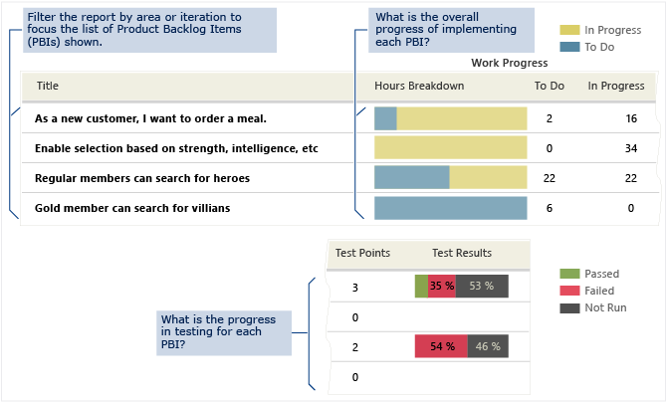
Backlog Overview:
The Backlog Overview report lists all product backlog items (PBIs), both active and completed. It doesn’t include bugs. The report presents a snapshot of the work that has been performed for the filtered set of PBIs.

Slide 27
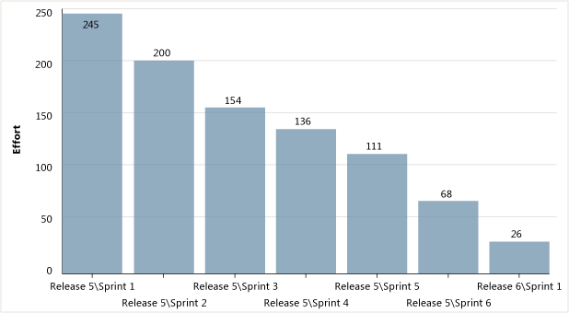
Release Burndown:
As the following illustration shows, a release burndown graph shows how much work remained at the start of each sprint in a release. The source of the raw data is your product backlog

Slide 28
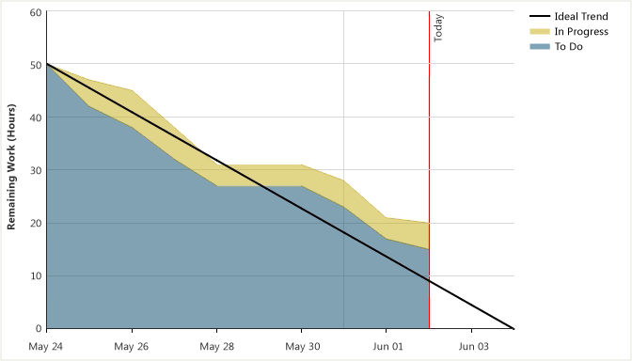
Sprint Burndown:
By reviewing a sprint burndown report, you can track how much work remains in a sprint backlog, understand how quickly your team has completed tasks, and predict when your team will achieve the goal or goals of the sprint.

Slide 29
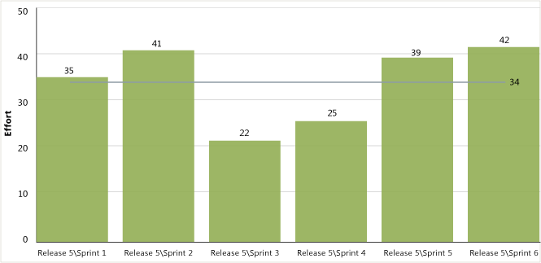
Velocity:
If your team has completed multiple sprints, you can forecast release and product completion dates and plan future projects more accurately by reviewing the velocity report

Slide 30
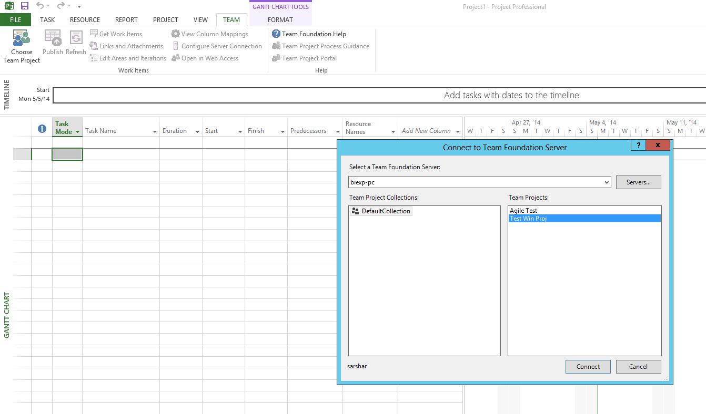
Integration with MPS

Slide 31
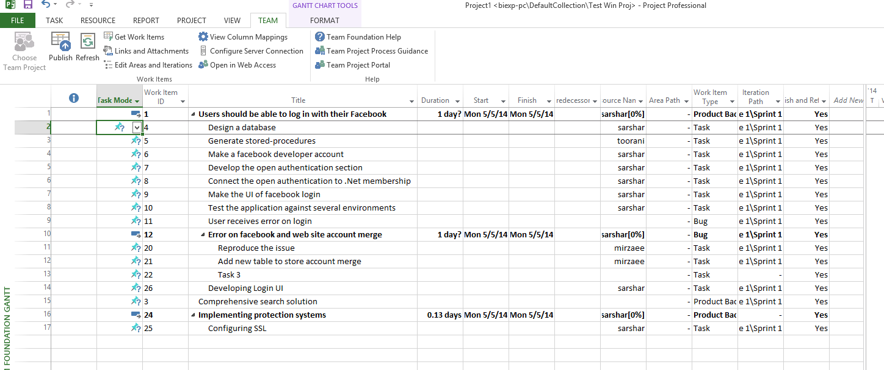
Integration with MPS

Slide 32
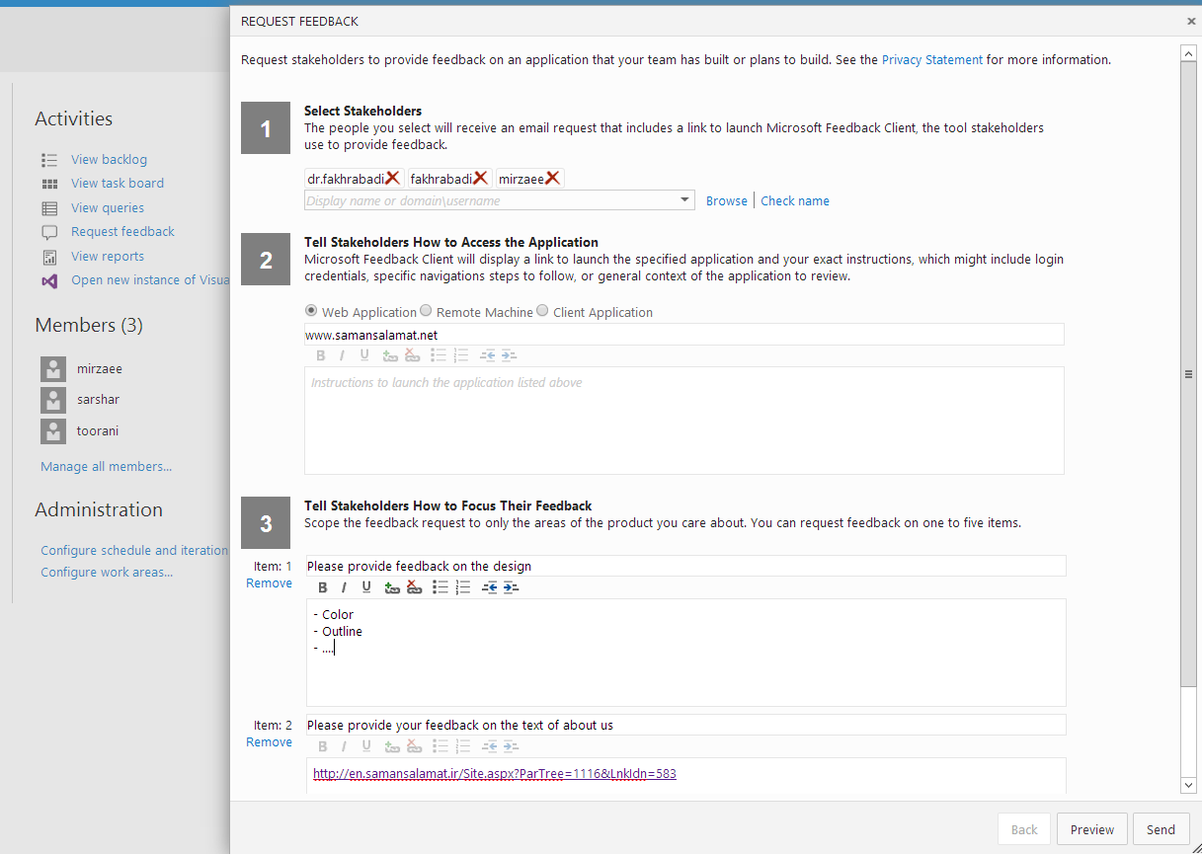
Managing feedbacks

Slide 33
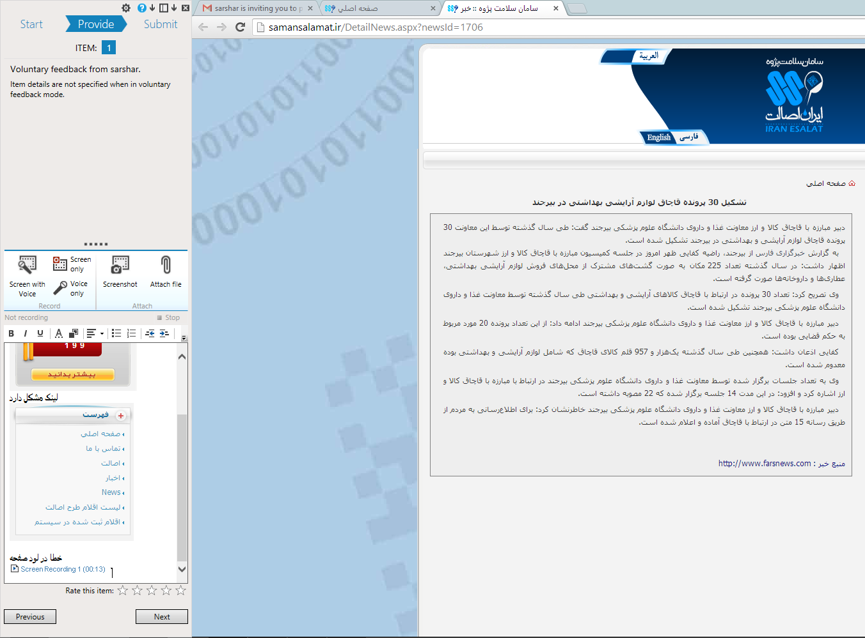
Make the feedback

Slide 34
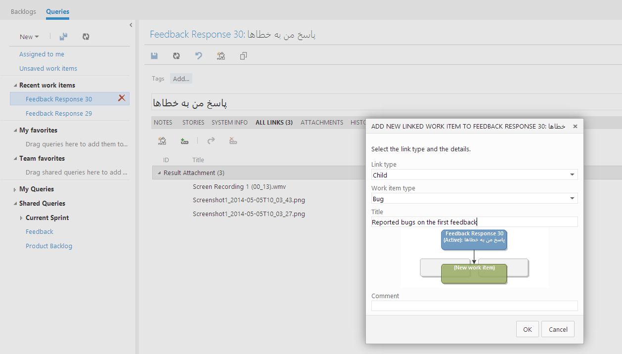
Attach it to tfs

Slide 35
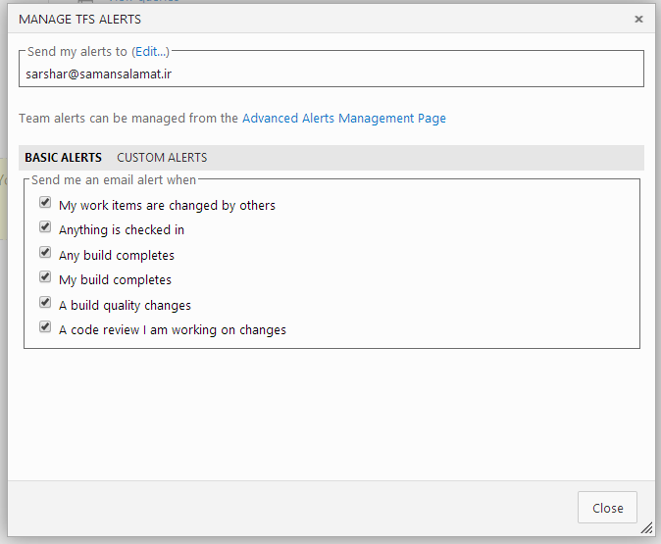
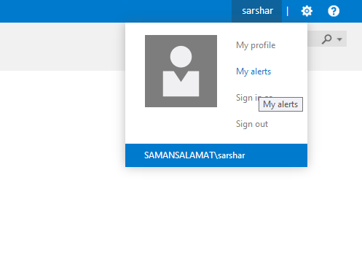
Communications and interactions

Slide 36
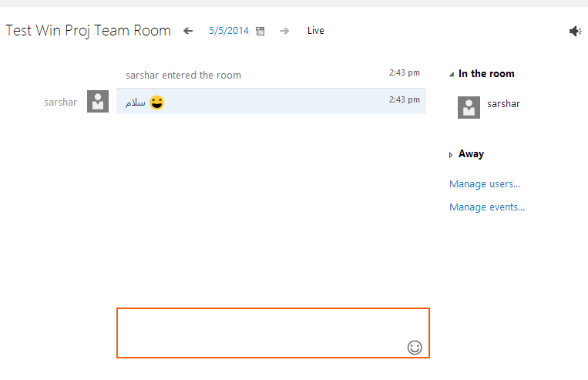
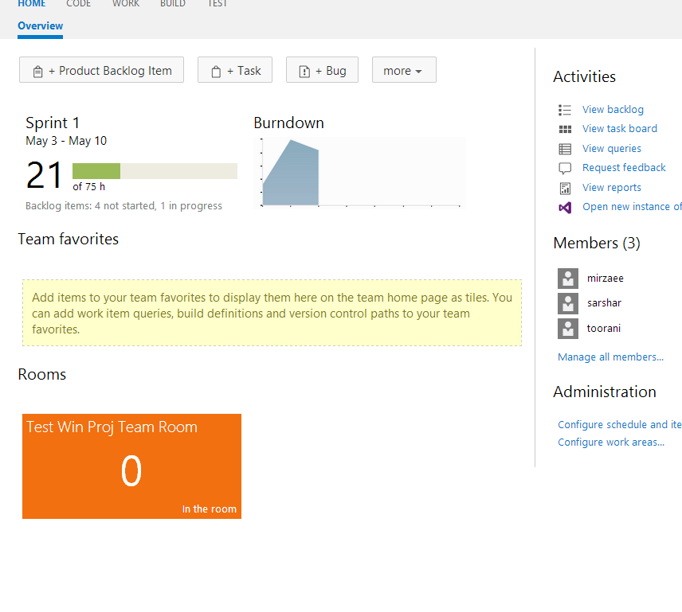
Communications and interactions

Slide 37
Thanks for your attention
Q & A

