Slide 1
Administration, Operation and Troubleshooting with Team Foundation Server 2013
Matteo Emili
http://mattvsts.blogspot.com
matteo.emili@live.com
http://twitter.com/MattVSTS

Slide 2
Who am I?
Visual Studio ALM MVP
Since 2010
Microsoft Certified Technology Specialist
Team Foundation Server
Professional Scrum Master I
Systems Engineering Advisor
Dell Software UK

Slide 3








Build Service | Load Testing Service | Continuous Deployment to Azure | Application Insights | Code Editing
Lab Management | Release Management | Load Testing | SharePoint | Project Server | System Center
Source Repos
Agile Planning
Team Rooms
Test Case Management
Feedback Management
Build and Continuous Integration
Team Foundation Server
Visual Studio Online

Slide 4
Usual stories…
John installs a TFS as a trial installation for his team…
…the team gets used to it, it works and it gets adopted by the company…
…John receives a communication about being the de-facto TFS Administrator of the company Team Foundation Server!

Slide 5
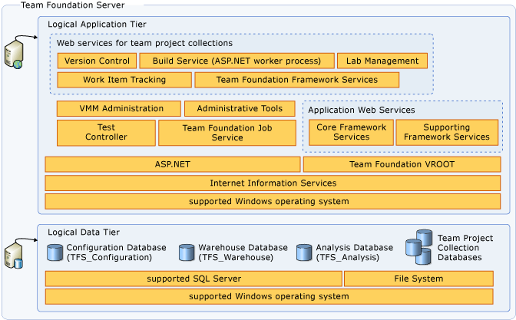
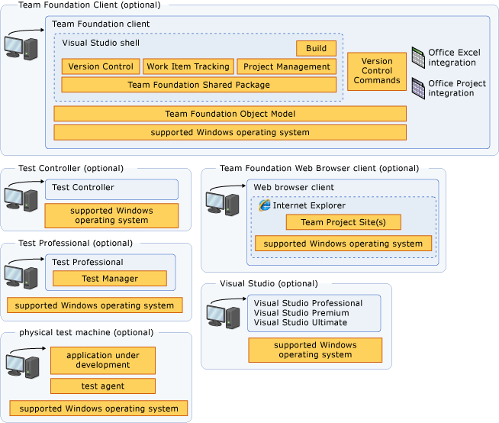
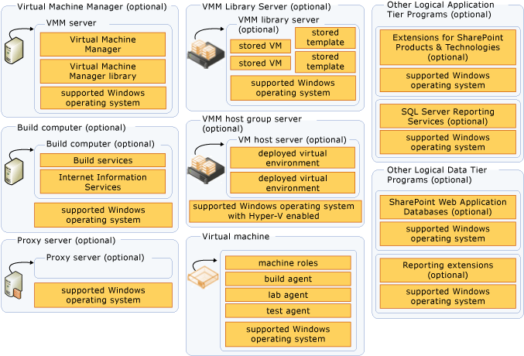
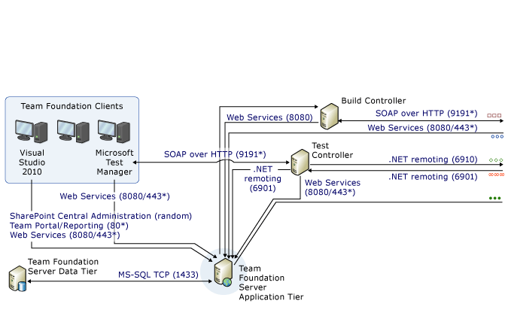
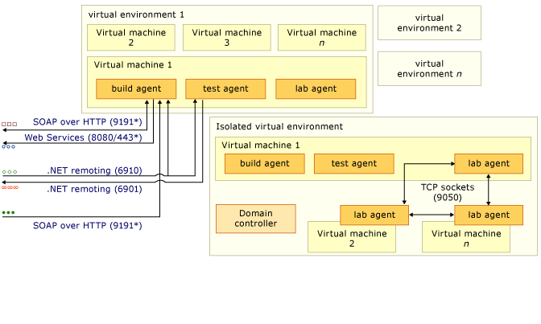

Slide 6
TFS Administrator skills
Windows
Active Directory
IIS
Networking
SQL Server
SharePoint
Project Server
SCOM
Hyper-V
SCVMM
Update Management
Migrations, consolidations
3rd party tools
…plus the development side!

Slide 7
Not really…
You do not need to be a master of all of them
A basic know-how is enough for the daily management
SQL Server and SharePoint are the main areas

Slide 8
Your tools of choice
Administration Console
TFSConfig.exe
Web Access
Operational Intelligence
Power Tools
Attrice TFS Sidekicks
Select OSS and Codeplex projects

Slide 9
Tip 0 – Visual Studio ALM Rangers
Checkout, print, spread around as the Bible – the Visual Studio ALM Rangers’ guidances and tools are the best possible material for whoever has to do with Team Foundation Server
http://blogs.msdn.com/b/willy-peter_schaub/archive/2012/03/31/understanding-the-visual-studio-alm-rangers.aspx
http://blogs.msdn.com/b/willy-peter_schaub/archive/2013/05/16/visual-studio-alm-ranger-solutions-catalog.aspx

Slide 10
TFSConfig.exe
The most powerful tool for TFS Management
It can set and modify every property in TFS
Handle with care!
Very handy for scripting purposes
http://msdn.microsoft.com/en-us/library/ms253116.aspx

Slide 11
Tip 1 – no common ACL
Scenario: adding a new user to TFS
Answer: you must add the required users/group to TFS, SSRS and SharePoint
How: TFS Administration Tool (http://tfsadmin.codeplex.com/)

Slide 12
Tip 2 – Test Attachments Cleaning
Scenario: Test Cases attachments make the DB extremely big and full of binaries
Answer: you must run the Test Attachment Cleaner, included in the TFS Power Tools
How: TFS Power Tools (http://visualstudiogallery.msdn.microsoft.com/f017b10c-02b4-4d6d-9845-58a06545627f)

Slide 13
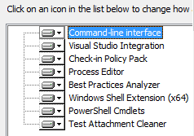
What’s inside?
Best Practices Analyzer
Team Explorer Enhancements (Work item templates not included)
Tfpt.exe command line interface
Check-in Policy Pack
Process Template Editor
Windows Shell Extension
Test Attachment Cleaner

Slide 14
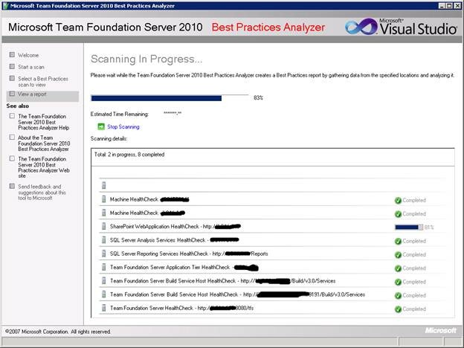
The Best Practice Analyzer
Regardless of your role (fulltime Admin or consultant or whatever) the first thing you should do upon a TFS is running the BPA
It provides you a scan of the entire TFS infrastructure with all the related issues
Specific scans are available as well
Very useful report to carry on

Slide 15
TFS Registry
Team Foundation Server stores its configuration registry in several non-contiguous keys in the Windows Registry
Schemaless, hierarchical key/value
Privilege Segregation is applied
Almost undocumented, can be hard to query even with the Object Model
http://msdn.microsoft.com/en-us/library/aa337607(v=vs.90).aspx

Slide 16
Neno Loje’s TFS Registry utility
http://msmvps.com/blogs/vstsblog/archive/2011/02/01/change-notification-delay-setting-in-tfs-2010.aspx
Command-line tool for interacting with the TFS Registry, built using the OM so it won’t do anything unsupported…

Slide 17
DEMO
Tools

Slide 18
Tip 3 - backups
For small to mid-sized environments, use the Backup tool included in the OOB installation
Big environments require other backup strategies and tools
REMEMBER – SSRS Encryption Key
REMEMBER – SQL Transaction Logs

Slide 19
Back to basics: the TFS Job Agent
TFS has a built-in scheduler and agent
The Job Agent runs on the tiers ensuring all the required conditions are met for an unattended run of a certain job
It uses the Service Account
More: http://msdn.microsoft.com/en-us/library/ms252450.aspx

Slide 20
Knowing your jobs…
Grant Holliday sums them up here
http://blogs.msdn.com/b/granth/archive/2013/02/13/tfs2012-what-are-all-the-different-jobs-built-in-to-tfs.aspx
Every job has a different impact on TFS. Some of them are very heavy.

Slide 21
TFS Operational Intelligence
It is a ‘Service Dashboard’ for every aspect of Team Foundation Server
Do not expect simple warning
It was born as an experimental product, and left in the system. It’s not something hidden, MSFT is well aware of it

Slide 22
DEMO
TFS Operational Intelligence

Slide 23
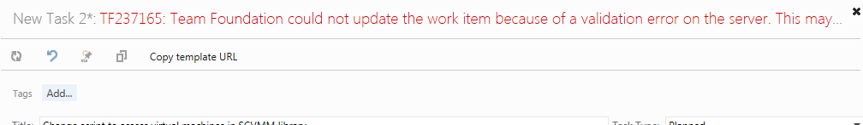
Troubleshooting story
We try to run the latest update or the latest version in production
TFS 2012.3 just came out

Slide 24
Steps – part 1
TF237165 – what is that?
Nothing relevant came out at the time…
Check the Process Template’s transitions
A wrong transition can lead to that error
The PT was a OOB one
TFS BPA to see if there was something wrong with the web services…
Nothing.

Slide 25
Steps – part 2
Check the TFS Operational Intelligence
Several -1 results came out, with full stacktrace and tons of useful informations
It turned out a problem with a Global List
Global lists are above the single PT rules evaluation, and a Project Server Global Workflow rule was breaching the validation
Remove the Project Server integration
tfsadmin projectserver …

Slide 26
Outcome
Contact MSFT CSS
After further investigations we got a targeted fix and a timeframe for full resolution (TFS 2012.4)
TFS 2012.4 contained the fix (http://support.microsoft.com/kb/2872520) “Assume that you have a TFS 2012 server that is configured for synchronizing with Project Server. When you try to save a copied work item in TFS web access, you may receive the following error message: TF237165: Team Foundation could not…”

Slide 27
Migrations, consolidations
TFS Integration Tools
http://visualstudiogallery.msdn.microsoft.com/eb77e739-c98c-4e36-9ead-fa115b27fefe
VSS Upgrade Tool for TFS
http://visualstudiogallery.msdn.microsoft.com/867f310a-db30-4228-bbad-7b9af0089282
Using Git is an option for migrations (Hg, SVN, etc)

Slide 28


Slide 29
Grazie agli sponsor

