Slide 1
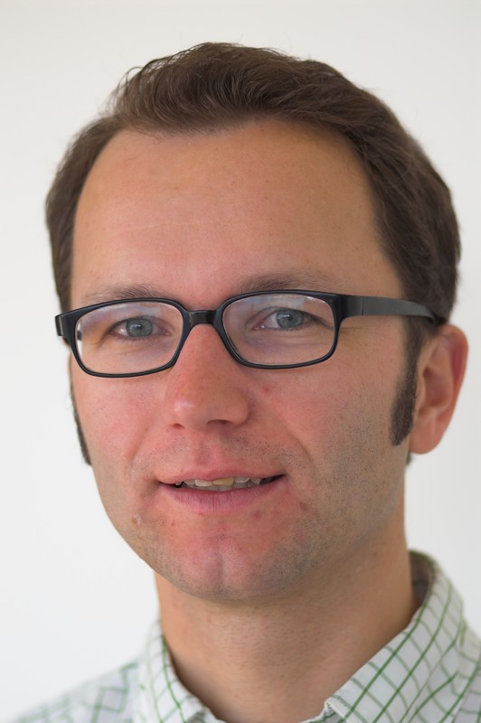

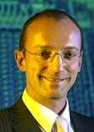
PIMO – A Framework for Representing Personal Information Models
6.9.2007, I-Semantics,
Leo Sauermann,
Ludger van Elst,
Andreas Dengel
{firstname.surname}@dfki.de

Slide 2
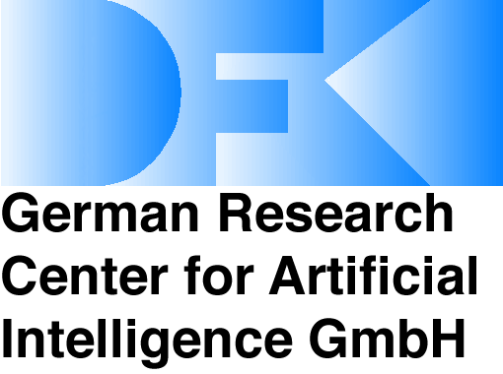


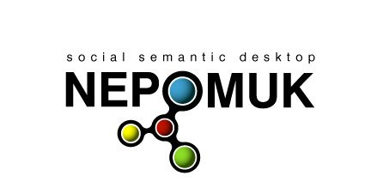

Leo Sauermann
Work on Semantic Desktop since 2002
Researcher at DFKI since 2004
Currently at the Nepomuk EU project
University Lectures on Semantic Web, Students and Diploma theses
Open Source developer, blogger
Sci-Workshops, Trainer, Consultant
leo.sauermann@dfki.de
http://www.dfki.de/~sauermann/

Slide 3
Personal Information Model PIMO
Overview
Scenario and Problem
Definitions
Realization
Applied Use
Related Work
Summary and Outlook

Slide 4
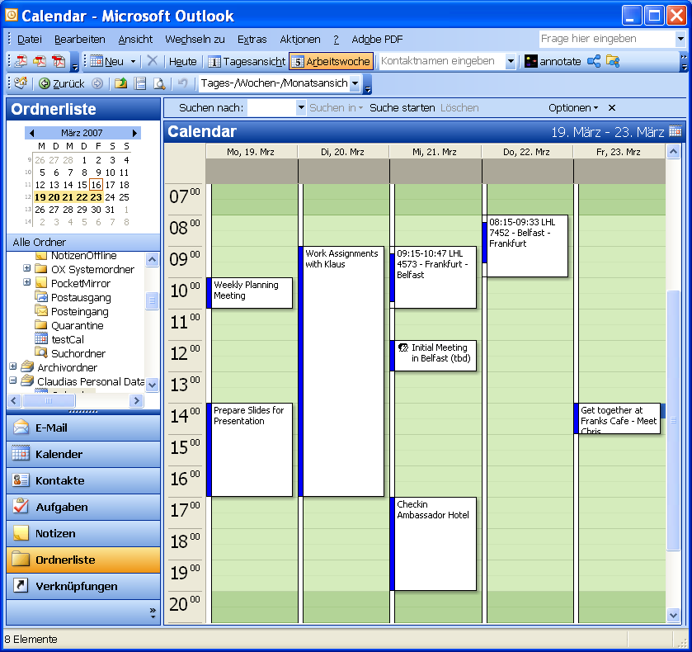
Personal Information Management
Trivia: Its all about appointments,
e-mails and contacts
Definition by Richard Boardman (PhD, 2004):
PIM can be defined as the management of personal information (information owned by an individual, and under their direct control) as performed by the owning individual.

Slide 5
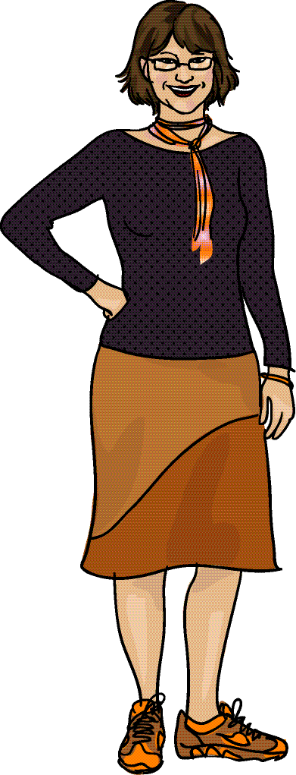




Szenario of EPOS and Nepomuk
Knowledge Worker „Claudia“ using Desktop PC
Problem: Data about single ideas are stored in several applications and without context
the CID project
files
emails
contacts
Documents
Papers
Projects
CID
Research
Inbox
Todo
SAP
CID-proj
Karlsruhe
Claudia Stern
Dirk Hagemann
Klaus Nord

Slide 6

Personal Information Management
People have mental models
of their environment
They think about Projects,
People, Goals, Structure
Documents are related to the
personal mental model
of the user
PIM is the main use of a PC –
why is it not defined in
the operating system?
Topic
Project
Document
new office
CID slides
Claudia
CID
Dirk
Karlsruhe
Who
Where
files
emails
contacts
Documents
Papers
Projects
CID
Research
Inbox
Todo
SAP
CID-proj
Karlsruhe
Claudia Stern
Dirk Hagemann
Klaus Nord
Seen our talk yesterday?
From Philosophy and Mental-Models to Semantic Desktop Research:Theoretical Overview

Slide 7
Definitions

Slide 8
Definitions
Personal Knowledge Workspaces
embraces all data “needed by an individual to perform knowledge work”. It is (1) independent from the way the user accesses the data, (2) independent from the source, format, and author of the data.
Native Resources
are part of the personal knowledge workspace, personal files of the user, e-mails, and other PIM related resources, such as appointments or contacts.
Native Structures
are categorization schemes for Native Resources such as file-system folders, bookmark folders, e-mail folders, tags. In the (common) case that a user operates in a document-centered way his internal representations are already largely reflected in content and structuring of his information elements.
The Mental Model
is part of the cognitive system of the person. Subjective to the person, the mental model is individual and cannot be externalized thoroughly.

Slide 9
Definition of a PIMO
A PIMO is a Personal Information Model of one person.
It is a formal representation of parts of the users Mental Model.
Each concept in the Mental Model can be represented using a Thing or a subclass of this class in RDF.
Native Resources found in the Personal Knowledge Workspace can be categorized, then they are occurrences of a Thing.

Slide 10
Realization

Slide 11
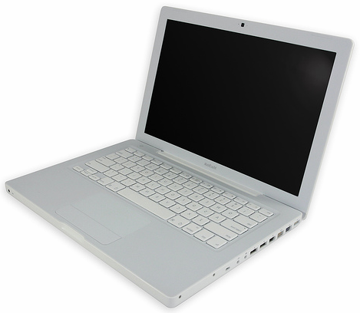
Claudia’s Mental Model
SAP
Claudia’s PIMO
of things
Claudia’s
native resources
Conceptual Background:
Mental Models are expressed in pimo:Things, the subjective, individual, personal level. It is unique as people are unique (constructivism).
Native resources from the personal knowledge workspace are categorized and annotated.
Claudia:SAP
http://www.sap.com/
Resources
Things
relations to
occurrences

Slide 12
PIMO ontology layers
Sharing Level
Representational, closed world semantics
RDFS + NRL
Global / World
domain-independent
Upper (foundational)
Thing
sub-classes
Wrapper implementations
Person
Role
Time
Document
Organization
Information Element Vocabularies
representing extracted data in RDF/S
multiple vocabularies
ontology imports
Mid (group)
domain ontologies, organization ontologies
Group /
Domain
NCAL
NCO
NID3
foaf
Person
Image
Contract
NMO
NFO
NEXIF
Manager
Project
Offer
Message
Company
Personal
Individual extensions
www.semanticdesktop.org/ontologies
Personal
InProceedings
Dirk
CID Project
EPOS
„Cool Uris“

Slide 13
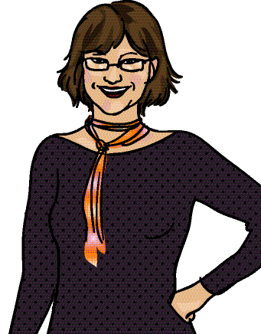
Claudia´s Personal Information Model
Rep Lang
Upper (foundational)
Native Data Vocabularies
Mid: Bibtech Ontology
Mid: Claudias Company (SAP)
personal information model of one user
Imports all other ontologies and defines extensions
Ontology side Native Resources
Claudia’s PIMO
Claudia imports
all of them
Dirk
File X
e-mail2
CID-Project
vCard H
Karlsruhe

Slide 14
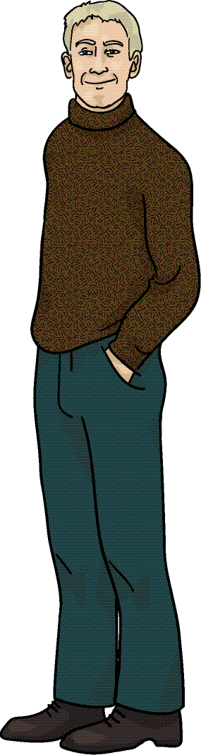
Identification in PIMO
Resources
Identifying things and matching across ontologies and multiple PIMOs
SAP
shared identifiers
http://www.sap.com/
http://ont.sap.com/id/SAPCompany
http://de.wikipedia.org/wiki/SAP
Things
Claudia:Dirk
Dirk:Claudia
Claudia:SAP
Dirk:SAP
Resources
Things

Slide 15
Identification of PIMO:Thing (1/2)
each user in own namespace/model
pimo:occurrence to any occurrence of a thing in native resources
pimo:groundingOccurrence to native resources which primary topic is the thing
these allow data integration on one Semantic Desktop
claudia: = http://ont.sap.com/pimo/claudiastern/
claudia:Dirk pimo:occurrence
<file://c/claudia/CIDReport2006.doc#author2>
claudia:Dirk pimo:groundingOccurrence
<semdesk://claudia/addressbook/1234>

Slide 16
Identification of PIMO:Thing (2/2)
pimo:hasOtherRepresentation to other Things in shared mid-level ontologies (compatible, can be smushed)
  allows sharing of metadata in groups
pimo:referencingOccurrence to any public resource which main topic is the thing represented
  allows fuzzy matching of multiple PIMOs
  “I mean the Dirk who is on myspace…”
claudia:Dirk pimo:hasOtherRepresentation
<http://ont.sap.com/id/DirkHagemann>
claudia:Dirk pimo:referencingOccurrence
<http://myspace.com/dirkhagemann>

Slide 17
DFKI Mid-Level Ontology (1/2)
avoid a cold start problem
pre-model a refinement of upper classes
  to support the user with common classes and properties needed in his/her domain
    EU-Project extending Project, for people doing them
    Lead/Opportunity as a Role, for salespersons
  as a shared formal ground to merge multiple PIMOs
    seed for a shared conceptualization

Slide 18
DFKI Mid-Level Ontology (2/2)
At DFKI we used this process
  seeding: existing native structures analyzed
  (names & hierarchy of file folders)
  result: initial mid-level model, manually done
  reality match: interviews with all people, if the initial covers everything and not too much (prec/rec)
  result: proposes changes
  evolution: taking changes and incorporating them
  after this: normal KM cycle = go on forever
p.s.: we did the same in other projects… its ok, not proven yet

Slide 19
Applied Use
Example PIMO for free
  http://ontologies.opendfki.de/repos/ontologies/pim/pauls-pimo.pprj
SQAPS project
  N. Fernandez-Garcia, L. Sauermann, L. Sanchez, and A. Bernardi. Pimo population and semantic annotation for the gnowsis semantic desktop. SemDesk WS 2006.
SBS Evaluation
  M. Siebert, P. Smits, L. Sauermann, and A. Dengel. Increasing search quality with the semantic desktop in proposal development. PAKM 2006
ConTag
  B. Adrian , L. Sauermann , T. Roth-Berghofer ConTag: A Semantic Tag Recommendation System. I-Semantics 2007
Nepomuk
and many more (SeMouse, …)

Slide 20

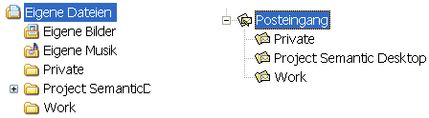
PIMO is filled
automatically from data
aperture.sf.net
(check it out!)
Data
Claudia‘s files & e-mails
PIMO Store
RDF Database
matching
to
ontology
adapter
to RDF

Slide 21

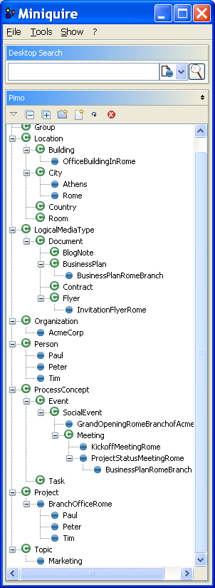
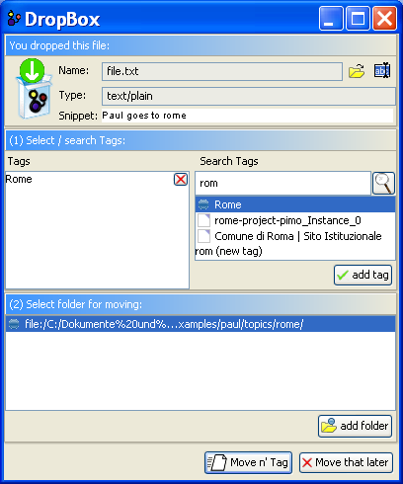
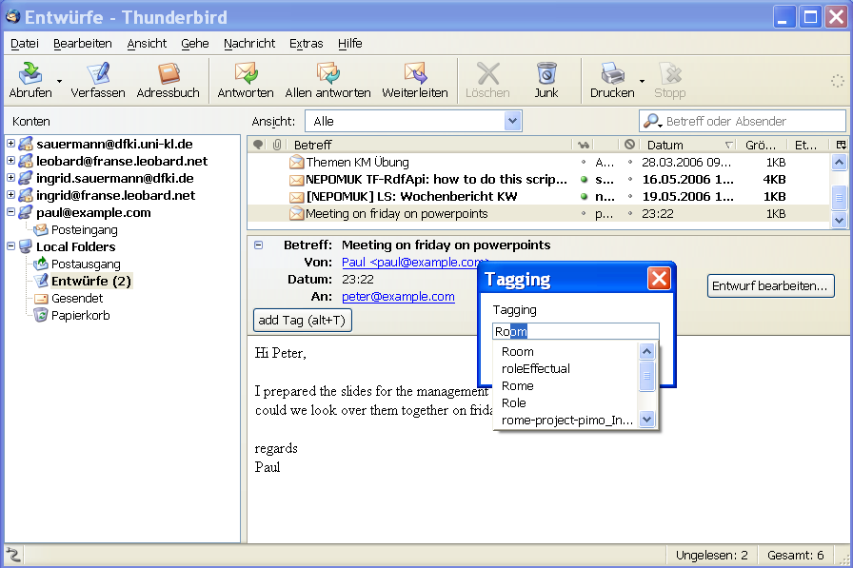
Screenshots
Download at gnowsis.opendfki.de

Slide 22
Related Work
For your reference when you download the slides, I will not talk about these in the presentation. From Paper:
  H. Xiao and I. F. Cruz. A multi-ontology approach for personal information management. In S. Decker, J. Park, D. Quan, and L. Sauermann, editors, Proc. of Semantic Desktop Workshop at the ISWC, Galway, Ireland, November 6, volume 175, November 2005.
  C. Alexakos, B. Vassiliadis, K. Votis, and S. Likothanassis. A multilayer ontology scheme for integrated searching in distributed hypermedia. In S. Sirmakessis, editor, Adaptive and Personalized Semantic Web, number 14 in Studies in Computational Intelligence. Springer, 2006.
  R. Boardman. Improving Tool Support for Personal InformationManagement. PhD thesis, Department of Electrical and Electronic Engineering Imperial College London University of London, July 13 2004.
  A. R. Dengel. Six thousand words about multi-perspective personal document management. In Proc. EDM IEEE Workshop. IEEE, Oct 2006.
NOT IN PAPER, but I like it
  Latif, K. & Tjoa, A.M. Combining Context Ontology and Landmarks for Personal Information Management, ICOCI 2006

Slide 23
Next Steps
A rehauled version of PIMO is under development, to be published before Dec 2007
!!! Before implementing something, contact us for the new version !!!
YOU can benefit from it, contact me for details.
Implementations in the NEPOMUK project will show how to use it (KDE 4.0, Beagle++, NEPOMUK-Java edition)
Web applications are obvious next step (delicious á la Semantic Web 2.0)
  beta.foafme.com
  www.koble.net (alpha)

Slide 24
Summary
Definition of Personal Knowledge Workspace, Personal Information Model
Subjective approach with the possibility to integrate group/domain ontologies
Identification scheme to map things
Use in research projects
Solve problems of Personal Information Management by reusing ideas from XTM and RDFS

Slide 25
see us on Triple-I !
Wed 4:30pm 11b:
NEPOMUK +
Philosophy
Fri 2pm room5:
ConTag System
Questions?
http://nepomuk.semanticdesktop.org
Leo Sauermann,
Ludger van Elst,
Andreas Dengel
{firstname.surname}@dfki.de
persona created using http://www.sp-studio.de/

Slide 26
Representational Assumptions
Closed World Semantics
  allows verification of domain/ranges
Things are the individual view on information elements & RDF resources
NRL (Nepomuk Representational Language) used to express inverse, transitive, symmetric properties, cardinality restrictions
Unique Name Assumption:
things with different URIs are different

