Slide 1
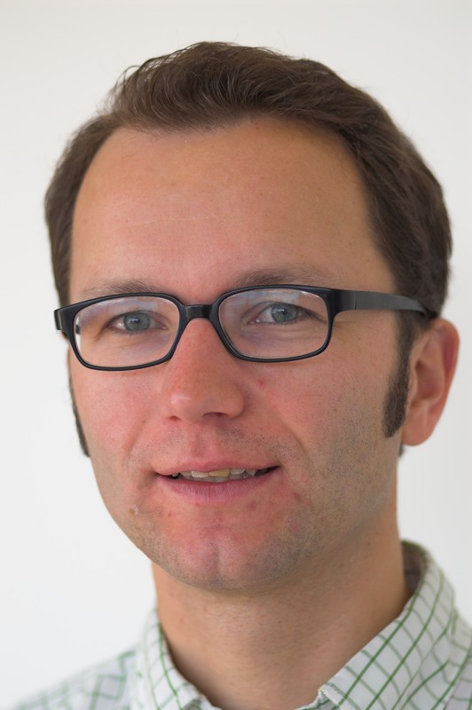
Hands on PIMO
Leo Sauermann
leo.sauermann@dfki.de
DFKI GmbH, Kaiserslautern, Germany

Slide 2
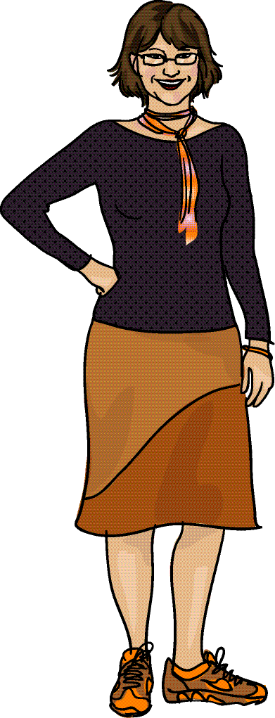

Background Information about PIM
Personal Information Management PIM
Personal Information PI
  different interpretations possible:
  owned, accessed, controlled by the Person
  directed at a Person
  about a Person, but kept by someone else
  relevant for Person
Personal Space of Information PSI
  all information elements
  within the definition of PI
  tools to interact with the information,
  Personal Knowledge Workspace
  borders unknown, fuzzy,
  overlaps with other’s PSI
Book: Personal Information Management
William Jones and Jaime Teevan (2007)
Book: Keeping Found Things Found
William Jones (2008)

Slide 3
Background Information about PIM
PIM activities by Knowledge Workers
  filing information for retrieval and storage
  (re) finding information
  organizing information and meta-level activities
Personal Information Collection PIC
  a list (category) of items, used to support activities
Typical behaviours observed in field studies
  character of workers differ: pilers VS filers
  walking the same beaten paths to known information
  orienteering: looking where you are to know the next step, knowing how you get there
  fulltext search as last resort
No education for workers provided!
Finding and Reminding: File Organization from the Desktop
Deborah Barreau and Bonnie A Nardi (1995)
The perfect search engine is not enough: a study of orienteering behavior in directed search
Teevan, Alvarado, Ackerman, Karger (2004)

Slide 4
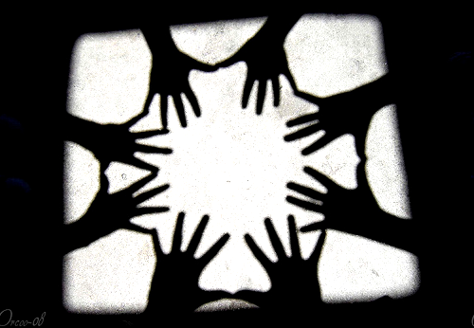
1.
3.
Ontologies
Aperture
PIMO
2.
4.
my PIMO
Alignment
http://www.flickr.com/photos/orcoo/2589296875/

Slide 5




Personal Information Model PIMO
Person
Ontologies
documents, e-mails, websites
are “tagged” with concepts
represents personal mental model
formal: classes, concepts,
relations in RDFS
basic classes predefined
user generated classes, concepts, relations
extensible with
  organizational knowledge
  ontologies
  extracted data
The CID Project
Topic
Project
Management
Document
Claudia
CID
CID slides
Karlsruhe
Person
Dirk
Location
Files
E-Mails
Contacts
Documents
Papers
Projects
CID
Research
Inbox
Todo
SAP
CID-proj
Karlsruhe
Claudia Stern
Dirk Hagemann
Klaus Nord
Data
PIMO - a Framework for Representing Personal Information Models
Sauermann, van Elst, Dengel (2007)
http://www.dfki.uni-kl.de/~sauermann/papers/sauermann+2007b.pdf
is a
Relation
Annotation
Notes:
2008-03-06

Slide 6
NEPOMUK Ontologies
Representational Layer
vocabulary with which other ontologies are represented
RDF
RDFS
NRL
Upper-Level Layer
NAO
high-level, domain-independent ontologies
NIE
PIMO
Foundational
Lower-Level Layer
group and personal ontologies
Group: domain-specific
Personal: personalized extension of group level
Group-level
Personal-Level
All Concepts a User of the Semantic Desktop deals with
All Concepts an Application Programmer of the Semantic Desktop deals with

Slide 7




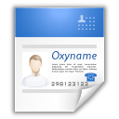



NEPOMUK Information Elements NIE
existing data
needed for
knowledge work
domain independent
Information Elements
http://www.flickr.com/photos/uniqueo/2667162885/

Slide 8
NEPOMUK Information Elements NIE
“NIE” identifies both the NIE ontology and the NIE framework of ontologies
builds on NRL – Nepomuk Representational Language (= RDFS + extensions)
Representing existing information, not replacing existing file formats
Integration and reuse amongst ontologies in the framework

Slide 9
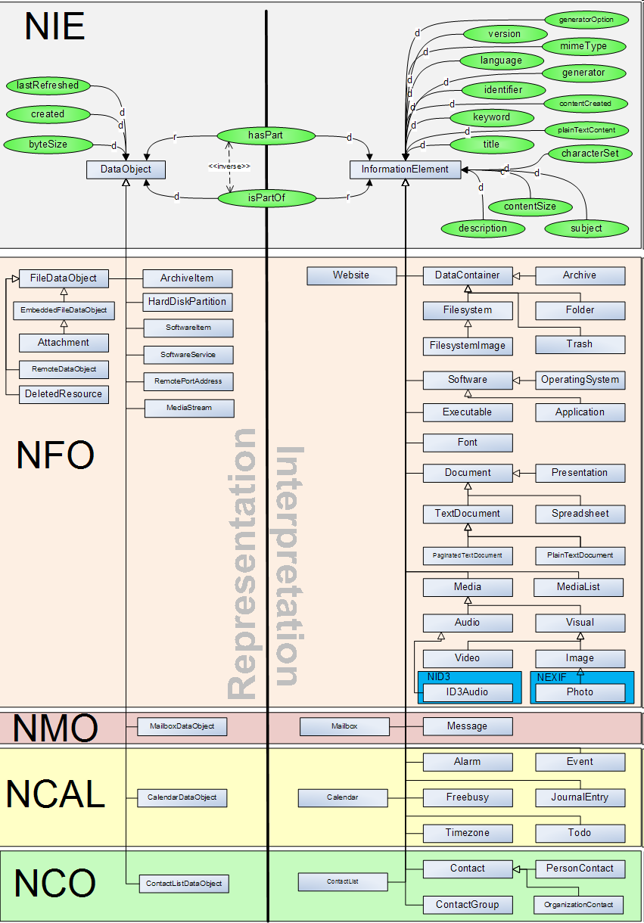
Two Parts
DataObjects represent physical entities that contain data.
files, mailboxes etc.
Bitstreams which need to be interpreted as InformationElement.
InformationElement is a piece of information stored within a data object.

Slide 10
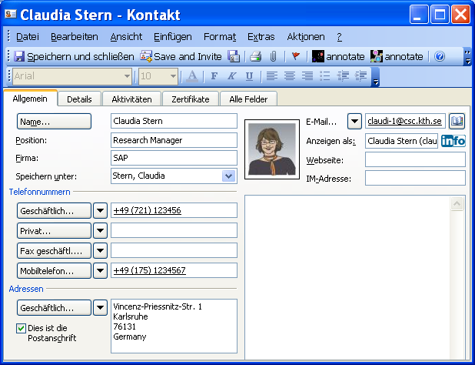
Notes:
RDF

Slide 11


Slide 12
@prefix nco: <http://www.semanticdesktop.org/ontologies/2007/03/22/nco#> .
@prefix nie: <http://www.semanticdesktop.org/ontologies/2007/01/19/nie#> .
<outlook://contact/000000009C998B6AFC07904AAAEC310F168000F604052000>
a nie:InformationElement, nco:Contact;
nie:title "Claudia Stern";
nco:fullname "Claudia Stern";
nco:nameFamily "Stern";
nco:nameGiven "Claudia";
nco:hasEmailAddress <urn:uuid:2cc48d56-7c30-4ba1-8b01-f7adebb620b3>;
nco:hasPostalAddress
<outlook://contact/000000009C998B6AFC07904AAAEC310F168000F604052000_BusinessAddress>;
nie:dataSource <http://nepomuk.semanticdesktop.org/datawrapper/aperture/rootUri/outlook>;
nie:isPartOf <outlook://folder/000000009C998B6AFC07904AAAEC310F168000F622810000>.
URI
identifies Information Object
to identify yourself, all these work for the task
outlook://contact/1 , addressbook://1,
urn:uuid:b086ad95-b056-47ec-86aa-fb907ee3e6ee
Notes:
but outside of outlook, as RDF.
my work.

Slide 13
@prefix nco: <http://www.semanticdesktop.org/ontologies/2007/03/22/nco#> .
@prefix nie: <http://www.semanticdesktop.org/ontologies/2007/01/19/nie#> .
<outlook://contact/000000009C998B6AFC07904AAAEC310F168000F604052000>
a nie:InformationElement, nco:Contact;
nie:title "Claudia Stern";
nco:fullname "Claudia Stern";
nco:nameFamily "Stern";
nco:nameGiven "Claudia";
nco:hasEmailAddress <urn:uuid:2cc48d56-7c30-4ba1-8b01-f7adebb620b3>;
nco:hasPostalAddress
<outlook://contact/000000009C998B6AFC07904AAAEC310F168000F604052000_BusinessAddress>;
nie:dataSource <http://nepomuk.semanticdesktop.org/datawrapper/aperture/rootUri/outlook>;
nie:isPartOf <outlook://folder/000000009C998B6AFC07904AAAEC310F168000F622810000>.
Type
a nie:InformationElement
a nie:Contact
A software converting data does not discriminate between Person and Organization, you can:
a nie:PersonContact
Notes:
but outside of outlook, as RDF.
my work.

Slide 14
@prefix nco: <http://www.semanticdesktop.org/ontologies/2007/03/22/nco#> .
@prefix nie: <http://www.semanticdesktop.org/ontologies/2007/01/19/nie#> .
<outlook://contact/000000009C998B6AFC07904AAAEC310F168000F604052000>
a nie:InformationElement, nco:Contact;
nie:title "Claudia Stern";
nco:fullname "Claudia Stern";
nco:nameFamily "Stern";
nco:nameGiven "Claudia";
nco:hasEmailAddress <urn:uuid:2cc48d56-7c30-4ba1-8b01-f7adebb620b3>.
<urn:uuid:2cc48d56-7c30-4ba1-8b01-f7adebb620b3> a nco:EmailAddress ;
nco:emailAddress "claudi-1@csc.kth.se" .
Statements
nie:title to be able to show anything in a GUI (= the “label”)
nameFamily, nameGiven
Notes:
but outside of outlook, as RDF.
my work.

Slide 15
@prefix nco: <http://www.semanticdesktop.org/ontologies/2007/03/22/nco#> .
@prefix nie: <http://www.semanticdesktop.org/ontologies/2007/01/19/nie#> .
<outlook://contact/000000009C998B6AFC07904AAAEC310F168000F604052000>
a nie:InformationElement, nco:Contact;
nie:title "Claudia Stern";
nco:fullname "Claudia Stern";
nco:nameFamily "Stern";
nco:nameGiven "Claudia";
nco:hasEmailAddress <urn:uuid:2cc48d56-7c30-4ba1-8b01-f7adebb620b3>.
<urn:uuid:2cc48d56-7c30-4ba1-8b01-f7adebb620b3> a nco:EmailAddress ;
nco:emailAddress "claudi-1@csc.kth.se" .
Sub-Resources for details
hasEmailAddress -> EmailAddress
to be able to annotate intended use
Notes:
but outside of outlook, as RDF.
my work.

Slide 16
@prefix nco: <http://www.semanticdesktop.org/ontologies/2007/03/22/nco#> .
@prefix nie: <http://www.semanticdesktop.org/ontologies/2007/01/19/nie#> .
<outlook://contact/000000009C998B6AFC07904AAAEC310F168000F604052000>
a nie:InformationElement, nco:Contact;
nco:hasPostalAddress
<outlook://contact/000000009C998B6AFC07904AAAEC310F168000F604052000_BusinessAddress>;
<outlook://contact/000000009C998B6AFC07904AAAEC310F168000F604052000_BusinessAddress>
a nco:PostalAddress ;
nco:streetAddress "Vincenz-Priessnitz-Str. 1" ;
nco:locality "Karlsruhe" ;
nco:country "Germany" ;
nco:contactMediumComment "work" ;
nco:postalcode "76131" .
Sub-Resources for details
for complex structures
Notes:
but outside of outlook, as RDF.
my work.

Slide 17
Second Example: A document
a “Word” File -> a NIE DataObject and a PaginatedTextDocument

Slide 18
Second Example: A document
@prefix nie: <http://www.semanticdesktop.org/ontologies/2007/01/19/nie#> .
@prefix nco: <http://www.semanticdesktop.org/ontologies/2007/03/22/nco#> .
@prefix nfo: <http://www.semanticdesktop.org/ontologies/2007/03/22/nfo#> .
@prefix xsd: <http://www.w3.org/2001/XMLSchema#> .
<file://C:/home/claudia_stern/documents/projects/CID/ProjectDescription6.doc>
a nfo:FileDataObject;
nfo:fileName "ProjectDescription6.doc";
nfo:fileSize "401408"^^xsd:long ;
nie:created "2008-01-27T14:48:00"^^xsd:dateTime;
nie:interpretedAs <urn:uuid:6653ac77-8198-471e-87d7-5b7e54407eff>.
<urn:uuid:6653ac77-8198-471e-87d7-5b7e54407eff>
a nie:InformationElement, nfo:PaginatedTextDocument;
nie:title "The CID Project";
nco:creator <urn:uuid:6653ac77-8198-471e-87d7-5b7e54407eed>;
nie:contentLastModified "2008-02-13T15:21:00"^^xsd:dateTime;
nie:isStoredAs <file://C:/home/claudia_stern/documents/projects/CID/ProjectDescription6.doc>;
nie:plainTextContent "... is participating in the EU funded project CID. CID is investigating intero...";
nco:contributor <urn:uuid:6653ac77-8198-471e-87d7-5b7e54407eed>.
<urn:uuid:6653ac77-8198-471e-87d7-5b7e54407eed> a nco:Contact;
nco:fullname "Claudia Stern" .
}
Data Object
hands-on:
create this NOW!
URI for Information Element D and C
D – type – nfo:PaginatedTextDocument
D – nco:contributor – C
C – type nco:Contact
C – nco:fullname “Claudia Stern”
}
Information Element

Slide 19
NEPOMUK Information Elements NIE
Summary
Data Objects represent physical entities that contain data. Bitstreams which need to be interpreted.
Information Elements represent facts
NIE Ontologies are integrated
Extracted data is not integrated nor aligned, extracting the data involves no intelligence

Slide 20
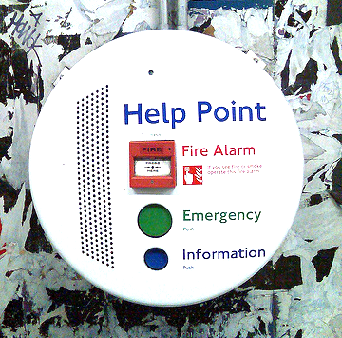
Questions?
3 minutes for
questions
http://www.flickr.com/photos/markhillary/1347412899/

Slide 21
1.
3.
Ontologies
Aperture
PIMO
2.
4.
my PIMO
Alignment
http://www.flickr.com/photos/orcoo/2589296875/

Slide 22
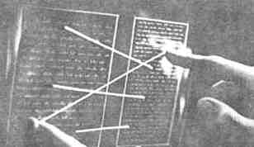
Some Questions towards PIMO
So far so good, but …
How to categorize it for
retrieval?
  It is about the project “CID” !
  It is a “Project Description” !
  It’s by “Claudia”
Didn’t the same Claudia show up in the address book?
In my knowledge workflow:
How can the ontology and user align?
Ted Nelson, Xanadu

Slide 23
NEPOMUK Ontologies
Representational Layer
RDF
RDFS
Knowledge Worker
NRL
Upper-Level Layer
NAO
Individual activities in PSI workflows:
filing
finding
thinking
NIE
PIMO
Foundational
Lower-Level Layer
Group-level
Personal-Level
All Concepts a User of the Semantic Desktop deals with
All Concepts an Application Programmer of the Semantic Desktop deals with

Slide 24
Personal Information Model
represents Personal Information Models of individuals.
consists of
RDF Vocabulary
Upper Ontology
class:PIMO
class:Thing
identifiers
relations
information fusion
basic concepts in PIM
Person, Location, Event, Organization, Topic, Document, Time

Slide 25
The knowledge worker’s world-view on information
Mental Model
Personal
Information
Model
Personal Space
of Information
Dirk
The CID Project
Files
claudia:CID
Documents
Papers
Projects
CID
Research
claudia:Dirk
<
file://C:/home/claudia_stern/documents/
projects/CID/ProjectDescription6.doc
>

Slide 26
Creating a user-PIMO
PIMO
Section 6
What to do:
create a user-PIMO: one model
for each knowledge worker
store in system
Why?
create structure
use identification space,
namespace
  identify user
  identify Things
store facts
for filing & finding & thinking
claudia:CID
claudia:Dirk

Slide 27

The namespace of the knowledge worker
PIMO
Section 6.1
PIMO is user-bound
Multiple choices for protocol
and addressing scheme.
http://<group-host>/<username>/pimo/
semdesk://<user-xmpp-id>/things/
http is server bound
xmpp is user bound
hands-on
semdesk://claudia@example.com/things/
http://www.flickr.com/photos/somemixedstuff/839984821/

Slide 28
Knowledge Worker and his user-PIMO
PIMO
Section 6.1
@prefix claudia: <semdesk://claudia@example.com/things/>.
@prefix pimo: <http://www.semanticdesktop.org/ontologies/2007/11/01/pimo#>.
claudia:Claudia a pimo:Person;
nao:prefLabel "Claudia Stern";
nco:hasEmailAddress mailto:claudia@example.com.
mailto:claudia@example.com a nco:EmailAddress;
nco:contactMediumComment "work";
nco:emailAddress "claudia@example.com".
claudia:PIMO a pimo:PersonalInformationModel;
pimo:creator claudia:Claudia;
nao:hasDefaultNamespace "semdesk://claudia@example.com/things/";
nao:hasDefaultNamespaceAbbreviation "claudia".
User
PIMO

Slide 29
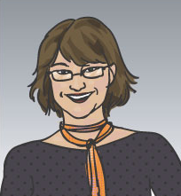
Aligning a Thing to Information Elements
Claudia
claudia:Claudia a pimo:Person.
TextDocument
title “The CID Project”
creator
Contact <outlook://contact/F16>
fullname “Claudia Stern”
<urn:uuid:a>
fullname “Claudia Stern”
occurrence of Claudia
groundingOccurrence

Slide 30
Hands-on: create these alignments
Create the alignments to get a unified view on “Claudia”
hands-on
claudia – pimo:occurrence - <D>
claudia – pimo:groundingOccurrence - <C>

Slide 31
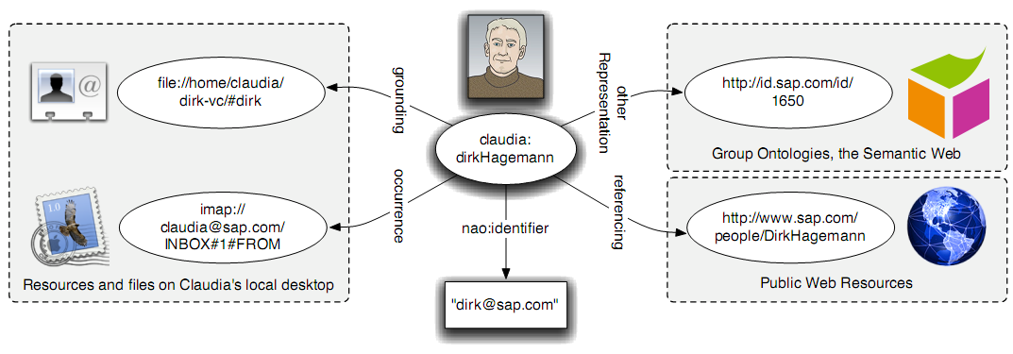
Different ways of identification
PIMO
Section 6.4

Slide 32
Hands-on: Identifiers from Address Books
Adding an identifier to the vCard allows software to keep track of an address book entry
In the future: we hope that global identifiers will be used more in knowledge work.
hands-on
<C> - nco:contactUID – "jpim-d723b2dd1d841d2064ec20f73fe3b936“.

Slide 33
Short overview on Labeling and Rating
Each Thing must have a nao:prefLabel
It is recommended to add a nao:personalIdentifier
this is equivalent to a “WikiName”
Users can “rate” their items with 1..10 values.
hands-on
<you:Claudia> - nao:prefLabel – “Claudia Stern“.
<you:Claudia> - nao:personalIdentifier – “ClaudiaS“.
<you:Claudia> - nao:numericRating – “8“^^xsd:float.

Slide 34

Classes of Things are subjective
PIMO
Section 6.10
PIMO-Types represent how the user interprets an information element, in the Mental Model
not how the computer interprets it
Knowledge Worker:
It’s a “Project Description”,
I need it when I talk to strangers
about the project
claudia:CIDProjectFlyer
a claudia:ProjectDescription
prefLabel “The CID Project”
pimo:groundingOccurrence
Computer:
“It’s a Paginated Text Document,
from MS-Word”
TextDocument
title “The CID Project”

Slide 35
Classes available in PIMO
PIMO
Section 6.12
PIMO contains an upper ontology for classes relevant for knowledge workers
Person, Location, Event, Organization, Topic, Document, Time.
Allow categorization of Things into
  Who is associated?
  Where is this?
  When is it?
  What is it about?
  Which Project, Which Task?
Six Thousand Words about Multi-Perspective Personal Document Management
Andreas Dengel, 2006

Slide 36
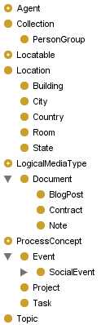
Defined Classes
PIMO
Section 6.12
hands-on
Write down on pen&paper
7 Things relevant for you
make two subclasses of Document (!)
one subclass of Organization
Leo says: Classes don’t grow on trees:
Combining Context Ontology and Landmarks for Personal Information Management
Khalid Latif and A Min Tjoa, 2006

Slide 37
Describing and linking things
PIMO
Section 6.14
For categorization and organization
of every Thing
Three basic relations
  isRelated
  hasPart <-> partOf (not transitive)
  hasTopic <-> isTopicOf (any Thing can be a topic in this relation)
hands-on
create 1 isRelated relation
create 1 partOf relation
create 1 hasTopic relation

Slide 38
Specific properties
PIMO
Section 6.15
To related specific types
example
  hasLocation – range must be location, domain locatable

Slide 39
Even more specific Properties
PIMO
Section 6.16
Custom properties
hands-on
create a custom sub-property of pimo:isRelated

Slide 40
Collections of Things
To organize multiple things in lists for PIM
Lists are instances of pimo:Collection
pimo:hasPart is the relation
also called “Piles” or “Personal Information Collections (PICs)”.

Slide 41
Extending PIMO with domain ontologies
PIMO
Section 9
Knowledge workers can share ontologies
Group ontologies – Organizational group, Project Group
  Alignment between peers
or domain ontologies – field of knowledge work, taxonomies
  Alignment inside a group of experts in an area
in the ontologies…

Slide 42
NEPOMUK Ontologies
PIMO
Section 9
Representational Layer
RDF
RDFS
NRL
Upper-Level Layer
NAO
NIE
PIMO
Foundational
Lower-Level Layer
Group-level
Personal-Level
All Concepts a User of the Semantic Desktop deals with
All Concepts an Application Programmer of the Semantic Desktop deals with

Slide 43
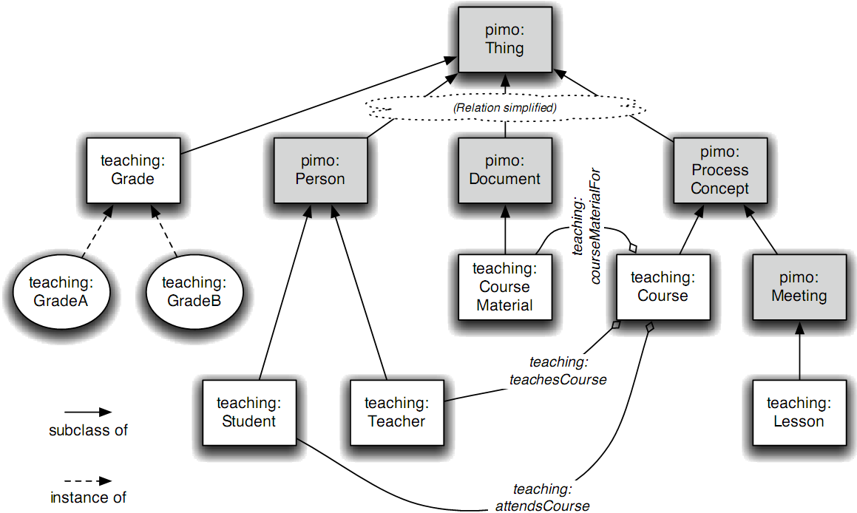
Short overview:
Teaching Domain
PIMO
Section 9.1

Slide 44
Hands-on: Annotating a file
PIMO
Section 11.7
claudia:BelfastBusTimetable
a pimo:Document;
nao:personalIdentifier "Belfast Bus Timetable";
pimo:isDefinedBy claudia:PIMO;
pimo:groundingOccurrence
<file://home/claudia/doc/tripplan.pdf>;
pimo:hasTopic
pimo:hasTopic claudia:Belfast.
claudia:Belfast
a pimo:City;
nao:personalIdentifier "Belfast";
pimo:isDefinedBy claudia:PIMO.
pimo:groundingOccurrence
<file://home/claudia/doc/tripplan.pdf>
a nie:TextDocument;
nie:title "Belfast Bus Timetable".

Slide 45
Questions?
3 minutes for
questions
http://www.flickr.com/photos/markhillary/1347412899/

Slide 46
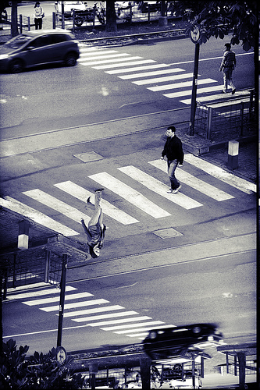
Comparison with other approaches
all go in the same
general direction,
but started on
different paths
http://www.flickr.com/photos/regolare/527627162/

Slide 47
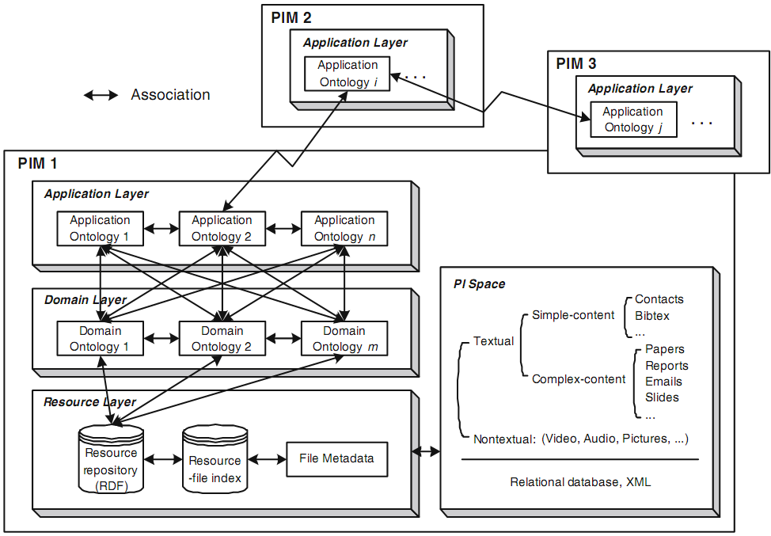
Alternative Approaches to PIMO: PIA
Isabel Cruz and Huiyong Xiao, 2005-2008
Personal
Information
Application
PIA
A layered framework supporting personal information integration and application design for the semantic desktop
Isabel F. Cruz and Huiyong Xiao, The VLDB Journal, 2008

Slide 48
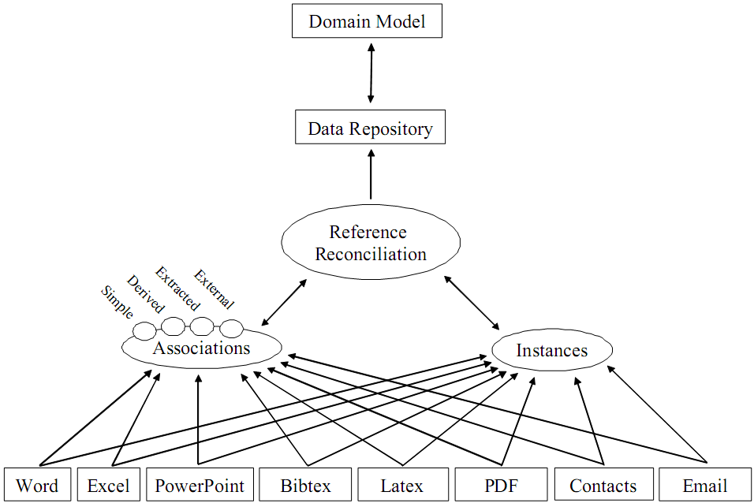
Alternative Approaches to PIMO: Semex
Xin Luna Dong, Alon Halevy, Yuhan Cai Jing Michelle Liu, Jayant Madhavan
focus on
reference reconciliation
A Platform for Personal Information Management and Integration.
Xin Dong and Alon Y. Halevy, CIDR, 2005

Slide 49
Other papers relevant for PIMO
Combining Context Ontology and Landmarks for Personal Information Management
Khalid Latif and A Min Tjoa, ICOCI 2006
Lessons for the future of Semantic Desktops learnt from 10 years of experience with the IDELIANCE Semantic Networks Manager
Jean Rohmer, SemDeskWS 2005

Slide 50
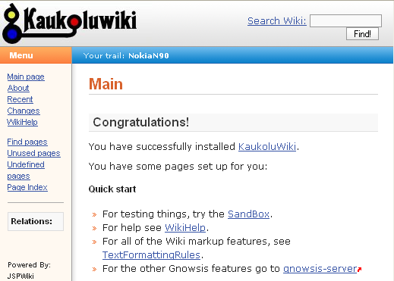
Data-flow between services
User Interfaces
Alignment
analyzes files and e-mails (and more)
matching to existing things
creating new things
Aperture.sf.net
crawling framework
converts all data to
RDF
read/write PIMO
Data
Person‘s files and
e-mails
PIMO
RDF
matching
to PIMO
adapting
to RDF
Files
E-Mails
Contacts
Documents
Papers
Projects
CID
Research
Claudia Stern
Dirk Hagemann
Klaus Nord
Inbox
Todo
SAP
CID-proj
Karlsruhe

Slide 51




mash it up!
</Pimo>
</rdf:RDF>
d
d
asdf
asfd
sadf
asfd
asdf
sadf
asdf
asdf
asdf
asdf
asdf
asdf
asdf
asdf
sda
fd
dfs
dfs
sda
df
da
sfd
asdf
f
fad
dsfsfd
fds
d
sfd
dfs
fds
PIMO!
Leo Sauermann
leo.sauermann@dfki.de
http://www.dfki.de/~sauermann/
Danke an Jesus, Ingrid Brunner-Sauermann, Heiko Maus, Sven Schwarz, Ansgar Bernardi, Andreas Dengel, Frank Osterfeld, Dominik Heim, Man Luo, Jeen Broekstra, Giovanni Tummarello, Michael Zeltner, Stephan Baumann, Gunnar A Grimnes, Ludger Van Elst, Harald Holz, Stefan Decker, Malte Kiesel, und alle anderen auf #swig

