Slide 1
PIMO Ontology Guide
16.07.2007, TF-Ont meeting,
Karlsruhe
Leo Sauermann, DFKI

Slide 2
<Title>
<Subtitle>
Text
  Text
    Text
      Text with Hyperlink in NEPOMUK blue
  To change footer text and date,
  go to „view-> header and footer“

Slide 3
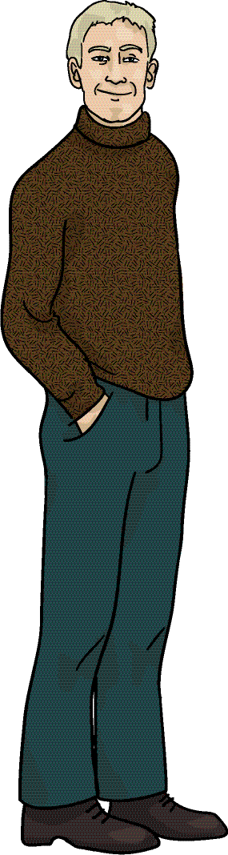
Dirk’s
mental model
Dirk’s concepts
pimo-things
Dirk’s files and
digital resources
SAP
dirk:SAP
http://www.sap.com/
Claudia
Resources
Things
relations to
occurrences

Slide 4

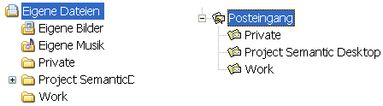
Szenario of Nepomuk
Knowledge Worker „Dirk“ using Desktop PC
Problem: Data about single ideas are stored in several applications and without context
Files ↔ Emails
Semantic Desktop

Slide 5
Three contributions
A representation of the user’s personal information items, including e-mails, files, and other data sources using RDF
„native resources“ = DOCS
A representation of the user’s mental model in a formal representation, using several layered ontologies.
„PIMO“
A desktop service to capture the current actions of the user, representing the actions using RDF and then calculating the current context of the user.
„Context Server“ = OBS
UM = DOCS + PIMO + OBS
Adaptive Applications

Slide 6
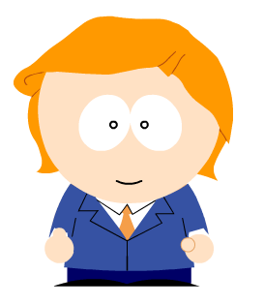
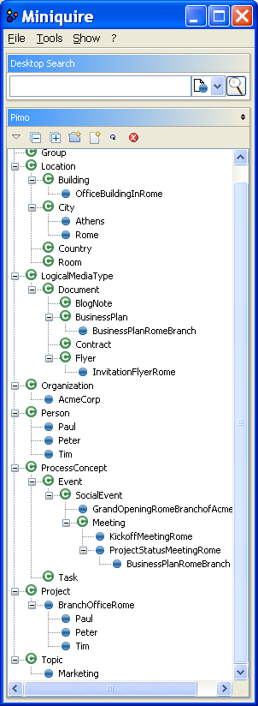


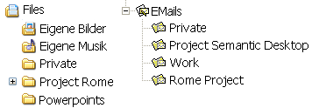
From Information Elements to PIMO
Data is expressed in NIE
  RDF/S vocabularies like NCO, NFO, NCAL
  data + folder structures
Personal Information Model PIMO
  Personal Concepts
    Topics
    Places
    People
    Types
    Workflow
with relations to files and folders
Notes:
if you remember Toshio Okamoto’s talk, you might remember the “type of knowledge” slide. This is what we at DFKI do since 10 years and we also put into gnowsis

Slide 7
PIMO is The “personal ontology”
“shared” across applications
filled from DOCS, Company ontologies and domain ontologies
used by the – user
  creates instances
  creates classes & properties (on the fly)
  annotates

Slide 8

PIMO is filled
automatically from data
aperture.sf.net
(check it out!)
Data
Dirk‘s files & e-mails
PIMO Store
RDF Database
matching
to
ontology
adapter
to RDF

Slide 9

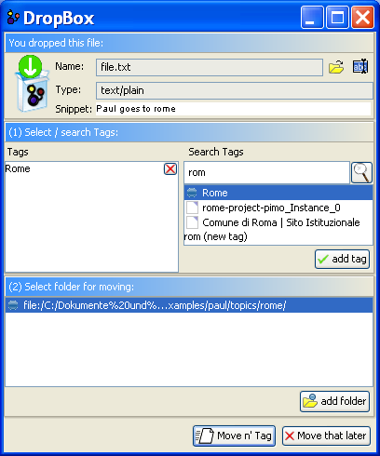
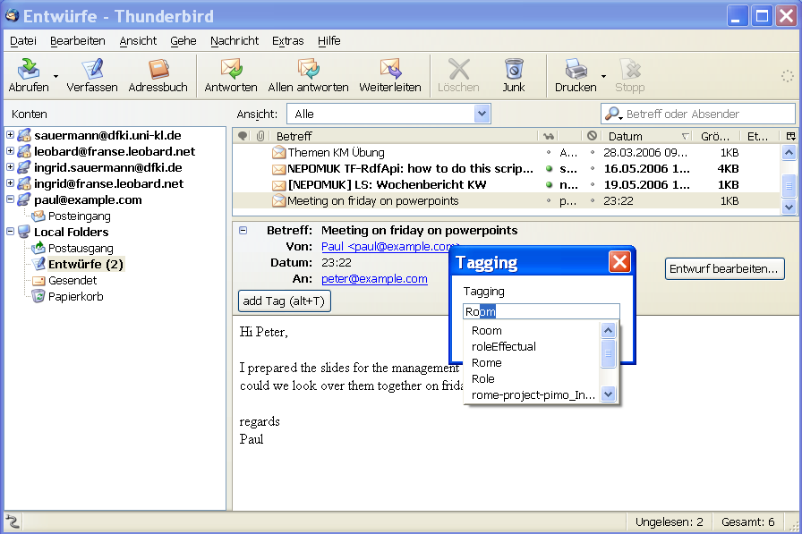
PIMO used and extended

Slide 10
PIMO ontology languages
basic superclasses
PIMO-Basic
dfki.de/ont/pim/pimo
PIMO-Upper
A domain-independent ontology defining abstract sub-classes of Thing.
PIMO-Mid:
Shared on the group level in the organization, shared projects, people, topics,
Thing
SystemItems
domain-independent
PIMO Foundational Level
Person
Role
Time
Document
Organization
ontology imports
PIMO Group/Mid-Level
domain-independent, adapted to Semantic Desktop and Nepomuk
Contract
Manager
Project
Offer
Message
Company

Slide 11
PIMO ontology languages
Domain ontologies
A set of domain ontologies where each describes a concrete domain of interest of the user. The user’s company and its organizational structure may be such a domain, or a shared public ontology.
dfki.de/ont/pim/pimo
Domain Model: Bibtech A
Organizational Structure
Report
Heiko
Car-Ent
EPOS
Report56

Slide 12
all PIMO ontology layers
basic superclasses
SystemItems
Levels of sharing
global world
group
personal
domain-independent
PIMO Foundational Level
Thing
sub-classes
Person
Role
Time
Document
Organization
Information Element Vocabularies
representing extracted data in RDF/S
multiple vocabularies
ontology imports
PIMO Group/Mid Level
domain ontologies, organization ontologies
NCAL
NCO
NID3
foaf
Person
Image
Contract
NMO
NFO
NEXIF
Manager
Project
Offer
Message
Company
Individual extensions
aperture.semanticdesktop.org/data
PIMO Personal Level
InProceedings
Heiko
Car-Ent
EPOS
Blah considred dangerous

Slide 13
Paul‘s PIMO - Personal Information Model
Rep Lang
PIMO Foundational Level
Native Data Vocabularies
PIMO Group/Mid-Level
Mid: Bibtech A
Mid: Paul’s company
personal information model of one user
Imports all other ontologies and defines extensions
Ontology side Native Resources
PIMO of Person:Paul
Paul
Paul imports
all of them
Paul
File X
e-mail2
Report41
vCard H
Project Z

Slide 14
The whole model (=what is in the repository)
repository = DOCS + PIMO + OBS
To capture a user model, we need to know
  PIMO the categories/model of the user
  DOCS the documents/e-mails attached to the categories
  OBS the current context of the user
This holistic user model can now be used for several personalized applications

Slide 15
Our goal
This is my personal
computer

Slide 16
Summary
The PIMO ontology stack and Dirk’s PIMO allow us to personalize using precise knowledge about the user
Applications use PIMO

Slide 17

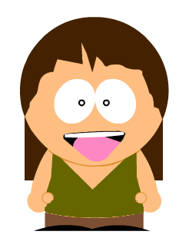
Questions
persona created using http://www.sp-studio.de/

