Slide 1
Psychedelics Capstone
Stephen Jones

Slide 2
Problem
Increasing Depression both pre and post COVID
As a tool to aid in treatment Psychedelics have seen a resurgence due to clinical trials and breakthrough studies.

Slide 3
Data
Morlock, Robert. (2021). Data from: Psychedelic mushrooms in the USA: knowledge, patterns of use, and association with health outcomes [Data set]. https://doi.org/10.5061/dryad.bzkh189b6

Slide 4
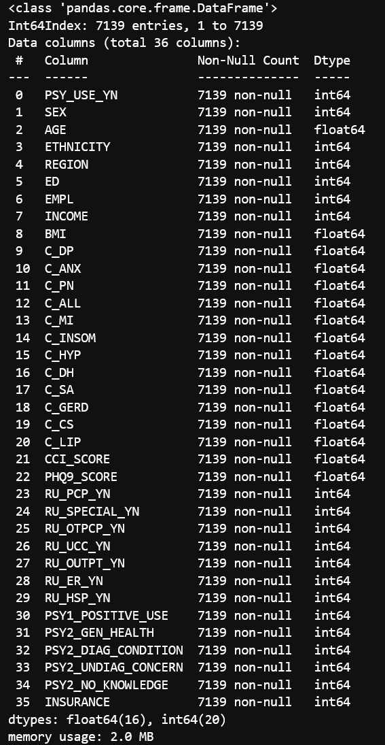
Data
Notes:
Dropped some rows that were highly correlated or important features through random forest so there is 36 features instead of 57 features

Slide 5
Question
Given patient features and psychedelic drug use, can we create a model to predict depression to support clinical improvement?

Slide 6
Conclusions & Recommendations
SVC model has the best performance on the recall(because we want to reduce false negatives) and MCC score
Test Recall: 0.771
MCC: .516
Recommend:
Trying more ensemble methods
dropping more unimportant rows
Expand parameter space used for model tuning

Slide 7
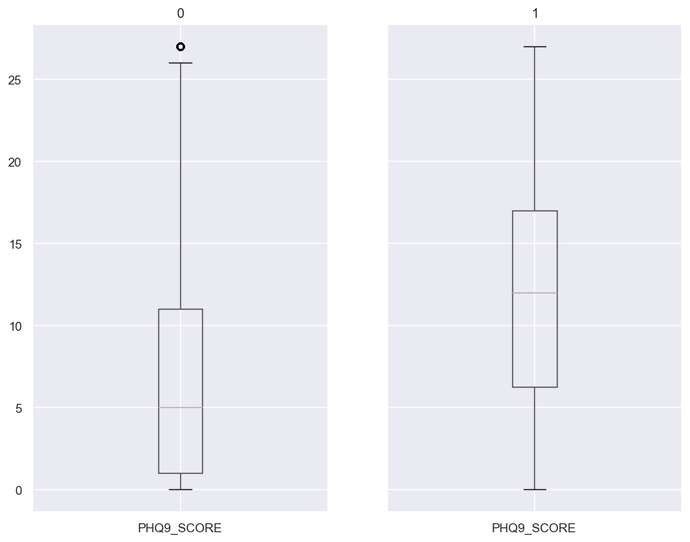
Exploratory Data Analysis
Took

Slide 8
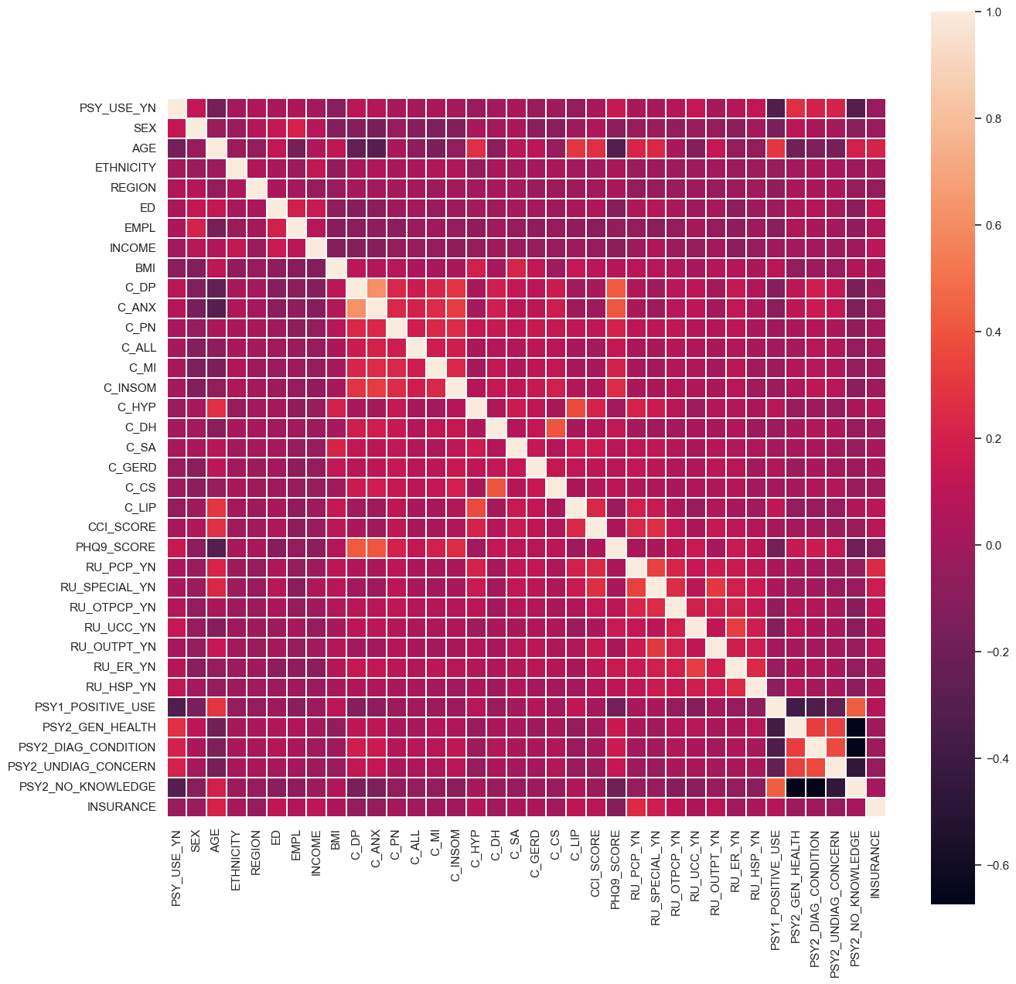
Exploratory Data Analysis

Slide 9
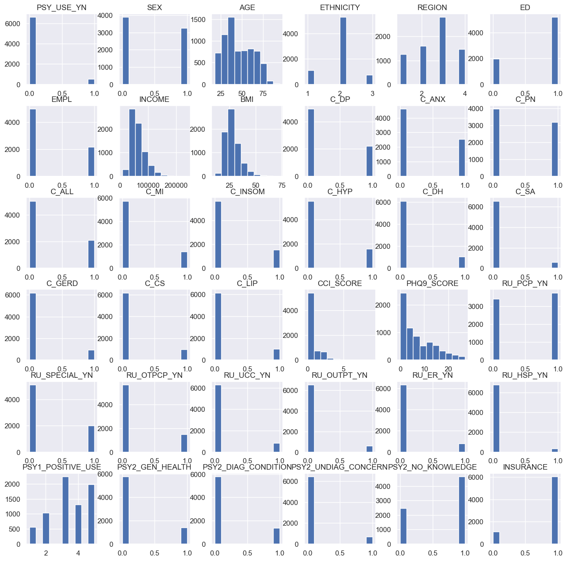
Exploratory Data Analysis

Slide 10
Modeling Metrics
Recall- Want to reduce false negatives to not leave patients untreated
MCC – a more balanced matric that takes the whole confusion matrix into account

Slide 11
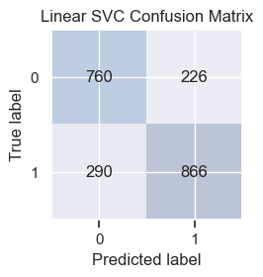
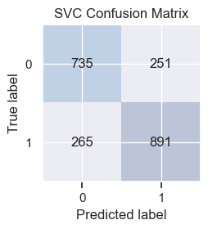
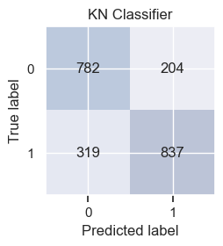
Modeling
Test Recall: .749
MCC: .518
Test Recall: .771
MCC: .516
Test Recall: .670
MCC: .428

Slide 12
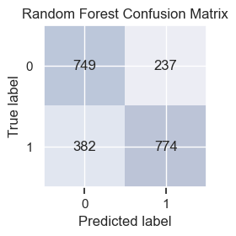
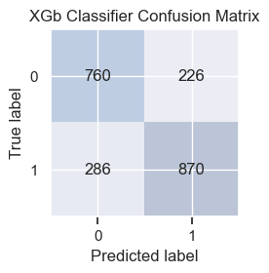
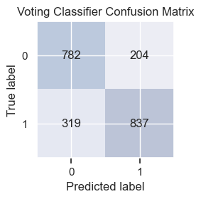
Modeling
Test Recall: .669
MCC: .429
Test Recall: .753
MCC: .522
Test Recall: .724
MCC: .516

Slide 13
Future Research
Explore voice analysis, social media pictures, video, etc. to be used to classify those that are depressed in need of therapy

