Slide 1
Introduction to SimpleScalar
(Based on SimpleScalar Tutorial)
CPSC 614
Texas A&M University

Slide 2
Overview
What is an architectural simulator?
  a tool that reproduces the behavior of a computing device
Why we use a simulator?
  Leverage a faster, more flexible software development cycle
    Permit more design space exploration
    Facilitates validation before H/W becomes available
    Level of abstraction is tailored by design task
    Possible to increase/improve system instrumentation
    Usually less expensive than building a real system

Slide 3
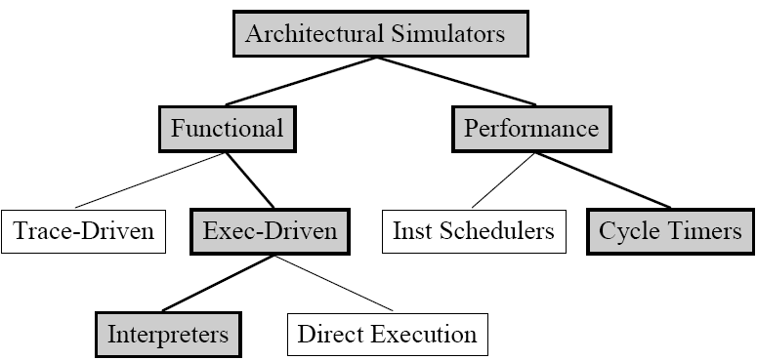
A Taxonomy of Simulation Tools
Shaded tools are included in SimpleScalar Tool Set
Notes:
Before I introduce the detail of simplescalar, I first give you some general knowledge about simulators. This graph here shows a classification of simulators.

Slide 4
Functional vs. Performance
Functional simulators implement the architecture.
  Perform real execution
  Implement what programmers see
Performance simulators implement the microarchitecture.
  Model system resources/internals
  Concern about time
  Do not implement what programmers see
Notes:
I mentioned in previous slide that simplescalar is highly flexible since it provide both functional and performance simulators.
Functional simulators:
Ex, for a branch predictor, you care more about the prediction accuracy than the actual timing
for example, memory and registers are visible resources to a programmer using assembly language
Performance simulators: programmers cannot see how an instruction is transmitted. However, the transmitting process is important for performance evaluation

Slide 5
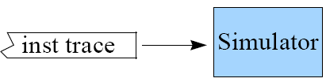
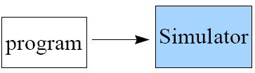
Trace- vs. Execution-Driven
Trace-Driven
  Simulator reads a ‘trace’ of the instructions captured during a previous execution
  Easy to implement, no functional components necessary
Execution-Driven
  Simulator runs the program (trace-on-the-fly)
  Hard to implement
  Advantages
    Faster than tracing
    No need to store traces
    Register and memory values usually are not in trace
    Support mis-speculation cost modeling
Notes:
One thing I want to point out is that a simulator can both be an execution driven and a performance simulator.

Slide 6
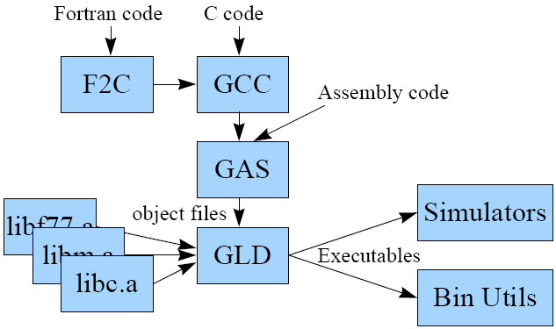
SimpleScalar Tool Set
Computer architecture research test bed
  Compilers, assembler, linker, libraries, and simulators
  Targeted to the virtual SimpleScalar architecture
  Hosted on most any Unix-like machine
Notes:
Alpha AXP: Anomalous X-ray Pulsar, a MIPS (Microprocessor without interlocked pipeline stages ) ISA

Slide 7
Advantages of SimpleScalar
Highly flexible
  functional simulator + performance simulator
Portable
  Host: virtual target runs on most Unix-like systems
  Target: simulators can support multiple ISAs
Extensible
  Source is included for compiler, libraries, simulators
  Easy to write simulators
Performance
  Runs codes approaching ‘real’ sizes

Slide 8
Simulator Suite
Sim-Fast
Sim-Safe
Sim-Profile
Sim-Cache
Sim-BPred
Sim-Outorder
300 lines
functional
4+ MIPS
350 lines
functional w/checks
900 lines
functional
Lot of stats
< 1000 lines
functional
Cache stats
Branch stats
3900 lines
performance
OoO issue
Branch pred.
Mis-spec.
ALUs
Cache
TLB
200+ KIPS
Performance
Detail

Slide 9
Sim-Fast
Functional simulation
Optimized for speed
Assumes no cache
Assumes no instruction checking
Does not support Dlite!
Does not allow command line arguments
<300 lines of code

Slide 10
Sim-Cache
Cache simulation
Ideal for fast simulation of caches (if the effect of cache performance on execution time is not necessary)
Accepts command line arguments for:
  level 1 & 2 instruction and data caches
  TLB configuration (data and instruction)
  Flush and compress
  and more
Ideal for performing high-level cache studies that don’t take access time of the caches into account

Slide 11
Sim-Bpred
Simulate different branch prediction mechanisms
Generate prediction hit and miss rate reports
Does not simulate the effect of branch prediction on total execution time
  nottaken
  taken
  perfect
  bimod bimodal predictor
  2lev 2-level adaptive predictor
  comb combined predictor (bimodal and 2-level)

Slide 12
Sim-Profile
Program Profiler
Generates detailed profiles, by symbol and by address
Keeps track of and reports
Dynamic instruction counts
  Instruction class counts
  Branch class counts
  Usage of address modes
  Profiles of the text & data segment

Slide 13
Sim-Outorder
Most complicated and detailed simulator
Supports out-of-order issue and execution
Provides reports
  branch prediction
  cache
  external memory
  various configuration

Slide 14
Sim-Outorder HW Architecture
Fetch
Dispatch
Register
Scheduler
Exe
Writeback
Commit
Memory
Scheduler
Mem
I-Cache
I-TLB
D-Cache
D-TLB
Virtual Memory
26年 11月 7日

Slide 15
Sim-Outorder (Main Loop)
sim_main() in sim-outorder.c
      ruu_init();
      for(;;){
      ruu_commit();
      ruu_writeback();
      lsq_refresh();
      ruu_issue();
      ruu_dispatch();
      ruu_fetch();
      }
Executed once for each simulated machine cycle
Walks pipeline from Commit to Fetch
  Reverse traversal handles inter-stage latch synchronization by only one pass

Slide 16
RUU/LSQ in Sim-Outorder
RUU (Register Update Unit)
  Handles register synchronization/communication
  Serves as reorder buffer and reservation stations
  Performs out-of-order issue when register and memory dependences are satisfied
LSQ (Load/Store Queue)
  Handles memory synchronization/communication
  Contains all loads and stores in program order
Relationship between RUU and LSQ
  Memory dependencies are resolved by LSQ
  Load/Store effective address calculated in RUU

Slide 17
Specifying Sim-outorder
  -fetch:ifqsize <size> -instruction fetch queue size (in insts)
  -fetch:mplat <cycles> - extra branch miss-prediction latency (cycles)
  …
  -bpred <type>
  -bpred:bimod <size>
  -bpred:2lev <l1size> <l2size> <hist_size>
  …
  -config <file>
  -dumpconfig <file>
For Assignment #1, change at least l1size.
$ sim-outorder –config <file> <benchmark command line>

Slide 18
Benchmark
SPEC CPU 2000
  Integer/Floating Point
  http://www.spec.org
  For homework: Alpha binaries, input data files
input
ref
179.art
data
output
CFP2000
…
src
test
164.gzip
…
train
CINT2000
…
Directory organization

Slide 19
SimPoint
Goal
  To find simulation points that accurately representatives the complete execution program based on phase analysis
Single Simulation Points (Standard for homework)
  If the Simulation Point is 90, then you start simulating at instruction 90 * 100 million (9 billion) and stop simulating at instruction 9.1 billion.
Multiple Simulation Points

Slide 20
References
SimpleScalar Tutorial/Hack Guide
  Read tutorial/Run, test, and debug
WWW Computer Architecture
  http://www.cs.wisc.edu/arch/www

