Slide 1



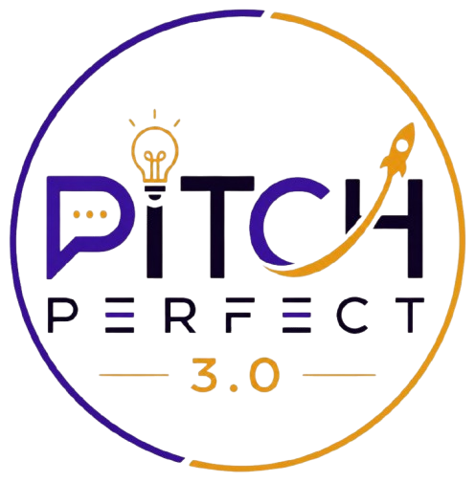
E-CELL
SKILL
SWITCH
AVCOE
Dream. Build. Lead.
.
  Human · multilingual · switchable soft-skills mentorship
  [ Your Team Name ]
  [ Team member names ]
  Amrutvahini College of Engineering
AMRUTVAHINI COLLEGE OF ENGNINEERING

Slide 2
PROBLEM STATEMENT
E-CELL
AVCOE
Dream. Build. Lead.
  Nearly half of India's graduates aren't job-ready — employability is only 56.35% (India Skills Report 2026), and the gap is soft skills, not technical ability.
  Colleges hire soft-skills trainers, but quality is inconsistent — and students can't switch a trainer who isn't working for them.
  Online alternatives lock students into one instructor per subscription, or replace human mentorship with AI-only feedback.
  English-only delivery turns language itself into a barrier to the confidence the training is meant to build.
  We lived this: our strong first-year trainer left, the replacement was weaker, and we had no way to switch — that's why SkillSwitch exists.
AMRUTVAHINI COLLEGE OF ENGNINEERING

Slide 3
PROPOSED SOLUTION
E-CELL
AVCOE
Dream. Build. Lead.
  SkillSwitch: a human, multilingual, switchable soft-skills mentorship platform — sold to colleges, free for students.
  Multilingual video lessons — soft skills taught in a Hindi + English blend, so language is never the barrier.
  Weekly task-video assignments — students record real skills (self-intro, presentation, group discussion) and get personal feedback from a human mentor.
  AI weekly plan — AI only turns the mentor's human feedback into a clear to-do list; assessment stays 100% human.
  Switch mentors on demand in a few clicks — no new subscription — plus optional live 1:1 video sessions.
AMRUTVAHINI COLLEGE OF ENGNINEERING

Slide 4
UNIQUE SELLING PROPOSITION
E-CELL
AVCOE
Dream. Build. Lead.
  Human mentor, not an AI-only coach.
  Switchable on demand, not locked in for a subscription term.
  One institutional subscription, not paid per-teacher by students.
  Regional-language delivery by design, not a bolted-on afterthought.
  Purpose-built for placement-readiness practice, not generic language learning or corporate training.
  No competitor combines all five — and our name is our moat: switch mentors, not subscriptions.
AMRUTVAHINI COLLEGE OF ENGNINEERING

Slide 5
BUSINESS MODEL
E-CELL
AVCOE
Dream. Build. Lead.
  B2B2C: colleges buy an institutional subscription; students pay nothing — matching how colleges already fund training.
  Pricing: ₹1,500–4,000 per student / year (benchmarked to Clicks Campus ₹3,999 and Indian EdTech norms; to be validated with placement officers).
  Supply: mentors work part-time / freelance — like Preply and Verbling — so employed professionals can mentor on the side.
  Main costs: mentor payouts, video hosting, platform, and a lean sales team.
  Extra lever: a NAAC / NBA accreditation-outcomes dashboard colleges will pay for.
AMRUTVAHINI COLLEGE OF ENGNINEERING

Slide 6
TARGET MARKET
E-CELL
AVCOE
Dream. Build. Lead.
  Buyer: college placement / T&P cells — 48,246 colleges and 1.1 crore graduates a year in India (AISHE 2023-24).
  Beachhead: Maharashtra — 4,692 colleges and ~540 engineering institutes — our home base (AVCOE) with existing placement-cell contacts.
  End users: students in placement-facing years, especially outside top tech streams where the employability gap is widest.
  Strategy: start local, prove the model in Maharashtra, then scale nationally.
AMRUTVAHINI COLLEGE OF ENGNINEERING

Slide 7
MARKET ANALYSIS
E-CELL
AVCOE
Dream. Build. Lead.
  India soft-skills training market: USD 722.5M (2024) → USD 1,758.5M (2033), 9.87% CAGR (IMARC).
  Demand: employability rose 46.2% → 56.35%, yet 92.8% of students still want practice-based, hands-on prep (India Skills Report 2026).
  Policy tailwind: NEP 2020 and NAAC / NBA now grade colleges on employability — and explicitly call for multilingual, skills-integrated EdTech.
  Competition: pieces exist separately (TrainX, Clicks Campus, Yoodli, Preply, Bodyswaps) — but none combine all four for Indian placement-readiness. That gap is ours.
AMRUTVAHINI COLLEGE OF ENGNINEERING

Slide 8
IMPLEMENTATION PLAN
E-CELL
AVCOE
Dream. Build. Lead.
  Phase 1 (0–3 mo): build the MVP — multilingual lessons + task-video + human-feedback loop; sign one pilot college in Maharashtra.
  Phase 2 (3–6 mo): run the pilot, add mentor-switching and live 1:1; validate pricing; set up DPDP-compliant video storage.
  Phase 3 (6–12 mo): add the AI weekly plan + accreditation dashboard; expand to 5–10 Maharashtra colleges.
  Phase 4 (12 mo+): scale across Maharashtra, then nationally; grow the mentor pool.
  Funding path: E-Cell → DPIIT recognition → AICTE Student Startup Policy (via AVCOE) → SISFS seed grant.
AMRUTVAHINI COLLEGE OF ENGNINEERING

Slide 9
ABOUT TEAM
E-CELL
AVCOE
Dream. Build. Lead.
  Founder-market fit: we're building the fix to a problem we lived at AVCOE — losing a great mentor with no way to switch.
  [ Member 1 name ] — [ role, e.g. Product & Vision ]
  [ Member 2 name ] — [ role, e.g. Tech / Platform ]
  [ Member 3 name ] — [ role, e.g. Partnerships & Sales ]
  Amrutvahini College of Engineering, Sangamner, Maharashtra.
AMRUTVAHINI COLLEGE OF ENGNINEERING

