Slide 1
BeaconPay
Gasless USDC payments with verifiable events
Powered by EIP-7702 + Sponsored Transactions
Deployable on Ethereum, Zircuit, Flow
Page 1

Slide 2



Mission & Vision
Mission: Break blockchain barriers with gasless, user-centric payments
Vision: Become the universal on-chain payment standard, bridging TradFi ↔ DeFi with:
Seamless on/off-ramps
AI-driven
intent payments
Automated cross-chain
settlements
Page 2

Slide 3
Problem
1.
Users don’t want to manage ETH for gas
2.
Merchants need verifiable, auditable events
3.
Multi-chain fragmentation complicates onboarding
4.
Existing sponsored transactions lack security & control
Page 3

Slide 4
Solution — BeaconPay Architecture
Eventor: Validates USDC payments (commit-reveal + transient storage)
Paymaster: Sponsors gas, merchants cover fees securely
Full Test Suite: Mainnet-forking & developer harness
Page 4

Slide 5

Core Feature — Sponsored Transactions
dApps/merchants cover
gas fees → gasless UX
Powered by EIP-7702
batched tx + Paymaster
Secure: only whitelisted
paymasters trigger
Page 5

Slide 6

How It Works (Flow)
User pays
in USDC,
no ETH needed
User signs off-chain (EIP-7702, authorized = Paymaster)
Merchant submits on-chain (pays gas)
Paymaster → Eventor verifies → emits
Page 6

Slide 7
Key Features & Security
USDC validation with
commit-reveal pattern
Transient storage reduces state risk & gas cost
Event emission for confirmed payments
Strict Paymaster authorization → no unauthorized sponsorship
Page 7

Slide 8
”
Use Cases
1
2
E-commerce & Subscriptions:
gasless checkout in USDC
Gaming & Content:
seamless micro-payments
3
4
Payment Gateway:
Web2 merchants
onboard easily
Future POS:
QR payments,
merchants pay gas
Page 8

Slide 9
Roadmap
Hackathon:
ETH + Zircuit demo live
1 Month:
Flow support, merchant dashboard
3 Months
Bulk settlement, SDK & templates
Vision
AI intent payments, cross-chain automation
Page 9

Slide 10
Contact
Eventor
The main contract that handles payment validation and event emission using a commit-reveal pattern.
Key Features:
Uses transient storage for temporary state between calls.
Validates USDC payment amounts and recipients.
Emits ConfirmedPayment events after successful validation.
Implements a commit-reveal pattern for payment validation.
Paymaster
The Paymaster contract is responsible for executing sponsored transactions. It has a sponsoredReveal function that can only be called by the registered paymaster address in the Eventor contract.
Page 10

Slide 11
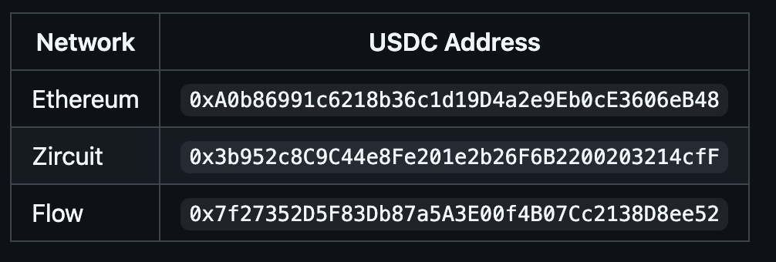
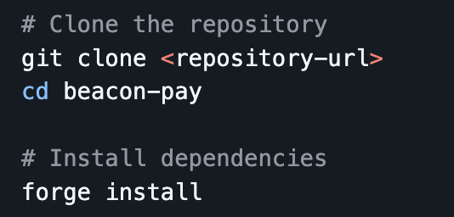
Supported Networks
Installation
Page 11

Slide 12
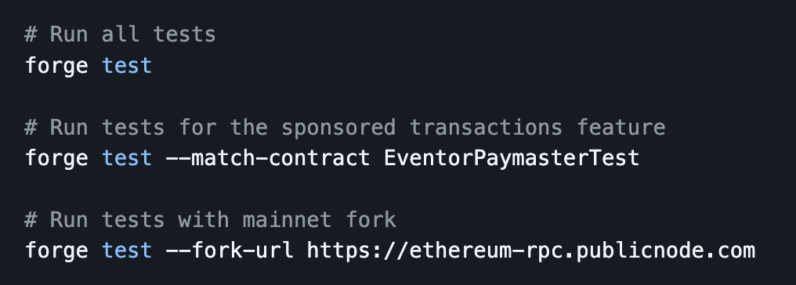

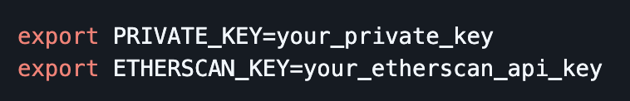


Usage
Test
Build
Deploy
Set your environment variables:
Deploy the Eventor and Paymaster contracts,
and then set the paymaster address
in the Eventor contract.
Page 12

Slide 13
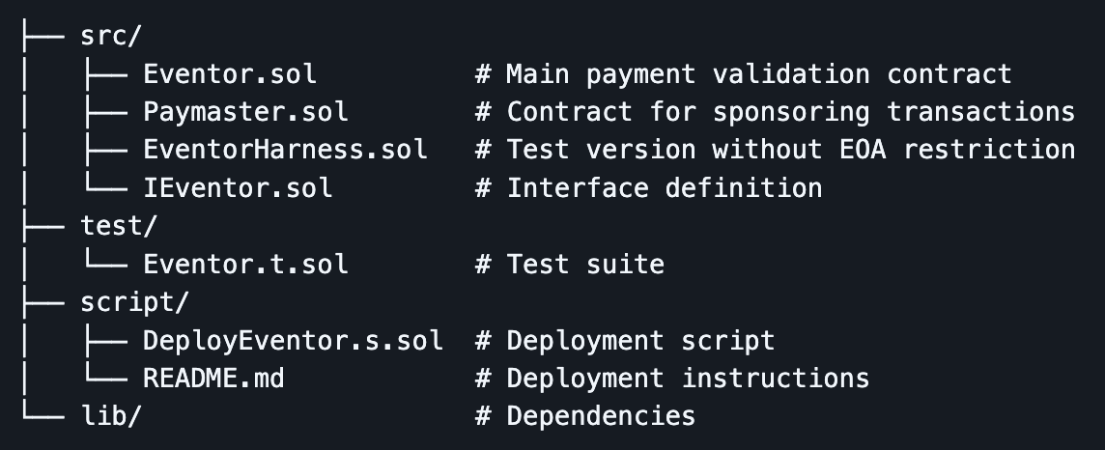
Development
Project Structure
Test
MIT
Page 13

Slide 14
THANK
YOU
Page 14

