Slide 1
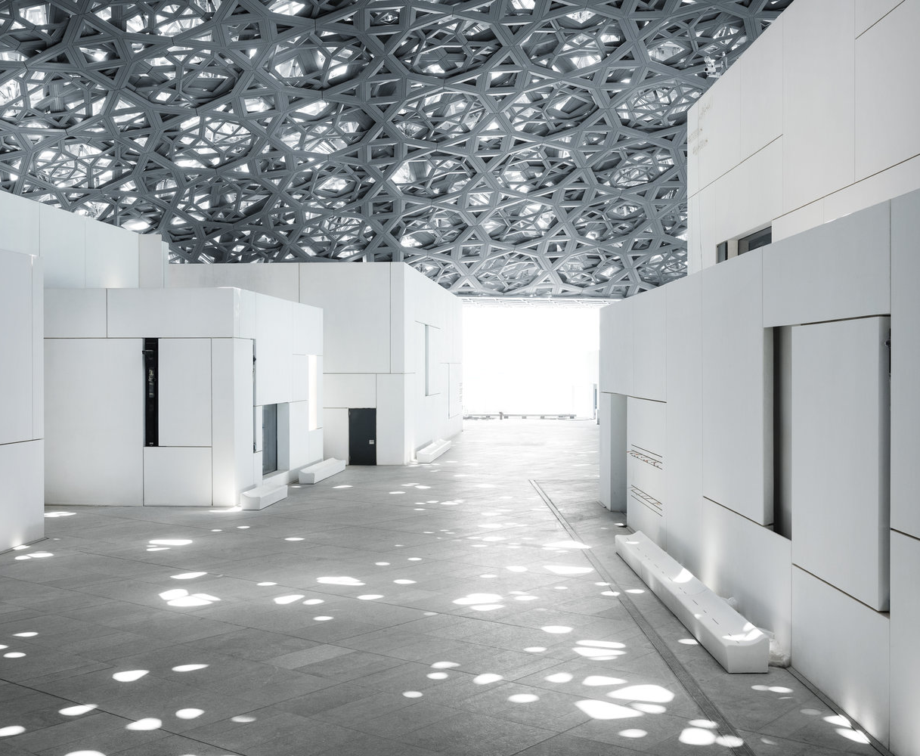
01 / SPATIAL PHENOMENON
RAIN
OF LIGHT
BENEATH A POROUS DOME,
DAYLIGHT BECOMES A
CULTURAL MEDIUM.
The roof does not simply shelter the museum;
it filters the sky into a moving field of light.
01
PERFORATED CANOPY
Four steel layers break the
roof into apertures.
02
FILTERED DAYLIGHT
Sunlight becomes a moving
field across the floor.
02
SOURCE / LOUVRE ABU DHABI — ARCHITECTURE

