Slide 1
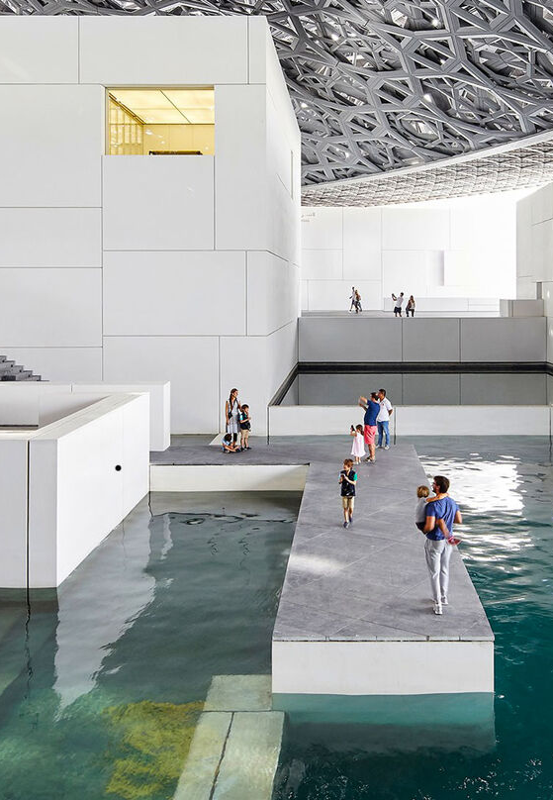
04 / CIVIC INTERIOR
WATER
AS PUBLIC ROOM
Paths cross the water beneath the dome,
turning the museum into a walkable urban room.
The visitor does not move around a single object.
The visitor moves through a sequence of thresholds.
01
ARRIVAL
02
PAUSE
land → water → threshold
shade → water → room
05
SOURCE / LOUVRE ABU DHABI — ARCHITECTURE

