Slide 1
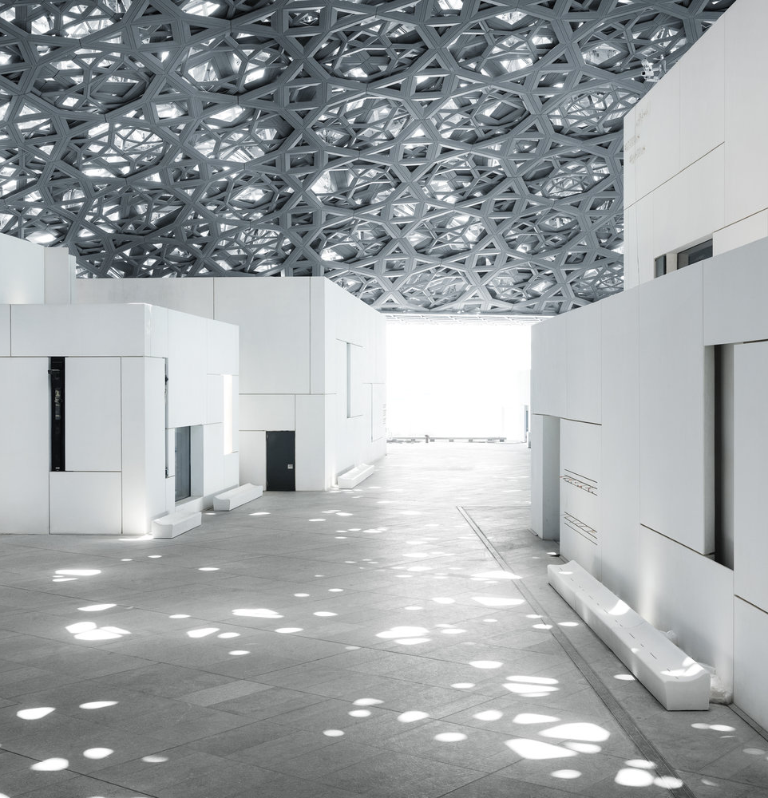
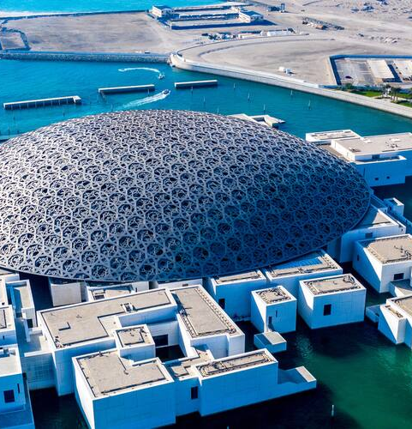
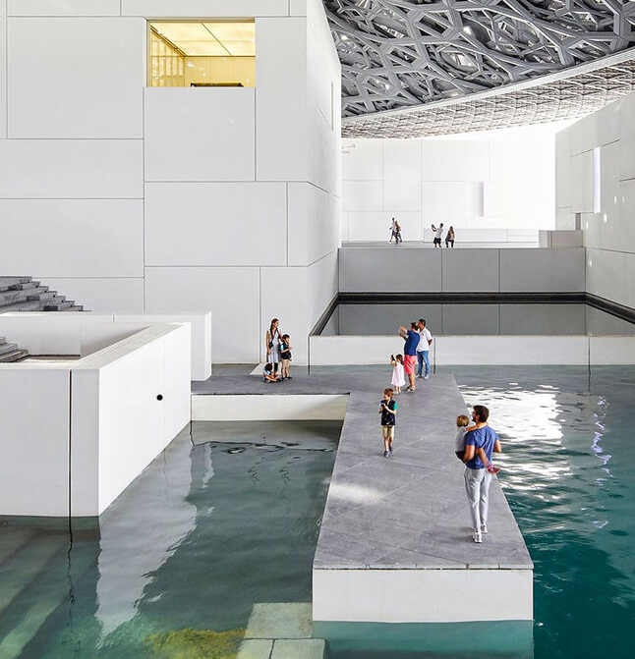
06 / SPATIAL SEQUENCE
WALK / PAUSE / RETURN
A MUSEUM DESIGNED AS A JOURNEY
01 / FILTERED DAYLIGHT
02 / CITY + SEA
03 / CIVIC WATER ROOM
ARRIVE THROUGH SHADE
ORIENT FROM ABOVE
RETURN TO WATER
07
SOURCE / LOUVRE ABU DHABI — ARCHITECTURE

