Slide 1
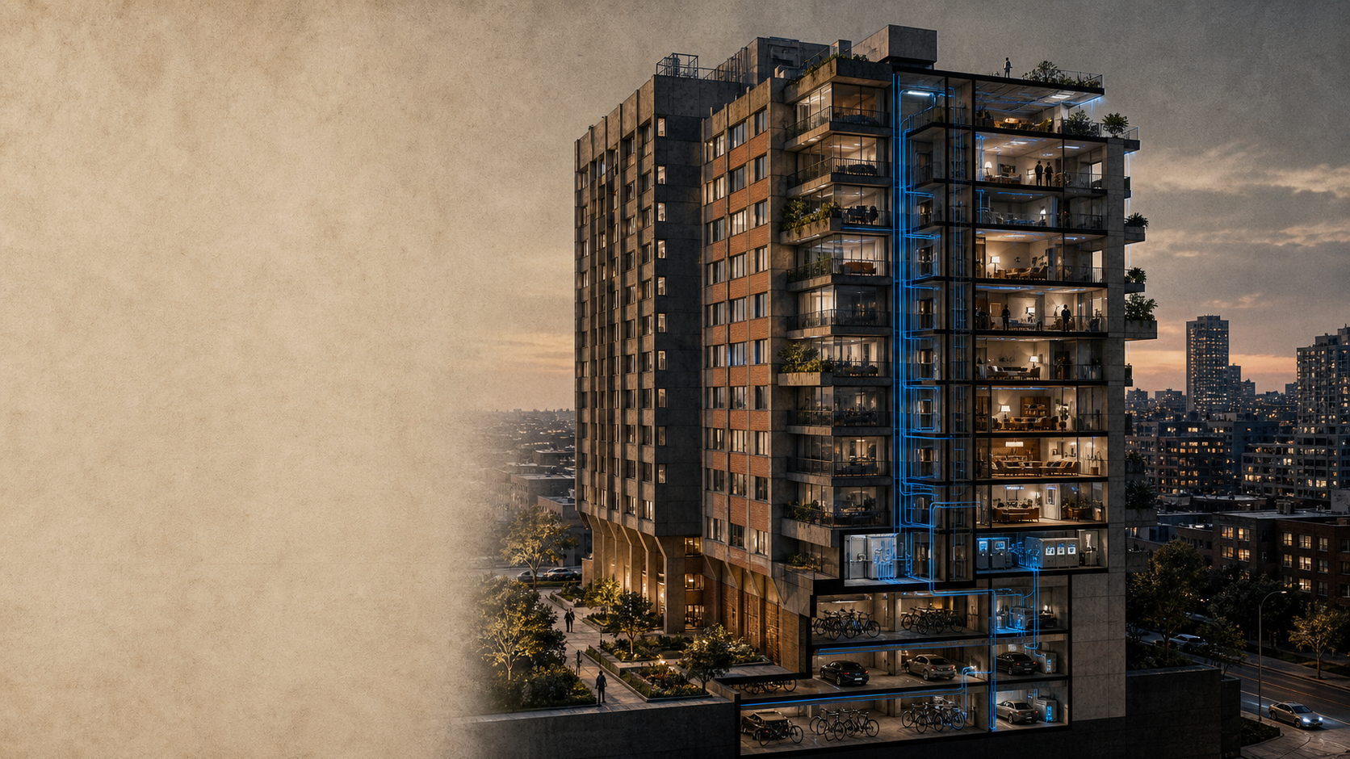
URBAN SYSTEMS / CASE 07
VERTICAL CITY
RETROFIT
The next city is not built from scratch.
It is upgraded in place.
A connected strategy for aging high-rise housing:
envelope · energy · shared space · care
CONCEPTUAL HERO VISUAL / NOT A REAL PROJECT
VERTICAL CITY RETROFIT · 2026

