Slide 1
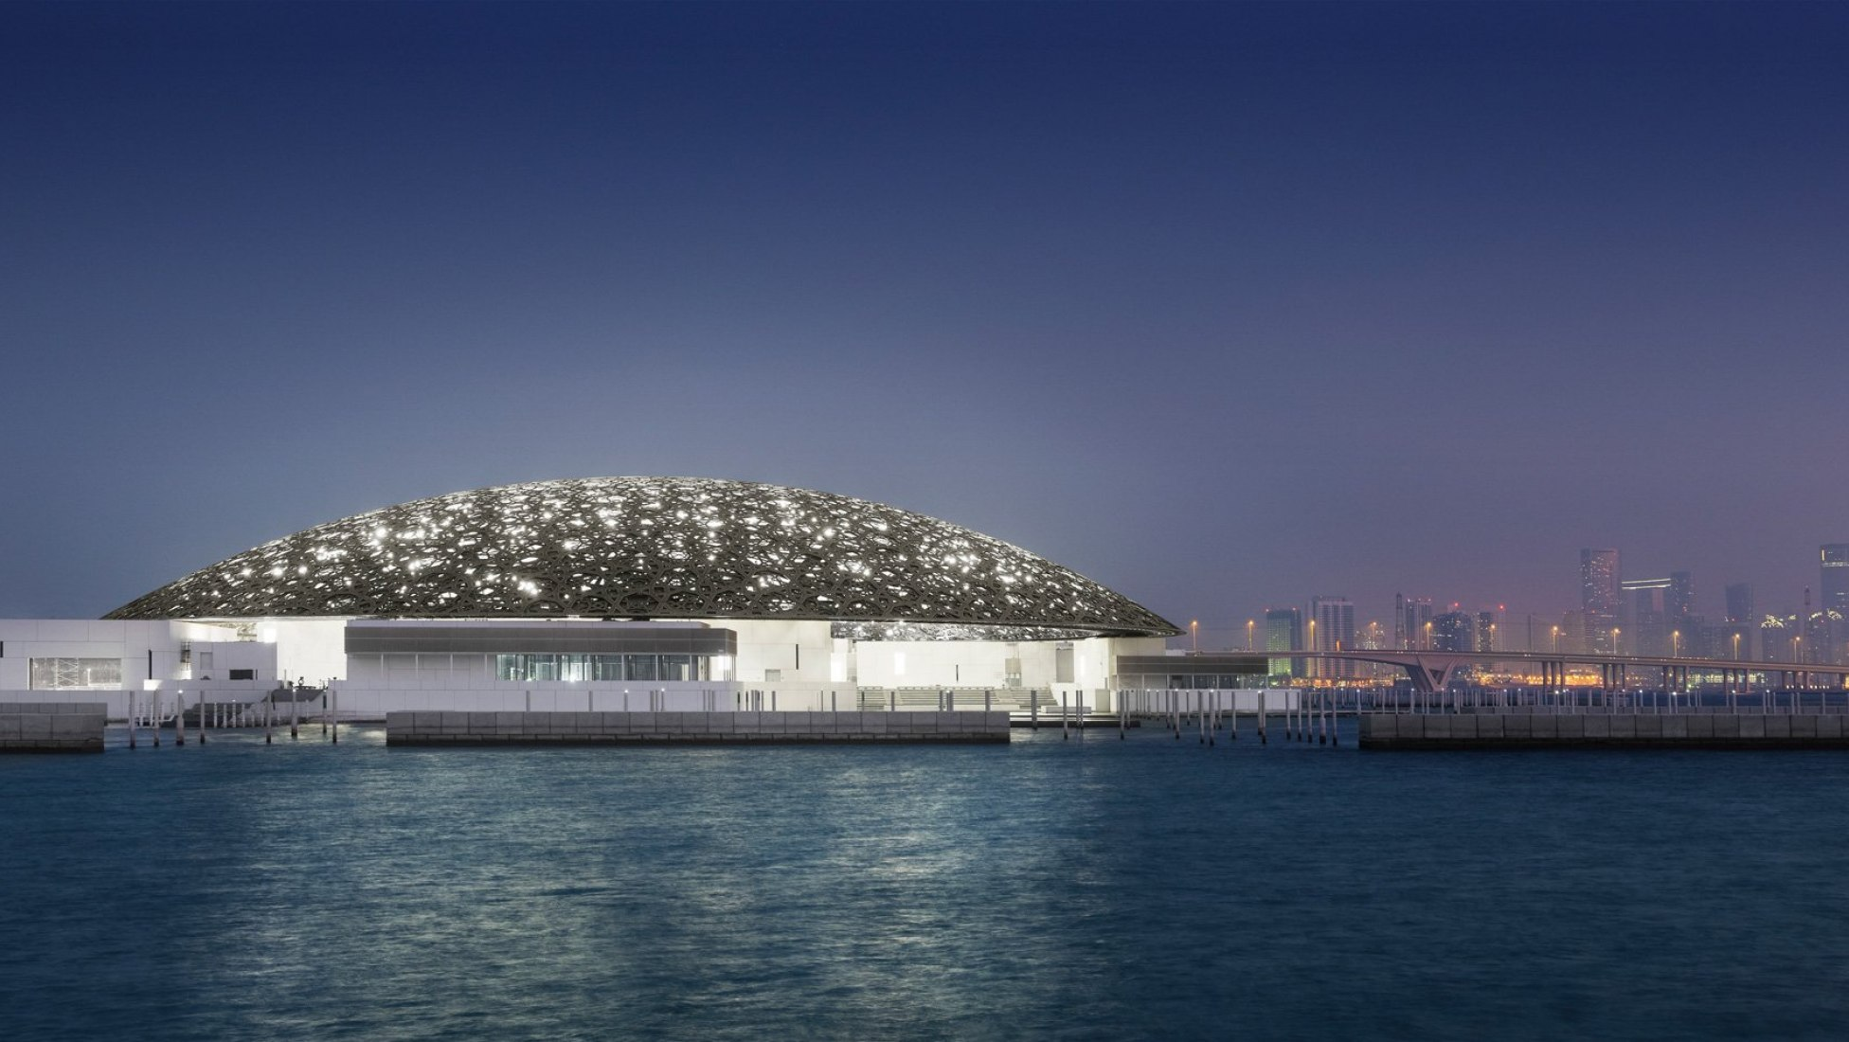
09 / CODA
LIGHT.
WATER.
CITY.
A common sky turns architecture
into a public cultural landscape.
THE CASE CLOSES ON A RELATIONSHIP
A landmark becomes civic when its
light, water and paths remain shared.
LOUVRE ABU DHABI / SAADIYAT ISLAND
10
SOURCE / LOUVRE ABU DHABI — ARCHITECTURE

