Slide 1
Evaluation Report for PSP and HiSIM:
Parameter Extraction and Circuit Simulation
Naoyuki Shigyo
Toshiba Corporation Semiconductor Company
CMC 2005

Slide 2
Outline
Model Parameter Extraction
Genetic Algorithm (GA)
Circuit Simulation
Summary

Slide 3
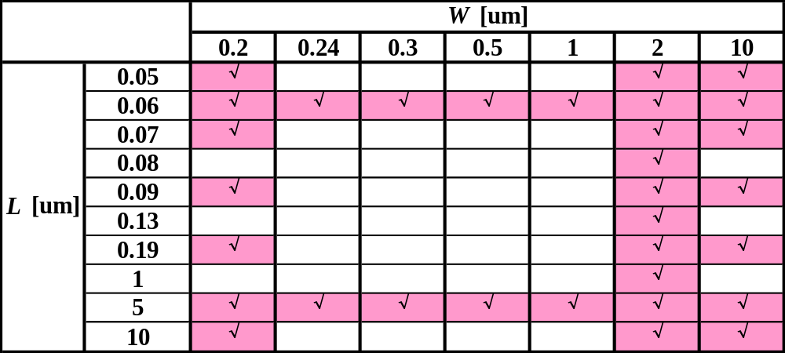
Environment for Parameter Extraction
Tool | ⋅ ICCAP ⋅ In-house Tool
Device | 90 nm CMOS
32 Devices were used for eztraction.

Slide 4
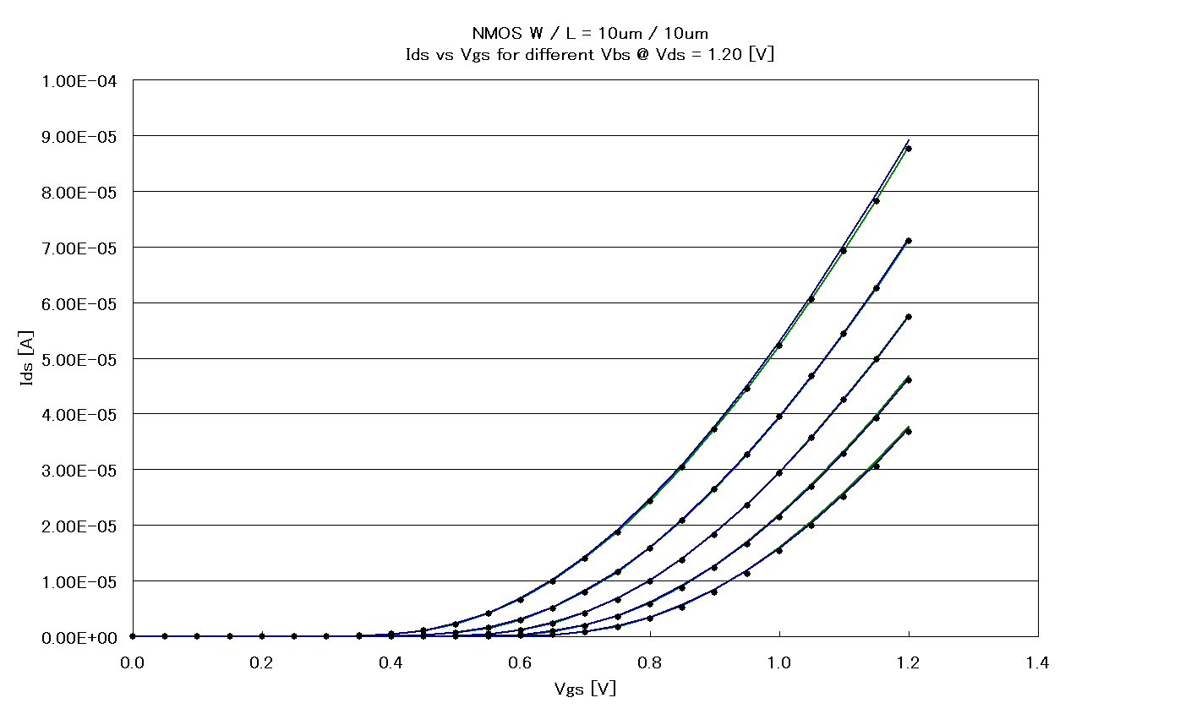
Extraction Results: I_{d}-V_{gs}
NMOS W/L = 10 μm/10 μm
• Measured
HiSIM
PSP
V_{ds} = 1.2 V
Different V_{bs}

Slide 5
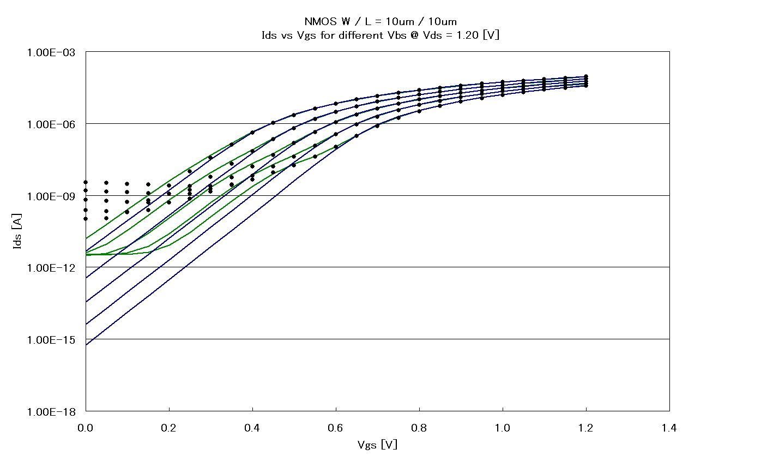
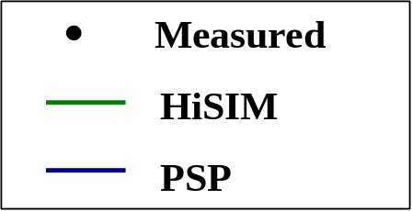
Extraction Results: log (I_{d})-V_{gs}
NMOS W/L = 10 μm/10 μm
V_{ds} = 1.2 V
Different V_{bs}

Slide 6
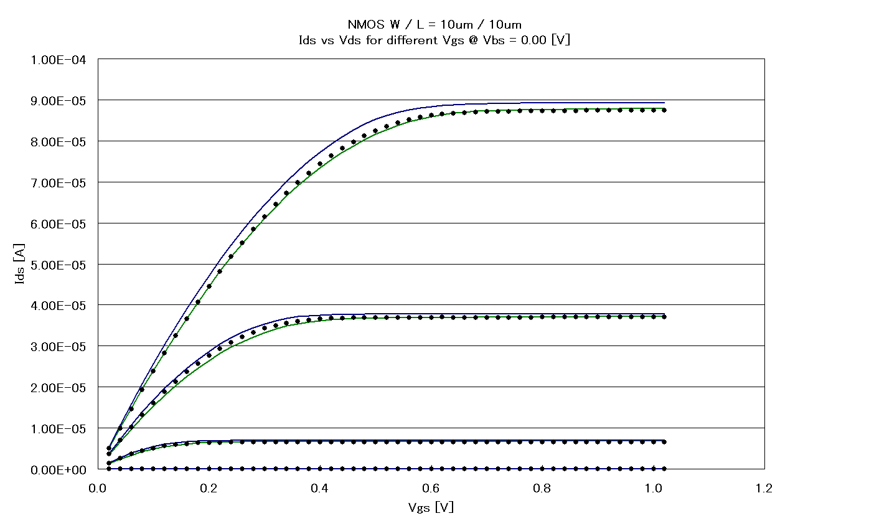
Extraction Results: I_{d}-V_{ds}
NMOS W/L = 10 μm/10 μm
V_{bs} = 0
Different V_{gs}

Slide 7
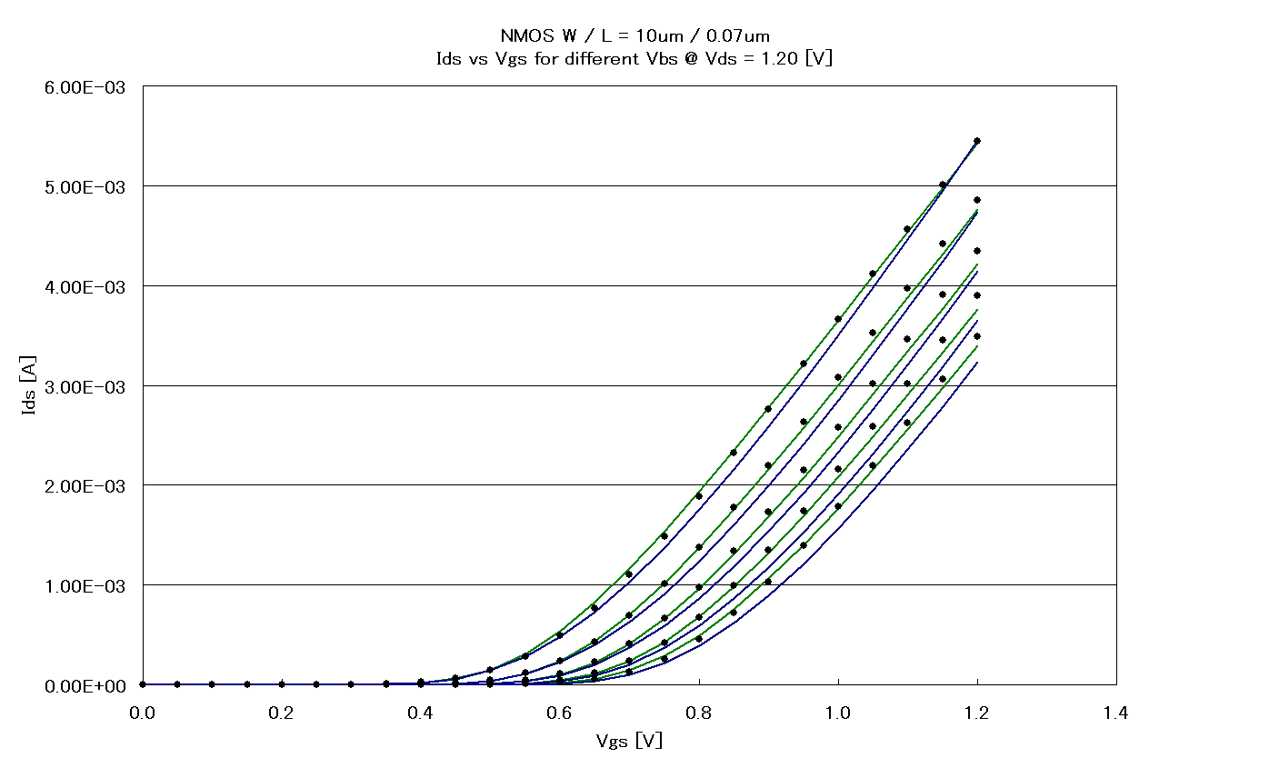
Extraction Results: I_{d}-V_{gs}
NMOS W/L = 10 μm/70 nm
V_{ds} = 1.2 V
Different V_{bs}

Slide 8
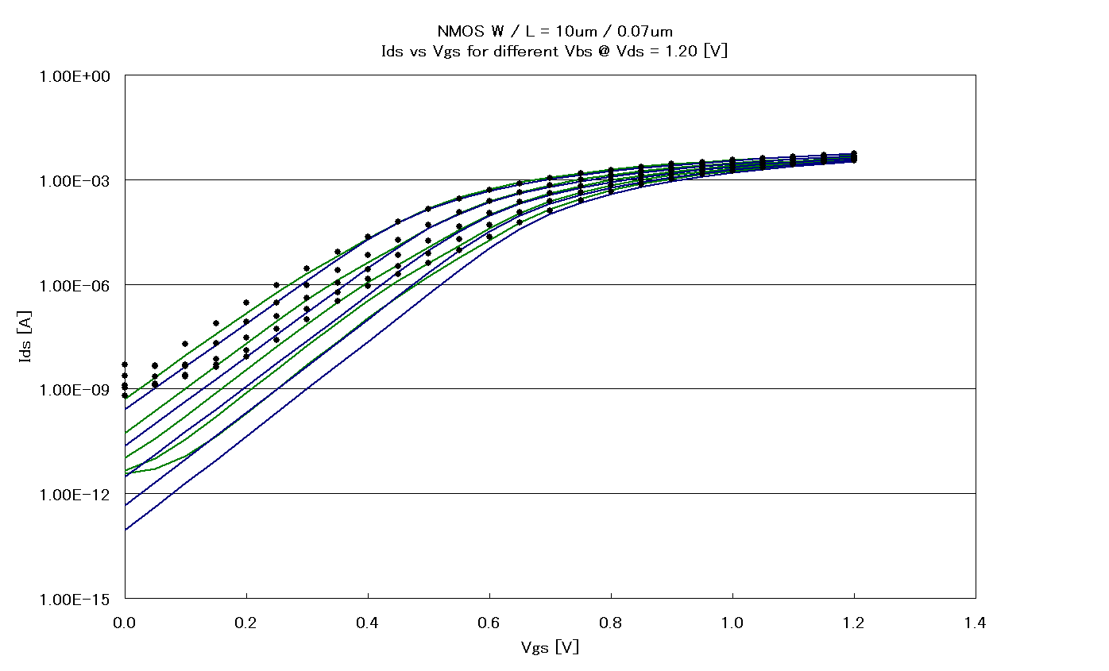
Extraction Results: log (I_{d})-V_{gs}
NMOS W/L = 10 μm/70 nm
V_{ds} = 1.2 V
Different V_{bs}

Slide 9
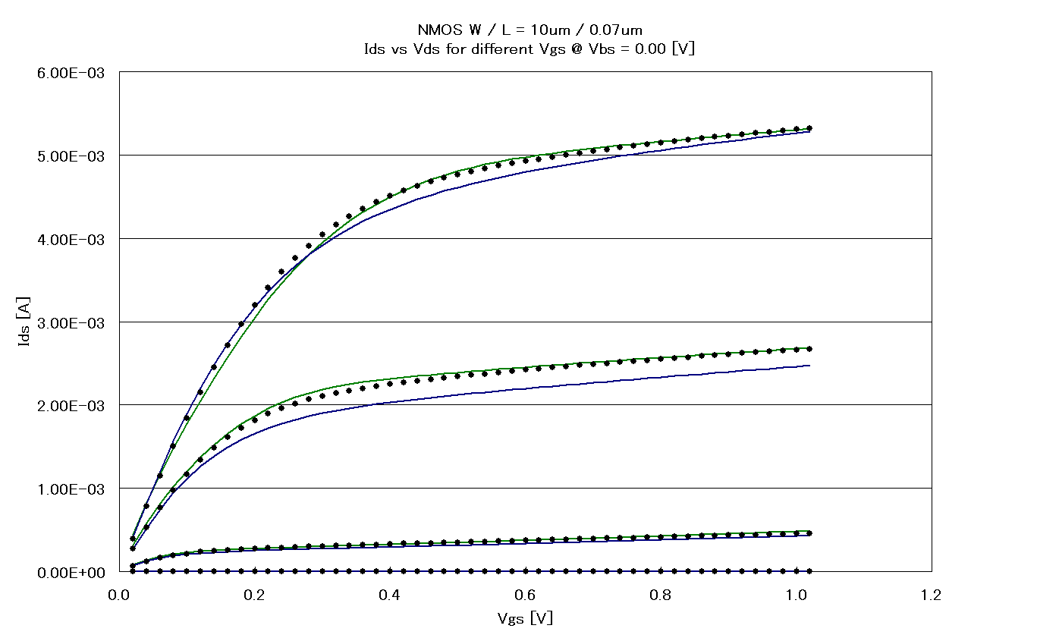
Extraction Results: I_{d}-V_{ds}
NMOS W/L = 10 μm/70 nm
V_{bs} = 0
Different V_{gs}

Slide 10
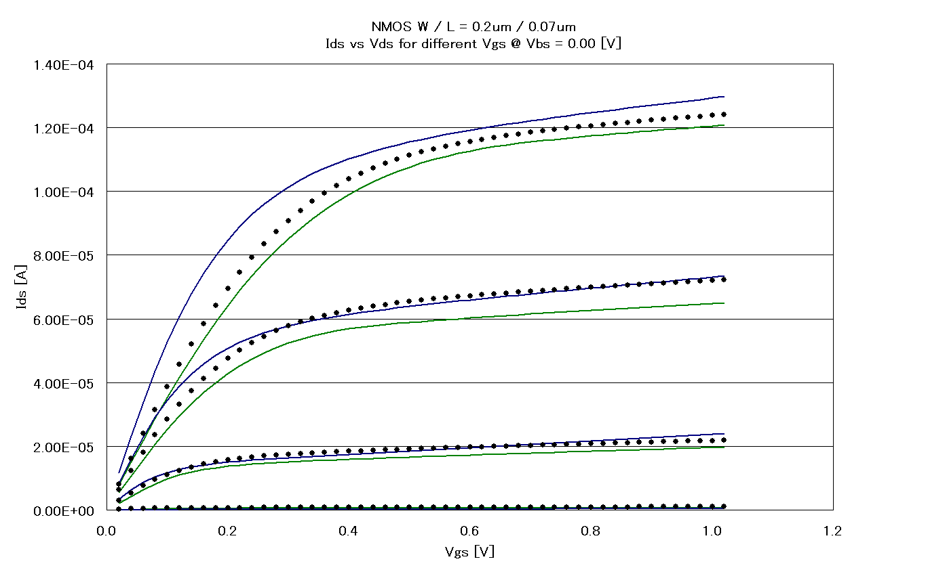
Extraction Results: I_{d}-V_{ds}
NMOS W/L = 0.2 μm/70 nm
V_{bs} = 0
Different V_{gs}

Slide 11
Model Parameter Extraction
Both PSP and HiSIM agreed well with measurements for model parameter extraction.

Slide 12
Outline
Model Parameter Extraction
Genetic Algorithm (GA)
Circuit Simulation
Summary

Slide 13
Genetic Algorithm (GA) Applied to HiSIM
Advantages of GA
Parameters can be extracted with low skill.
Automatic extraction
Time and cost can be saved.
Three-step-strategy for parameter extraction:
1st : L dependence
2nd : W dependence
3rd: Short L & narrow W dependence
GA is released by Evolvable Systems Research Institute, Inc.
http://www.ehw.co.jp/e_index.html

Slide 14
Process of GA parameter extraction
GA : 1.4 days (33.5 hours) , Manual : 5 days
160
Parameter extraction
for L dependence
Parameter extraction
for W dependence
140
120
100
27 hours
6 hours
0.5 hours
RMS Error [%]
80
RMS Error(%)
Short L &
narrow W
60
40
20
0
0
5
10
15
20
25
30
35
40
Time [hours]
Time(hour)

Slide 15
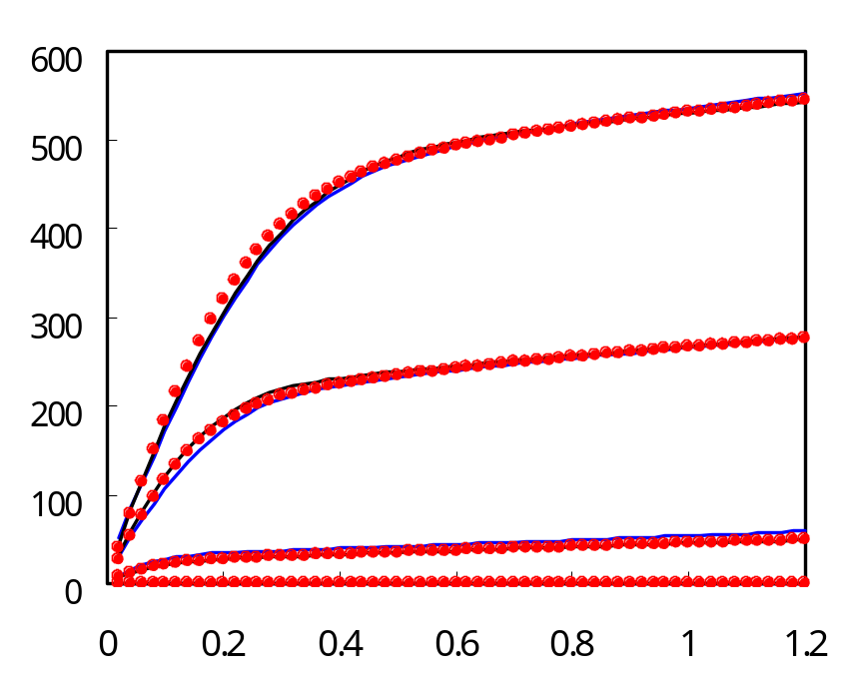
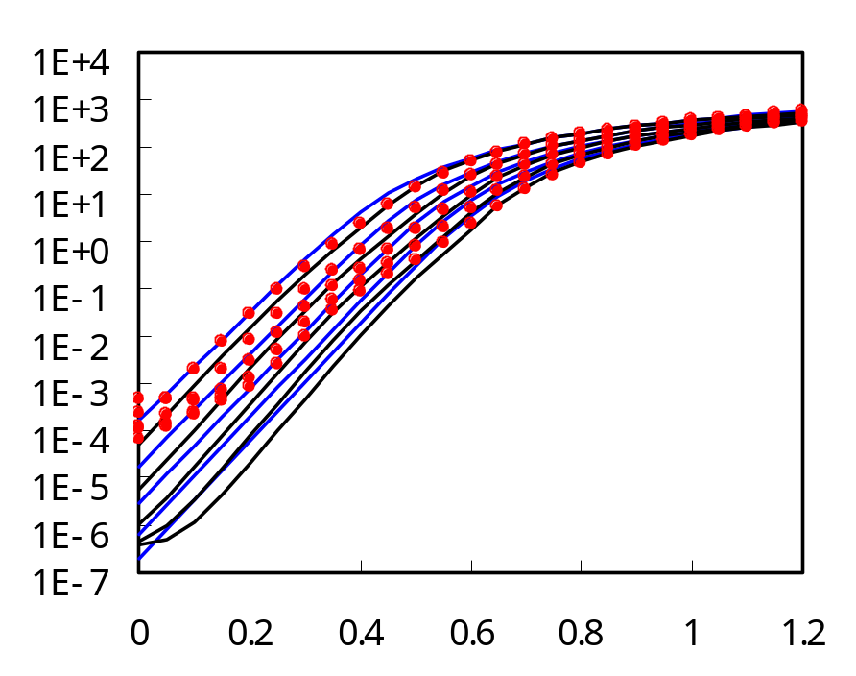
Comparison of I_{d}-V_{ds} and I_{d}-V_{gs}
for GA and Manual Extractions
NMOS W/L = 10 μm/70 nm
Measured
V_{ds} = 1.2V
Manual
GA
I_{d} [μA/ μm]
I_{d} [uA μm]
V_{bs} = 0
Measured
Manual
GA
V_{ds} [V]
V_{gs} [V]

Slide 16
L and W dependences of I_{on} for NMOS
L dependence on I_{on}
(W = 10 μm)
W dependence on I_{on}
(L = 60 nm)
10⁻²
10⁻²
10⁻³
HiSIM
10⁻³
Measured
HiSIM
I_{on} [A]
V_{bs} = 0)
I_{on} [A]
Measured
V_{bs} = −0.3 V
V_{bs} = 0)
10⁻⁴
10⁻⁴
V_{bs} = −0.3 V
V_{bs} = −0.6 V
V_{bs} = −0.6 V
V_{bs} = −0.9 V
V_{bs} = −0.9 V
V_{bs} = −1.2 V
10⁻⁵
10⁻⁵
V_{bs} = −1.2 V
0.01
0.1
1
10
0.1
1
10
L [μm]
W [μm]

Slide 17
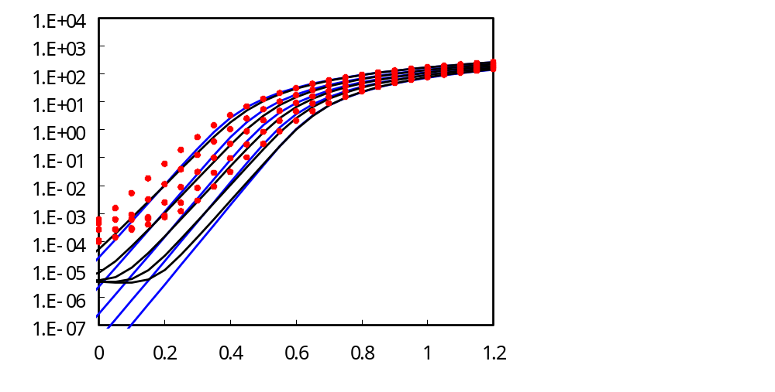
Comparison of I_{d}-V_{ds} and I_{d}-V_{gs}
for GA and Manual Extractions
PMOS W/L = 10 μm/60 nm
-300
Measured
-1.E+04
-250
Manual
-1.E+03
GA
-1.E+02
-200
V_{bs} = 0
-1.E+01
I_{d} [μA/ μm]
-1.E+00
-150
-1.E-01
I_{d} [uA μm]
Measured
-100
-1.E-02
Manual
-1.E-03
GA
-50
-1.E-04
-1.E-05
V_{ds} = −1.2 V
0
-1.E-06
0
-0.2
-0.4
-0.6
-0.8
-1.0
-1.2
-1.E-07
0
-0.2
-0.4
-0.6
-0.8
-1.0
-1.2
V_{ds} [V]
V_{gs} [V]

Slide 18
Genetic Algorithm (GA)
Automatic Genetic Algorithm (GA) was successfully applied to HiSIM.
Accuracy was comparable with manual extraction.
GA was three times faster than manual.
GA was not applied to PSP, because of limited evaluation period.

Slide 19
Outline
Model Parameter Extraction
Genetic Algorithm (GA)
Circuit Simulation
  Environment
  SmartSpice
  Spectre
  Verilog-A
  C-codes
Summary

Slide 20
Evaluated Circuits
 | HD-SRAM | AD Converter | Low Noise Amplifier | 7-stage Inverter Chain
# Nodes | 11,973 | 18,066 | 36 | 10
# Elements | 24,145 | 7,544 | 73 | 16
# Diodes | 0 | 0 | 0 | 0
# BTT’s | 0 | 0 | 0 | 0
# JFET’s | 0 | 0 | 0 | 0
# MOSFET’s | 4,942 | 7,296 | 7 | 14
Large circuits

Slide 21
Simulation Results using SmartSpice (1/5)
CPU time for transient simulation [s]
 | HD-SRAM | AD Converter
HiSIM | 5,803 | 12,874
PSP | Not converged | 18,417
BSIM3 | 4,751 | 4,982

Slide 22
Simulation Results using SmartSpice（2/5)
WL
HD-SRAM
SRAM bit cell
BL
BL
Address
SA
This node voltage is shown in next page.
Output

Slide 23
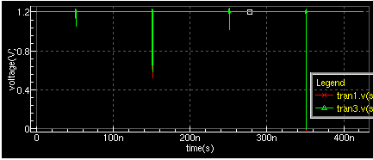
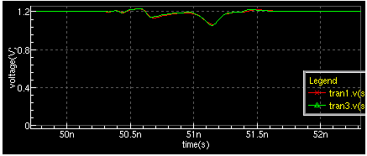
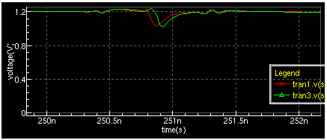
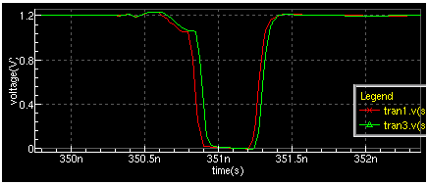
Simulation Results using SmartSpice (3/5)
time1
time2
time3
time4
HD-SRAM
Red :BSIM3
Green:HiSIM
PSP was not converged.
time1
time2
time3
time4

Slide 24
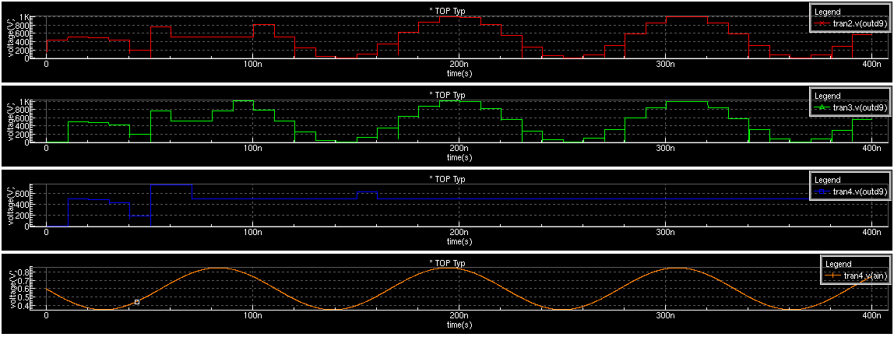
Simulation Results using SmartSpice (4/5)
AD Converter
Converted Digital outputs and Analog input
BSIM3
HiSIM
PSP
PSP shows strange result.
Input

Slide 25
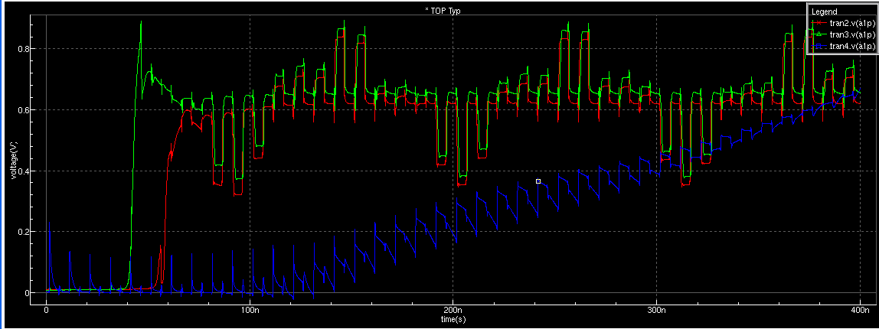
Simulation Results using SmartSpice (5/5)
Red :BSIM3
Green : HiSIM
Blue : PSP
AD Converter
Internal analog node voltage
PSP shows strange result.

Slide 26
Simulation Results using Spectre
Spectre released by Cadence for CMC member
Both PSP and HiSIM were not converged for low noise amplifier (LNA) circuit.

Slide 27
Simulation Results using Verilog-A
HSPICE
CPU time for transient simulation [s]
 | HD-SRAM | AD Converter
HiSIM | Not Converged | Not Converged
PSP | 34,842 | Not Converged
BSIM3 | 10,291 | 66,295

Slide 28
Simulation Results using C-Codes
WindowsXP and SPICE3f5
Sample Circuits at PSP Web : chainddc.spice3f5.ckt
PSP verification using PSP1.0.0 released at Web
Original Circuit (4-stage inverter chain) : Completed
Test Circuit 1 (6-stage inverter chain) : Not converged
PSP1.0.1 released from Freescale, and also 1.0.4 released at Web
Original Circuit (4-stage inverter chain) : Completed
Test Circuit 1 (6-stage inverter chain) : Completed
Test Circuit 2 (7-stage inverter chain) : Not converged
HiSIM were completed for above circuits.

Slide 29
Comparison of models for circuit simulation
 | PSP | HiSIM
SmartSpice | Not converged for HD-SRAM | Converged
Spectre | Not converged for LNA | Not converged for LNA
Verilog-A | Not converged for AD Converter | Not converged for HD-SRAM and AD Converter
C-Code | Not converged for 7-stage inverter chain | Converged

Slide 30
Summary
Toshiba 90 nm CMOS was used for model evaluation.
For parameter extraction, both PSP and HiSIM agreed well with measurements.
Automatic Genetic Algorithm (GA) was successfully applied to HiSIM, which was three times faster than manual.
Comparison of circuit simulation
  SmartSpice: PSP was not converged for HD-SRAM circuit.
  Spectre: Both PSP and HiSIM were not converged for LNA.
  Verilog-A: HiSIM was not converged for large circuits.
  C-Codes: PSP was not converged even for small circuits.
This is hardly the moment
for evaluation using circuit simulation.

Slide 31
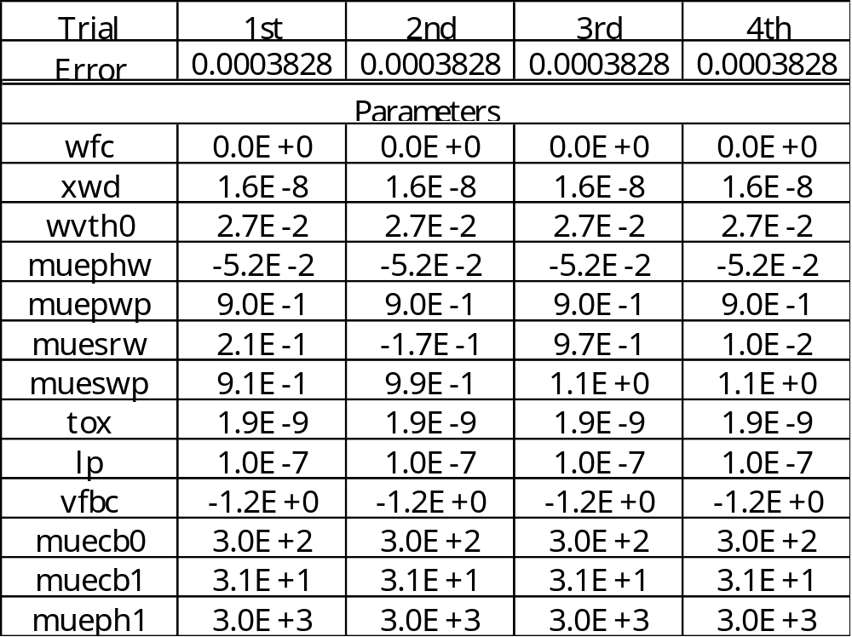
Appendix: Repeatability check in GA
The extracted parameter value has been repeatable.

