Slide 1
OCP/International Partnership
Bus Protocol
Jong yoon Lim
Version 1.2

Slide 2
Table of Contents
Next generation bus
General bus specifications
Spec overview
Signal descriptions
Timing chart
Tools
Implementation guidelines

Slide 3
Next generation Bus
기존의 버스
  AMBA : APB , AHB ,
  Memory mapped register
  문제점
    Ultra hi bandwidth를 요구하는 Application에는 대응하지 못함.
      HD-TV / 3D Application
    BUS를 자원이 아닌 Channel로 보는 관점에서 시작함
    ➔ 효율적인 버스 자원 활용이 않됨
    Power Control 이 버스에서 분리되어 따로 되어 있음.
      IP마다 제각기 Power Control 방식을 가지고 있음

Slide 4
Feature of next generation bus
BUS를 자원으로 보는 시점
  Bus의 Time Slice를 하나의 자원으로 보고 최대한 활용하는 것이 중요한 목표임.
  Out of order transaction
  Register Slice
NOC
  Point 2 Point 방식의 Network를 설정하거나 이에 준하는 기능을 하도록 설계를 함.
Power Control
  각 IP Level에서 수행하였으나 새로운 Bus 프로토콜에서는 Bus Level에서 필요한 프로토콜을 정의함.

Slide 5
AMBA
CPU Core
On-chip
Memory
DMA
Bus Master
AHB or ASB
High BW
Memory IF
Bus
Bridge
APB
Timer
UART
PIO

Slide 6

APB
PCLK
장점 : Simple
단점 : Low Performance
PADDR
A
PWRITE
A
PENABLE
PWDATA
A
PRDATA
A
Data Sample
AHB
HCLK
장점 : High Performance
단점 : Complex Protocol
HADDR
A
B
C
D
Control
A
B
C
D
HREADY
HWDATA
A
B
C
HRDATA
A
B
C

Slide 7
M-BUS
제작자 : Chips and Media
Feature
  Memory Control에 중점을 둔 Bus
  SDRAM 등의 특징을 최대한 살려서 Control
    Bank 단위 access
    Linear address로 보이기 위하여 Virtual Address개념을 도입
  Two Level 개념의 QoS를 지원함
단점
  Bus라는 개념보다는 Memory Controller에 가까운 버스
  완전한 BUS Spec이 아니라 Memory Control을 얼마나 효율적으로 할 수 있는가에 중점

Slide 8
AXI
ARM의 차세대 BUS Protocol
Feature
  BUS의 Protocol이 정의되어 있으나 내부적으로는 일종의 Agent (FIFO) 개념이 요구됨
    Out of transaction
    Clock Control
    Power Control
  Market Leader의 Bus이므로 향후 시장에서 표준으로 정착할 확률이 높음
단점
  표준이 나온 지 얼마 않되어서 제품 출시까지는 많은 시간이 소요될 것으로 생각됨.
  실제 Sonics의 Agent와 같은 개념의 Sub I/F IP를 설계하거나 각 IP마다 Module화 해야 하는 문제가 있슴.

Slide 9
OCP
Open Core Protocol
AMBA에 대응하기 위한 버스로 정의
  TI/Nokia가 주도적으로 정의하였음.
장점
  License Fee가 없슴
  AMBA/AXI보다 상위 개념의 protocol을 지원하고 있슴
단점
  업계 Defacto Standard가 아니어서 아직 많은 대중적인 지지를 받고 있지 못함.
  ARM에 반대하는 구룹위주로 지원을 받고 있슴
    MIPS, TI , etc…

Slide 10
OCP
OCP-Spec overview
System with OCP configuration
Characteristics of OCP
Hierarchy of Elements
Signal descriptions
Timing charts

Slide 11
OCP-Spec overview
OCP/IP Version 1.0 - 2001
OCP/IP Version 2.0 -2003/Sep
  Signal group / Tool 관련 부분을 정리함.
Specification
  Part I : Signal description
    Extension signal 정의 수정
  Part 2 : Timing chart
  Part 3 : Tools and Scripts
    Version 2.0에서는 제외됨
  Part 4 : Implementation guidelines

Slide 12
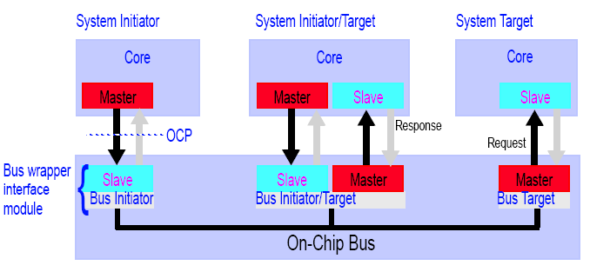
System with OCP configuration
Parameters
BUS

Slide 13
Characteristics of OCP
Point-to-Point Synchronous Interface
  uni-directional signals driven
  sampled by the rising edge
  All signals other than the clock are strictly point-to-point.
Bus Independence
Pipelining
In-band Information
  Core can pass core-specific information

Slide 14
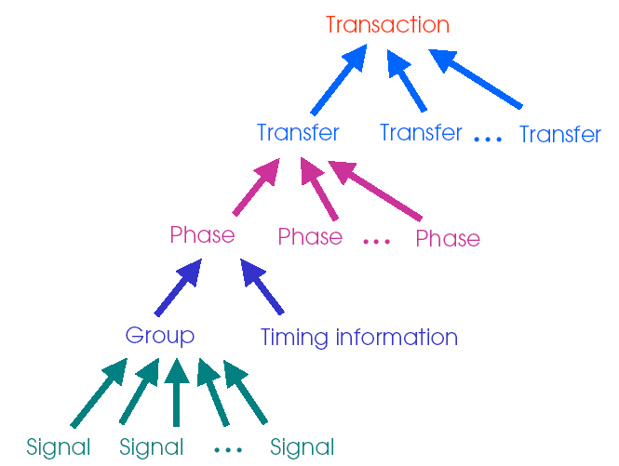

Hierarchy of Elements

Slide 15
Signal descriptions
Basic Signals
  The basic OCP signals that must be present in any OCP interface
Simple Extensions
  Address space, Byte enables, Burst, Data handshake, Response flow control
Burst Extensions
Thread Extensions
Sideband Signals
  Reset, Interrupt, Error, and Core-specific Flag Signals
Test Signals
  Scan interface , JTAG

Slide 16
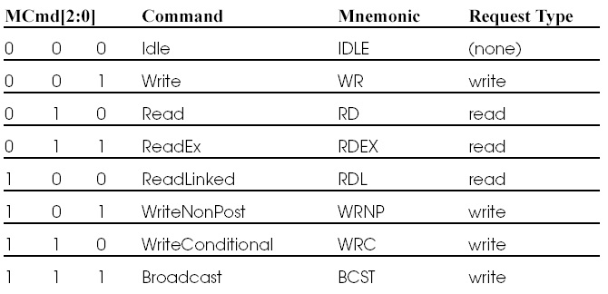
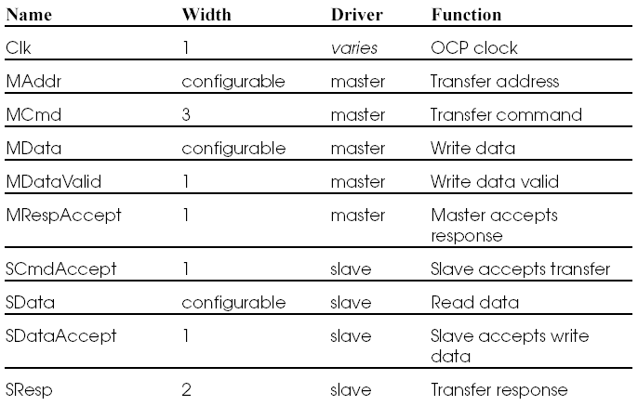
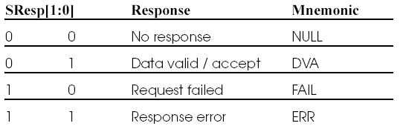
Basic Signals
The basic OCP signals that must be present in any OCP interface.
Only Clk and MCmd are required. The remaining OCP signals are optional.
The FAIL response is legal only for
WriteConditional commands.

Slide 17
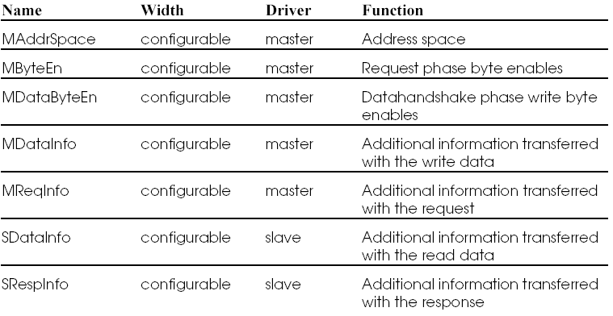
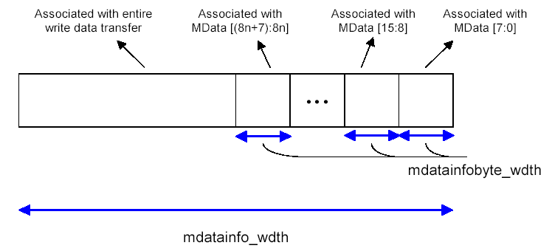
Simple Extension
The extensions add address spaces, byte enables, burst support, datahandshake, and response flow control.

Slide 18
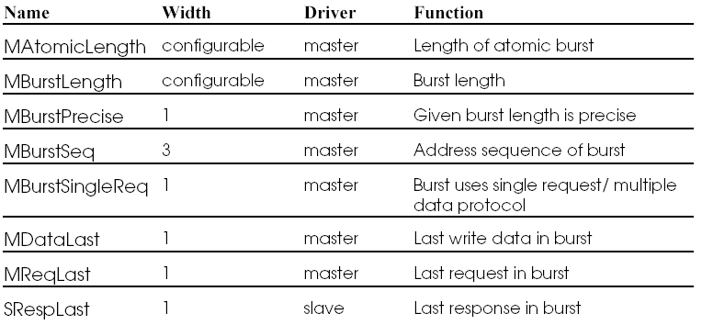
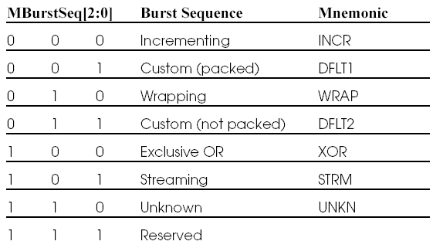
Burst Extensions
The burst extensions allow the grouping of multiple transfers that have a defined address relationship.
This field indicates whether the precise length of a burst is known at the start of the burst or not.
1 : Precise length burst Operation
0 : Hint of remaining burst size

Slide 19
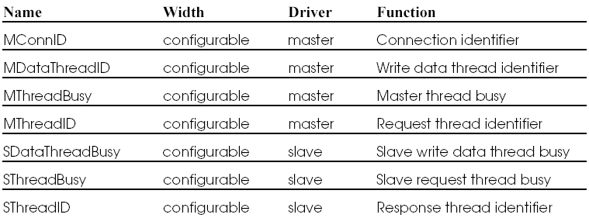
Thread Extensions
The extensions add support for multi-threading of the OCP interface.
Notes:
SThreadBusy
Host보고 지금 알려주는 Thread는 바쁘니까 다른 커맨드를 미리 보내라… 라는 의미로 정의되는 신호이다.

Slide 20
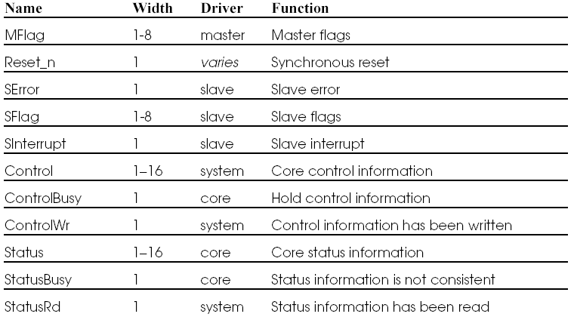
Sideband Signals
Sideband signals are OCP signals that are not part of the dataflow phases, and so can change asynchronously with the request/response flow. Sideband signals convey control information such as reset, interrupt, error, and core specific flags. They also exchange control and status information between a core and an attached system. All sideband signals are optional.

Slide 21
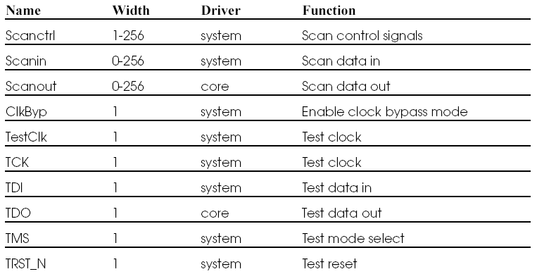
Test signals

Slide 22
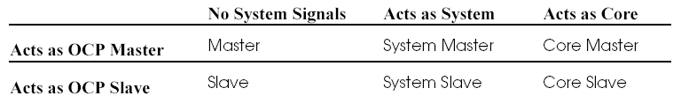
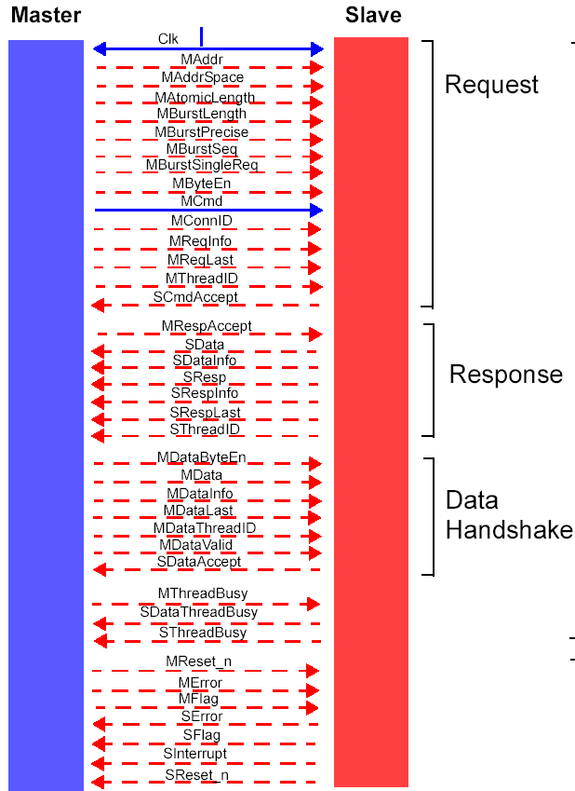
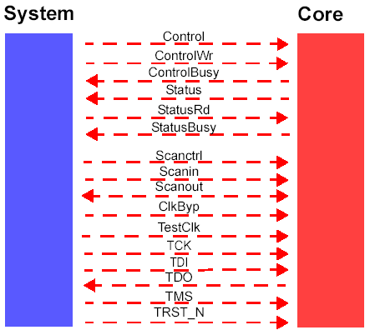

Signal summary

Slide 23
Timing charts
Simple Write and Read Transfer
Request Handshake
Request Handshake and Separate Response
Pipelined Request and Response
Non-Pipelined Read
Burst Read
Response Accept
Datahandshake Extension
Threaded Read

Slide 24
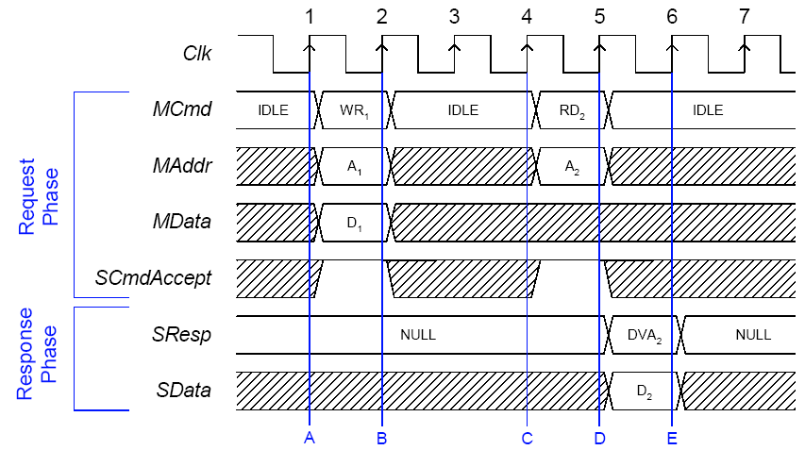
Simple Write and Read Transfer
With response on write disabled.

Slide 25
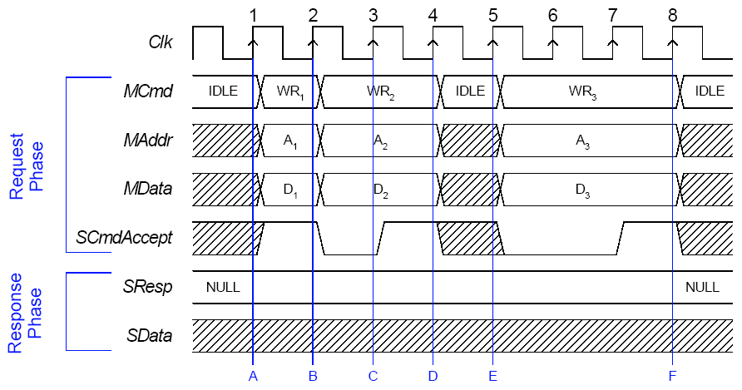
Request Handshake

Slide 26
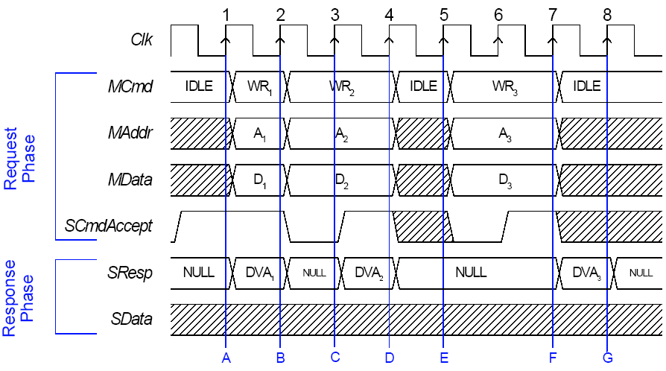
Write with Response
With response on write enabled.
The slave drives DVA on SResp
to indicate a successful transaction

Slide 27
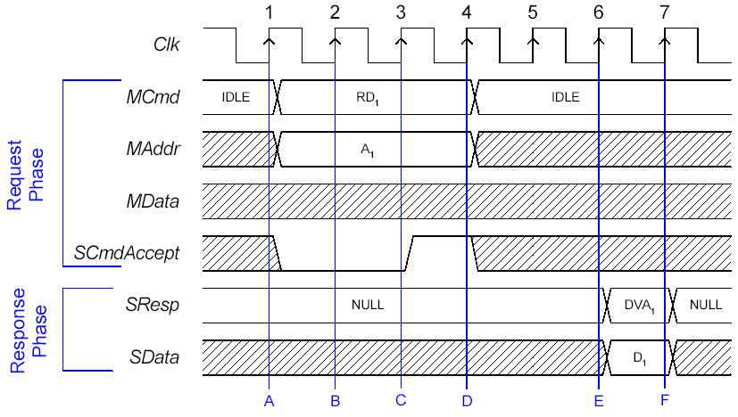
Request Handshake and Separate Response

Slide 28
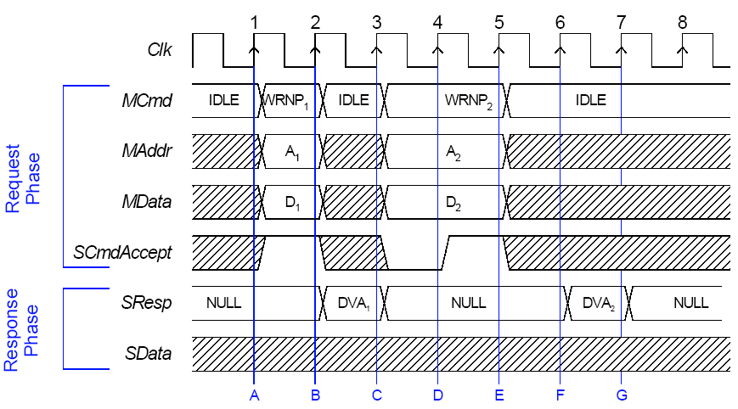
Non-Posted Write
The response must be returned to the master once the write operation occurs
There is no difference in the command acceptance, but the response may be significantly
delayed.
If this scheme is used for all posting sensitive transactions,
the result is decreased data throughput but higher system reliability.

Slide 29
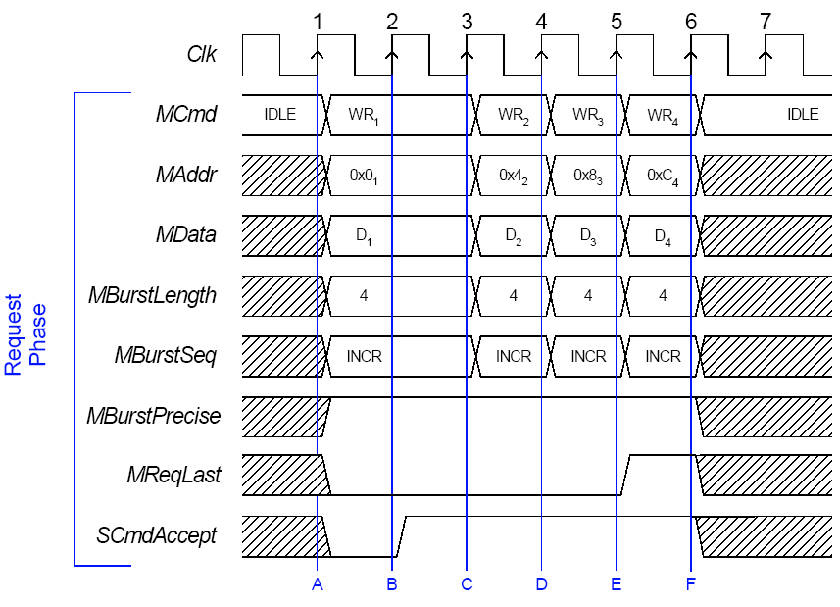
Burst Write
MReqLast flags the last request of the burst,

Slide 30
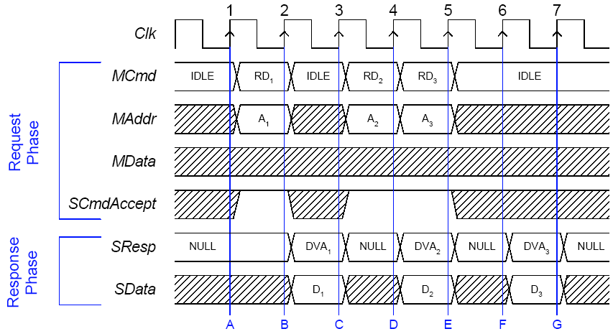
Pipelined Request and Response
Command accept latency is zero
Response is returned same or later cycle
Slave가 Command FIFO가 있다고 가정하고 동작함.

Slide 31
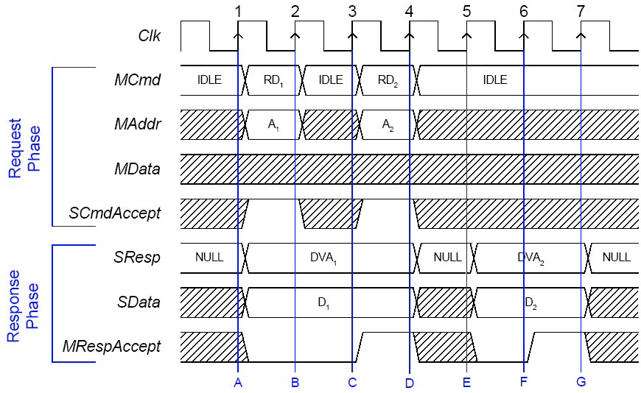
Response Accept
Response accept operation by Master
MRespAccept, is added to the response phase. This signal may be used by the master to flow-control the response phase.

Slide 32
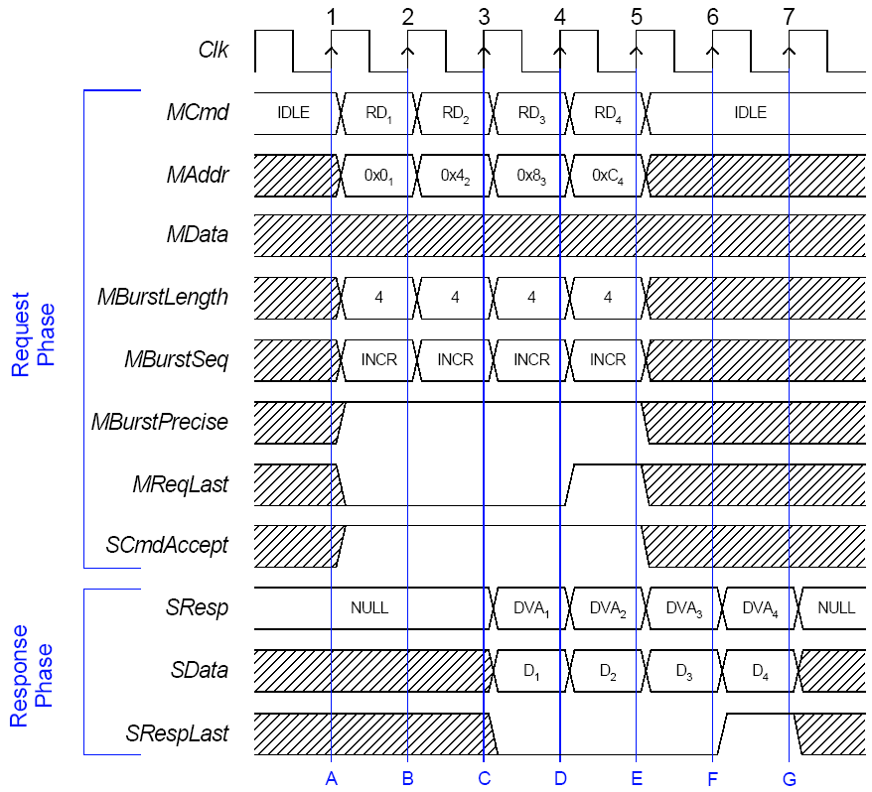
Incrementing Precise Burst Read
MBurstLength의 동작을 정의
  Burstlength parameter
  For precise bursts, the value indicates the total number of transfers in the burst, and is constant throughout the burst.
  For imprecise bursts, the value indicates the best guess of the number of transfers remaining (including the current request),
1 : Precise burst
0 : Imprecise burst

Slide 33
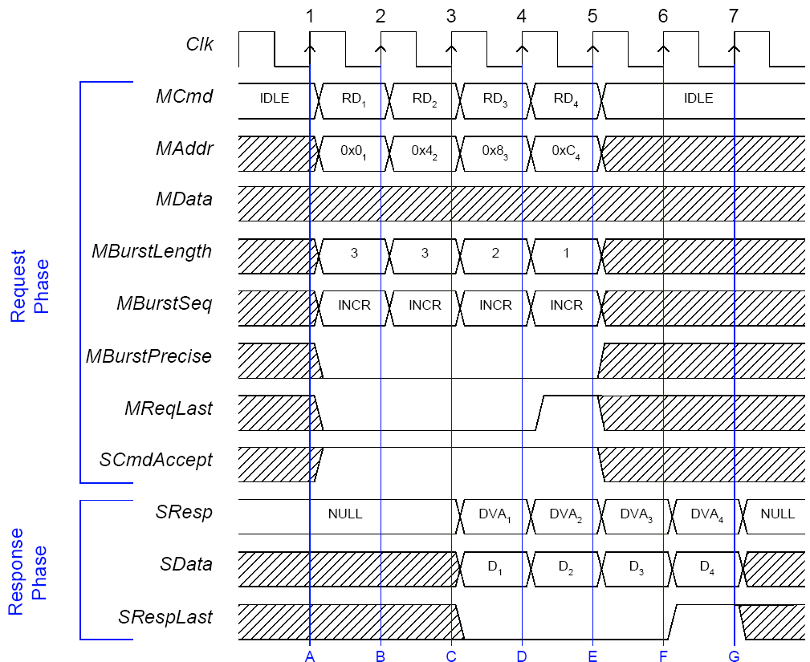
Incrementing Imprecise Burst Read
1 : Precise burst
0 : Imprecise burst

Slide 34
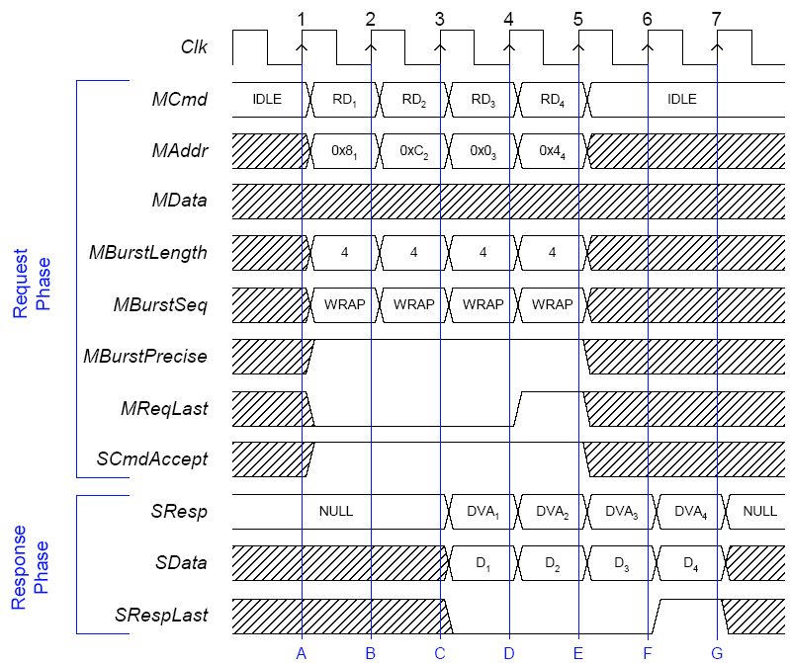
Wrapping Burst Read
Cache fill operation

Slide 35
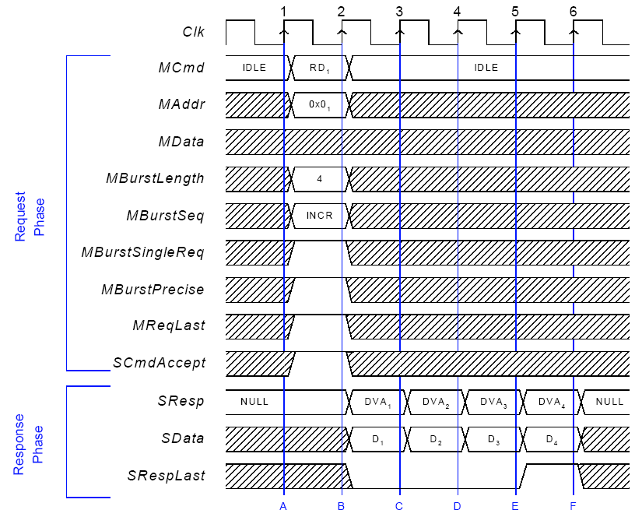
Single Request Burst Read

Slide 36
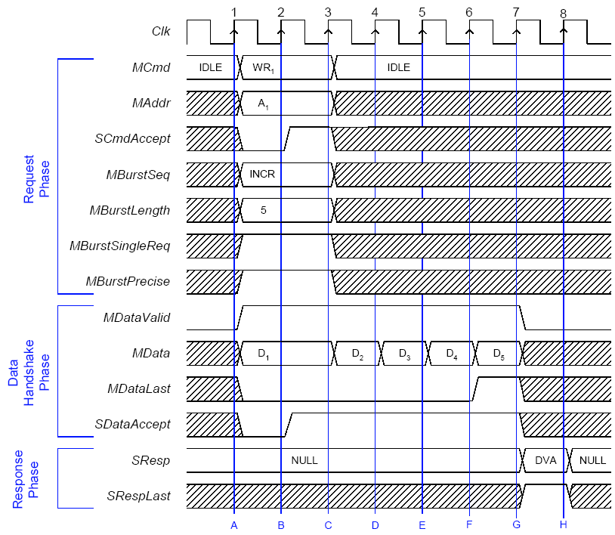
Burst Write with Combined Request and Data

Slide 37
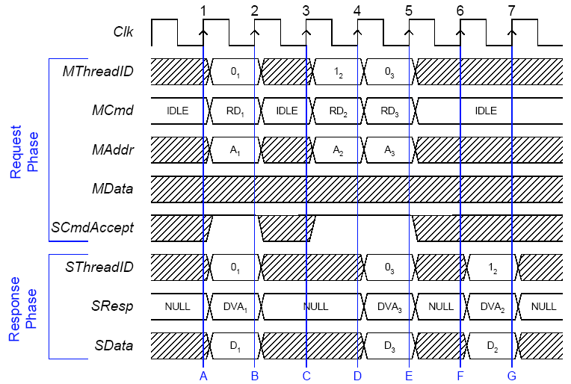
Threaded Read
Out-of-order completion of read transfers using the OCP thread extension

Slide 38
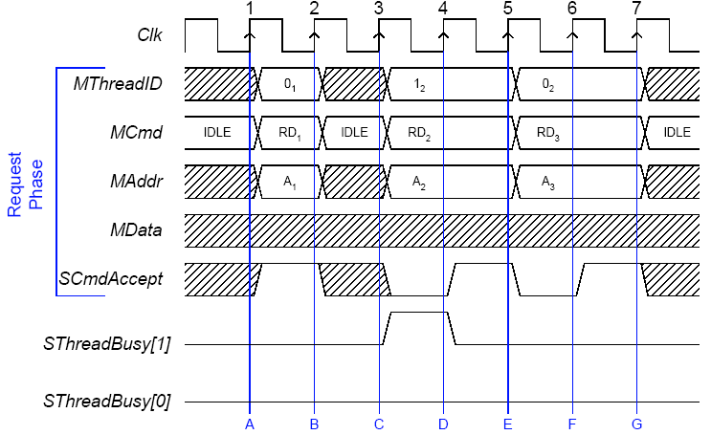
Threaded Read with Thread Busy
Slave Thread 1이 바쁘다고 하지만 Master가 무시하고 뻐꾸기를 계속 날리는 경우임
Slave Thread1이 나 바쁜데 하고 있음

Slide 39
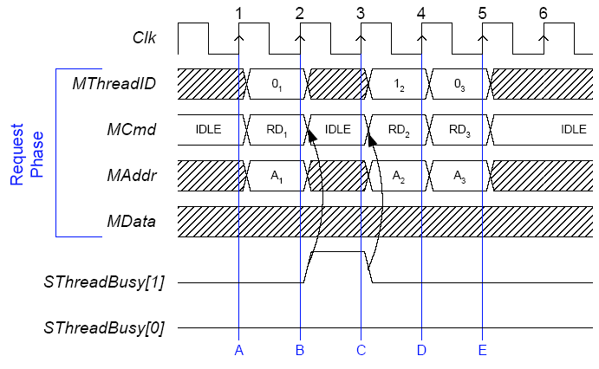
Threaded Read with Thread Busy Exact
Slave Thread 1이 바쁘다고 하여서 Master Thread1이 다음 뻐꾸기를 안날리고 IDLE로 들어간다. IDLE 구간에서 다른 Thread가 들어올 수 있다.

Slide 40
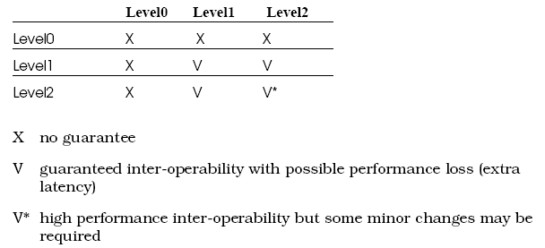
Timing guidelines
Level0 identifies the core interface as having been designed without adhering to any specific timing guidelines.
Level1 timing represents conservative interface timing.
  only use 25%, 50%
Level2 represents high performance interface timing.

Slide 41
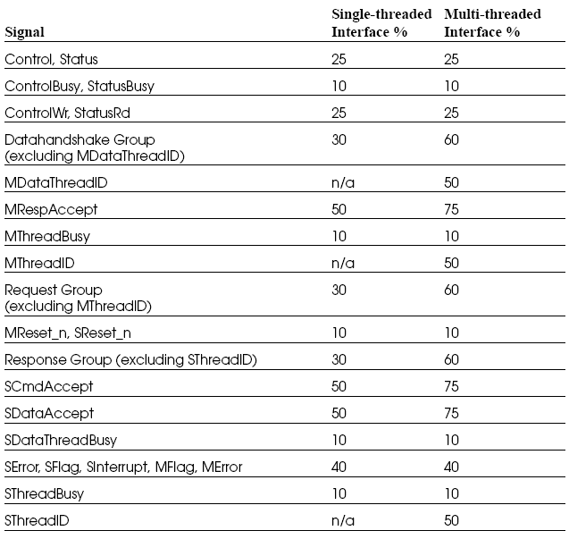
Level2 Timing

Slide 42
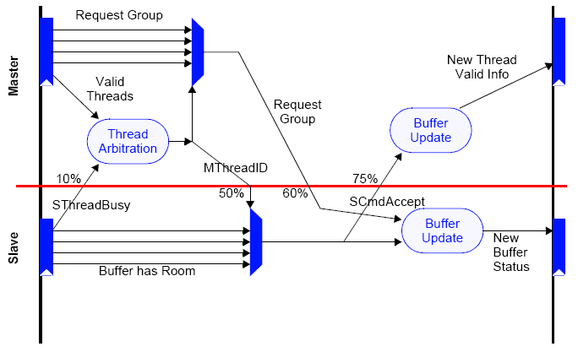
Multithreaded OCP Interface Implementation

Slide 43
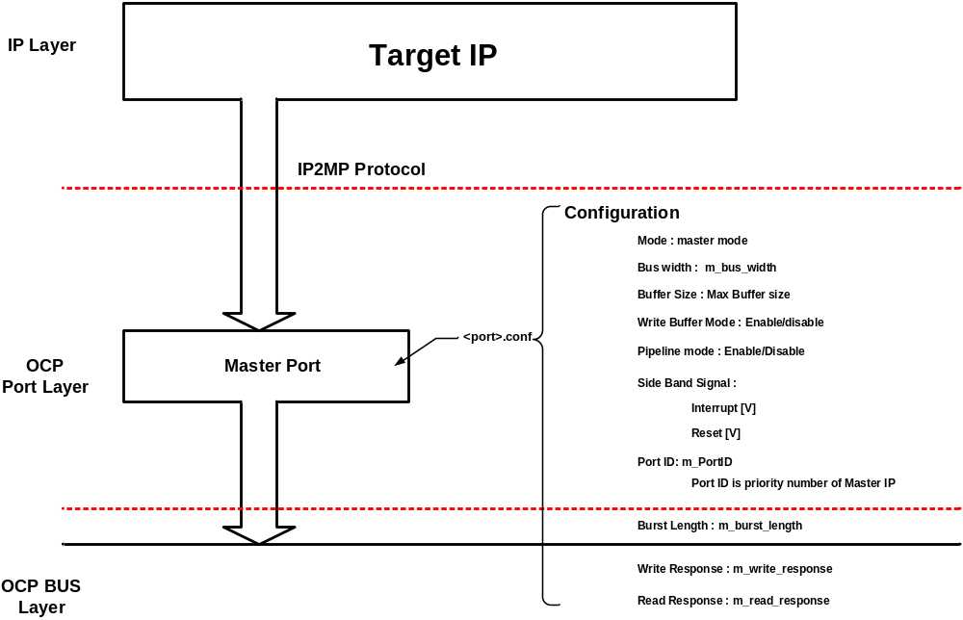
NCCoreGen

Slide 44
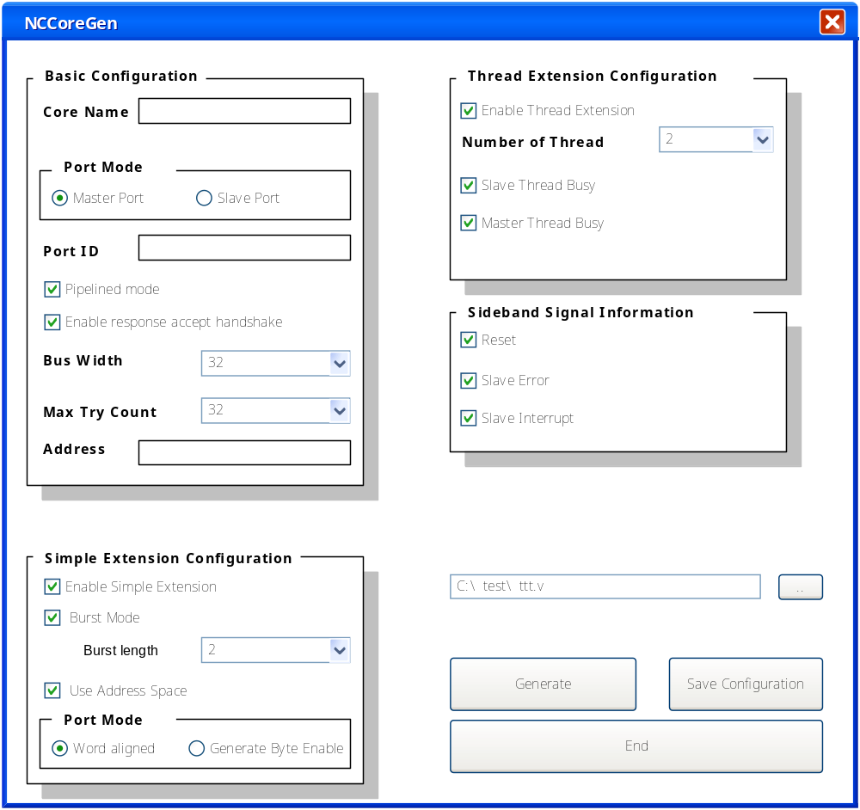
NCCoreGen

Slide 45
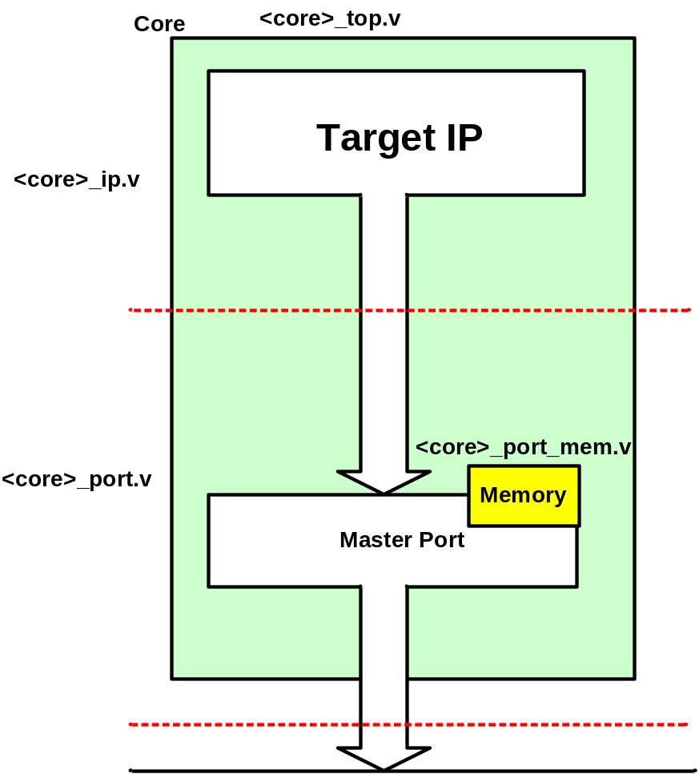
NCCoreGen

Slide 46
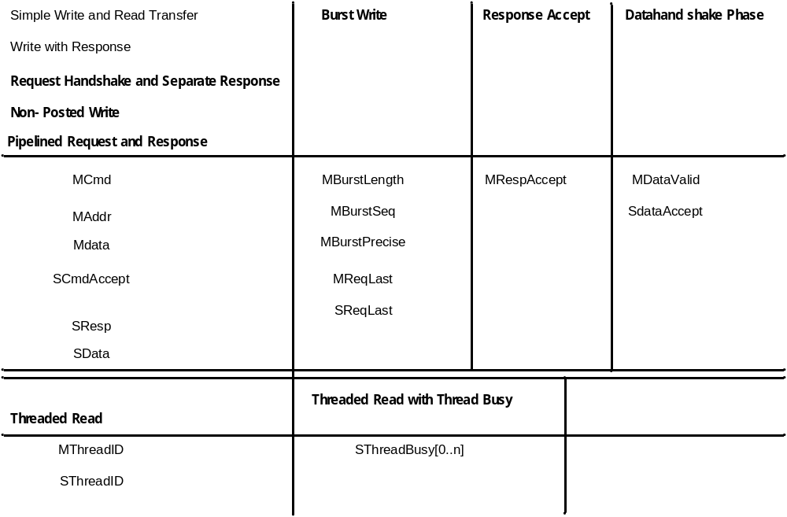
Signal Group for Implementation

Slide 47
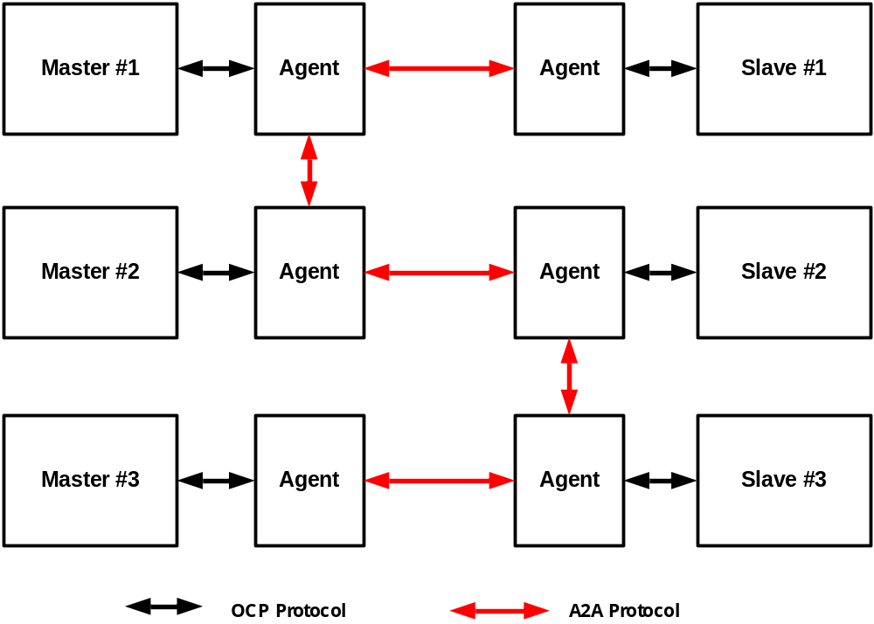
OCP Bus System

Slide 48
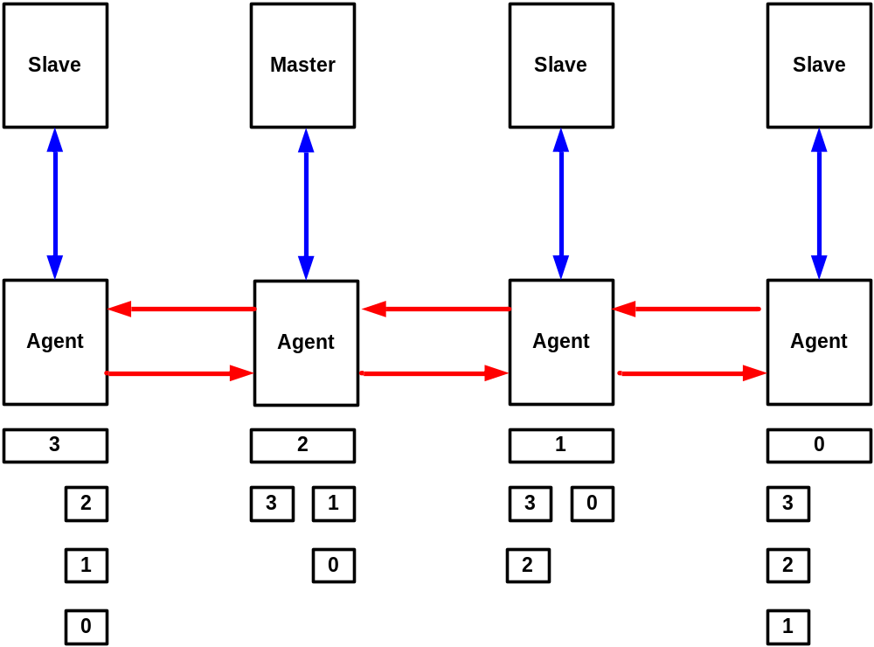
Implementation algorithm

Slide 49
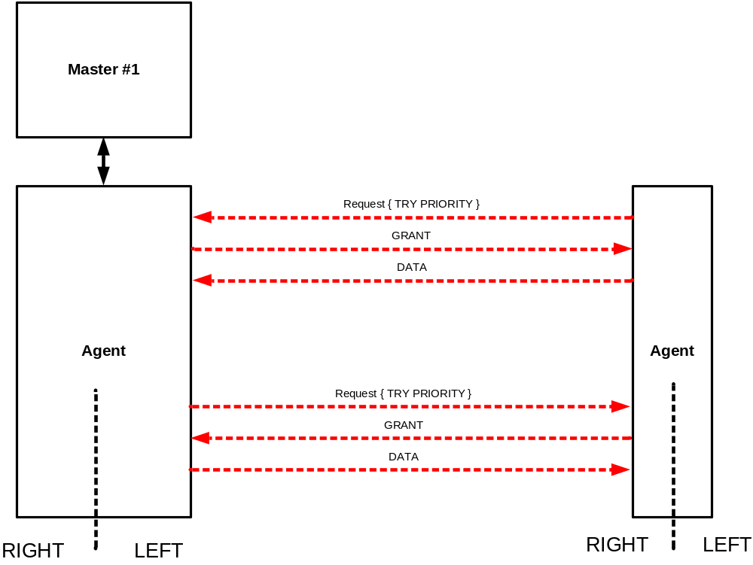
Abstract Level Bus Connection

Slide 50
OCP Bus를 구현시 고려 점
Protocol support Level
Automatic IP Wrapper generator
A-A Bus connection
  Agent-Agent Handshake Protocol
Sideband signal에 대한 Agent 통과 여부
  Interrupt Signal이 Agent를 통과할 필요가 있는가 ?
  Single Bus로 진행할 필요가 있는가 혹은
  Bi-Direction으로 진행하여도 되지 않는가 ?

Slide 51
The End

Slide 52
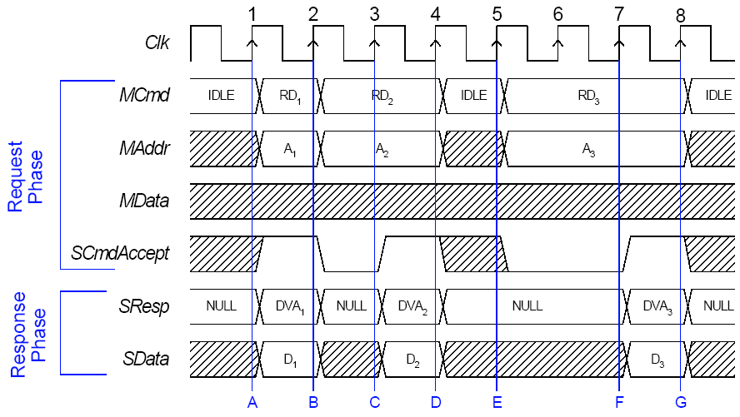
Non-Pipelined Read

Slide 53
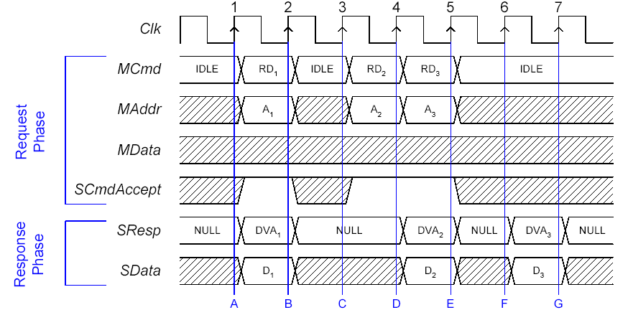
Pipelined Request and Response

Slide 54
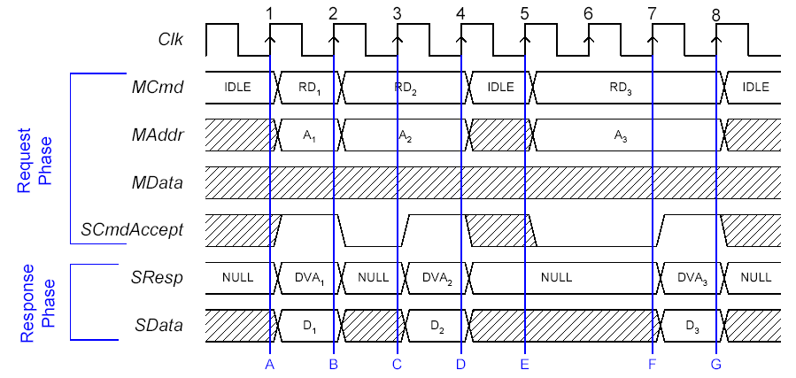
Non-Pipelined Read

Slide 55
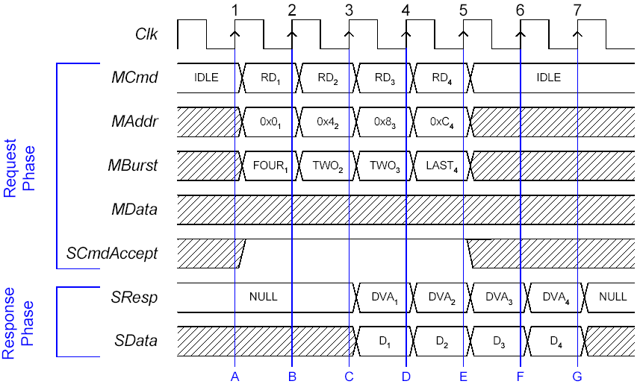
Burst Read

Slide 56
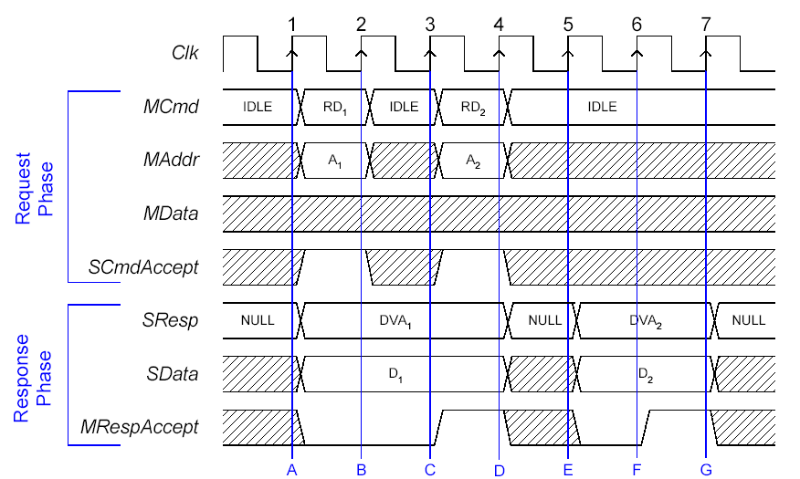
Response Accept

Slide 57
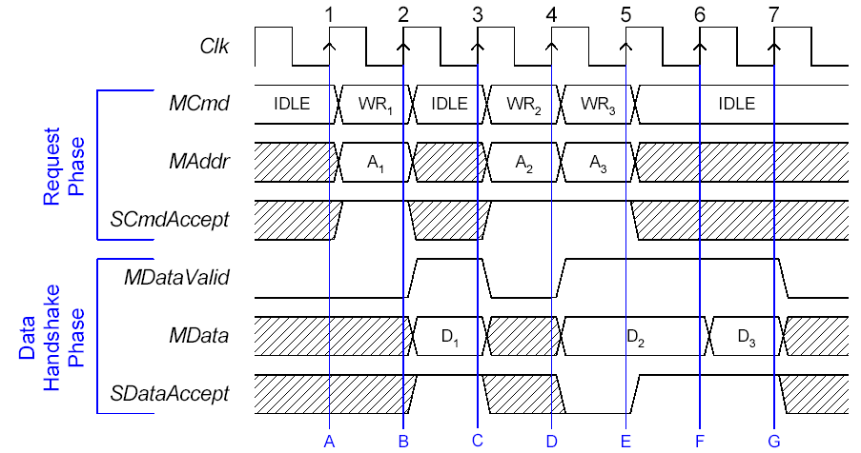
Datahandshake Extension

Slide 58
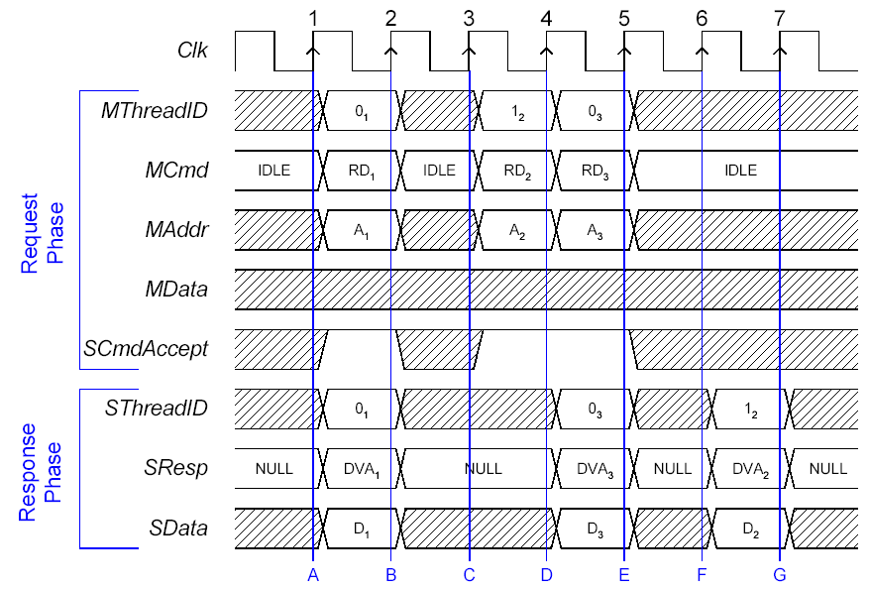
Threaded Read

Slide 59
Tools and Scripts
Behavioral Models
  Q-Master
  Q-Slave
Socket Transaction Language
Configuration Files
  Core RTL Configuration File
  Testbench RTL Configuration File
  Interface Configuration File
  Core Synthesis Configuration File
  Package File

Slide 60
Implementation Guidelines
Developer’s Guidelines
  State machine examples
    Sequential Master / Slave
    Combinational Master / Slave
Timing Guidelines
  Level 0
  Level 1
  Level 2

Slide 61
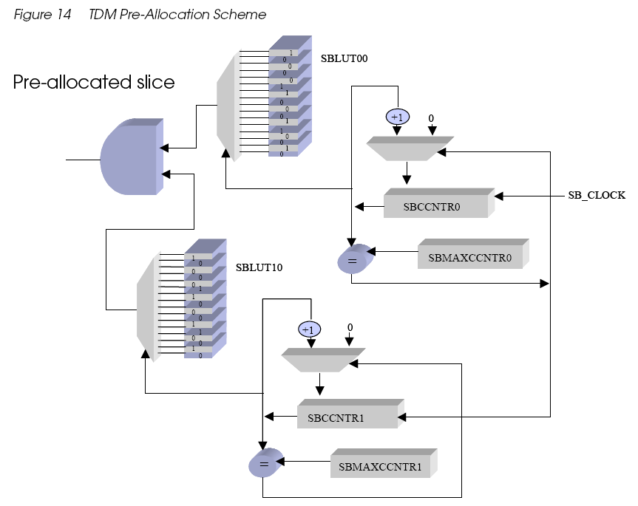
SB Bus Allocation block

Slide 62
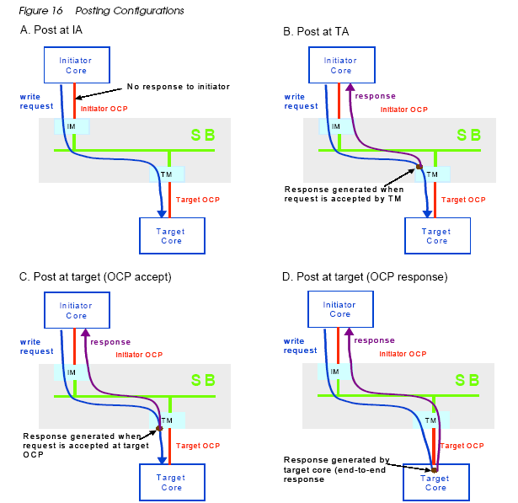

Slide 63

Interrupt Propagation

Slide 64

Synapse 3220 Operation

