Slide 1

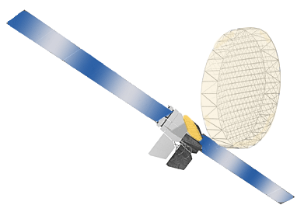

Asia Pacific Satellite Industries Co., Ltd
Asia Pacific Satellite Industries Co., Ltd
9 FL, IT Castle 2-Dong, #550-1 GaSan Dong, GumCheon-Gu, Seoul, Korea
Tel : +82-2-2026-7700, Fax : 82-2-2026-7771
Web Site : www.apsat.co.kr

Slide 2

Core Business
Core Business: Total Solution Provider of Satellite Multimedia Products
  Subway Real-time Broadcasting (SRB) System
  Satellite 2-way HUB-System (HomeSat CS)
  Satellite 2-way Set-Top Box (HomeSat RT)
  Satellite Mobile Hand Held Terminals (GEM-GSM HHT/GEM only HHT/GEM Module), Fixed Docking Unit, Transceiver Unit
  AMS (Asset Management System)
APSI Introduction

Slide 3
Competitiveness
Unique Technologies & Global Competitiveness
  APSI’s unique Satellite Communication Protocol Source (SSMA & GMR) & Design Technologies(Modem and etc.)
  Competitiveness of the Price & Technology compared to the global company
Market Competitiveness of Product
  Development & Production technology with the smallest, the best function & the lowest price in the world
  Core & Unique Technology in Satellite Mobile phone
  - Satellite Communication Source developed by its own technology
  Development of SRB(Subway Real-time Broadcasting) system first in the world
  Development of AMS(Asset Management System) which is the LBS(Location Based Service) in Vehicle/Vessel,etc
APSI Introduction

Slide 4
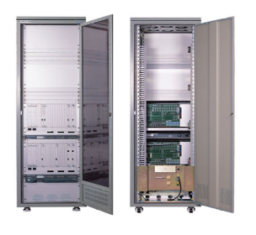
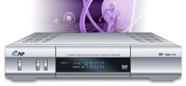
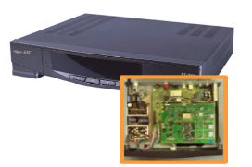
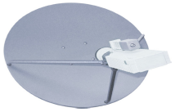
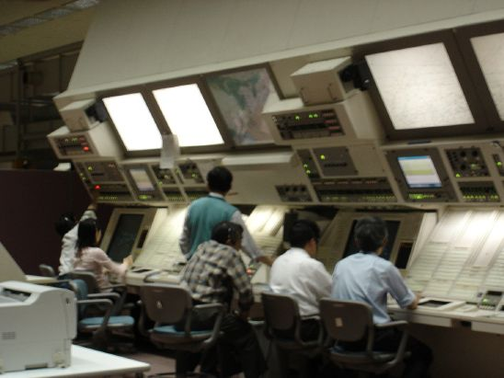
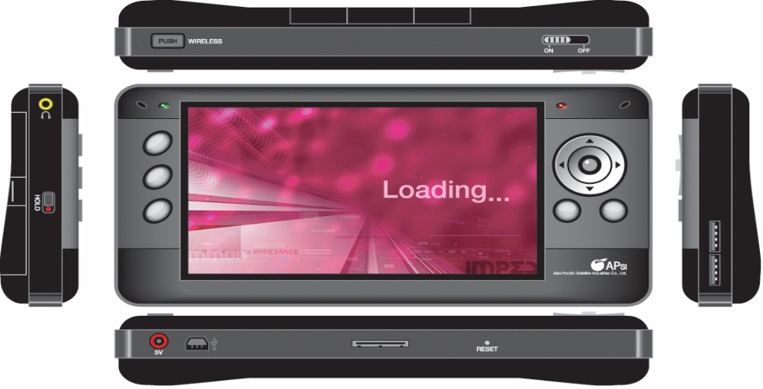

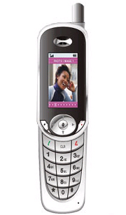
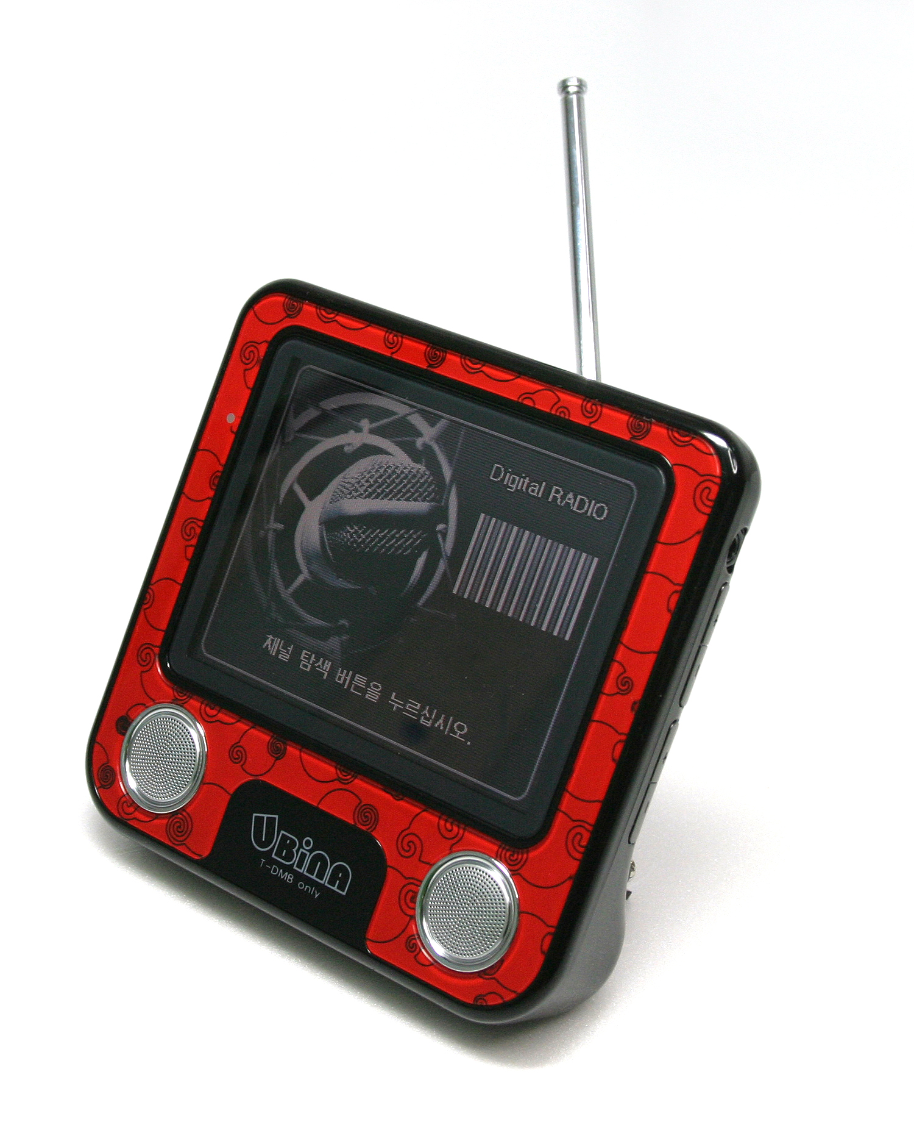
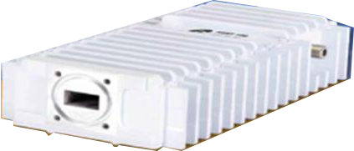
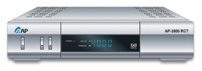
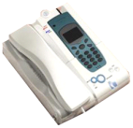
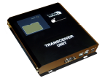

Business Area
Satellite Broadcasting System
(Set Top Box)
Satellite Two-way System
(HomeSat RT, HomeSat CS)
Satellite Equipments
Asia Pacific Satellite Industries
Co., Ltd
SRB (Subway Real-time
Broadcasting) system
PMP + Mobile Device
Terrestrial Two-way System
(DVB-RCT & MHP)
Satellite Terminal
(Satellite Mobile phone,
FDU, TU, MAU)
The other products
APSI Introduction

Slide 5
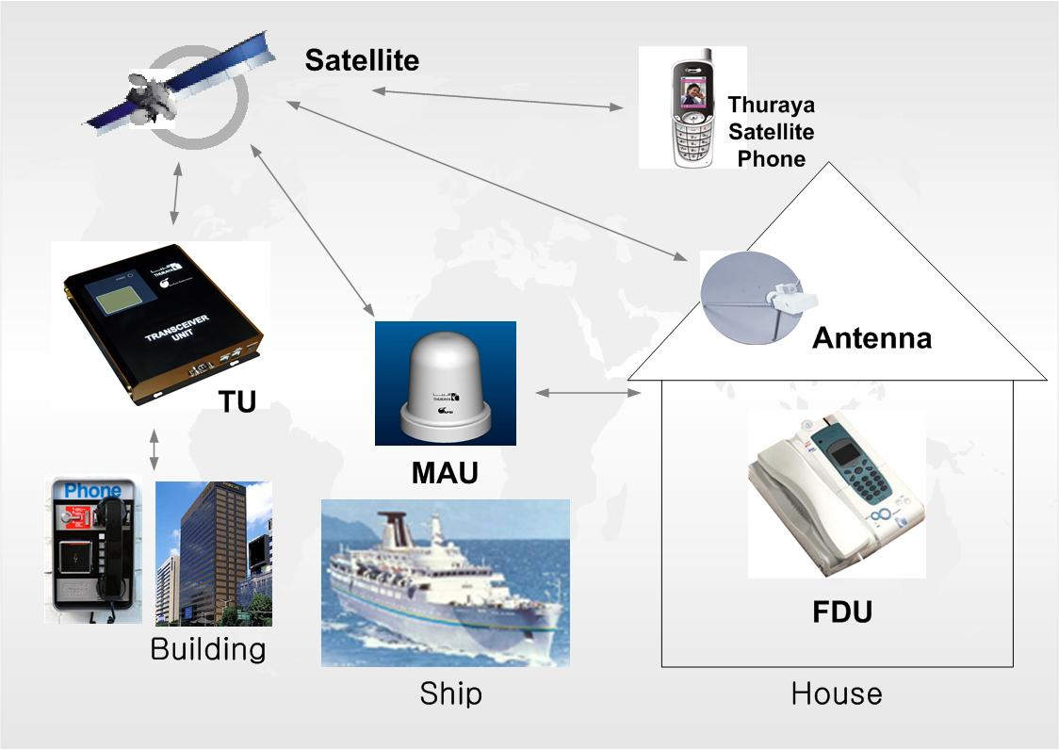
Satellite Terminal
Fixed Docking Unit (FDU)
Transceiver Unit (TU)
Maritime Antenna Unit (MAU)
Satellite Phone
APSI introduces Satellite communication devices for the following.
Public
Phone
APSI Satellite Terminal

Slide 6
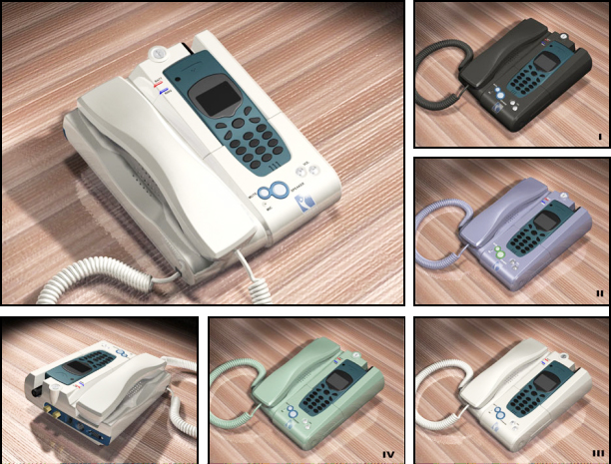
Satellite Terminal/
Fixed Docking Unit (FDU)
FDU (Fixed Docking Unit) is used with User Terminal for indoor use of voice, fax and data communications.
Supports outdoor antenna connection for indoor use.
Supports FAX, voice band modem, external phone, and other PC device communications.
FDU is made to overcome the difficulties to get the Satellite signal, therefore FDU is used by connected with Satellite & GPS Antenna installed outside the house.
CE Certificate
APSI Satellite Terminal

Slide 7
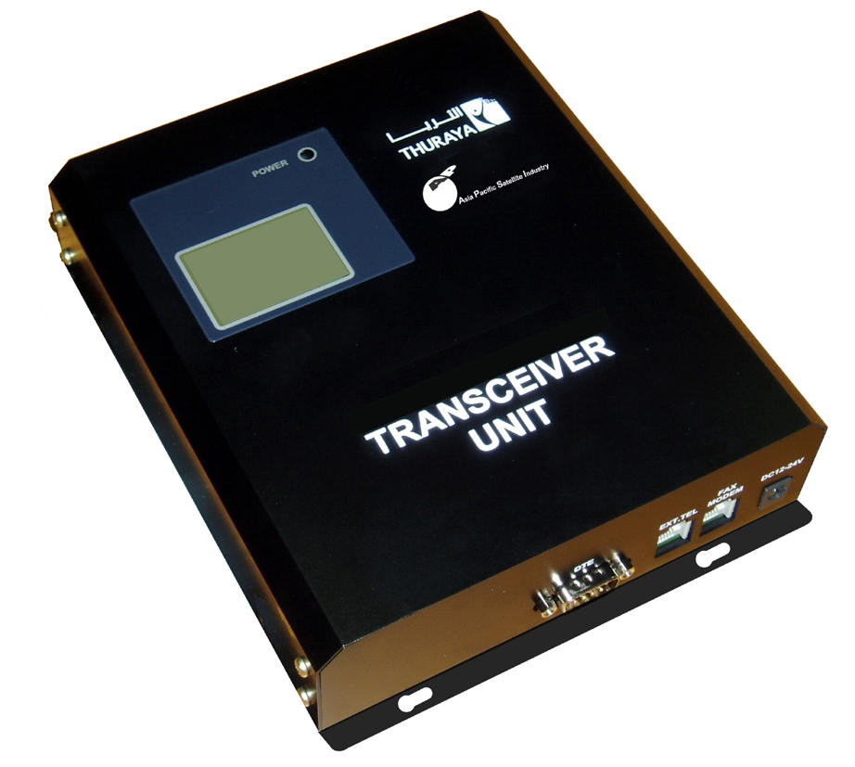
Satellite Terminal/
Transceiver Unit (TU)
TU (Transceiver Unit) is a relay device for Satellite communications.
TU allows local payphone service possible via satellite within the satellite network for both indoor & outdoor via extended antenna.
TU also allows various communications possible by connecting FAX, voice band modem, external phone, PC and other communication devices.
TU is produced to overcome the difficulties to receive the Satellite signal inside such as inside the house, or building, this real device is used installed outside.
Upgrade by OTA(Over The Air) function
CE certificate
APSI Satellite Terminal

Slide 8
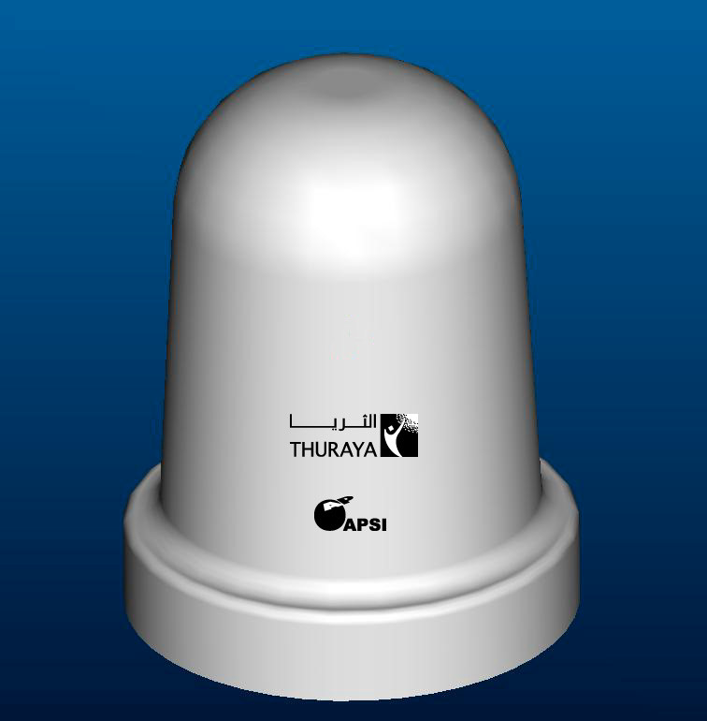
Satellite Terminal/
Maritime Antenna Unit (MAU)
Maritime Antenna Unit (MAU) is an extended antenna for ships or for common indoor User Terminal and/or FDU.
MAU offers for superb telecommunications and fleet management systems with all types of marine vessels such as boats, yachts and ships.
No additional GPS antenna set in MAU is required because of a built-in GPS antenna and LNA.
LNA: Low Noise Amplifier
GPS: Global Positioning System
CE Certification
APSI Satellite Terminal

Slide 9
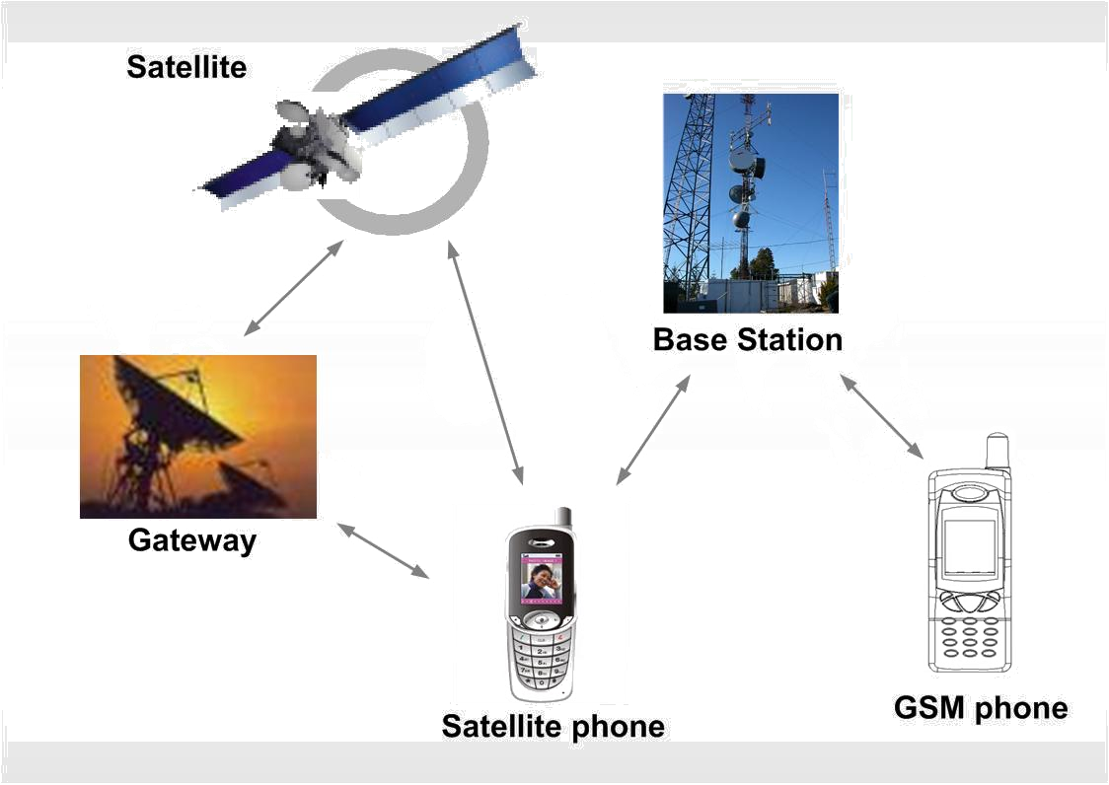

Satellite Terminal/
Satellite Mobile Phone
Satellite Phone
Satellite Phone works in both GSM and Satellite mode.
(The system is available of the telephone call and the additional service anytime, anyplace where is not the terrestrial networks like the remote island, the vessels and the business trip.)
APSI Satellite Terminal

Slide 10
Asset Management System
The system using the satellite performs the real-time communication, the analysis of past information
and notification about the current status, the location, the operating route, the emergency information
and applications for all the movable assets like the vehicles, the vessels and the flights etc with
efficiency and economy.
All country
Support
in Service coverage
Based on
GIS & LBS
Technology
Support
Web base
service
Use
Satellite
Network
Based on
GPS receiver/
SMS call
Service
Type
Vehicle Monitoring & Tracking Service
Vessel Monitoring & Tracking Service
SCADA Service
GIS : Geographic Information System
LBS : Location Based Service
SCADA : Supervisory Control And Data Acquisition
APSI Asset Management System

Slide 11











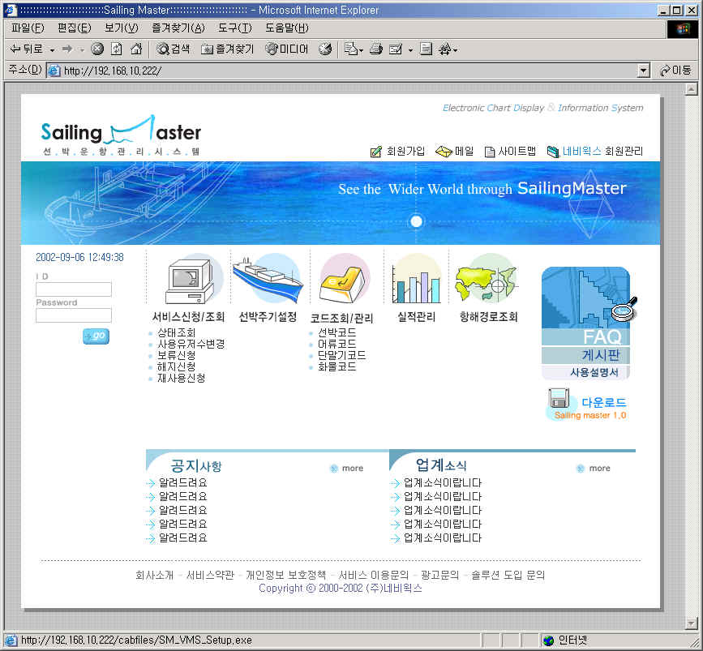
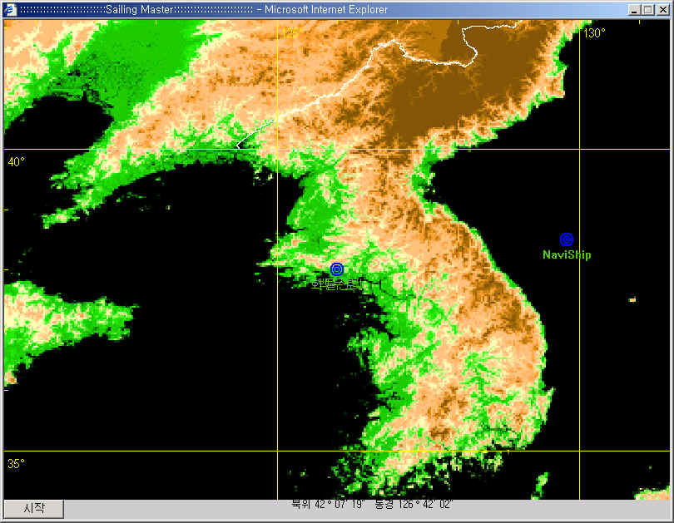
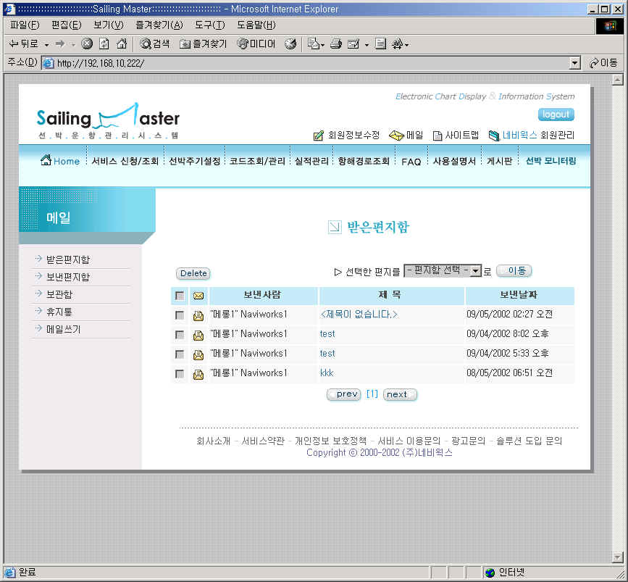
Asset Management System/
System Configuration/S-MCC Structure
The system installs the S-MCC as based on the large scale subscribers
Asset
Location information/
Communication information
Location information/
Communication information
Thuraya Satellite
Thuraya Main Gateway
Transportation
(SCADA sensor, vessel, vehicle)
S-MCC
Location information/
Communication information
Client
Out of Office
SMS Alert
E-mail
Web Tracking
Location
information
MCC
SMSC
(Short Message Service Center)
User authentication
accounting
In Office
APSI Asset Management System

Slide 12
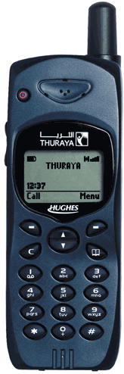
Asset Management System/
System Configuration/PC-MCC Structure
The system uses the PC(PC-MCC) as based on the small scale subscribers
Asset
Location information/
Communication information
Thuraya Satellite
Location information/
Communication information
Transportation
(SCADA sensor, vessel, vehicle)
PC-MCC
Client
HHT
Out of Office
SMS Alert
E-mail
Web Tracking
No
Thuraya
SMSC
User authentication
accounting
In Office
APSI Asset Management System

Slide 13

Asset Management System/
Main Features
Available of providing the various system as per the business situation and the needs
Thuraya network dependent
system development
World-wide service
Need World map license & data
Web based system construction
- Must understand Thuraya
satellite network
Need the project experience
with Thuraya
AMS
Support various applications
Need GIS/LBS/SCADA total
solution
Need the engine of GIS/LBS/
SCADA
Development & system
integration project
Shorten development period
- Need the project experience
about GIS & LBS
Use the commercial engine module
and equipments
Optimize the function
Step by step system upgrade
APSI Asset Management System

Slide 14
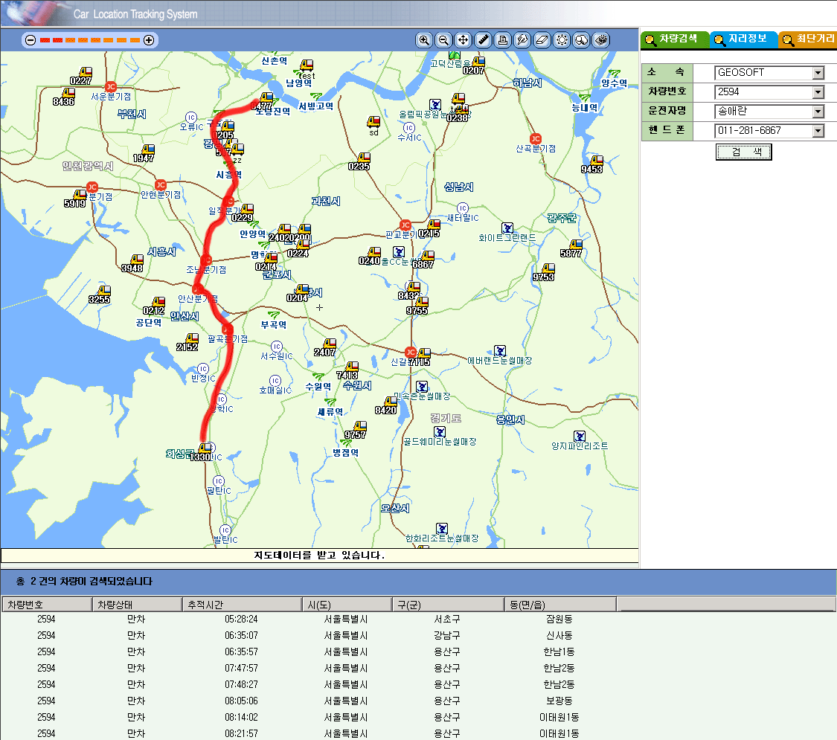
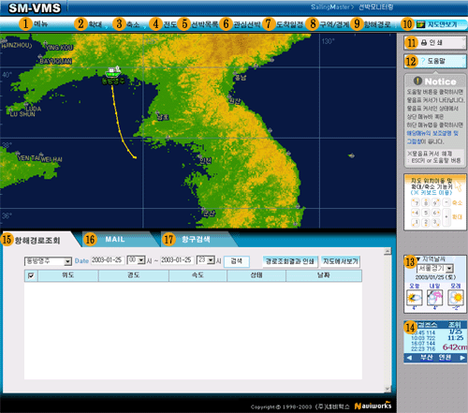
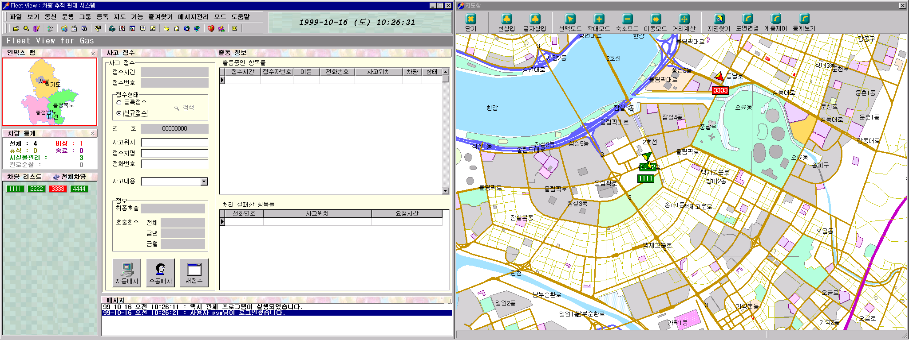
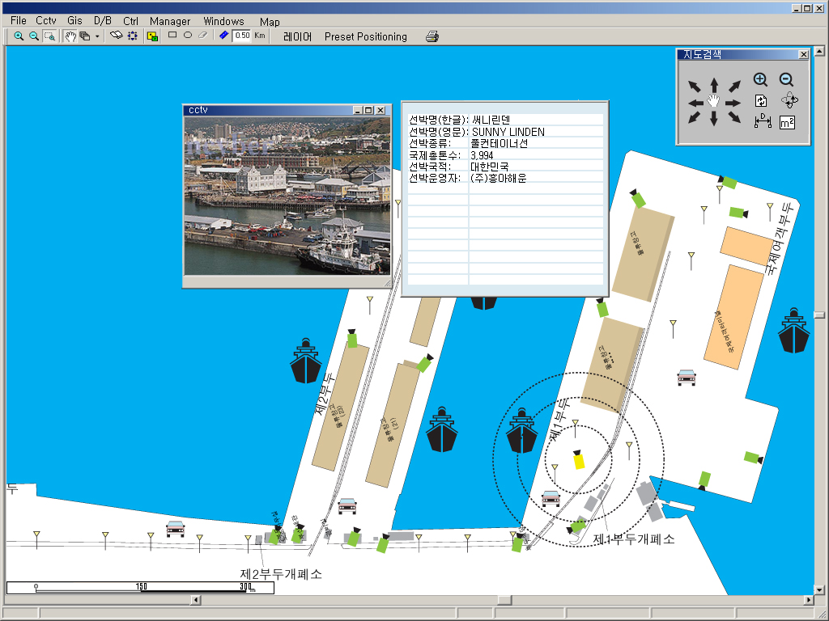
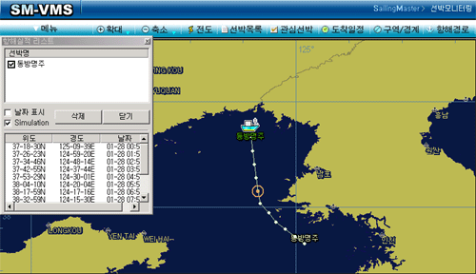
Asset Management System/
GIS & LBS Technology
Vehicle Monitoring & Tracking
Vessel Monitoring & Tracking
APSI Asset Management System

Slide 15
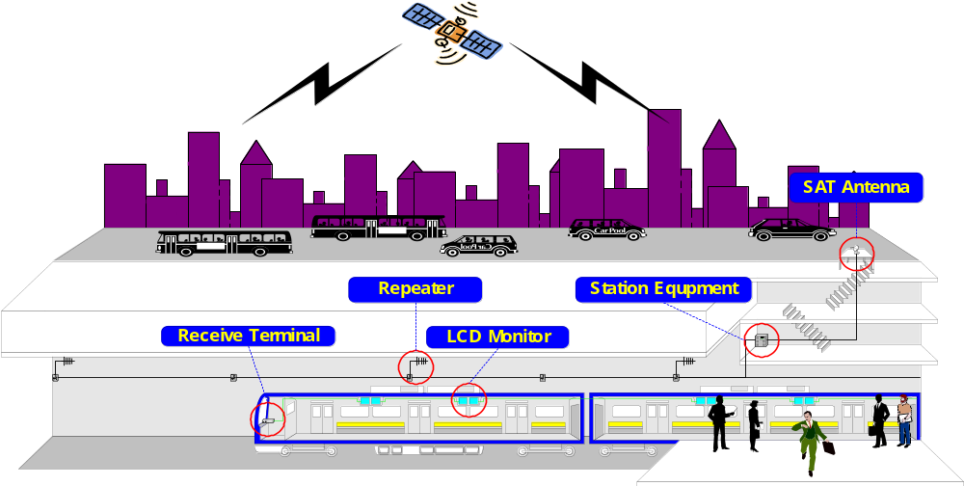
Subway Real-time Broadcasting System
2
1
3
4
6
5
7
8
APSI Subway Real –time Broadcasting System

Slide 16
SRB System/
Data Flow
  Real-time Satellite Broadcasting System
1
2
3
  SAT Antenna: Receiving the Real-Time Satellite Broadcasting Signal
4
  Station Equipments: Receiving the Satellite Broadcasting and Transferring the signal
5
  Repeater: Transmitting and Amplifying the broadcasting signal
6
  Receiver: Receiving the broadcasting and picture/voice signal output
7
  LCD Monitor: Screen Indication
8
APSI Subway Real –time Broadcasting System

Slide 17
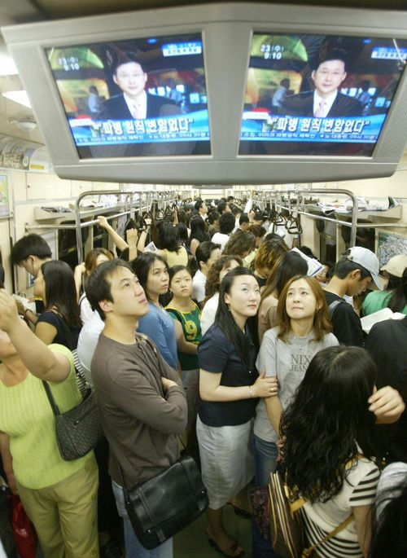
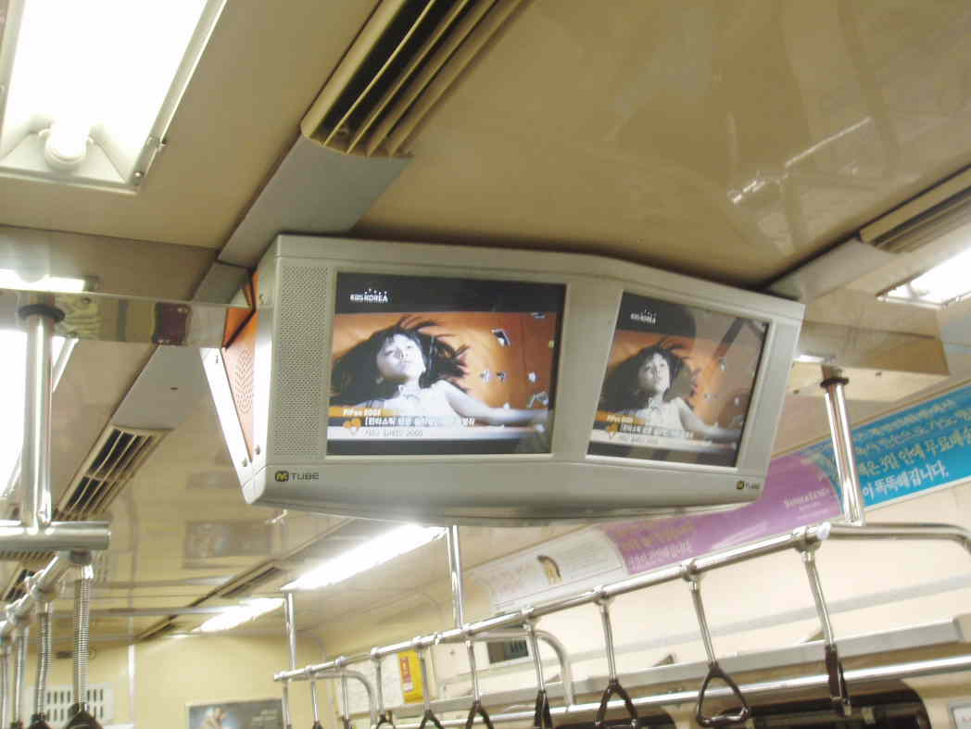
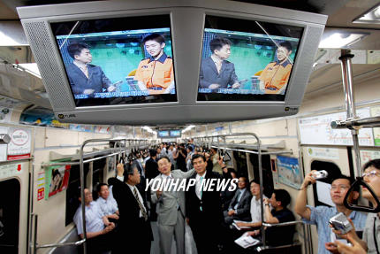
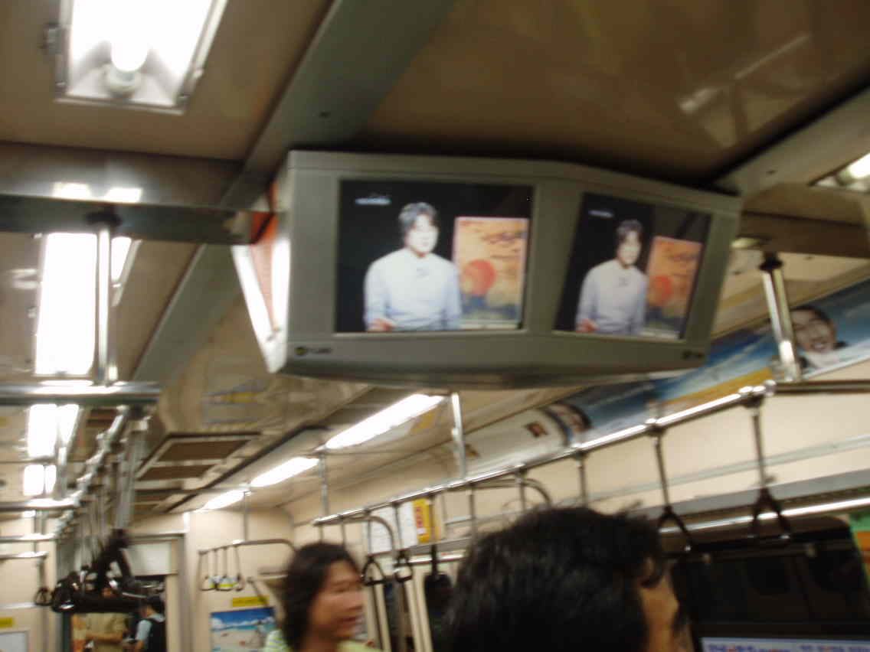
SRB System/
Demonstration in Seoul Subway
APSI Subway Real –time Broadcasting System

Slide 18
SRB System/
Main Features
Receiving system
on the high speed move
Movable Real-time
Broadcasting System
Available of receiving the
broadcasting on the vehicle
moving high speed like subway
Real-time broadcasting system
which is no need of memory
Available of transmitting
the real-time information,
news, sports relay
SRB
System
System using the low
output RF
Available of the weak RF
signal using the hypersensitivity
RF Receiver
High definition picture/Wide
screen broadcasting system
System based on the digital
broadcasting
Available of transmitting the
movable picture with high
definition over 15 inches screen
Available of receiving the
broadcasting with wireless incase
of installing the TV on the platform
Superb picture based on RTOS device
Superb system reliability using RTOS device
Low cost with system installation
APSI Subway Real –time Broadcasting System

Slide 19
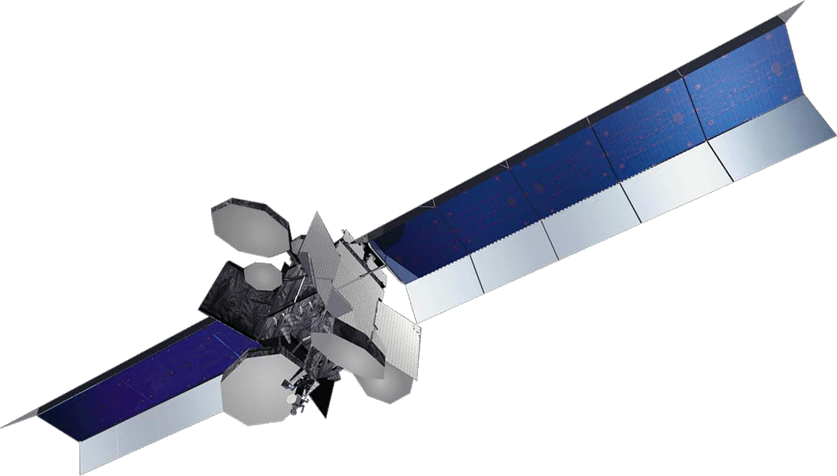
Satellite Two-way System
The system using the satellite performs the two-way communication like the internet broadcasting with efficiency and economy at the difficult place of terrestrial communication and movable vehicles which consists of the service provider devices and the subscriber ones
DVB-S
DVB-S
W-CDMA
Internet Service
Provider
(ISP)
Subscriber
Central Station (Hub Station)
Remote Terminal
ISP satisfies Requirements of Subscribers.
Subscribers want Various Services.
Information
Service
Information
Entertainment
Service
Entertainment
APSI Satellite Two-way System

Slide 20
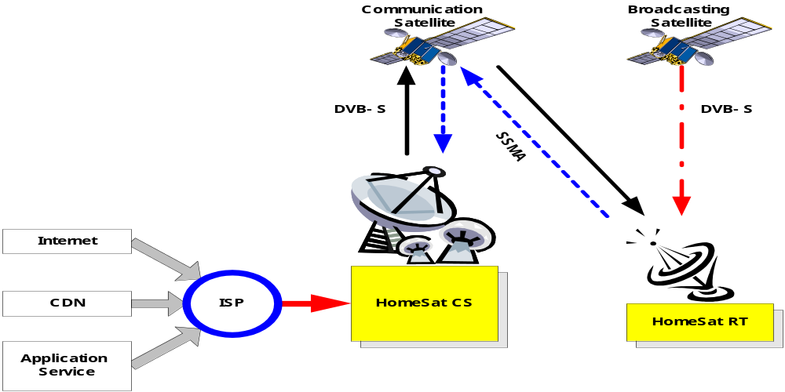
Satellite Two-way System/
System Configuration
BC(Broadcasting & Communication) Dual System
  Satellite Data Communication TX/Rx
  Satellite Digital Signal Rx
-CDN : Contents Delivery Network
CS : Central Station
RT : Remote Terminal
SSMA : Satellite Spread Multiple Access
APSI Satellite Two-way System

Slide 21
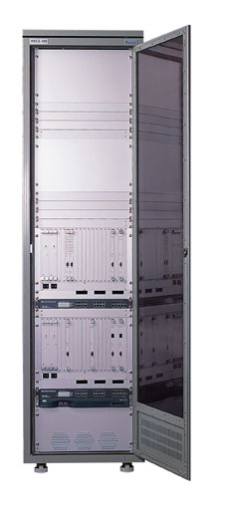
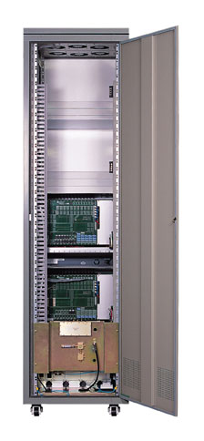
Satellite Two-way System/
HomeSat CS(Hub Station)
Host system providing satellite services to the users with the remote terminals.
Characteristic
  MPEG-2/DVB-S & W-CDMA
  Support High Speed Transmission
  Support Satellite Two-Way Data Communication &
  Satellite Broadcasting
  Operation & Monitoring using NMS
  Low Cost/High Efficiency
Application
  High Speed Internet
  Virtual Network
  Global ISP Service
  Remote Video Conference/Remote Education
  /Remote Diagnostics
  Monitoring System
  Interactive Multimedia Service
APSI Satellite Two-way System

Slide 22
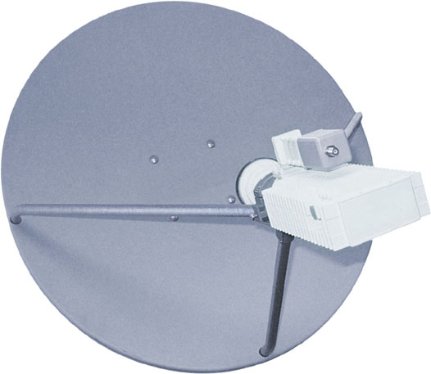
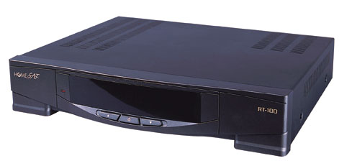
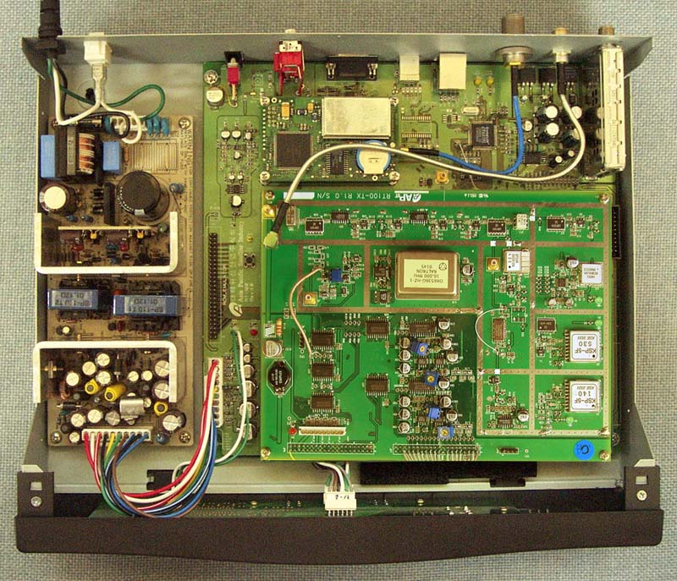
Satellite Two-way System/
HomeSat RT
A user could be a satellite service subscriber and the service subscriber uses the RT for Two-way communication service access.
Characteristic
  MPEG-2/DVB-S & W-CDMA
  Support High Speed Transmission
  Support Satellite Two-Way Data Communication &
  Satellite Broadcasting
  Ease to Install
  Support Data Communication Using USB/Ethernet
  Low Cost/High Efficiency
Application
  High Speed Internet
  Virtual Network
  Global ISP Service
  Video Conference/Distant Education
  /Distant Medical Care
  Monitoring System
  Receive Satellite Broadcasting
  Interactive Multimedia Service
Outdoor Unit
Indoor Unit
APSI Satellite Two-way System

Slide 23
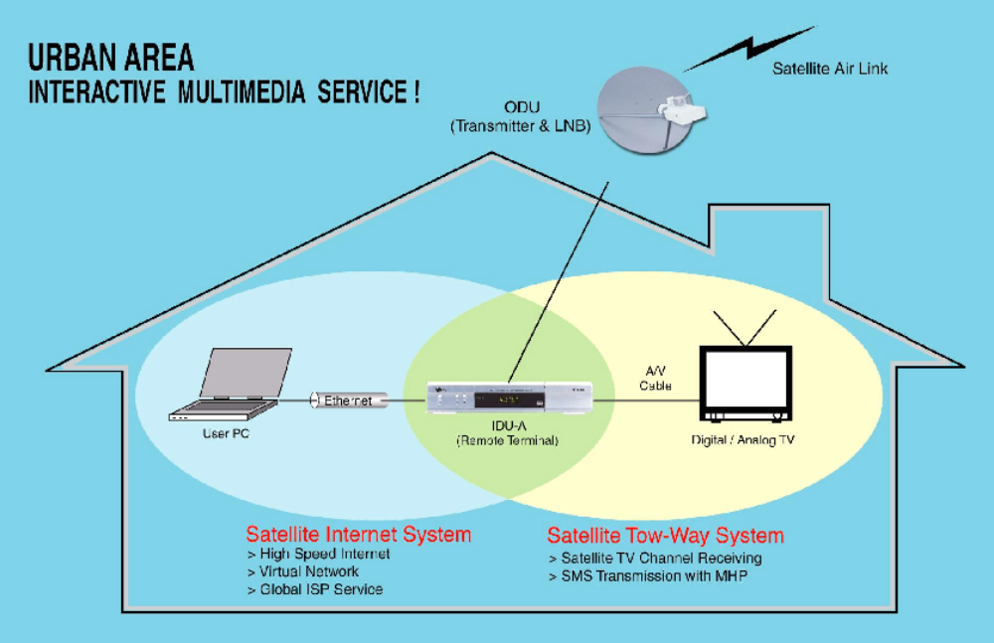
Satellite Two-way System/
Urban Area
APSI Satellite Two-way System

Slide 24
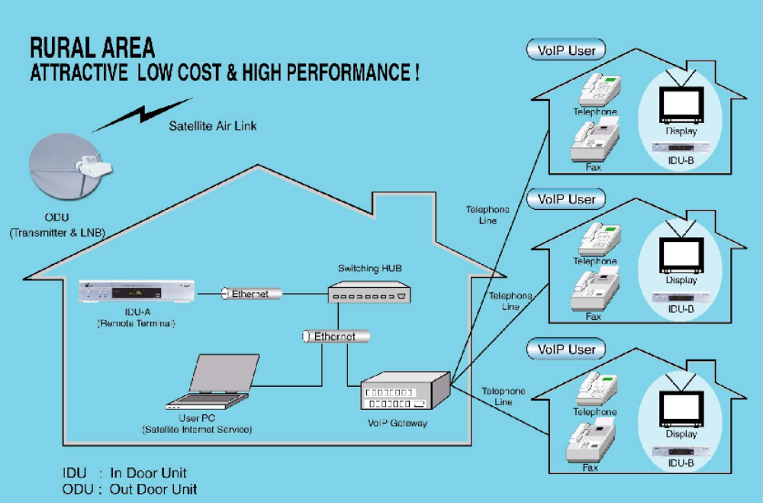
Satellite Two-way System/
Rural Area
APSI Satellite Two-way System

Slide 25











Satellite Two-way System/
Applications
Satellite Advertisement Service
Satellite Stream Broadcasting Service
Satellite Remote Monitor & Control
DVB-S Receiver
Satellite Enterprise Network
Satellite VoIP Service
Satellite Internet Service
Satellite Remote Education
Satellite Video Conference
APSI Satellite Two-way System

Slide 26
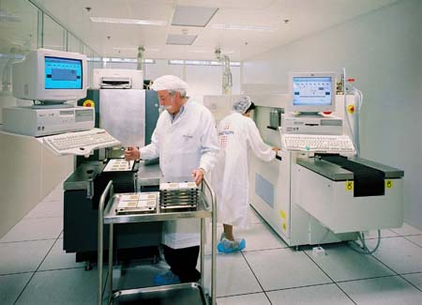
Satellite Equipments
APSI has own technique
for Satellite Equipments
Satellite Two-way Terminal
Solid State Recorder (SSR)
Ground Station Equipment
Electronic Ground
Support Equipment
(EGSE)
Solid State Equipment
(SSR)
Ground Station
Equipment
APSI Satellite Equipments

Slide 27
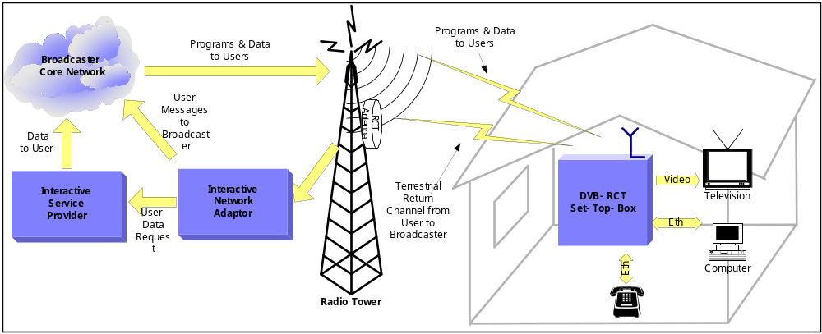
Terrestrial Two-way System (DVB-RCT)
Not only the receiving the broadcasting as a terrestrial TV broadcasting, but also transmitting which consists of the Broadcaster, Devices, Transmitter, Customer devices.
DVB-RCT (Digital Video Broadcasting & Return Channel Terrestrial) is terrestrial two-way receivers, and well-known for their effective frequency, low price, various function and flexible Multiple Access OFDM system.
APSI DVB-RCT System

Slide 28

PMP + DMB + Navigation+ Mobile
PMP (Personal Multimedia Player)
Video
MP3
20 ~40GB HDD
A/V Recording
Voice Recording
Service
Wireless Internet
Digital Camera
Digital Camcorder
Schedule management
e-Book (documents, e-dictionary)
e-Album (Image, Cartoon and etc.)
Game
T-DMB
T-DMB
DAB
Navigation
Tracking Search
Tracking Guidance
Intelligence/Telematics
Mobile Phone
CDMA
GSM
GEM
MMS
APSI PMP + Mobile Device

Slide 29
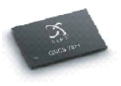
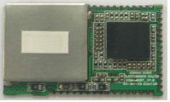
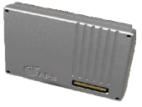
Main Features of PMP
Playing the multimedia contents included in the Videos of various media types, MP3 and etc.
4.3” TFT LCD Wide Screen
Available of high-capacity Storage with built-in HDD
Available of Receiving the Real-time Broadcasting with built-in HDD
Perfect Navigation function with built-in GPS receiver
Available of Telecommunication function with built-in Phone module (Option)
APSI PMP + Mobile Device

Slide 30
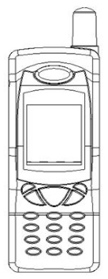
Other Products
Ku Band
Transmitters
On Going
GSM Phone
T-DMB
T-DMB HHT(UBINA)
APSI Other products

Slide 31
Thank you
Real-time Broadcasting Terminal
Satellite Two-way System
APSI Co., Ltd
Pioneer of Satellite Industry
With the Global Technology
Global Technology/
Competitiveness
&
Economical Price
Satellite Terminal
Asia Pacific Satellite Industries Co., Ltd

