Slide 1
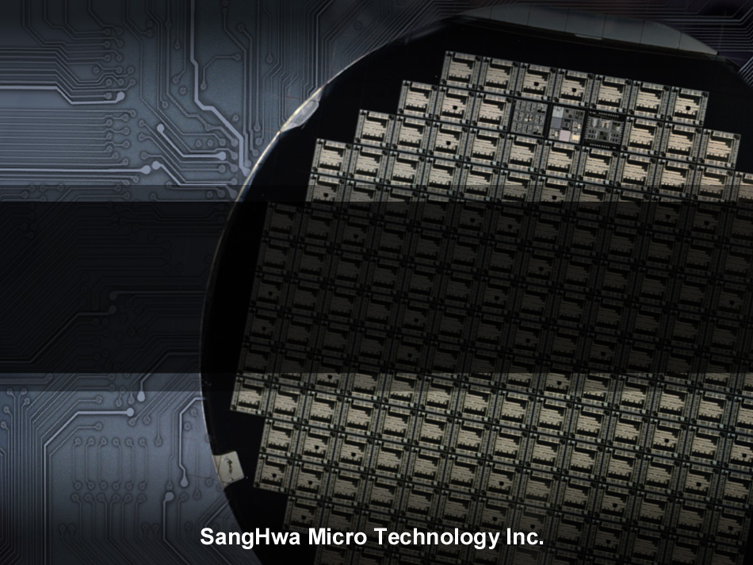
Company Profile
( SMT confidential)
Feb. 01, 2006
Notes:
Thank you for visiting our new office.
Good morning, I’m pleased to discuss IP business opportunities with you.
My name is H.S.Hong, and I’m in charge of ASIC division. I’m appreciating Our sales & marketing team –Mr.H.K.Lee, Mr.Mark Shim, Mr.Y.S.Son attend here and Technical Team –Mr.H.K.Kim, etc.

Slide 2
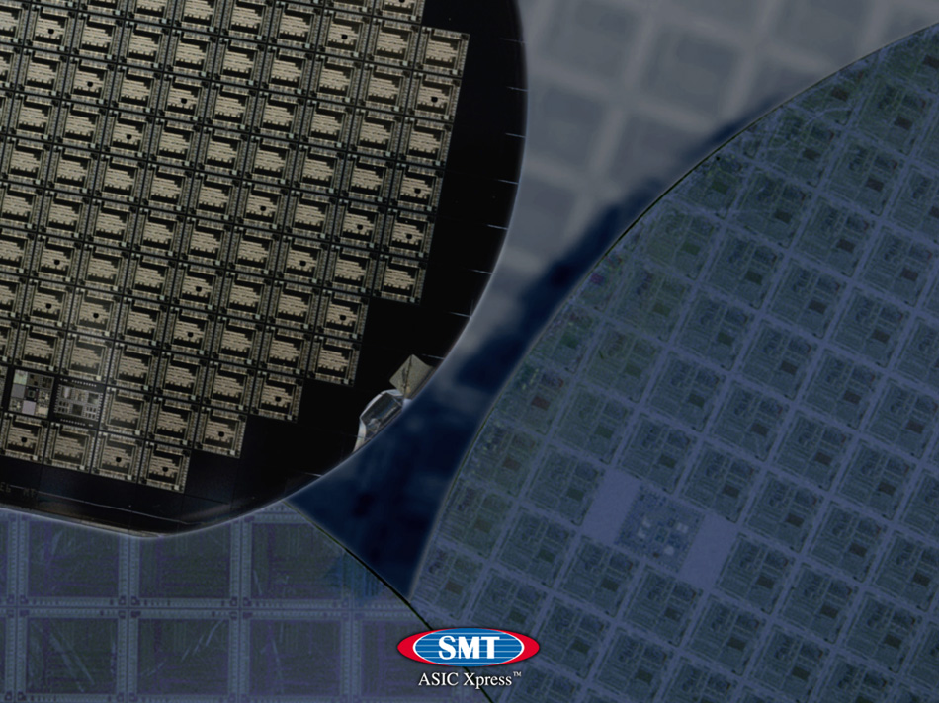
SangHwa Micro Technology Inc.
Contents
Company Profile
Technical Capability
3. Summary
Notes:
I’ve divided my talk into three parts;
First, the Company profile,
then I’d like to review current opportunities with you in detail,
and finally I’d like to discuss possible cooperation with you.
If you have any concern or question, feel free to interrupt me.

Slide 3
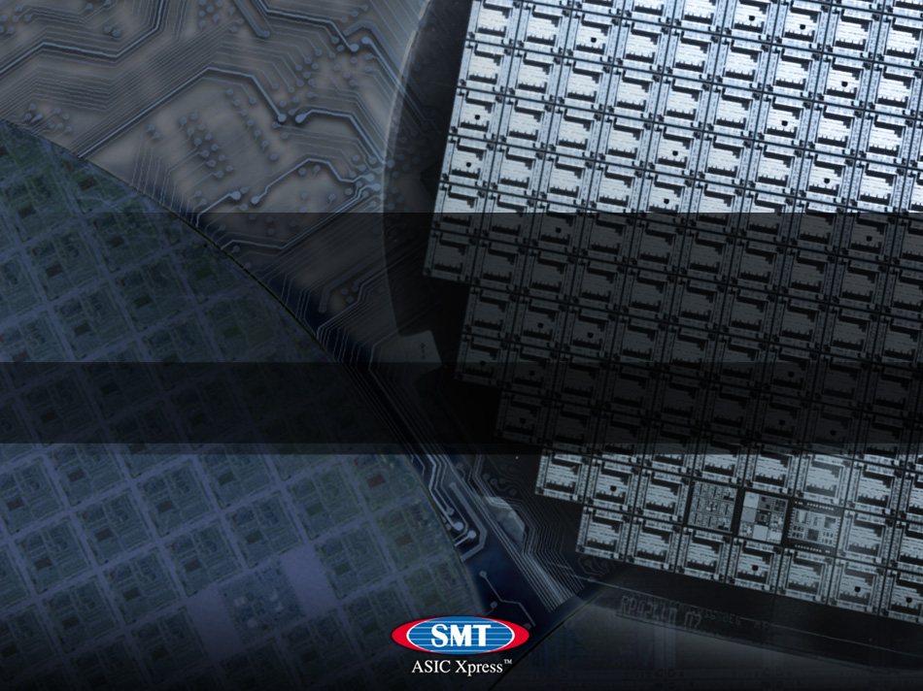
Chapter 1
Company Profile
Notes:
Regarding the first part – Company profile, we already present before when you visited our office.
So, I’d like to briefly explain this part if you grant it.
Let’s move on to the next page.

Slide 4
Profile & History
Company Title | Sanghwa Micro Technology Inc.
CEO | H.S.Han
Address | East Bldg, 8th Floor, IT Venture Tower, 78 Garakbon-Dong, Songpa-Gu, Seoul, Korea
Establishment | Jan. 15, 1997
Major Products | ASIC, SoC
Sales | US$30M (2004)
Capital | US$2.8M
No. of Employees | 40 (as of Feb. 2006)
IPO | Listed on KOSDAQ, Dec. 2003 ( KOSDAQ is similar to NASDAQ)
Jan | 1997 | Established Sanghwa Micro Technology Inc (SMT).
Jul | 1997 | Registered ASICXpress™ as Trademark
Dec | 1997 | Made Pro-ASIC Design Center agreement with Zycad (US)
Mar | 1998 | Made Korea ASIC Design Center agreement with VLSI(US)
Aug | 1999 | Made agreement as Artisan Service Net Program Member of Korea
May | 2000 | Registered as the official partners related to ASIC with Samsung Electronics and Samsung SDI
Jun | 2000 | Opened and got certificate for semiconductor technology research center
Jun | 2001 | Made the agreement with LEDA System as IP Business Partner in Korea
Sep | 2002 | Made DCA (Design Center Alliance) agreement with TSMC (Taiwan)
Dec | 2003 | Listed on KOSDAQ
Jan | 2004 | Made ATAP Design Partnership agreement with ARM (UK)
Jul | 2005 | Moved to the new Office

Slide 5
Mission
Leading ASIC/SoC
Design Service company
Clean and healthy
Turnkey
ASIC/SOC business
Customer Satisfaction
Financially stable
Devotion to society
Marketing focused
on Customer
Oversea market
State-of-the art
Technology
Notes:
Our goal is to become a leading ASIC/SoC design service company in world-wide.
Also, we’re planning to expand into overseas market soon.

Slide 6
Organization (Total, 2006)
President
Total : 40
Taiwan Office (2)
Sales (8)
R & D (25)
Management (5)
Warehouse
Trade
Support
ASIC
Sales
AI (5)
ATAP (10)
ASIC (15)
Accounting
Test Support
ATAP/SoC
Sales
Analog IP
Development
ATAP & SoC Support
Front-End
Service
Administration
Sales
Admin
Back-End
Service
Planning
Notes:
SMT. consists of three business divisions. It’s quite simple organization.

Slide 7
Stable Growth
Stable Growth with CAGR over 40%
Sales Volume
CAGR 40%
Unit: Hundred Million Won
400
300
200
182
300
265
150
Product
148
Service
34
35
50
100
2003
2004
2005
2006(E)
Notes:
Regarding revenue wise, As you can see from this graph, our revenue is been increasing steadily.
The vietical line represents Korea million Won. Last year we met US$30million.
Also, service sales volume account for 11% of our total revenue.
It’s little bit hard to achieve this year forecast, honestly speaking. However, all member of Our sales & Technical teams will do our best to achieve goal.
Let’s move on the next page.

Slide 8
Differentiated Business Model
The Only Fabless ASIC maker providing Turnkey ASIC solution in Korea
Business Model enabling batch process service such as chip planning, design, manufacturing and tests for ASIC
ASIC or IC Design Company
Foundry
Advanced Assembler
Test House
Plan
SPEC
Desision
Architecture
& Circuit design
Front-end
&
Back-end
Design
Fabrication
(Mask, Wafer)
Package
Assembly
Final Test

Slide 9
Leading Design Center in Korea
Worldwide Class Foundry, recognized technical capability of SMT
Foundry
Advanced Process Technologies
in the World
Highest Quality, On time Delivery and Very stable Fabrication in the World
Reliabilities for stable
Mass production
SMT
Acquisition of design technologies appropriate for advanced process Technologies as the leading design center in Korea
Widening the technical gap from other ASIC firms

Slide 10
Top-Notch Design Capability in The Industry
SMT’s design capability is recognized as World Class in the industry through development of ASICXpressTM
Development
Of ASICXpressTM
Self-Design Program
Win-Win Performance
With Customers
100% success of
Design service
Projects
Integrated solution management all processes from design,
Manufacturing, progresses to test (simulation)
Powerful function including
IP/ASIC design and consulting
Including preliminary and post-
design
Secured a number of verified IPs
Realization of Time-To-Market
Preventing losses and substantially reducing development period for design by unified project management
Cost reduction by reducing design time
Reducing time for Fab Process on the basis of distinguished design technologies
100% success of design service projects so far
Success by Product sales
Success if design service projects induces product sales as being directly linked to mass production

Slide 11


Approved ARM Design Partner
SMT Offers ARM’s customers additional choices to execute quality, timely, ARM based, SoC designs.
Tools and models
Support, training & maintenance
Peripherals
FOUNDRY
Net-list or Layout Database
Layout
Microcell
Timing details & ASIC Lib

Slide 12
Partners
Total Service enhanced on the basis of close cooperation with prominent partners in each area
Foundry partner
Package partner
CP Test partner
SMT
Turnkey QA/QC partner
ATAP partner
ARM UK
F/T partner
IP partners
Library partner
Artisan (USA)

Slide 13
Acquisition of Customer’s Reliability by High Success Rate
Acquisition of long-term customers and Co-growth with Customers by 100% Successes in all Projects
Building reliability according to recognition on technologies and Time-To-Market of SMT
Sharing technologies and future project roadmap based on built reliability
Using technologies of IP, core element of SoC, of ARM and advanced process
Continuous Project Development with Customers under Reliability
Realizing competitive advantage of customers
by providing the function for specialization
Providing design technologies of Time
to Market and stable foundry
Leading markets on the basis of
Bulk orders ← Specialization
Requesting future projects on the basis of reliability

Slide 14
Success Stories
Technology | Application | Area
0.13um | UWB | Telecommunication
0.15um LV | DTV | Consumer
0.15um G | Mobile | Mobile
0.18um | WCDMA BB | Telecommunication
 | WCDMA BB | Telecommunication
 | DTV | Consumer
 | PDP | Consumer
0.25um | Optical BB(51MHz) AUPP | Telecommunication
 | Optical BB(51MHz) | Telecommunication
 | Optical BB(155MHz) | Telecommunication
 | B-ISDN (1MHz) | Telecommunication
 | ATM MODEM IC (155MHz) | Telecommunication
 | Camcoder | Video
 | Audio Process | TOY
 | FLCD | Consumer (TV)
 | LBP | Printer

Slide 15
Success Stories
Technology | Application | Area
0.35um Logic | VTR (CODEC) | Consumer
 | VTR(ECC) | Consumer
 | TV | Consumer
 | TV | Consumer
 | TV | Consumer
 | ISPP | Telecommunication
 | ISPP-PLUS | Telecommunication
 | CELL ROUTER | Telecommunication
 | WLL Filter | Telecommunication
0.25um E-Flash | VCXO IC | Telecommunication

Slide 16
Vision
Fabless ASIC Specialist
Penetrating into a wide range of business areas and enhancing SoC technologies
Win-Win strategy for co-growth with customers
Providing total solution from quick and
stable design services to competitive mass production support
Intensification of R&D Ability
Intensive investment on semiconductor design
Continuous development of differentiated semiconductor design techniques
Improvement of design abilities of all researchers
Intensification of Marketing Ability
Participation in ATAP program of ‘ARM’ (Increasing the percentage of SoC design)
Keeping long-term customers on the basis of technologies
Customer Satisfaction through the quality first policy
Penetration into Overseas Markets
Expansion of business areas as penetrating into overseas markets including Japan, China and Taiwan
Enhancement of Win-Win strategy with international firms

Slide 17
Continuous Development of Technologies
Building foundation to achieve visions
through continuous development of technologies
Development of ASIC for a wide range of sectors including wireless, RF, home networking and multimedia
2006
Expansion to emerging market
by developing SoC
in a wide range of sectors
Development of ASIC
for digital image/display sector
Application in SoC and SoC design service using IPs and ARM
Maximization of Time-To-Market by supporting a variety of IP
2005
2004
Enhancement of ASIC total service technology
Stabilization of customer-focused solutions

Slide 18
Chapter 2
Technical Capability
Notes:
My final topic is on discussing possible cooperation to have close partnership.

Slide 19

Design Engineer Resource
Design Manager
팀장
Front-End 설계 업무
책임 급 이상 담당자
Synthesis
Physical Synthesis
Simulation
SI
Xtalk
IR-drop
Tool Kit
Back-End설계 업무
책임 급 이상 담당자
Floorplan
Powerplan
Placement
Optimization
Xtalk
IR-drop
LVS, DRC
Proven Successful Engineers = Silicon Success

Slide 20
Design Service Scope
ASIC/SoC Design Service
  C, C++ Language based Algorithm design
  VHDL, Verilog-HDL based High-level RTL design
  Front-End Logic Implement design
  Back-End Layout design
  FPGA to ASIC Conversion Service
  Standard Cell, Embedded Array, Full Custom Design
  Available ASIC Technology
  Design Conversion
  IP Design
ARM (ATAP) SOC Service
  SMT is developing complex SOCs based on AMBA, an on-chip bus, using ARM RISC core and peripheral IP cores.
  SMT established a S/W and H/W design environment of ARM to provide system houses with completed design services.
Notes:
We specialize in designing ASIC/SoC Turnkey service throughout Korea.
Most of our expert engineers have been in this industry for more than 9 years.
Also, our technical team. is committed to providing the best productivity and customer-friendly products.

Slide 21
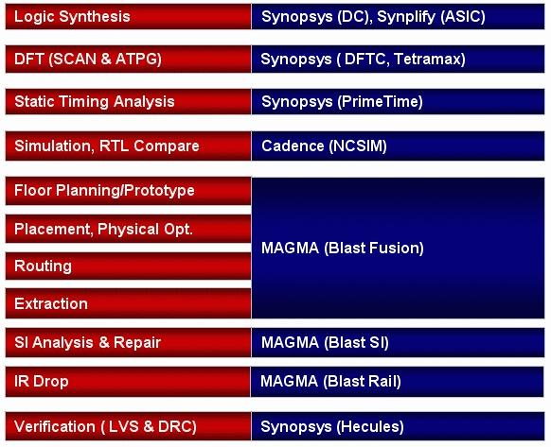
Logic Design Flow

Slide 22
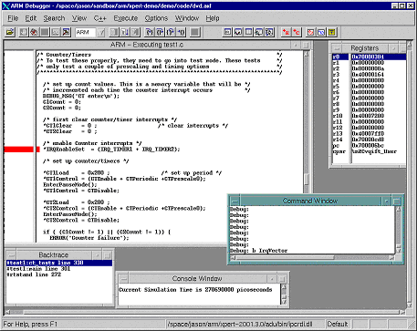
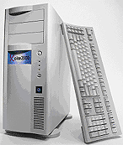
Design Capability
SoC Design Capability for ARM
Platform based verification system from AXIS.
  - Simulation acceleration 100 times faster than conventional
  simulators
  - Emulation support for up to 2 Million gates
Supported ARM cores
ARM7
ARM9
ARM10
ARM11

Slide 23
Design Capability
IP Solution
TSMC libraries : Standard cell, I/O, SRAM, etc
TSMC IPs : High Speed I/O, PLL, ADC, DAC, etc
Star IPs : embedded processor, DSP, Rambus controller, Serdes, etc
Special process IPs : embedded flash, embedded 1T-RAM, embedded logic NVM, etc
ARM IP Name
ARM UART
ARM Static Memory Controller
ARM SDRAM Controller
ARM Real Time Clock
ARM ps/2 Keyboard/Mouse Interface
ARM GPIO (General Purpose Input Output)
ARM DMA Controller
ARM AMBA Basic

Slide 24
Chapter 3
Summary

Slide 25
Summary
Business Status
TSMC & ARM DCA (Unique Model in Korea)
Turnkey ASIC/SoC/IP Design Service
More than 300 successful codes
Prominent Partners for IP, PKG, Test…
Stable Growth and Abundant Success in ASIC/SoC
High rate CAGR in Sales Revenue
Abundant ASIC Design/MP success stories
Top-Notch Design Capabilities and Vision
Differentiated Design Capabilities
Vision will be realized

