Slide 1
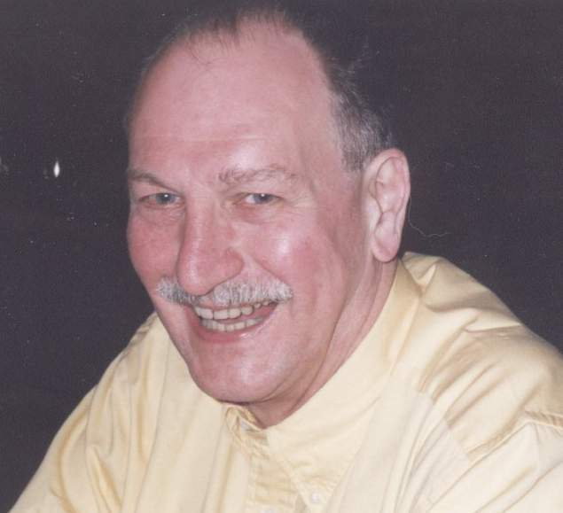
ETSI ICT Roadshow – at Park Air Systems, Peterborough - 1st December, 2005
An Overview of Transport Standardisation in ETSI
Oliver J Wheaton - Consultant to DTI
Head of the UK Delegation to the ETSI General Assembly – former
chair of ETSI TC-ERM (EMC and Radio Spectrum Matters)

Slide 2
What you always wanted to know about Transport Standardisation ?

Slide 3
International and European Bodies concerned with Transport Standardisation (1)
International Administrative/Standardisation Bodies
ITU – International Telecommunications Union
ICAO – International Civil Aviation Organisation
IMO – International Maritime Organisation
plus……….
International Standardisation Organisations
ISO – International Organization for Standardization
IEC – International Electrotechnical Commission
plus……….

Slide 4
International and European Bodies concerned with Transport and Standardisation (2)
European Administrative Bodies
European Union
European Free Trade Association
EUROCONTROL – European Organisation for the Safety of Air Navigation
CEPT - Conference of European Postal and Telecommunications Administrations
plus………..

Slide 5
International and European Bodies concerned with Transport and Standardisation (3)
European Standardisation Organisations
ETSI – European Telecommunications Standards Institute
CEN – European Committee for Standardization
CENELEC – European Committee for Electrotechnical Standardization
EUROCAE – European Organization for Civil Aviation Equipment
ERTICO – European Road Transport Telematics Implementation Coordination Organisation

Slide 6
Conclusion – so far?
there are a large number of administrative
and other organisations involved in Transport Standardisation………..

Slide 7
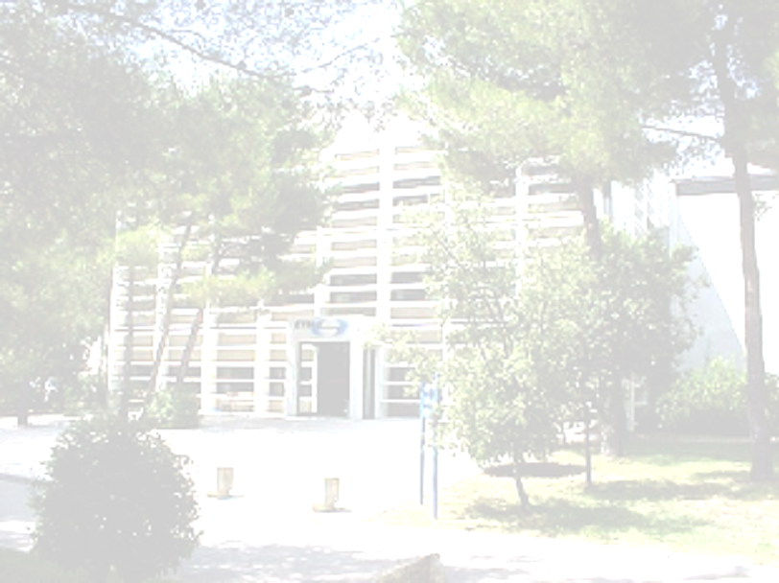
A look at
Transport Standardisation within ETSI
The European Telecommunications Standards Institute

Slide 8
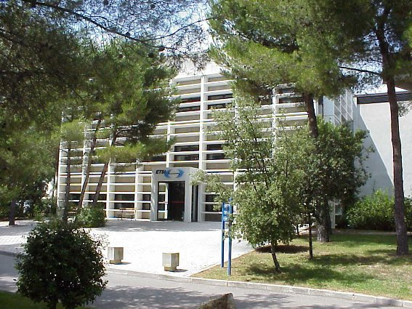
ETSI Headquarters – Sophia Antipolis

Slide 9
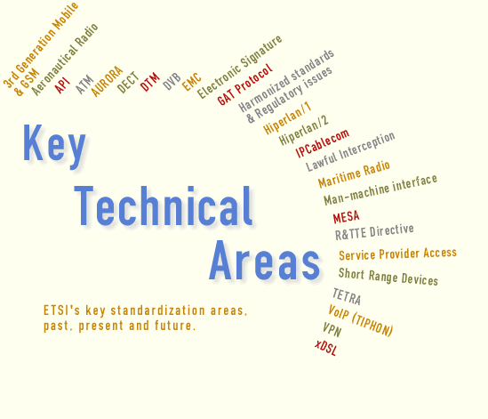
Key Technical Areas in ETSI

Slide 10
ETSI’s mobile communications
portfolio is extensive - it includes GSM, 3G systems, DECT, TETRA, HIPERLAN ……….
much of the ‘specialist’ standards for use in the transport sector have their focus in TC-ERM, which includes aeronautical, maritime and automotive standards.

Slide 11
First - ETSI’s Working Methods

Slide 12
Electronic Working is the Norm
most ETSI meetings are now paperless
  document distribution is via e-mail and web access
all ETSI meeting rooms are equipped with wired and radio LANs
  full internet access is provided for on-line document access and updates and e-mail facilities
most administrative tasks are undertaken using web applications, including:
  meeting organization and registration
  document numbering and 'distribution'
  approval of deliverables (standards and reports)
  download of published deliverables
  IPR declarations and database

Slide 13
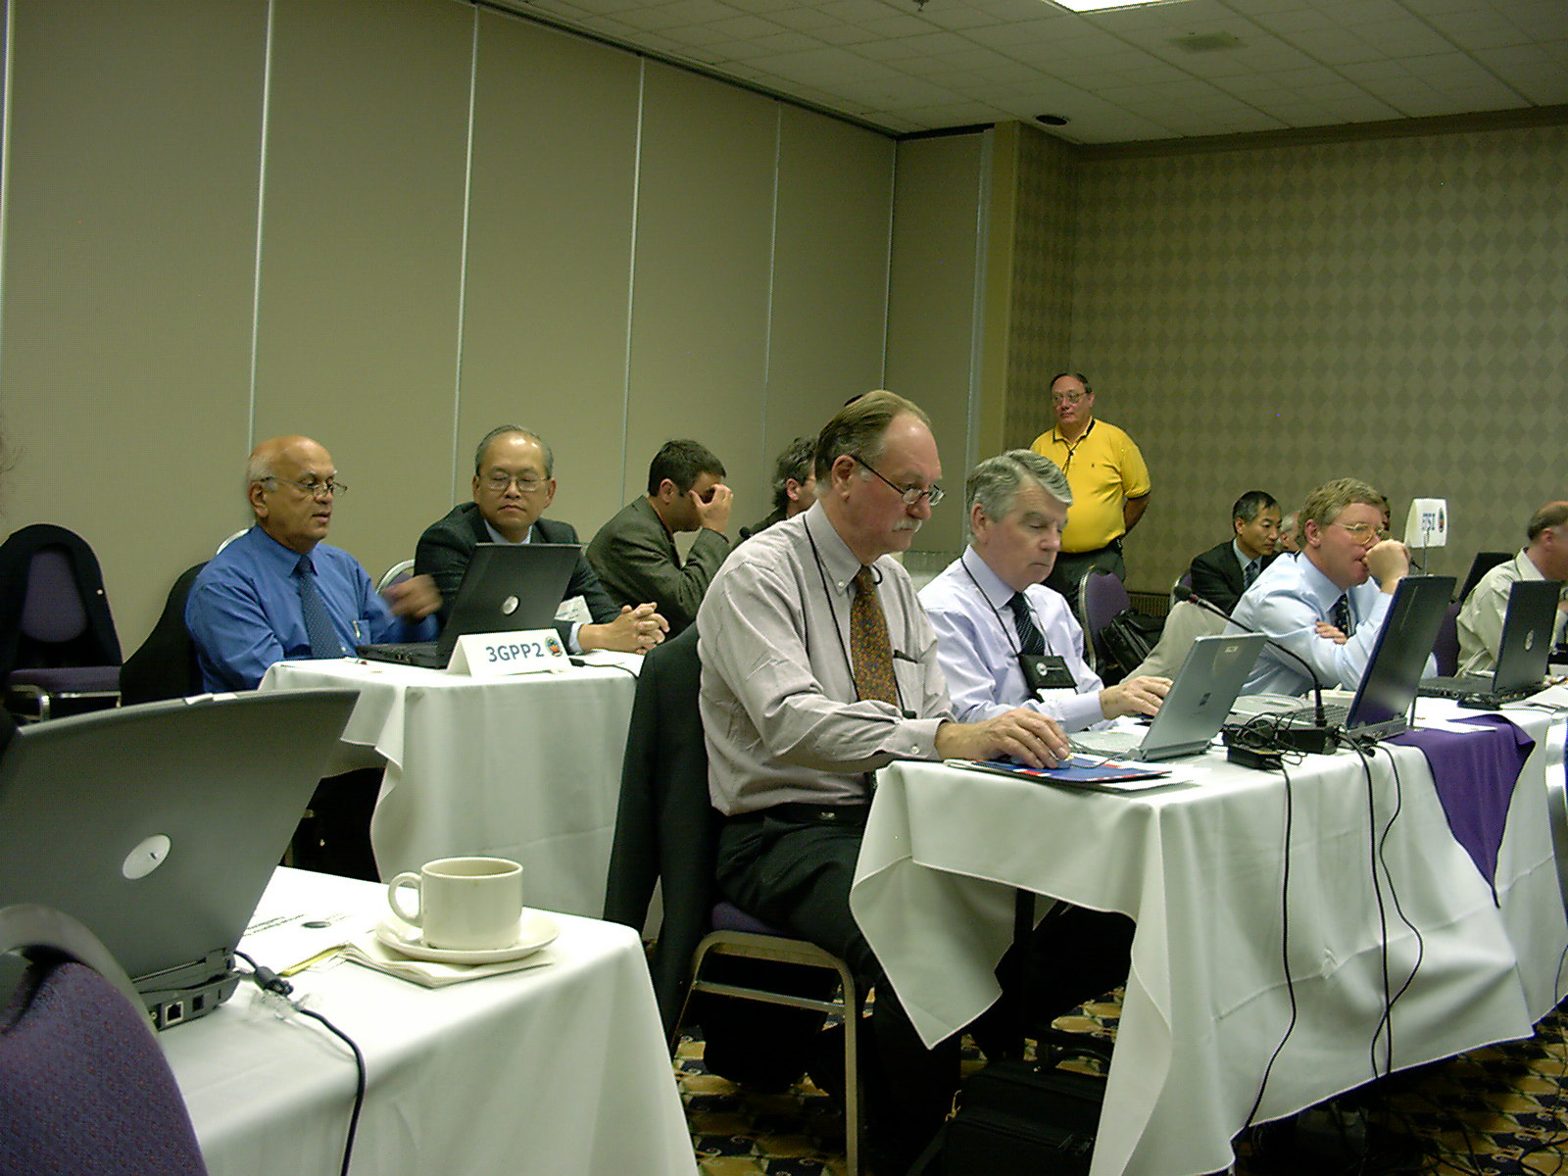
Electronic Meeting in Canada

Slide 14
BUT - What does TC-ERM actually do?
the co-ordination of radio spectrum interests in ETSI, and representation in the EU and CEPT on radio spectrum issues via its Radio Matters working group
standardisation of electromagnetic compatibility (EMC) across ETSI and co-ordination with IEC and CENELEC on EMC issues via its Electromagnetic Compatibility working group
plus a wide range of radio standardisation activities via product focussed Task Groups established for specific activities and disbanded on task completion
TC-ERM is chaired by Dr Gabrielle Owen - Ministry of Economic Affairs - NETHERLANDS (NL)

Slide 15

TC-ERM – Task Groups Concerned with Transport Standardisation
Automotive
ERM-TG04 - Automotive EMC (now closed)
ERM-TG29 - Road Transport & Traffic Telematics - DSRC - (now combined with TG37)
ERM-TG31b - Ultra Wideband Automotive Radar
ERM-TG37 - Intelligent Transport Systems
Aeronautical
ERM-TG25 - Aeronautical
Maritime
ERM-TG26 - Maritime
plus others such as
ERM-TG28 - Generic Short Range Devices

Slide 16
Key Activities and Deliverables
ERM-Task Groups (1)
ERM-TG25 - Aeronautical provides:
  ETSI with its formal interface with ICAO, CEN, EUROCAE and EUROCONTROL on air traffic management issues
Aspects include:
  The Single European Sky Initiative
  Mandates M/239 and M/318 relating to VDL modes 2 and 4 plus the Galileo local component
ERM-TG26 - Maritime provides:
  ETSI with its formal interface with the ITU, IMO, IEC and CENELEC on maritime radio issues
Aspects include:
  Maritime radio equipment that falls outside the SOLAS (Safety Of Life At Sea) Convention
  Maritime equipment for vessels on inland waterways

Slide 17
Key Activities and Deliverables
ERM-Task Groups (2)
ERM-TG04 - Automotive EMC provides:
  ETSI lead on the revision of the Automotive EMC Directive (95/54/EC)
  interface with the vehicle constructors group ACEA
ERM-TG31b - UWB Automotive Radar provides:
  product and harmonised standards for UWB vehicle radar applications
  anti-collision vehicle radar is a key new safety option under the EU’s E-Safety policy
  interface with the ISO/IEC SC31 related activities

Slide 18
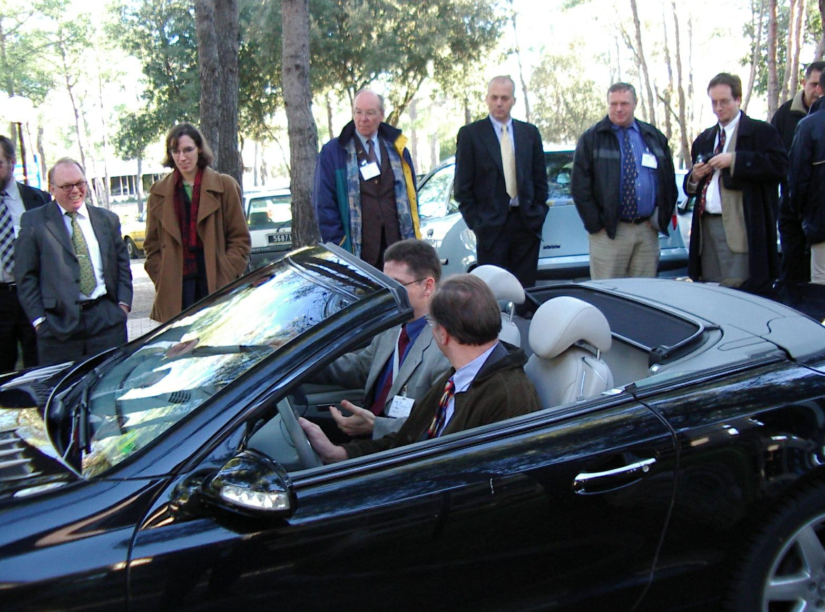
Anti-Collision Vehicle Radar – Test Vehicle

Slide 19
Key Activities and Deliverables
ERM-Task Groups (3)
ERM-TG29 - Road Transport & Traffic Telematics (joint with CEN TC 278) provides:
  product and harmonised standards for Dedicated Short Range Communications (DSRC)
  DRSC provides road toll and related features
ERM-TG37 - Intelligent Transport Systems provides:
  ETSI interface with ISO TC 204 - CALM (Continuous Air interface for Long and Medium)
  CALM offers communications between vehicles and roadside using alternative communication media
  ETSI covers spectrum, market access and interface requirements to existing telecommunications networks

Slide 20
TC-ERM - How does it operate?
TC-ERM normally meets 3 times per year in plenary session, at ETSI HQ - Sophia Antipolis - ERM is an all electronic committee
TC-ERM uses correspondence procedures to complement physical meetings when appropriate
The ERM Working Groups and Task Groups meet between the ERM plenary sessions - they are hosted throughout Europe by ETSI members
TC-ERM provides a full ‘Summary Record’ that is reviewed, amended and agreed on its final day

Slide 21
Final Words on Transport Standardisation
Standards preparation requires the active support of all of the market players, participation by regulators alongside other market players is a pre-requisite
Consensus is a fundamental principle in preparing open standards, but tools are available to deal with disputes
Standards will only be fit for market they are market lead, relevant and timely
Please participate

Slide 22
The UK ETSI Members’ Conference and the ETSI General Assembly
the ETSI General Assembly (GA), is normally held twice per year and is the highest level of the ETSI activity; it determines overall policy, appoints the Director General and Deputy and the ETSI Board members
the UK ETSI Members’ Conference provides a forum for the UK members to prepare for their participation in Assembly meetings, where representation is by National delegation
the conference is chaired by the head of the UK delegation to the ETSI GA – that is currently Olly Wheaton – DTI
details can be found at - http://www.uketsi.org.uk

Slide 23

ETSI's experience has proven…

Slide 24
Thank You - Any Comments ?
My Contact data
Oliver Wheaton
Phone +44(0)1732 458 789 - Mobile +44(0)7986 283 945
2 The Middlings,
Sevenoaks,
Kent, TN13 2NW, UK

