Slide 1

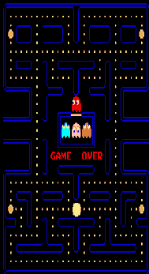
240-492
Games Programming with Java
Montri Karnjanadecha
Andrew Davison

Slide 2
Chapter 2
Introduction to
Artificial Intelligence
<footer>240-492 Games Programming with Java
::: AI :::

Slide 3
Outline
Definition of Artificial Intelligence
Uninformed Search Methods
Informed Search Methods
Game AI

Slide 4
What is AI?
Systems that think like humans
  “The exciting new effort to make computer think ….. machine with minds, in the full an literal sense”
  “Activities that we associate with human thinking, activities such as decision-making, problem-solving, learning…”
Systems that think rationally
  “The study of mental faculties through the use of computational models”
  “The study of the computations that make it possible to perceive, reason, and act”

Slide 5
That is AI? (cont’d)
Systems that act like humans
  “The art of creating machines that perform functions that require intelligence when performed by people”
  “The study of how to make computers do things at which, at the moment, people are better”
Systems that act rationally
  “A field of study that seeks to explain and emulate intelligent behavior in terms of computational processes”
  “The branch of computer science that is concerned with the automation of intelligent behavior”

Slide 6
What is AI? (cont’d)
To make the computer think

Slide 7
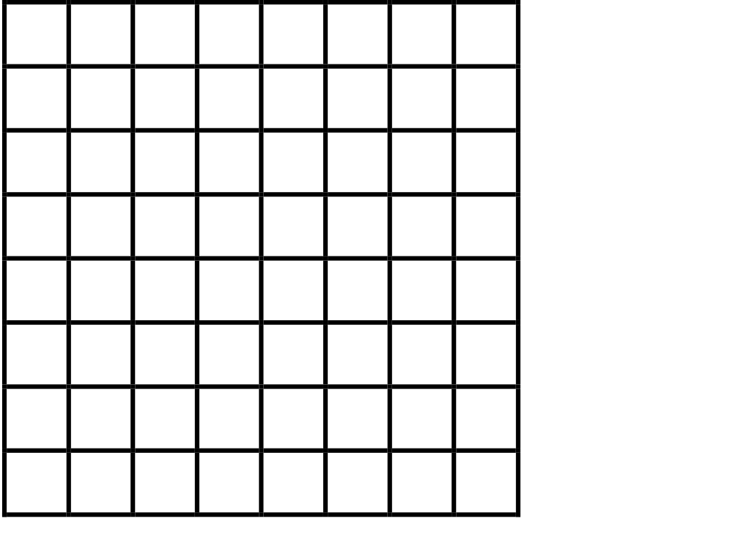
Simple AI Stuff
A board with tokens

Slide 8
Closing the gap
A board with tokens

Slide 9
Chase Algorithm
if (lx!=dx) // check for non-matching x
{
if (lx>dx)
{
lx--; // higher x, so decrease it
}
else
{
lx++; // lower x, so increase it
}
}
if (ly!=dy) // check for non-matching y
{
if (ly>dy)
{
ly--; // higher y, so decrease it
}
else
{
ly++; // lower y, so increase it
}
}

Slide 10
Evade Algorithm
if (lx!=dx) // check for non-matching x
{
if (lx>dx)
{
lx++; // higher x, so increase it
}
else
{
lx--; // lower x, so decrease it
}
}
if (ly!=dy) // check for non-matching y
{
if (ly>dy)
{
ly++; // higher y, so increase it
}
else
{
ly--; // lower y, so decrease it
}
}

Slide 11
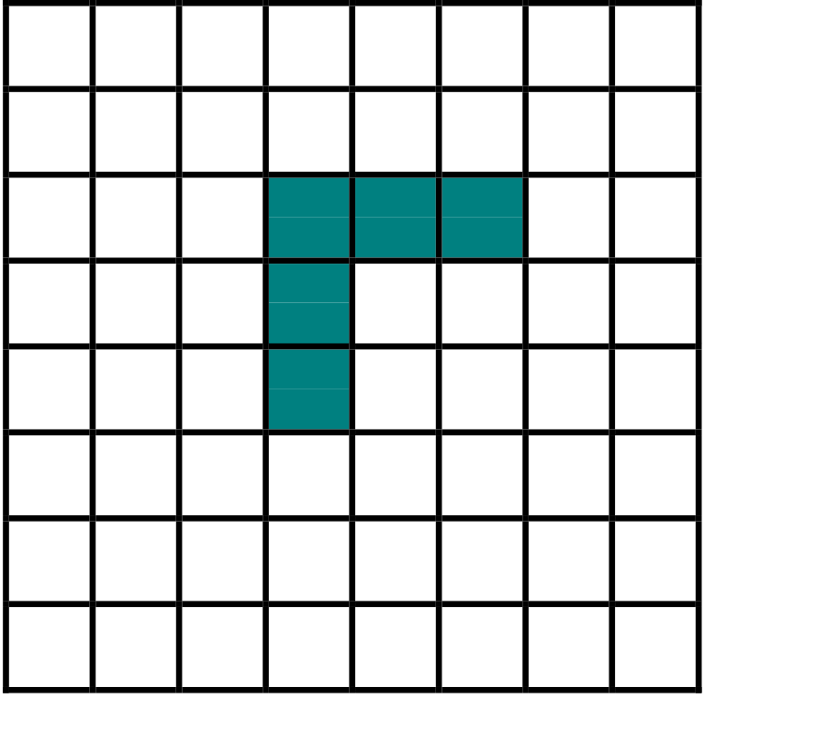
Chasing Struck
The simple chase algorithm fails when unmovable blocks are presented

Slide 12
Evading the Obstacle

Slide 13
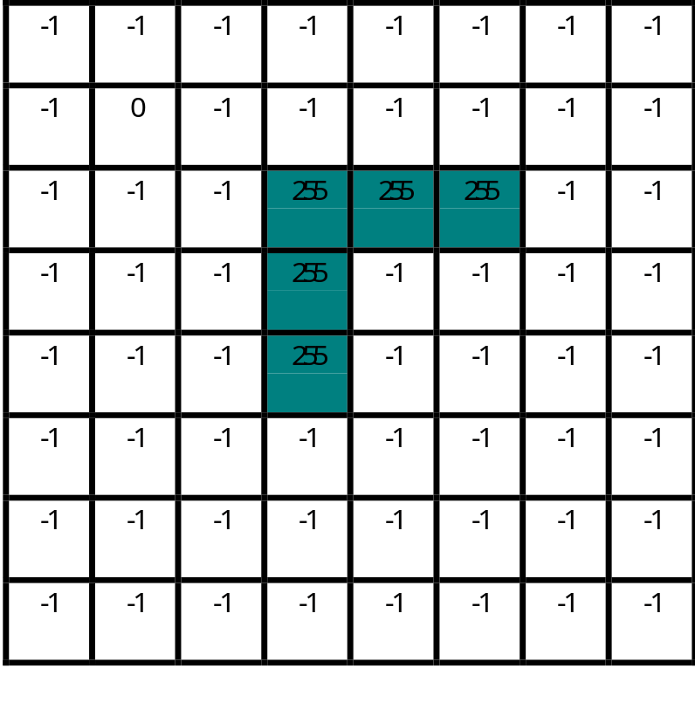
More Advanced Pathfinding
A* pathfinding algorithm
1. Create a 2-D integer array as large as the map size
2. Fill all cells with -1 (-1 means not tested yet)
3. For any “blocked” cell, put a large number (e.g. 255)
4. Place a 0 in the target cell

Slide 14
A* pathfinding algorithm
Path finding
5. Start at the target cell (the known distance cell)
6. Determine valid adjacent cells
7. Give the adjacent cells a known distance value
8. Repeat step 5
Stop Citeria
1. No adjacent cells
2. The cell of origin gets filled in

Slide 15

When It’s All Done
Path finding
5. Start at the target cell (the known distance cell)
6. Determine valid adjacent cells
7. Give the adjacent cells a known distance value
8. Repeat step 5
Stop Criteria
1. No adjacent cells
2. The cell of origin gets filled in

Slide 16
Backtracking
In order for the red piece to capture the green piece, the red piece must move to lower-values cells-- from 7->6, 6-> 5, 5->4, 4->3, 3->2, 2->1 and 1->0

