Slide 1
Tactical AI
Michael Zyda
Zyda@isi.edu

Slide 2
Week 5 – Autonomous Game Play & Interaction
Project 5: Develop an AI client that fights/plays against the live players in the networked game using the internal representation of the state of the game built for project 4. Use a finite state machine architecture for this.
Reading: http://www.aiwisdom.com/bytopic_statemachines.html

Slide 3
Week 6 – Genetic Algorithms & Evolutionary Behaviors
Project 6: Continue developing the fight/play behavior of your AI client. Consider how to develop clients that can dynamically evolve and develop new tactics and behaviors. Consider developing an entire evolving architecture of characters that fight/play against the live characters in the networked game.
Reading: http://www.aiwisdom.com/bytopic_genetic.html
http://www.aiwisdom.com/bytopic_genetic.html
http://aiwisdom.com/bytopic_strategy.html
http://aiwisdom.com/bytopic_strategy.html

Slide 4
Strategic and Tactical Reasoning with Waypoints
Lars Lidén (Valve Software)
AI Game Programming Wisdom, 2002.
Topics: Movement, Strategy, Tactical; Genres: FPS, Action
  Abstract: Non-player characters (NPCs) commonly use waypoints for navigation through their virtual world.
  This article will demonstrate how preprocessing the relationships between these waypoints can be used to dynamically generate combat tactics for NPCs in a first-person shooter or action adventure game.
  By precalculating and storing tactical information about the relationship between waypoints in a bit string class, NPCs can quickly find valuable tactical positions and exploit their environment.
  Issues discussed include fast map analysis, safe pathfinding, using visibility, intelligent attack positioning, flanking, static waypoint analysis, pinch points, squad tactics, limitations, and advanced issues.

Slide 5
The big idea …
How to preprocess the terrain so that non-playing characters (NPCs) can show intelligence dynamically during combat.
  By precalculating and storing tactical information about the relationship between waypoints in a bit-string class, NPCs can quickly find valuable tactical positions and exploit their environment.

Slide 6
Instrumenting the world …
It is common practice in 3D games for level designers to place waypoints in their levels for NPCs to navigate the environment.
These waypoints serve as nodes in a node-graph that represents all the ways in which an NPC can navigate through the world.
Connections between nodes in the node-graph are either generated automatically in a preprocessing step, or placed manually by a level designer.
Pathfinding algorithms such as A* are then used to generate routes through the node-graph.

Slide 7
As the waypoints used for navigation inherently contain information about the relationship between positions in the world, they can be exploited to efficiently calculate information about the strategic value of particular world locations.
A closer look at a node-graph reveals that in addition to pathfinding information, it also contains data about the approachability of each waypoint, whether a waypoint is a dead end, and even if a waypoint is the sole approach to a particular region.

Slide 8
Furthermore, with a little extra work, the node-graph can be used to generate static visibility information between nodes.
Precalculating whether one-waypoint has line-of-sight to another allows for fast runtime evaluation of map locations.

Slide 9
Fast map analysis
For the real-time evauation of a map to be effective, an economical method for assessing the danger and strategic value of each location in the map must be employed.
This is of particular importance when an NPC has to contend with multiple enemies, as any assessment must take the visibility and location of each enemy into account.
The computational cost of such a method must not become prohibitive as the number of nodes and enemies increases.

Slide 10
An effective technique is to store connectivity and visibility information in a bit sting class that consists of a string of bits of arbitrary length with operatiors for Boolean operations such as <and>, <or>, and <not>.
For a node-graph Nn, consisting of n nodes, connectivity is represented by a set of n bit strings, Cn, in which the length of each bit string corresponds to the number of nodes in the node-graph, and each bit represents the connectivity from node n to every other node in the node-graph.

Slide 11
Network visibility is represented by a set of bit strings, Wn, in which the length of each bit string corresponds to the number of nodes in the node-graph, and each bit represents the visibility from node n to every other node in the node-graph.
If B(Ei, t) is a function that returns the nearest waypoint for enemy i at time t, then the visibility of an enemy i is given by the bit string:
  Vit = WB(Ei,t)
  This is a bit 1 if visible, or 0 if not visible.

Slide 12
Using visibility
The most straightforward use of visibility is to determine which locations are potentially safe, and those that are likely to be dangerous.
For an NPC with a set of k enemies Ek, the set of dangerous waypoints is determined by <or>ing the visibility bit strings for each enemy’s nearest waypoint:
V = Y Vj, (j=0,k)
V is then the set of waypoints from which the NPC might have a line-of-sight (LOS) to shoot at an enemy.
  To determine LOS, each enemy must still be checked explicitly, as visibility bit strings tell us only about the visibility of each enemy’s nearest waypoint, not their actual position. BUT that is a fast way to determine for whom such a calculation should be made.

Slide 13
Safe nodes are given by the inverse, V-Hat.
These nodes are good candidates for safe locations to which an NPC can flee or reload safely.

Slide 14
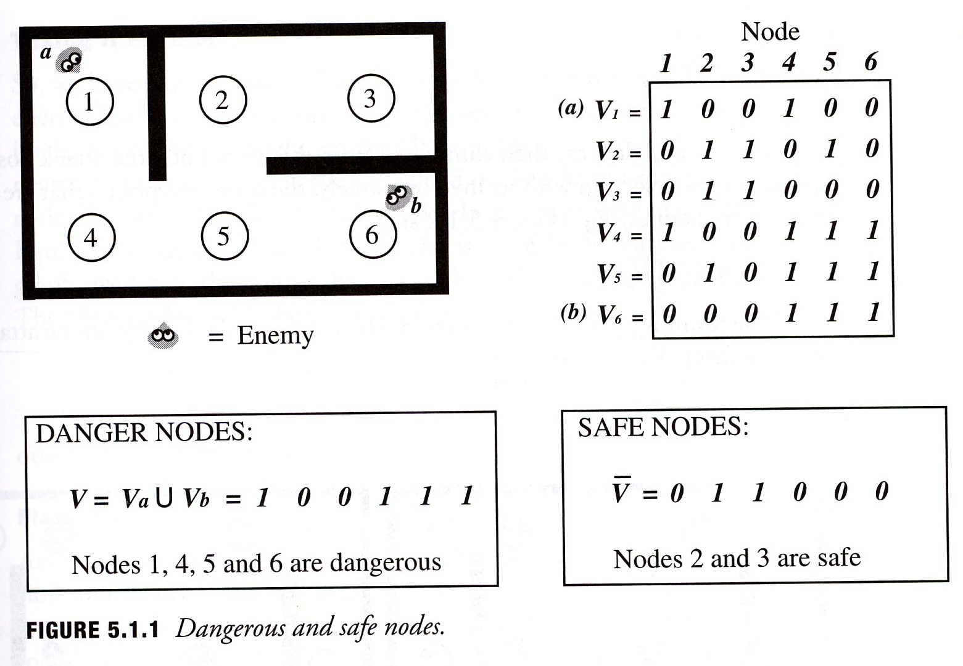

Slide 15
Safe Pathfinding
Another straightforward use of visibility information is to find safe paths for an NPC to traverse the environment.
Most pathfinding algorithms use a cost function to determine the shortest path through the node-graph.
If a penalty is added to transitions that pass through nodes that are designated as not being safe, the pathfinding algorithm will be biased toward finding safe paths for the NPC.
Depending on the size of the penalty given to dangerous waypoints, the NPC can be made to favor either: (1) safe paths when they aren’t particularly longer than a regular path, or (2) safe paths at any cost, even when they take the NPC well out of its way.

Slide 16
Intelligent attack positioning
Although an all-out frontal assault can have its place, it isn’t always the most intelligent form of attack.
The set of dangerous waypoints, V, can give us locations from which an NPC can attack its enemies; it does nothing to protect the NPC from attack.
A more sophisticated strategy would be to find a location from which the NPC can attack a particular enemy that also protects it from simultaneous attack by other enemies.
Fortunately, determining such locations is straightforward and can be computed quickly.

Slide 17
The set of potential waypoints from which a particular enemy, Ea, can be attacked is given by the set of nodes that are visible to that enemy (Fig. 5.1.2 Step 1):
Va = WB(Ea)
Nodes that are visible to the NPC’s other enemies are determined by <or>ing their individual visibilities (Fig. 5.1.2 Step 2)
These waypoints are then eliminated from the set of potential attack positions, by taking the intersection with its inverse; namely the set of waypoints that are safe from the other enemies.
The result is a set of locations from which a particular enemy can be attacked that are safe from all other enemies (see Figure).

Slide 18
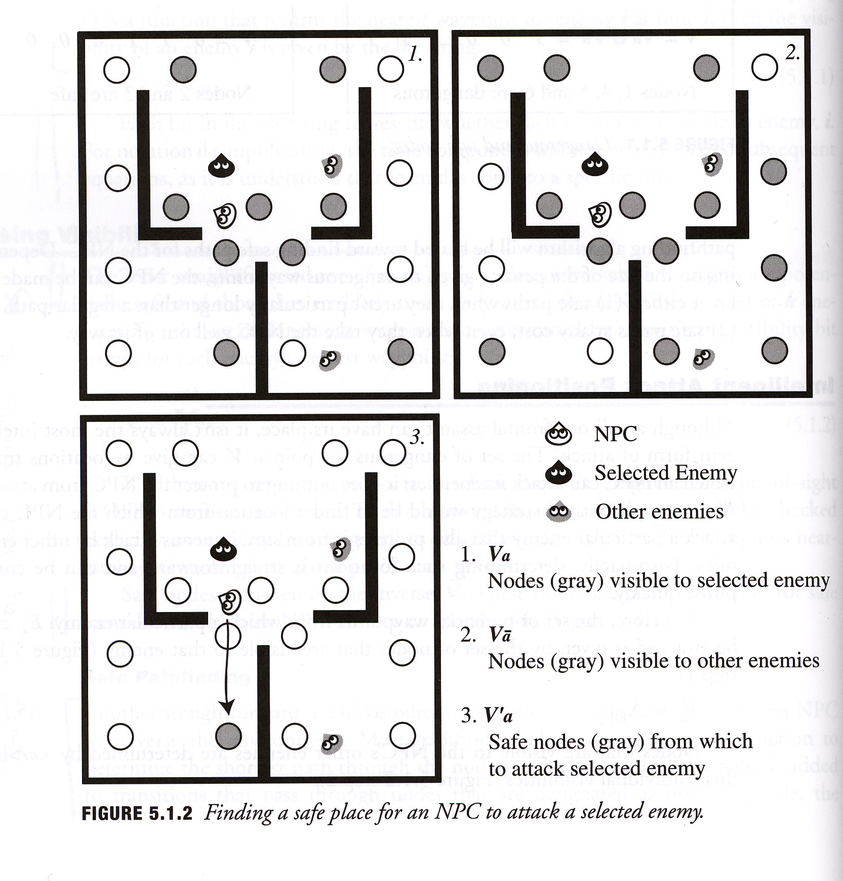

Slide 19
Taking it further …
So, we have a quick way to find candidate locations from which to attack a particular enemy that is also safe from other enemies.
Some other strategies …
It would be nice if our attack location had safety nearby in case our NPC needed to reload or the selected enemy suddenly launched a rocket in our NPC’s direction.
This is an easy qualification to add.

Slide 20
From Equation 5.1.2, the set of all safe nodes is given by V-Hat.
From the node-graph, we know the connectivity of each of the candidate attack nodes, namely Ca.
Therefore, nodes in Va should be eliminated if:
Ca I V-Hat = 0
The reamining locations have LOS to the selected enemy, are protected from other enemies, and have nearby locations to take cover from all enemies.

Slide 21
Flanking
Another interesting combat behavior is that of flanking.
Flanking takes both the position and facing direction of an enemy into account, the goal being to surprise an enemy by attacking from behind.
The procedure for finding potential flanking attack locations is virtually identical to that of finding normal attack locations.
The only difference being that before eliminating nodes that are visible to other enemies, the set of potential attack locations, Va, should be culled to remove waypoints that the selected enemy is facing.

Slide 22
Once a flanking waypoint has been selected, if the pathfinding algorithm has been weighted to use safe waypoints, the NPC will look for a path that is out of sight of the selected enemy.
The resulting behavior will be that of the NPC sneaking around behind to attack its enemy.

Slide 23
Static waypoint analysis
Unless cheating is employed, its likely that an NPC doesn’t have perfect knowledge about the locations of each of its enemies.
Additonally, an NPC might want to place itself in a strategic location before enemies arrive.
Consequently, in addition to finding tactical positions for a set of enemy locations during runtime, it is also useful to characterize each waypoint’s strategic value in a static environment.
Such characterization can be done in a preprocessing step before the game is played.

Slide 24
As we have seen, in quantifying a location’s strategic value, visibility is perhaps the most important factor.
Highly visibile locations are dangerous, as they can be attacked from many positions.
One can readily identify such locations by looking at visibility between nodes in the node-graph.
The danger of each node can be characterized by giving it a weight based on the number of other nodes in the graph that have visibility to that node (Fig 5.1.3 step 1).
If the weights are used to adjust the pathfinding cost function, the NPC will prefer to take paths that are less likely to be visible to an enemy.

Slide 25
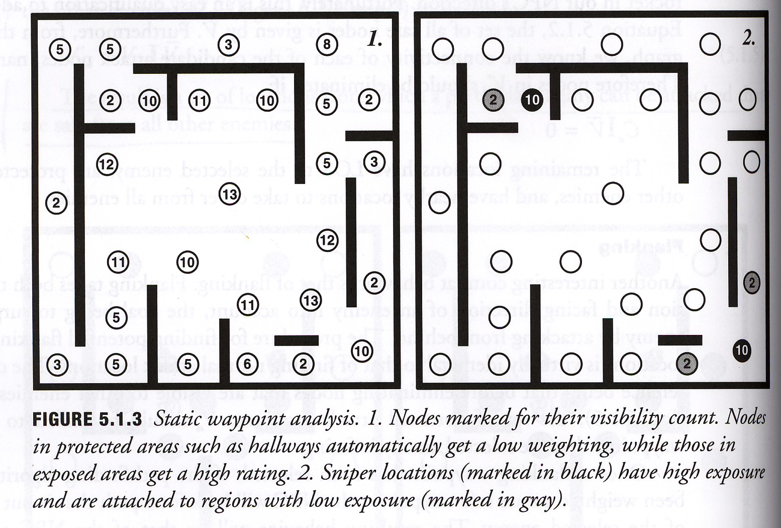

Slide 26
Pinch points & squad tactics
Observation of human players reveals that experienced FPS players anticipate the actions of their oponents.
For example, if an enemy enters a room with a single exit, rather than follow the enemy into that room, an experienced player will wait just around the corner, setting up an ambush at the exit point.

Slide 27
One can readily precalculate such tactical pinch-points by analyzing the node-graph (Fig. 5.1.4 Step 1)
For each node, Ni, the the node-graph with only two neighbors:
  Temporarily eliminate node, N, from the graph, call its neighbors as A and B.
  If both A and B are connected to large regions, N is not a pinch point; try another N.
  Attempt to find a path between A and B.
  If path exists, N is not a pinch point; try another N.
  Call the node connected to the larger region, O (for outside).
  Call the node connected to the smaller region, I (for inside).

Slide 28
To find potential ambush locations for N, we need a waypoint that has LOS to O and not N.
This is simply: A = V0 I V-Hatn
When an enemy enters the region gated by node I, and NPC can set up an ambush at any of the nodes in the set A.
See the figure …

Slide 29
