Slide 1
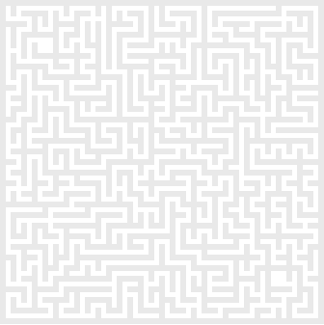
CS 5400 Graduate Seminar
Comparing, Analyzing and Discussing about A* Path Finding and Fringe Search Algorithms in Computer Game Development
Instructor: Dr. Ruizhong Wei Student: Zhongjun Zhang
Lakehead University, Thunder Bay

Slide 2
Abstract
Pathfinding on a map is a fundamental problem in many applications, including animals, human beings, robotics and computer games. Typically a grid is put over the map where each cell on the grid forms a unique state. A two dimension grid based search algorithm, such as A* or IDA*(Iterative deepening depth-first search), is then used for finding the optimal (shortest) path. In this presentation, I will compare and analyze the search behaviour of A*, Memory-Enhanced IDA* and Fringe Search which was developed in 2005. I will also discuss the Binary Space Partitioning (PSB) tree’s application in pathfinding.

Slide 3
Contents
Introduction
A Note on Human Path Finding
Heuristics and Algorithms
Terminology
Two Examples
Five Variations of A* Pathfinding Algorithms
A* Pathfinding Algorithm
  Dijkstra's Algorithm and Best-First-Search
  A* Search Algorithm
  Heuristics Function h(n)
  Summary of A* Algorithm
Fringe Search: Beating A* at Pathfinding on Game Maps
IDA*, -- Iterative Deepening depth-first search
A* has three advantages over IDA*
Memory-Enhanced IDA* Algorithm
Fringe Search
Conclusions and Future Work
Demo

Slide 4
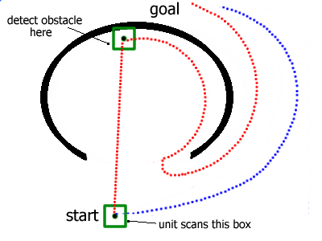
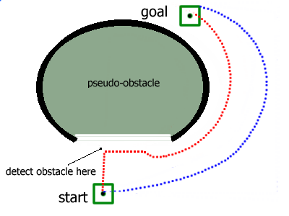
Introduction
Human beings, Animals and Computer Games’ behavior in Path Finding.
It is very important to find the best path before starting.
The time spent on both finding the better path and going there should be less than by going randomly.

Slide 5
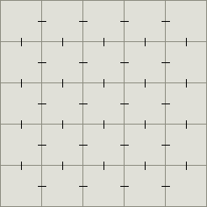
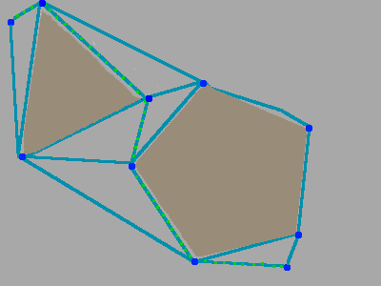
Polygonal maps
One form of graph that you may want to use if your game does not have terrain, but has polygonal obstacles, is based on "navigation points".
In this diagram, I've marked the corners of every obstacle with a blue dot. In addition, the start and end points are blue dots. These navigation points are the nodes to feed to A*. In addition, A* needs to know which points are connected. To determine this, look at each pair and decide whether the straight line between the two points is unobstructed. In this diagram, these edges are the light blue lines. The third piece of information A* needs is distances between the points. Depending on how your units move, that can be a Manhattan distance, diagonal grid distance, or straight line distance.
Basic Simplify
The pathfinding algorithms from computer science textbooks work on graphs in the
mathematical sense―a set of vertices with edges connecting them.
The two-dimensional grids tiled game map can be considered a graph with each tile being a
vertex and edges drawn between tiles that are adjacent to each other:

Slide 6
A Note on Human Path Finding
The Context
Knowing the location of the target
Target is static or dynamic(moving)
Tracing a path with or without a map
With or without obstacles
Results: 1. Find the target
2. Find more than one of the same targets.
3. Can’t find the the target because the target doesn’t exist or if an obstacle blocks the path.
Algorithm and Strategy
The random method, but remembering the path I had walked.
The crash and turn path finding algorithm
Simple pathfinding algorithm in maze
Advanced algorithm

Slide 7
Terminology
A path is a route between two points. It may also be used similarly, as a logical route to a desired state or destination.
A node is a state that the problem's world can be in. In pathfinding a node would be just a 2d coordinate of where we are at the present time.
Next, all the nodes are arranged in a graph where links between nodes represent valid steps in solving the problem. These links are known as edges.
Path planning is the art of deciding which route to take, based on and expressed in terms of the current internal representation of the terrain.
Path finding is the execution of this theoretical route, by translating the plan from the internal representation in terms of physical movement in the environment.
Cost is the computer CPU and memory usage when the pathfinding program runs.

Slide 8
Heuristics and Algorithms
An algorithm is a set of steps which you can follow to solve a problem, which always works for valid input.
A heuristic is when it gives up one of the steps of an algorithm to gamble on one succeeding path.
Often, one can find specially crafted problem instances where the heuristic will in fact produce very bad results or run very slowly; however, these instances might never occur in practice because of their special structure. Therefore, the use of heuristics is very common in real world implementations.

Slide 9
Objective of Path Finding
How to get from place A to B on the map
How to get around obstacles in the way
How to find the shortest possible path
How to find the path quickly
A example:
http://www.tonypa.pri.ee/tbw/tut22.html

Slide 10
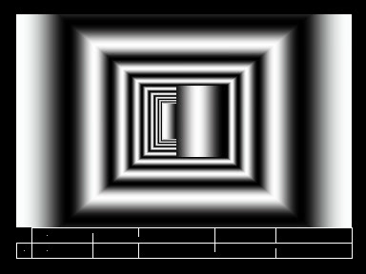
An Animation of Path Finding

Slide 11
Overview of path finding methods
Through the years, a few different approaches to the problem of finding paths through space have been proposed within various disciplines where the problem naturally occurs. Most of these lead to some sort of graph search problem. Here is given a very brief introduction to the most common of these approaches.
Local Path Finding Algorithm:
Local approaches try to find a path to a destination by analyzing the surroundings of the current position only.
Global algorithms, on the other hand, analyze the area as a whole and trace the best path using all the information, not only the surroundings.

Slide 12
Five Variations of A* Pathfinding Algorithms
Beam search
One drawback is that you have to keep your set sorted to do this, which limits the kinds of data structures you’d choose.
2. Dynamic weighting
3. Bandwidth search
4. Bi-directional search
5. Dynamic A* and Lifelong Planning A*

Slide 13
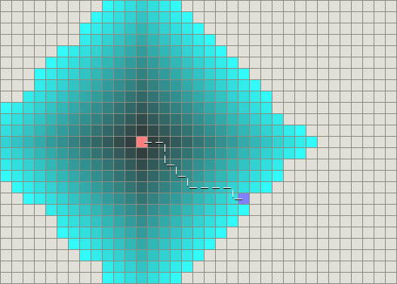
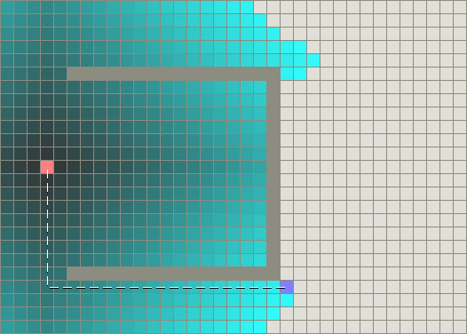
Dijkstra's Algorithm (1959)
It is also called Breath-First Search
Named after its inventor, Dutch computer scientist Edsger Dijkstra, is an algorithm that solves the single-source shortest path problem for a directed graph with nonnegative edge weights.

Slide 14
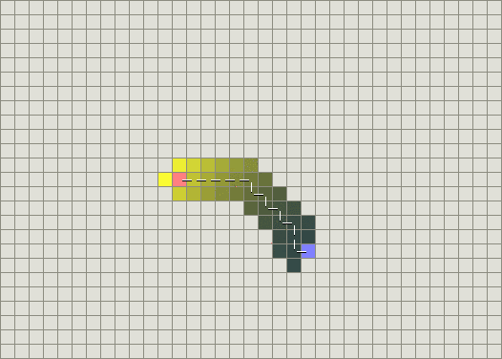
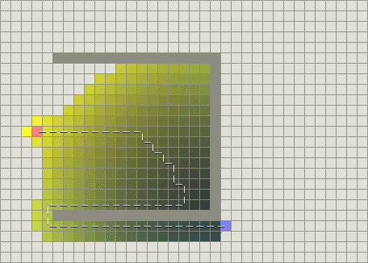
Best-First-Search
Best-first search is a search algorithm which optimizes depth-first search by expanding the most promising node chosen according to a rule.

Slide 15
A* Algorithm
Path-finding - A* algorithm is used by units to find their way around in the environment.
Definition:
The A* search algorithm (pronounced "A star") is a graph search algorithm that finds a path from a given initial node to a given goal node (or one passing a given goal test). It employs a "heuristic estimate" that ranks each node by an estimate of the best route that goes through that node. It visits the nodes in order of this heuristic estimate. The A* algorithm is therefore an example of a best-first search.
A* is not guaranteed to perform better than simpler search algorithms. In a maze-like environment, the only way to reach your destination might be to travel south first and eventually turn around. In this case trying nodes closer to your destination first may cost you time.

Slide 16
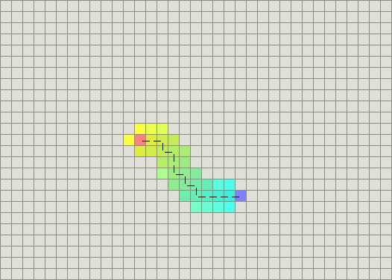
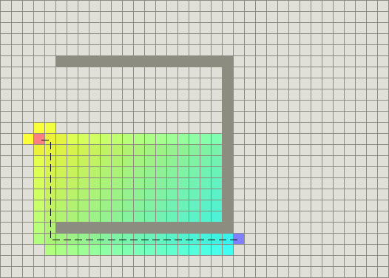
A* (A Star) Demonstration
c

Slide 17
A* Algorithm (continued)
What is A-Star?
The secret to its success is that it combines the pieces of information that Dijkstra's algorithm uses (favoring vertices that are close to the starting point) and information that Best-First-Search (BFS) uses (favoring vertices that are close to the goal).
The problems that A-Star is best used for are those that can be represented as a state space.
What A-Star does is generate and process the successor states in a certain way.
A* balances the two as it moves from the starting point to the goal.
Each time it goes through the main loop, it examines the vertex n that has the lowest f(n) = g(n) + h(n).

Slide 18
Details of the A* Algorithm
Each node n maintains the following:
g(n) = the cost of getting from the initial node to n.
h(n) = the estimate, according to the heuristic function, of the cost of getting from n to the goal node.
f(n) = g(n) + h(n); intuitively, this is the estimate of the best solution that goes through n.

Slide 19
Details of the A* Algorithm (Continue)
Each node also maintains a pointer to its parent, so that later we can retrieve the best solution found, if one is found.
A-Star has a main loop that repeatedly gets the node, call it n, with the lowest f(n) value from the OPEN list.
In other words, the node that we think is the most likely to contain the optimal solution.
If n is the goal node, then we are done, and all that is left to do is return the solution by backtracking from n.
Otherwise, we remove n from the OPEN list and add it to the CLOSED list. Next, we generate all the possible successor nodes of n.

Slide 20
Initialize OPEN list
Initialize CLOSED list
Create goal node; call it node_goal
Create start node; call it node_start
Add node_start to the OPEN list
while the OPEN list is not empty
{
Get node n off the OPEN list with the lowest f(n)
Add n to the CLOSED list
if n is the same as node_goal we have found the solution; return Solution(n)
Generate each successor node n' of n
for each successor node n' of n
{
Set the parent of n' to n
Set h(n') to be the heuristically estimate distance to
Set g(n') to be g(n) plus the cost to get to n' from n
Set f(n') to be g(n') plus h(n')
if n' is on the OPEN list and the existing one is as good
or better then discard n' and continue
if n' is on the CLOSED list and the existing one is as
good or better then discard n' and continue
Remove occurrences of n' from OPEN and CLOSED
Add n' to the OPEN list
}
}
 | A* Pseudocode

Slide 21
A* Algorithm and the Heuristic Function
The success of A-Star rests heavily on the heuristic function chosen.
To guarantee that we will find the optimal solution, if one exists, the heuristic must be admissible.
Another issue is how quickly the heuristic function can be computed?

Slide 22
The Heuristic Function h(n)
A*'s Use of the Heuristic
The heuristic can be used to control A*'s behaviour.
At one extreme, if h(n) is 0, then only g(n) plays a role, and A* turns into Dijkstra's algorithm, which is guaranteed to find the shortest path.
If h(n) is always lower than (or equal to) the cost of moving from n to the goal, then A* is guaranteed to find the shortest path. The lower h(n) is, the more node A* expands, making it slower.
If h(n) is exactly equal to the cost of moving from n to the goal, then A* will only follow the best path and never expand anything else, making it very fast. Although you can't make this happen in all cases, you can make it exact in some special cases. It's nice to know that given exact information, A* will behave perfectly.
If h(n) is sometimes greater than the cost of moving from n to the goal, then A* is not guaranteed to find the shortest path, but it can run faster.
At the other extreme, if h(n) is a very high relative to g(n), then only h(n) plays a role, and A* turns into a Best-First-Search.

Slide 23
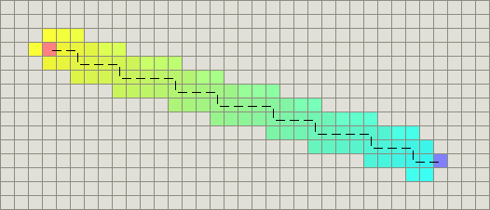
The Heuristic Function h(n)
Manhattan distance
h(n) = D * (abs(n.x-goal.x) + abs(n.y-goal.y))

Slide 24
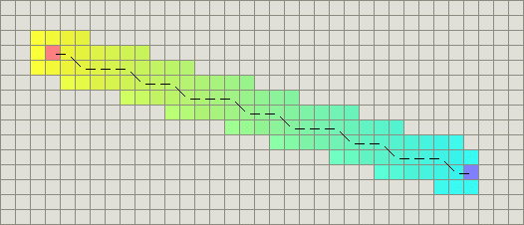
The Heuristic Function h(n)
Diagonal distance
h(n) = D * max(abs(n.x-goal.x), abs(n.y-goal.y))
h_diagonal(n) = min(abs(n.x-goal.x), abs(n.y-goal.y))
h_straight(n) = (abs(n.x-goal.x) + abs(n.y-goal.y))
h(n) = D2 * h_diagonal(n) + D * (h_straight(n) - 2*h_diagonal(n)))

Slide 25
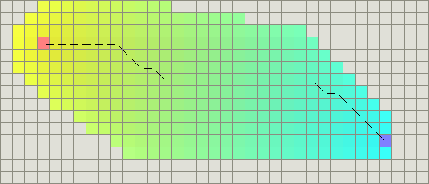
Euclidean distance h(n) = D * sqrt((n.x-goal.x)^2 + (n.y-goal.y)^2)

Slide 26
Conclusions of A* Algorithm
There is much on-going discussion and research about
A-Star. Topics being examined include the value and
feasibility of various heuristics, specific implementation
issues such as optimal data structures, and novel
situations where A-Star can be applied. For more
information, please refer to the references section below
at the end. Hopefully this has been an enlightening
introduction to one of the most useful search algorithms
around.

Slide 27
IDA* Pathfinding Algorithm
Iterative deepening depth-first search is a states-space search strategy, that visits each node in the search tree in the same order as depth-first search but does so by gradually increasing the maximum depth limit of the search iteratively. At each iteration, the maximum depth is increased and the search is re-run. This is repeated until the depth limit reaches d, the depth of the shallowest goal state. Iterative Deepening can be effectively considered as the repeated application of depth-limited search, increasing the bound with each iteration.

Slide 28
A* has three advantages over IDA* that allows it to build smaller search trees:
IDA*cannot detect repeated states, whereas A* benefits from the information contained in the Open and Closed lists to avoid repeating search effort.
IDA*’s iterative deepening results in the search repeatedly visiting states as it reconstructs the frontier(leaf nodes) of the search. A*’s Open List maintains the search frontier.
IDA* uses a left-to-right traversal of the search frontier. A* maintains the frontier in sorted order, expanding nodes in a best-first manner.

Slide 29
Memory-Enhanced IDA* Algorithm (ME-IDA)
ME-IDA* uses a transposition table that is large enough to store information about all states. The table keeps track of the length of the shortest path found so far to each state( g value) and the backed up f-value.
There are three advantages to store this information:
First, a node is re-expanded only if entered via a shorter path (g(s)<gcached(s))
Second, by storing the minimum backed-up f-value in the table
Third, to the best of our knowledge, has not been reported in the literature before. When using non-uniform edge costs it is possible that ME-IDA* reduces the number of iterations by backing up a larger f-limit bound for the next iteration.

Slide 30
Fringe Search: Beating A* at Pathfinding on Game Maps
(developed by Path finding research group, University of Albert in 2005)
Fringe Search is a new algorithm that spans the space/time trade-off between A* and IDA*.
Fringe Search is generalized into a search framework that encompasses many of the important single-agent search algorithms.
Experimental results evaluating A*, memory enhanced IDA*, and Fringe Search. In our test domain, pathfinding in computer games, Fringe Search is shown to run significantly faster than a highly optimized version of A*, even though it examines considerably more nodes.
The research group use the standard single-agent notation: g, the cost of the search path from the start node to the current node, h is the heuristic estimate of the path cost from the current node to the goal node; f = g + h; and h* is the real path cost to the goal.

Slide 31
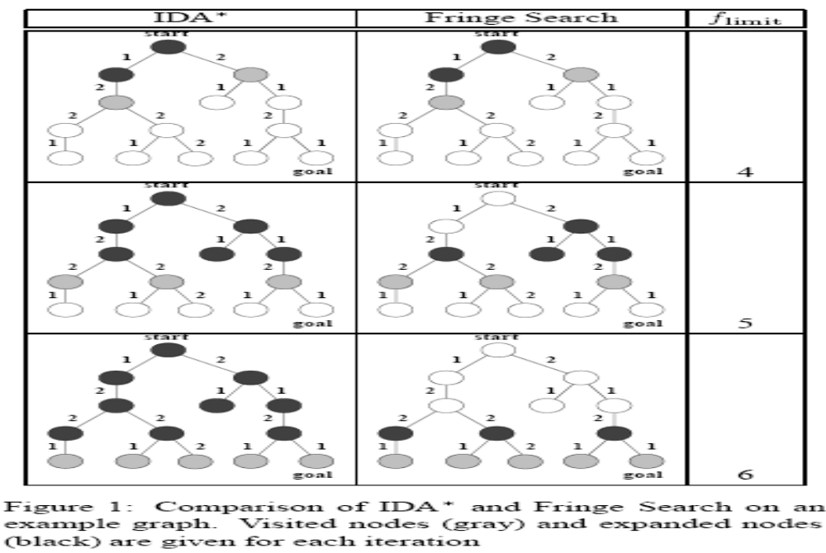

Slide 32
Implementation of Fringe Search Iterating
The node at the head of the now list (head) is examined and
one of the following actions is taken:
1. If f(head) is greater than the threshold then head is
removed from now and placed at the end of later.
In other words, we do not need to consider head on
this iteration (we only visited head), so we save it for
consideration in the next iteration.
2. If f(head) is less or equal than the threshold then we
need to consider head’s children (expand head). Add
the children of head to the front of now. Node head
is then discarded.

Slide 33
Fringe Search vs. A*
The major performance differences in the two
algorithms can be reduced to three factors:
1. Fringe Search may visit nodes that are irrelevant for
the current iteration (the cost for each such node is a
small constant).
2. A* must insert nodes into a sorted Open List (the cost
of the insertion can be logarithmic in the length of the
list).
3. A*’s ordering means that it is more likely to find a
goal state sooner than the Fringe Search.

Slide 34
Figure 2: Pseudo-code for
Fringe Search
Developed by Dr. Jonathan Schaeffer’s research group, University of Alberta in 2005
Initialize:
Fringe F ← (s)
Cache C[start] ← (0, null),
C[n] ← null for n _= start
flimit ← h(start)
found ← false
Repeat until found = true or F empty
fmin←∞ Iterate over nodes n ∈ F from left to right:
(g, parent) ← C[n]
f ← g + h(n)
Iff > flimit
fmin ← min(f, fmin)
continue
If n = goal
found ← true
break
Iterate over s ∈ successors(n) from right to left:
gs ← g + cost(n, s)
If C[s] _= null
(g_, parent) ← C[s]
If gs ≥ g_
continue
If F contains s
Remove s from F
Insert s into F after n
C[s] ← (gs, n)
Remove n from F
flimit ← fmin
If found = true
Construct path from parent nodes in cache

Slide 35
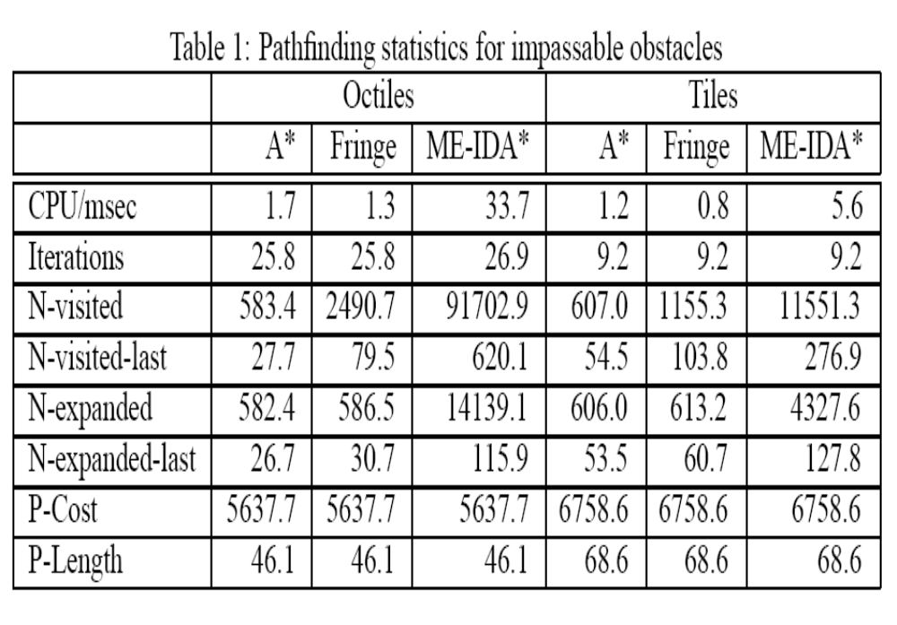

Slide 36
Fringe Search vs. ME-IDA*
The main motivation for the Fringe Search algorithm was to eliminate IDA*’s overhead of re-expanding the internal nodes in each and every iteration.
In general, the error increases as the game maps get more sophisticated (larger and/or more obstacles). We can see that as the heuristic error increases, the better the Fringe Search algorithm performs relative to ME-IDA*.
The data shows that Fringe Search is substantially faster than ME-IDA* under all models (by roughly an order of magnitude). The savings come from the huge reduction in visited and expanded nodes.

Slide 37
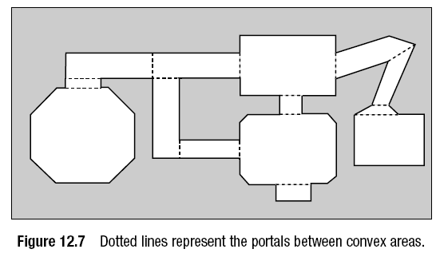
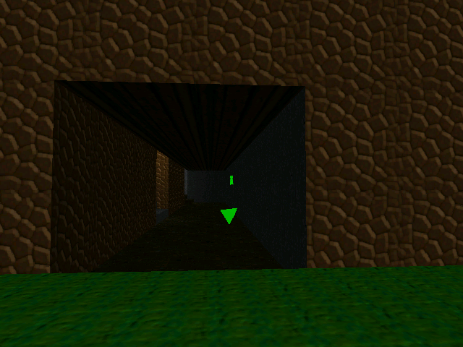
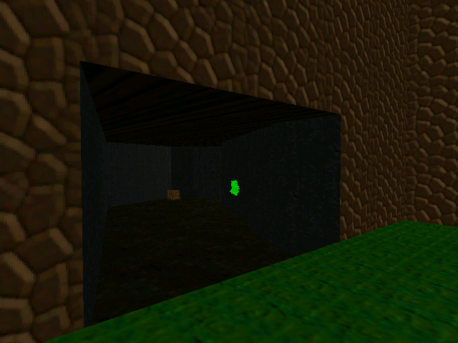
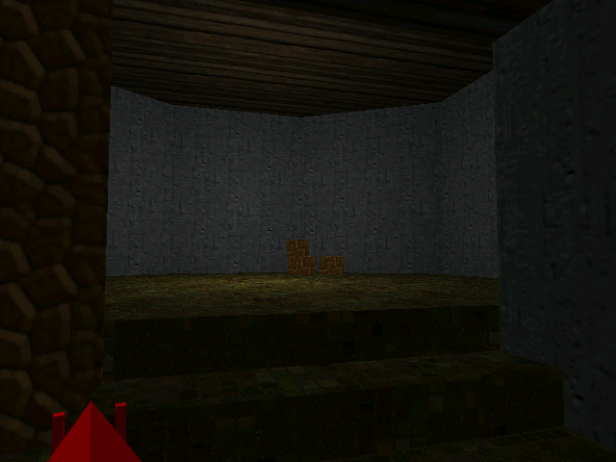
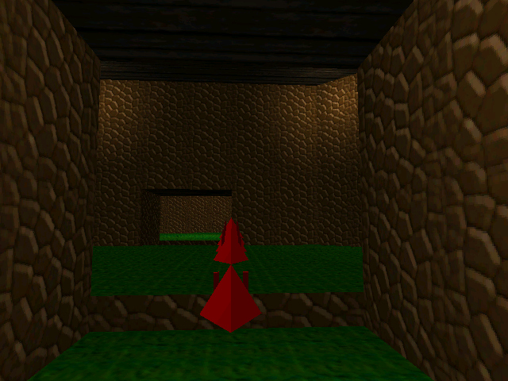
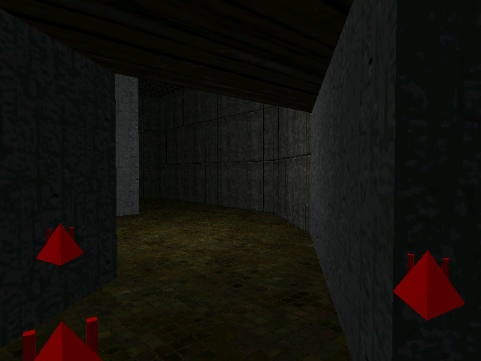

Slide 38
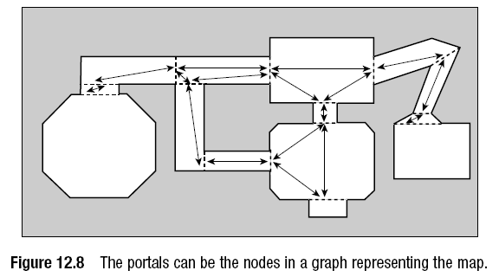
PSB tree’s application in pathfinding

Slide 39
Conclusions
Fringe Search out-performs optimized versions of A* and ME-IDA*. Significant margins when pathfinding on grids typical of computer-game worlds, in comparison to ME-IDA* which the benefits come from avoiding repeatedly expanding interior nodes; compared to A*, Fringe Search avoids the overhead of maintaining a sorted open list. Although visiting more nodes than A* does, the low overhead per node visit in the Fringe Search algorithm results in an overall improved running time.
Since we ran the above experiments we have spent substantial time optimizing our already highly-optimized A* implementation even further.
Despite of all that effort A* is still not competitive to our initial Fringe implementation, although the gap has closed somewhat (the speedup is ca.10% for octiles and 20% for tiles). This is a testimony of one of the greatest strengths of the Fringe search, its simplicity.
Future Work
As for future work, one can possibly do better than Fringe Search. Although the algorithm is very optimal with respect to the size of the tree explored (since it can mimic A*), as this paper shows there is much to be gained by a well-crafted implementation.

Slide 40
References
1. Björnsson, Y. Enzenberger, Holte M. R. , and Schaeffer J. “Fringe Search: Beating A* at Pathfinding on Game Maps”, IEEE Symposium on Computational Intelligence and Games, Essex, 2005
(http://www.cs.ualberta.ca/~games/pathfind/publications/cig2005.pdf )
2. Brackeen, D. Developing Games in Java. Indianapolis: New Riders, 2004
3. Dalmau, D. S. Core Techniques and Algorithms in Game Programming. Indianapolis: New Riders, 2004
4.Encyclopedia:
http://en.wikipedia.org/wiki/A%2A
5.“Game and Game Programming”
http://www.gamespp.com/algorithms/pathfinding
6. Lester, P. A*寻路初探 GameDev.net
http://blog.vckbase.com/panic/archive/2005/03/20/3778.html
7. Pa, T. “Tile Based Games”
http://www.tonypa.pri.ee/tbw/tut22.html
8. Patel, A. J. “Amit's Thoughts on Path-Finding and A-Star” 2003
http://theory.stanford.edu/~amitp/GameProgramming
9. Schaeffer, J, “Pathfinding in Computer Games”
http://www.cs.ualberta.ca/~games/pathfind
10. Tsai, B. “Introduction to the A-Star Algorithm”, http://upe.acm.jhu.edu/websites/Benny_Tsai/Introduction%20to%20AStar.htm
11. Remko Tronçon and Joost Vennekens's JSearch demo: demonstrates various search algorithms, including A*.

Slide 41
Next Topic
Artificial intelligence (AI) in computer game development
Design pattern in computer game development

Slide 42
Thank You!

