Slide 1
Industrial OpenGL ES
Introduction
Neil Trevett
Senior VP Market Development, 3Dlabs
President, Khronos Group
Chairman OpenGL ES Working Group

Slide 2
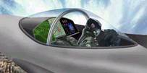

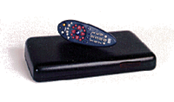


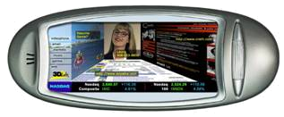
Diverse Platforms Need 3D Graphics
Safety Critical
Line-powered
Appliances
Avionics
Life-critical displays
Consoles
Settop
Boxes
Automotive
Entertainment solutions
Automotive console and heads-up displays
Phones
PDAs
Hand-held
Appliances
Advanced Personal Computing

Slide 3

Safety Critical Profile
Targeted at avionics and automotive applications
  Enabling OpenGL ES drivers that can be DO178-B certified
Khronos Safety Critical Working Group in progress now
  To produce profile specification by mid-2005
Generic, minimum footprint, full function 3D enables diverse graphics applications
Common
Absolute minimum code size and complexity to ease safety certifications. Support for certified legacy applications
Safety
Critical
Some games-only functionality removed and display list functionality restored for legacy and auto-generated code
A new OpenGL ES Profile to meet the different needs of a specific market segment

Slide 4




OpenGL ES SC = Safety Critical
Promoters
Contributors
OpenGL ES SC Working Group for companies interested to address the industrial market
A Working Group for
each API standard
SC
Ratified
Specifications
Adopter
Packages
SDKs
Implementers
Adopters

Slide 5
OpenGL ES Roadmap – Two Tracks
OpenGL Shading Language for programmable hardware –
Backwards compatible with
OpenGL 1.5
OpenGL 2.0
GLSL
Widely available cross-platform 3D graphics API
OpenGL ES 2.0
OpenGL ES 2.X
OpenGL 1.3
OpenGL 1.5
OpenGL ES 1.0
OpenGL ES 1.1
OpenGL ES 1.2
OpenGL ES 1.X
Probable two-track evolution based on customer needs and feedback
OpenGL ES SC 2.X
OpenGL ES SC 1.0 based on OpenGL ES 1.0 Common Profile
OpenGL ES SC 1.0
OpenGL ES SC 1.X
2003
2004
2005

Slide 6

Any Questions?

