Slide 1

Advanced OpenGL ES Programming
Dan Ginsburg (dginsbur@ati.com)
Senior Software Engineer, ATI

Slide 2
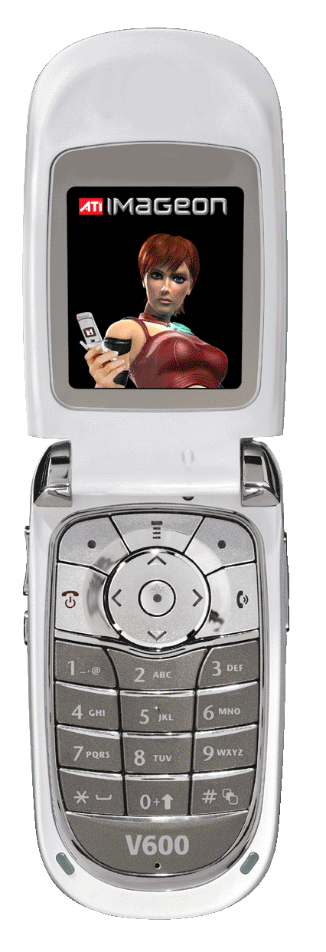
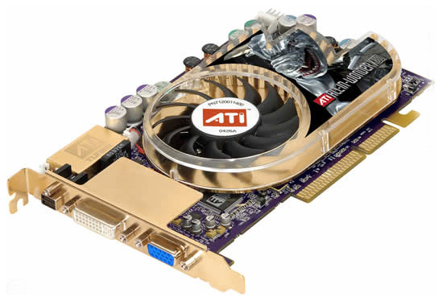
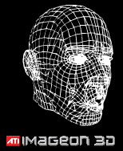


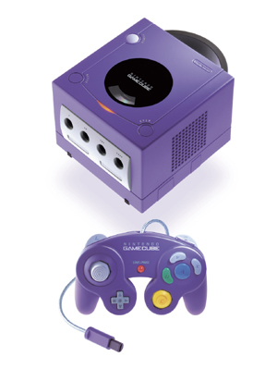

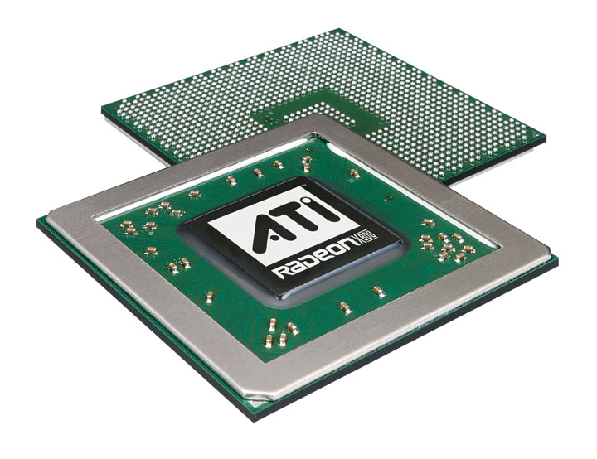

ATI is bringing forth industry leading mobile phone features leveraged from proven PC technologies
Multimedia
  Digital Camcorder and Video Player features
  Digital Camera features
  Digital Audio features
3D Graphics

Slide 3
Overview – Advanced OpenGL ES
Per-Pixel Effects
  Texture Combine
  Dot3 Bump Mapping
Vertex Skinning
Point Sprites
  Usage
  Distance Attenuation
Render-to-Texture
  EGL method
  OES_framebuffer_object extension

Slide 4
Texture Combine
Texture Combine added to OpenGL ES 1.1
Provides for flexible texture blending operations:
CT₀
Cconst₀
Cprev
Texture Combine 0
CT₁
Cdiffuse
Cconst₁
Coutput
Texture Combine 1
Cdiffuse

Slide 5
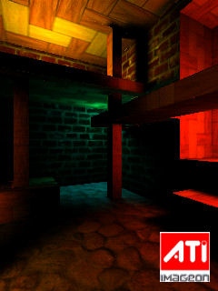
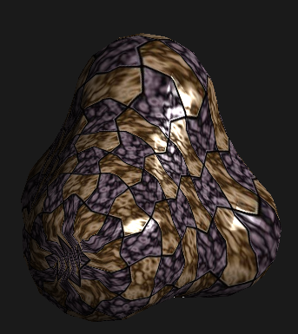
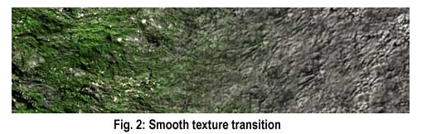
Texture Combine
Important for mobile space because:
  Allows effects that previously had to be done in multiple passes to be done in a single pass
  Improves performance over multipass because it reduces transform and framebuffer blending costs
  Introduces flexible new equations and inputs that provide for new effects
Texture combine operation examples:
Texture Interpolation
INTERPOLATE (A,B,C) = (T0 * Cd.a) + (T1 * (1-Cd.a))
T0 – Grass Texture
T1 – Rock Texture
Cdiffuse.a = Interpolation factor
Source: Delphi3D (http://www.delphi3d.net/)
LightMapping
MODULATE (A*B) = T0*T1
T0 – Base
T1 – Lightmap
“Specular” Highlights
ADD (A+B) = (T0 * Cdiffuse) + T1
T0 – Base
T1 –Specular
Cdiffuse = N.L

Slide 6
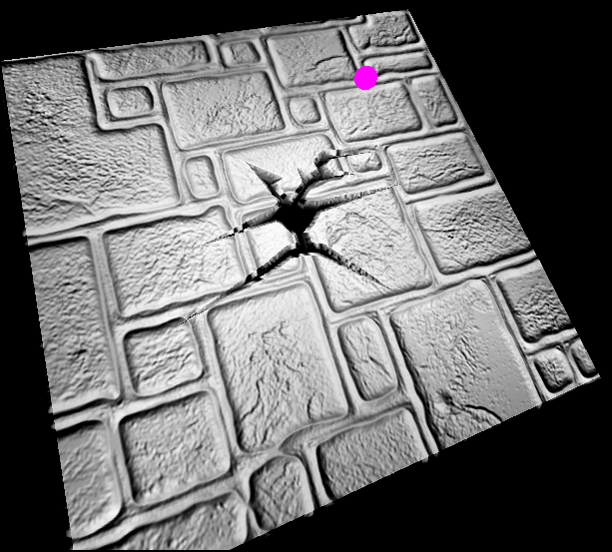
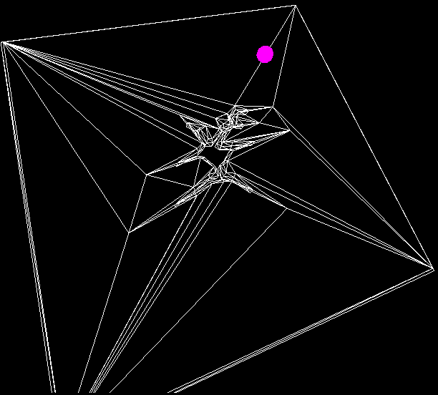
Texture Combine – DOT3
New blend equation DOT3 introduced in OpenGL ES 1.1
Provides the ability to do the diffuse lighting equation (N.L) on a per-pixel basis
Important for mobile because:
  Provides the appearance of surface complexity with less polygons
  Reduces geometry memory footprint
  If not fill limited, can be done very cheaply

Slide 7
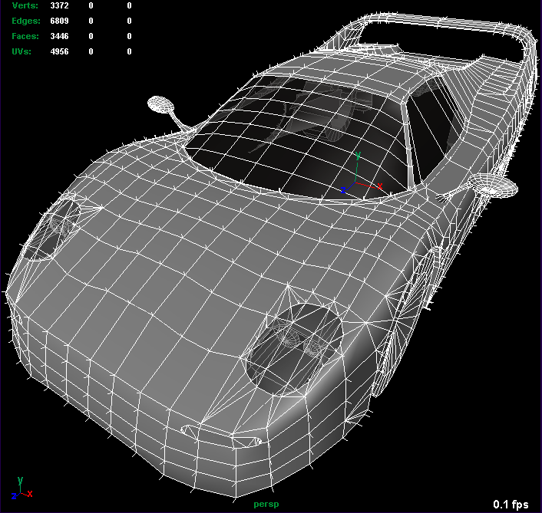
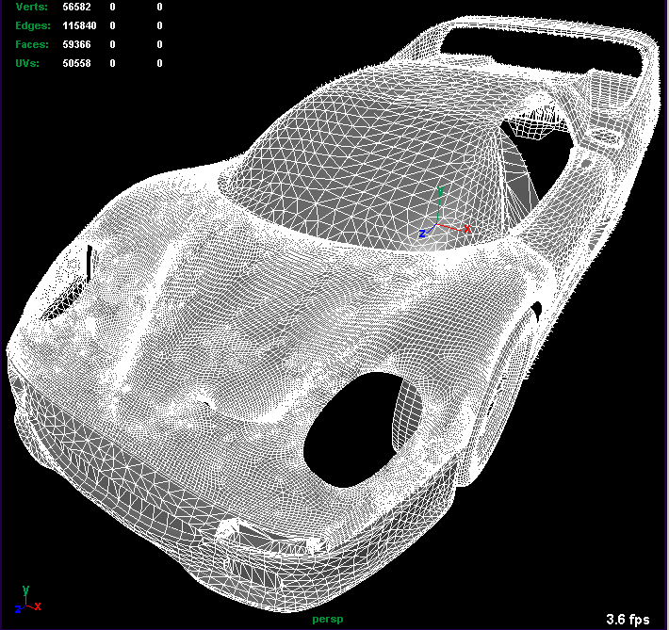
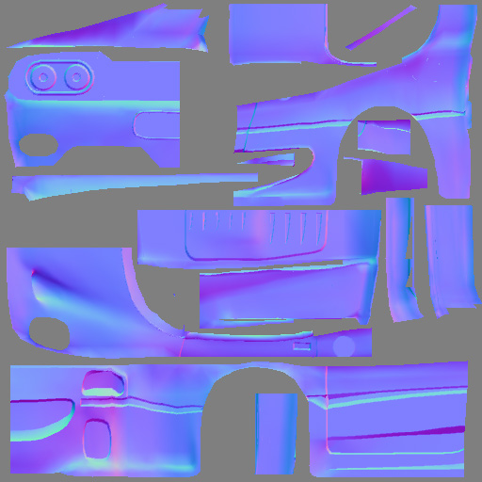
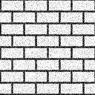
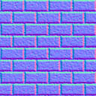
Step 1 – Author a DOT3 map
Many tools provide the ability to generate normal maps
  ATI’s NormalMapper tool generates normal maps from a low and high poly version of a model
  DOT3 maps can also be created directly from height maps
    ATI’s NormalMapGenerator tool uses Söbel filter to generate DOT3 map

Slide 8
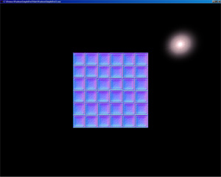
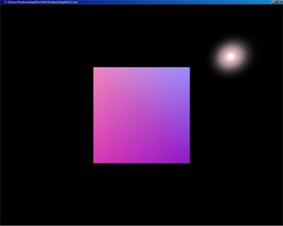
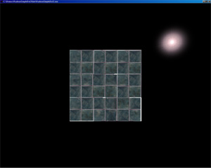
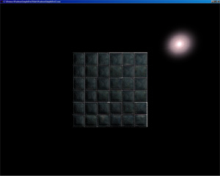
Step 2 – Configure Texture Combine
DOT
X
Normal
Light
Normal
Base
=

Slide 9
Step 2 – Configure Texture Combine
Bind two textures:
  Texture 0 – DOT3 Map
  Texture 1 – Basemap
Place the tangent-space light vector into the vertex diffuse color
Setup texture combine:
  // UNIT 0
  // find dot product of N (stored in the texture map) and L (stored
  // as the PRIMARY_COLOR).
  glActiveTexture(GL_TEXTURE0);
  glBindTexture (GL_TEXTURE_2D, dot3TextureID);
  glTexEnvi(GL_TEXTURE_ENV, GL_TEXTURE_ENV_MODE, GL_COMBINE);
  glTexEnvi(GL_TEXTURE_ENV, GL_COMBINE_RGB, GL_DOT3_RGB);
  glTexEnvi(GL_TEXTURE_ENV, GL_SOURCE0_RGB, GL_TEXTURE);
  glTexEnvi(GL_TEXTURE_ENV, GL_OPERAND0_RGB, GL_SRC_COLOR);
  glTexEnvi(GL_TEXTURE_ENV, GL_SOURCE1_RGB, GL_PRIMARY_COLOR);
  glTexEnvi(GL_TEXTURE_ENV, GL_OPERAND1_RGB, GL_SRC_COLOR);
  // UNIT 1
  // modulate the base texture by N.L
  glActiveTexture(GL_TEXTURE1);
  glBindTexture (GL_TEXTURE_2D, baseTextureID);
  glTexEnvi(GL_TEXTURE_ENV, GL_TEXTURE_ENV_MODE, GL_COMBINE);
  glTexEnvi(GL_TEXTURE_ENV, GL_COMBINE_RGB, GL_MODULATE);
  glTexEnvi (GL_TEXTURE_ENV, GL_SOURCE0_RGB, GL_PREVIOUS);
  glTexEnvi (GL_TEXTURE_ENV, GL_OPERAND0_RGB, GL_SRC_COLOR);
  glTexEnvi (GL_TEXTURE_ENV, GL_SOURCE1_RGB, GL_TEXTURE);
  glTexEnvi (GL_TEXTURE_ENV, GL_OPERAND1_RGB, GL_SRC_COLOR);
Blend0 = N.L
Src0 = DOT3 map
Src1 = Light vec
Blend1 = N.L * T1
Src0 = N.L (prev)
Src1 = Base map

Slide 10
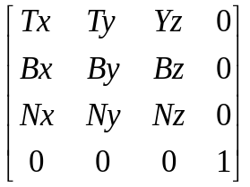
Step 3 – Tangent Space
In application, the light vector must be transformed into tangent space
Tangent matrix is defined per-vertex as:
Any time light moves, it must be re-transformed into tangent space
Place the tangent-space light vector into the diffuse vertex color component
T = Tangent
B = Binormal
N = Normal
Tangent = vector in direction of change in s or t
Binormal = cross product of normal and tangent

Slide 11
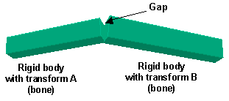
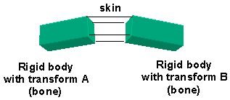
Vertex Skinning
What is vertex skinning?
  Solves the problem of gaps in between bones
  Provides for more realistic looking characters
Matrix palettes introduced in OpenGL ES 1.1
Skinning computation is offloaded from the CPU onto the GPU
  Important for mobile space where there is not efficient floating-point CPU

Slide 12
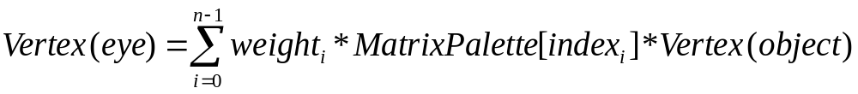
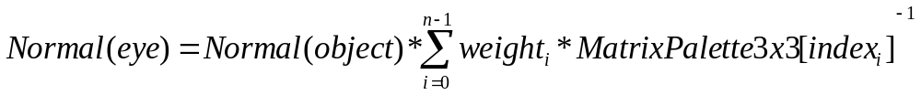
Matrix Palette
A matrix for each bone at the current keyframe is stored in the palette
Each vertex contains:
  A set of n indices, one index for each bone into the palette of m matrices
  A set of n weights, one weight for each bone
The vertex is transformed by:
The normal is transformed by:

Slide 13
Matrix Palette Interface
glMatrixMode(GL_MATRIX_PALETTE)
  Set the matrix mode to palette
glCurrentPaletteMatrix(n)
  Set the currently active palette matrix
  Load each matrix in the palette
Enable vertex arrays
  glEnableClientState(MATRIX_INDEX_ARRAY)
  glEnableClientState(WEIGHT_ARRAY)
Load the index and weight per-vertex data
  glWeightPointer()
  glMatrixIndexPointer()
Use normal draw routines for rendering

Slide 14
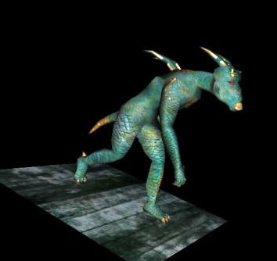
Matrix Palette Tips
The matrix palette size and number of vertex units are implementation dependent
If the matrix palette size is exceeded, break up draw calls by sets of bones
The keyframe interpolation should still be done on the CPU
  This is a relatively simple computation which should only happen once per-frame per-animation
This feature is fully orthogonal - all GL lighting just works!

Slide 15
Point Sprites
Added to OpenGL ES 1.1
Provides a fast method for drawing screen-aligned sprites
Important for mobile space because:
  Reduces geometry footprint and transform cost – only one vertex per-point sprite
  Reduces CPU burden for aligning billboard to screen
  Useful for rendering particle systems as well as other 2-D effects such as:
    Lens flares
    Light glows
Point sprite is rendered as a textured quad:
(0,0)
(1,0)
P
(0,1)
(1,1)

Slide 16
Point Sprites - Usage
glEnable(GL_POINT_SPRITES)
  There is one global enable to turn on/off point sprite rendering
  Once enabled, all points will be drawn as point sprites.
glTexEnvi(GL_POINT_SPRITES, GL_COORD_REPLACE, GL_TRUE)
  Enables [0..1] texture coordinate generation for the four corners of the point sprite
  Can be set per-texture unit. If disabled, all corners of the quad have the same texture coordinate
Any geometry rendered as GL_POINTS will be drawn as a sprite when point sprites are enabled
Completely orthogonal, texture environment and blending can be used as normal

Slide 17
Point Sprites – Size Control
Point size can be controlled in one of two ways:
  A global point size can be set for all points
  A point size can be specified per-vertex to control the size per-point
glPointSize()
  Specifies a global point size
glPointSizePointer()
  Vertex array entrypoint to control point size per-point
  Used like any of the other vertex arrays functions
In either mode, points can be distance attenuated

Slide 18
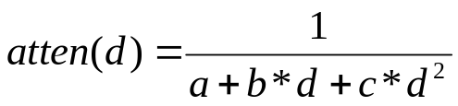
Point Sprites – Distance Attenuation
glPointParameters(GL_POINT_DISTANCE_ATTENUATION, …)
  Input the constants (a, b, c) to the distance attenuation equation:
  Where:
    d = GL computed eye-coordinate distance from eye (0, 0, 0, 1)
  By default (a, b, c) = (1.0, 0.0, 0.0) which yields attenuation(d) = 1 (no attenuation)
  Example values:
    (a, b, c) = (0.0, 0.0, 1.0) gets (1 / d²) attenuation
    (a, b, c) = (0.0, 1.0, 0.0) gets (1 / d) linear attenuation
glPointParameters(GL_POINT_SIZE_[MIN/MAX], …)
  Controls the minimum and maximum values of the derived point size

Slide 19
Render-to-Texture with EGL
EGL 1.1 spec introduced render-to-texture functionality
  Allows the driver to skip the copy step required by glCopyTexImage – the texture can be directly bound
  Based on the WGL_ARB_render_texture method
Several setup steps are required:
  Create an off-screen rendering surface for the pbuffer (eglCreatePbufferSurface)
  Create a context for the pbuffer (eglCreateContext)
  Share the context with the main window rendering context to share texture objects and vertex buffer objects
To render to the texture:
  Call eglMakeCurrent() for the pbuffer drawable
  Perform drawing operations
To use as a texture:
  Call eglMakeCurrent() for the window drawable
  Call eglBindTexImage() to bind the pbuffer surface as a texture

Slide 20
Disadvantages of EGL Method
Adding render-to-texture was nice, but like the WGL method, the EGL method has many shortcomings:
  Switching between contexts with eglMakeCurrent may be an expensive operation
  A GL context must be created for each texture format
  The pbuffer surfaces can not share ancillary buffers such as depth and stencil
  Relies on potentially non-portable window system components
The EXT_framebuffer_object extension was created to address many of these shortcomings in WGL.
The OES_framebuffer_object extension similarly addresses these issues in EGL.

Slide 21
OES_framebuffer_object
Provides for more efficient render-to-texture
The API is contained fully within the GL API (no reliance on the window-system)
Multiple contexts are not required:
    Removes the performance hit for switching contexts
    Texture formats that differ from that of the window can be created on one context
A single framebuffer object allows rendering to an unlimited number of texture objects
Provides more flexible binding of buffers:
    Depth/stencil buffers can be used for multiple renderable textures
    This potentially reduces the memory footprint for certain applications

Slide 22
OES_framebuffer_object - Overview
Framebuffer Object Diagram
Framebuffer
Framebuffer Object
Attachment Points
Color 0
…
Color n
Depth
Stencil
-OR-
Texture Object
Texture Object
Texture Object
Renderbuffer Object
Renderbuffer Object

Slide 23
OES_framebuffer_object - RTT Usage
glGenFramebufferOES()
  Generate ids for n framebuffer objects
  A framebuffer object contains the collection of logical buffers used to render with (color, stencil, depth)
glGenRenderbufferOES()
  Generate ids for n renderbuffers (for RTT, this will be depth and/or stencil)
  For color buffers that will be used as textures, texture object ids are generated as usual with glGenTextures()
glBindFramebufferOES()
  Bind the framebuffer object
glFramebufferTexture2DOES()
  Bind a texture as the color buffer

Slide 24
OES_framebuffer_object - Usage (cont’d)
glBindRenderbufferOES()
  Bind a renderbuffer (for RTT, this is used to bind the depth or stencil buffer)
glRenderbufferStorageOES()
  Set the internal format for the renderbuffer (e.g. GL_DEPTH_COMPONENT24)
glFramebufferRenderbufferOES()
  Attach a renderbuffer to the framebuffer object (for RTT, this is used to attach the color or stencil buffer)
glCheckFramebufferStatusOES()
  Determine whether a particular framebuffer object is complete
Now let’s look at an example…

Slide 25
OES_framebuffer_object – RTT Example
Example: create an RGB8 renderable texture with 24-bit Z and a stencil buffer
First generate our objects:
  glGenFramebuffersOES(1, &fb);
  glGenTextures(1, &color_tex);
  glGenRenderbuffersOES(1, &depth_rb);
  glGenRenderbuffersOES(1, &stencil_rb);
Bind the framebuffer object:
  glBindFramebufferOES(GL_FRAMEBUFFER_OES, fb);
Setup the color buffer for use as a renderable texture:
  glBindTexture(GL_TEXTURE_2D, color_tex);
  glTexImage2D(GL_TEXTURE_2D, 0, GL_RGB8, 512, 512, 0,
  GL_RGB, GL_INT, NULL);
  glFramebufferTexture2DOES(GL_FRAMEBUFFER_OES,
  GL_COLOR_ATTACHMENT0_OES,
  GL_TEXTURE_2D, color_tex, 0);

Slide 26
OES_framebuffer_object – RTT Example
Initialize the depth buffer:
  glBindRenderbufferOES(GL_RENDERBUFFER_OES, depth_rb);
  glRenderbufferStorageOES(GL_RENDERBUFFER_OES,
  GL_DEPTH_COMPONENT24, 512, 512);
  glFramebufferRenderbufferOES(GL_FRAMEBUFFER_OES,
  GL_DEPTH_ATTACHMENT_OES,
  GL_RENDERBUFFER_OES, depth_rb);
Initialize the stencil buffer:
  glBindRenderbufferOES(GL_RENDERBUFFER_OES, stencil_rb);
  glRenderbufferStorageOES(GL_RENDERBUFFER_OES,
  GL_STENCIL_INDEX, 512, 512);
  glFramebufferRenderbufferOES(GL_FRAMEBUFFER_OES,
  GL_STENCIL_ATTACHMENT_OES,
  GL_RENDERBUFFER_OES, stencil_rb);
Now, before proceeding, make sure to check the framebuffer status.

Slide 27
OES_framebuffer_object – RTT Example
To render into the texture, simply bind the framebuffer object:
  glBindTexture(GL_TEXTURE_2D, 0);
  glBindFramebufferOES(GL_FRAMEBUFFER_OES, fb);
  // .. Draw to texture
To use the framebuffer as a texture, simply bind the texture object:
  glBindFramebufferOES(GL_FRAMEBUFFER_OES, 0);
  glBindTexture(GL_TEXTURE_2D, color_tex);
It’s that easy…
  More complex configurations are easy to create, for example multiple textures that share a depth and stencil buffer.
  The setup and rendering code are highly simplified and more efficient

Slide 28





Any Questions?

