Slide 1

Borgar Ljosland, President & CEO
GDC 2005

Slide 2
Company Introduction
A Hardware Company
  3D graphics and video accelerators for mobile devices
A Software Company
  Full API software stack
  OpenGL®ES and Java
Headquartered in Trondheim, Norway
Game Developer Relationships in US
  SDK and hardware prototypes for selected game developers

Slide 3
Introduction
Game Complexity
Image Quality
Advanced Features

Slide 4
Game Complexity: High Poly Counts
Use Vertex Buffer Objects in OpenGL ES 1.1
EXT_draw_range_elements
Multitexturing Saves Vertex Processing
Get the Most From Early-Z
  Don’t change the depth comparison function during rendering
  Sort meshes by depth (front-to-back)
  State changes are practically free

Slide 5
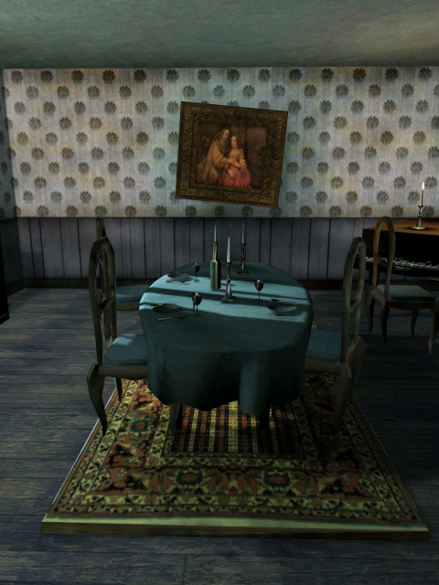
Game Complexity: Effects
Multitexturing
  For precomputed lighting
  Use multitexturing w/two texture sets
  (triple-texturing costs extra)

Slide 6
Game Complexity: Effects
Realtime, Dynamic Lighting
  Expensive on CPU
  No problem with hardware T&L
Particle Effects
  OpenGL ES 1.1
    GL_OES_point_sprite
    GL_OES_point_size_array
Stencil Shadows

Slide 7
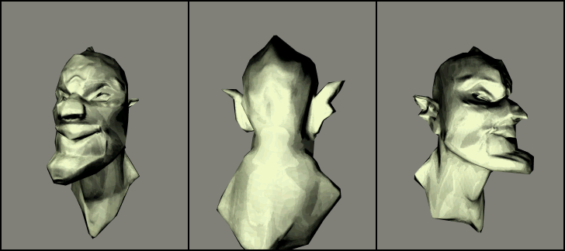
Game Complexity: Effects
Dot3 lighting
use normalmaps to save geometry

Slide 8
Image Quality: Antialiasing
Small, Low Resolution Displays
  Does not make FSAA less important
  “VGA quality on QVGA screen”
  glEnable( GL_MULTISAMPLING )
  "Anti-aliasing is as important, if not more important, for mobile phones than for the PC, due to the limited area and resolutions available in the smaller screens."
        Frank Gilson, Producer, Atari

Slide 9
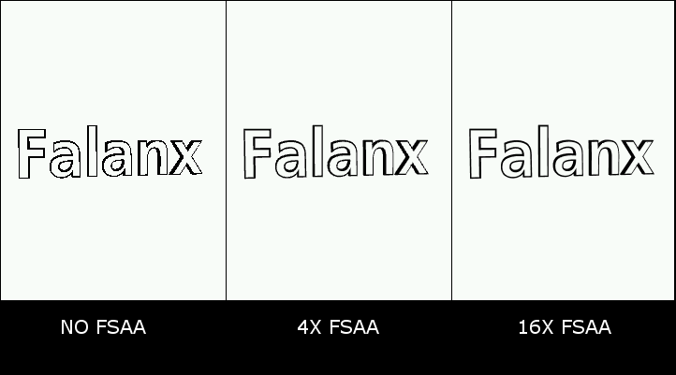
Image Quality: 3D Text Antialiasing
3D Text

Slide 10
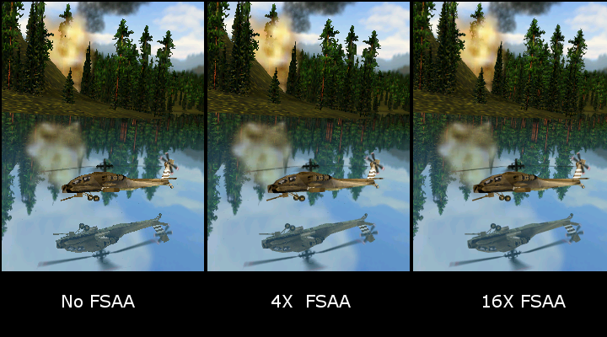
Image Quality: Antialiasing
SPMark04
Supersampling gives much better quality for alpha tests (trees)

Slide 11
Image Quality: Mip-mapping
Always Use It!
  Better image quality
  Better performance
  GL_LINEAR_MIPMAP_NEAREST
Problem: Hard Transitions Between Mipmap Levels
Solution: Sample from Closest, Trilinear Mipmap Levels
  GL_LINEAR_MIPMAP_LINEAR
  Smooth transitions, but lower performance
  Mali processors have performance trilinear

Slide 12
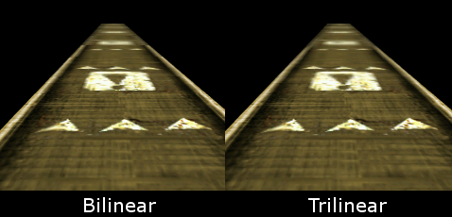
Image Quality: Mip-mapping
Bilinear versus trilinear
Trilinear provides soft mipmap transitions

Slide 13
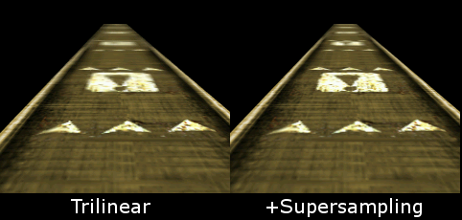
Image Quality: Mipmapping
Trilinear with Supersampling
Supersampling gives less blurry mipmaps

Slide 14
Advanced Features: Texture Compression
glCompressedTexImage2D in OpenGL ES
Benefits
  Reduced memory usage
  Reduced bandwidth
  Reduced loading times
    Smaller files
    No PNG/JPEG decoding required
  Increases potential amount of game data
FLXTC
  2bpp compression
  RGB and RGBA
  Used for all textures in our demos
  We have tools available

Slide 15
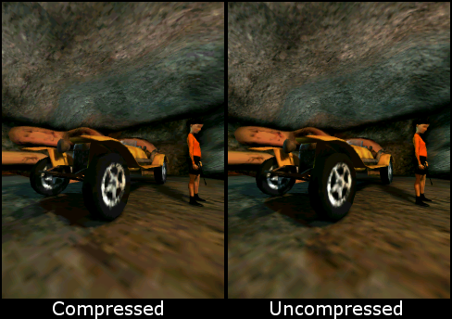
Advanced Features: Texture Compression
FLXTC Sample

Slide 16
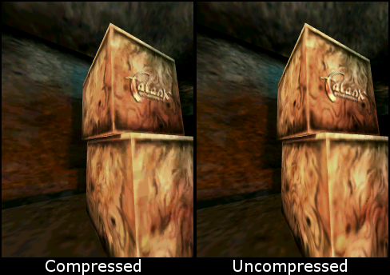
Advanced Features: Texture Compression
FLXTC Sample

Slide 17
Advanced Features: More Multisampling
Multisampling of Frame Buffers a Must
Mali110 can Multisample Depth and Stencil Buffers
  Smoother stencil shadows
  Intersecting geometry looks better

Slide 18
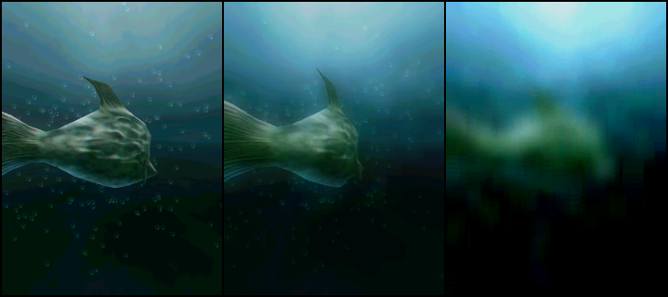
Advanced Features: Render To Texture
RTT Example
RTT enables Blur, Glow/Bloom & Depth-of-field

Slide 19
Advanced Features: Vertex Shaders
Moves CPU Intensive Tasks to Hardware
  Tangent space calculations
  Shadow volume extrusion
  Vertex skinning
  Advanced lighting calculations
More Freedom for You
  No longer bound by the fixed-function pipeline
Pixel Shaders are Coming
  OpenGL ES 2.0

Slide 20
Summary
Highest Poly Counts Possible
  Hardware T&L
  Vertex Buffer Objects
  Early-Z
Image Quality Counts
  Use FSAA
  Use mipmaps
  Use trilinear filtering
  Use compressed textures

Slide 21





Questions?

