Slide 1
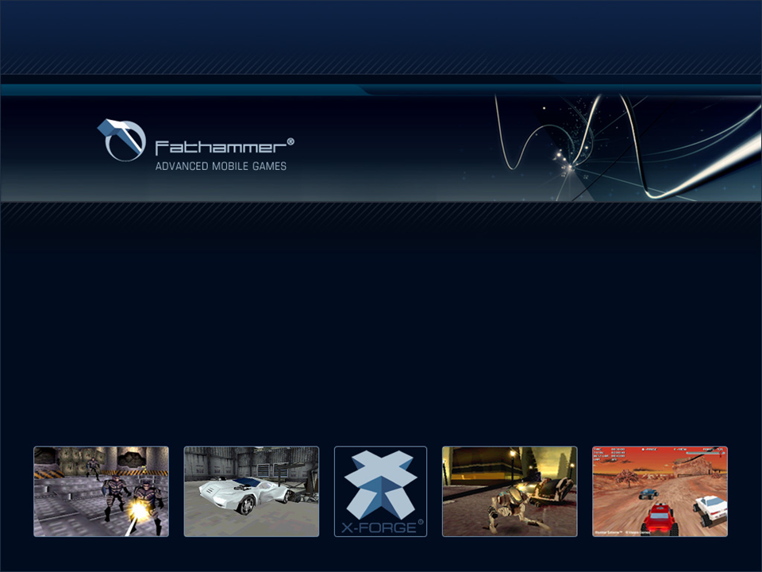

Fathammer XF 2.1 SDK for SKT GIGA
December 8, 2004
John Lee
Director
Fathammer, Asia & Pacific
Sales & Marketing

Slide 2

Company Introduction
Fathammer is the leading game development tools & technology provider for the mobile game industry
Fathammer develops and licenses X-Forge™, which enables the creation and deployment of console quality 3D games on all major mobile platforms
X-Forge is licensed as two separate editions:
X-Forge™ Developer Edition
X-Forge™ OEM Edition
The X-Forge™ Developer Edition is a complete cross-
platform C++ based game development SDK and toolkit.
It is licensed to game publishers and developers.
The X-Forge™ OEM Edition enables mobile device manu-
facturers to turn their devices into powerful 3D gaming
consoles and to boost up their developer tools offering.
Additionally, Fathammer provides a broad range of professional services for companies developing mobile devices, operating systems, 3D graphics accelerator processors and other hardware components
The company was founded in 2000 and currently employs 40 people in Helsinki (Finland) and Seoul (Korea).

Slide 3









OEM References
Early on Nokia chose Fathammer as a key technology provider on N-Gage™
Approximately half of all N-Gage games are based on X-Forge, including 5 launch games
X-Forge is the only licensed game engine on N-Gage today
Tapwave chose X-Forge as their 3D game middleware solution for the Zodiac™ (Palm OS) gaming device
Fathammer built a tailored X-Forge game development SDK for Tapwave along with providing premium support services to Tapwave developers
Tiger Telematics chose X-Forge as their 3D game middleware solution for the Gametrac™ (MS .NET OS) gaming multimedia device
Fathammer built a tailored X-Forge game development SDK for Gametrac along with providing premium support services to Gametrac developers
Sony Ericsson chose Fathammer and X-Forge to power and develop the premium launch games for the P800 smartphone (Symbian UIQ)
3D games Men in Black II™: Alien Pursuit and Stunt Run™ are bundled with all P800 smartphones

Slide 4
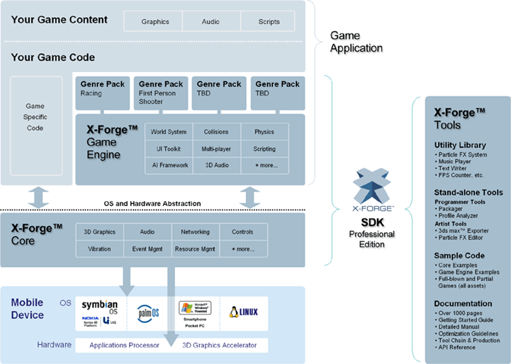
The X-Forge™ Software Development Kit (SDK)
WIPI/GIGA

Slide 5
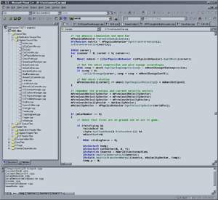





X-Forge Graphic Library and Hardware Drivers
Developer
Application / Game Code
Fathammer
X-Forge™ GL Core
Hardware Solution
Software Solution
Mobile
GL Base
GL Default
Manufacturer
H/W Drivers
OS Drivers
Screen

Slide 6
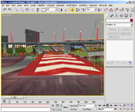
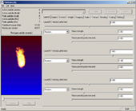
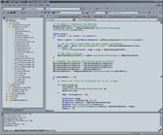

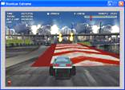
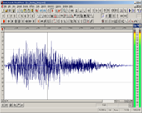
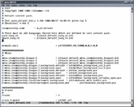

The X-Forge™ Tool Chain
3D Content
2. Particle Effects
CODE
Executable
(EXE)
PC Emulator Version
CONTENT
Compressed File Library (CFL)
3. Audio
4. Scripts
Native Device Version

