Slide 1



Reakosys M3D™
SDK for SKT GIGA

Slide 2

Table of Contents
01. Company Introduction
02. M3D™ SDK for SK Telecom GIGA

Slide 3
01 Company Introduction
Company Overview
Technology Platform & Partner
History of SKT GIGA 2.0 Project

Slide 4


Company Overview
Overview
Company Name: Reakosys
CEO : Lee, Chang Keun
Established: 1/Jan/2001
Employee : 100
(With 70% Employees are
engineers and game developers)
Location : Seoul, Korea
Contact : 02-557-8535
Core Capabilities
Diverse Project Experience with Manufacturers and
Operators
Employee with
mobile expertise,
and R&D
Orientation
Reakosys
Business Focus
Ability
to Provide
Timely response
To
Customers’ Need
Various Applications
3D Planning
Mobile 3D Engine - M3D™
Mobile 2D & 3D Content Services
Mobile Phone MPEG-4 Solution – M4™
Mobile Image Compression Solution
Wireless Instant Messenger Solution

Slide 5












Reference Customers and Partners
Technical Platforms
J2ME/JSR 184
Technical Partners

Slide 6
History of SK Telecom GIGA Project
2003. 12 Selected as a standard 3D engine for SKT GIGA platform
2004. 1 Collaborated SKT with GIGA project (GIGA 1.3, GIGA 2.0)
2004. 8 GIGA Smart Phone project (Smart Phone GIGA 1.3 , GIGA 2.0)
2004. 12 More than 10 GIGA models are currently launched.
2004. 12 Scheduled to launch GIGA Game phone (GIGA 2.0)
2003. 12 Selected as a standard 3D engine for SKT GIGA platform
2004. 1 Collaborated SKT with GIGA project (GIGA 1.3, GIGA 2.0)
2004. 8 GIGA Smart Phone project (Smart Phone GIGA 1.3 , GIGA 2.0)
2004. 12 More than 10 GIGA models are currently launched.
2004. 12 Scheduled to launch GIGA Game phone (GIGA 2.0)

Slide 7
02 M3D™ SDK for SKT GIGA

Slide 8
M3D™ Introduction
M3D™ Solution
Reakosys mobile 3D graphic engine, M3D™, is software 3D graphic rendering engine optimized for 2.5G and 3G mobile platforms. No additional hardware is required to fully utilize the Reakosys M3D engine.
M3D™ Structure
Main Features
M3D™ API 2.5
Software Rendering Engine
CPU : Min. 60MHz required
Engine Size : 38Kbyte
Sample Data : over 100KB
Working Memory : about 300KB
Performance: About 20,000 Polygon / sec
M3DX API
MMZ API
3D Model Engine
3D Indoor Engine
M3D Rendering Pipeline & 3D Utilities
OEM Device

Slide 9
M3D™ Introduction (Con’t)
M3D™ 3.0 Solution
In the M3D™ 3.0 environment, 3D Graphics Library follows OpenGL ES Standard, which provide H/W acceleration. OPEN GL ES is also a key factor for performance of M3D solution
M3D™ 3.0 Solution
M3D™ API 3.0
M3DX3 API
M3DDEF API
3D Game Engine
3D Utilities
OpenGL ES API
OEM Device

Slide 10
M3D™ 3.0 Structure
3D Content 1
3D Content 2
3D Content 3…
M3DX 3
Model
Import
Transform-
ation
Control
Animation
Control
Frame
Mesh
Map
Component
Layer
Library Layer
Rendering Pipeline [OPEN GL ES]
OEM Screen Device

Slide 11

Main Feature of M3DX 3
Support 3D data set :
Grouping process for contents developed with 3D Authoring tool (i.e., 3DS Max)
to make OGL-ES environment compatible data.
2. Support Ease-to-use API set:
Standard API sets are readily available for content developers. Easy and fast API writing become offered without additional API development.
Support various 3D data management algorithms:
Memory and data resource management presents content development customized to mobile environment.

Slide 12
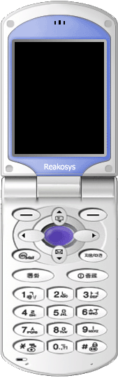
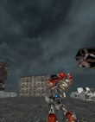

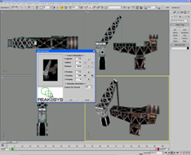
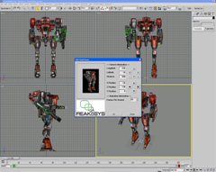
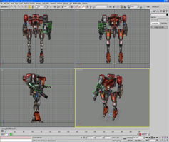
M3D™ Contents Development Processes
M3D Polygon Content Development Process
3
View and Check Output Through
M3D OVP (Object Viewer
& Phone Emulator)
2
Create A3D and ACT file by
Converting Polygon Game Content
Plug-In Tool is used in this process
1
Polygon Game Content
Development using 3D MAX

Slide 13
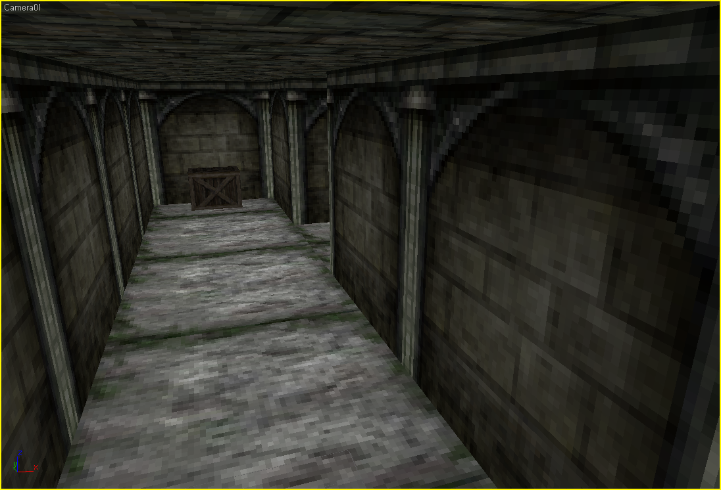
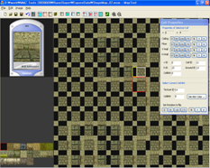
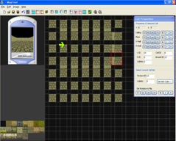
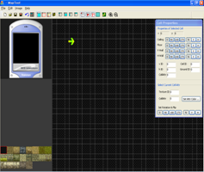

M3D™ Contents Development Processes
MMZ Content Development Process 1
3
2
Create Map, while viewing through
Emulator
Game Map Development using
Map source
1
Map Source Design Using
MMZ Engine Tool

Slide 14

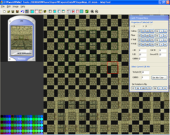
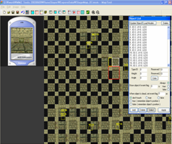
M3D™ Contents Development Processes
MMZ Content Development Process 2
6
5
Rendering Process:
3D Polygon support by MMZ
Engine
Designate coordinates by
Color, and create event
(ex, End Point, Doors)
4
After completing a MAP
Locate Objects at various
positions

Slide 15
M3D™ With GIGA 2.0
GIGA 2.0 M3D™ Solution
By providing Open GL ES compliant H/L engine, M3D™ supports various useable functions and data structures. Details are illustrated at the following figures.
GIGA 2.0
Contents
H/L engine library with OpenGL ES API
M3D ™
WIPI GIGA API
WIPI CORE
GIGA CORE
(OpenGL ES)
Strengths
Saving space for engine gives more space for
contents, Improving the quality for contents
Improved 3D contents performance
Stabilized service quality
HAL
CAL
OEM

Slide 16
M3D™ With GIGA 2.0
GIGA
Version
GIGA 1.3
GIGA 2.0 + OpenGL ES
GIGA 2.0 + OpenGL ES
M3D
Version
M3D Version 2.5
M3D Version 3.0
M3D Version 4.0
Spec
3D Indoor map
Billboard Sprite Object
Activate Door System
Triangle Based Rendering
Single Texture
Camera Zoom In/Out
Transform Method
Hierarchical 3D Model
Bone Based Animation
Directional Lighting Fog Multipass Texture Linear Filtering Mipmap
In-between Animation Bone Hierarchy Tile Texture Terrain Quad Tree Map Point Particle
Scene Graph
Skinned Model
Poly morphing
Physical Engine
BSP
Octree
Etc.
Environment
Only MSM 6xxx
MSM 6xxx + Accelerator
MSM 7xxx + Accelerator
Performance
(Polygon/Sec)
20,000 Polygon/Sec
150,000 Polygon/Sec
200,000 Polygon/Sec
2004. 06
2005.1

Slide 17

Challenge of Open GL ES
Issues when applying H/L library on H/W Based Open GL ES
1. Difficult to build development environment
- Require ranged optimized processes for each handset models and manufacturers
- Require EVM board applied to each chipsets for smooth optimization processes
2. H/W chipset applied without Open GL ES Conformance Test may
cause compatibility issues
3. No mathematical function support to use fixed point

Slide 18
Challenge of Open GL ES
Major Issues related to content development
1. Require Vector graphic to utilize 2D Graphics
- Mobile content developers’ preferences to pixel graphics may cause
difficulty when they develop vector-based graphics
2. Mere Graphic API support and No H/L support
- Without H/L engine, each content developer has to make its own H/L
game engine and authoring tool
3. Required know-how related to handset H/W & S/W environment to solve
potential porting issues

Slide 19
DEMO

Slide 20
Q&A

