Slide 1



Getting Started with OpenGL ES
Seoul, December2004
Toshiharu TAKEUCHI
TAKEUCHI_Toshiharu@hicorp.co.jp

Slide 2
Agenda
What is OpenGL ES
Check the sample
Walk through the source code
Information source
Notes:
Made text bigger – too hard to see from back of room

Slide 3

Why OpenGL ES?
Many embedded devices had it’s own graphics APIs (before OpenGL ES)
  Very messy for applications developers
  Sometimes designed by people with little background of game or graphics
Khronos Group released OpenGL ES (at SIGGRAPH 2003)
  OpenGL ES 1.0 is based on OpenGL 1.3
  Designed for limited computation power and memory
  Non floating point processor is assumed
Notes:
Made text bigger – too hard to see from back of room

Slide 4
OpenGL ES – What is this?
OpenGL ES
  API for full-function 3D graphics on embedded systems
  Royalty free API set
  Cross platform
Provided by OpenGL ES are Functions for
  Drawing primitives (e.g.: Dot, Line,Triangle …)
  Lighting
  Affine transformation
  Effect.
  Etc..
Notes:
Made text bigger – too hard to see from back of room

Slide 5

OpenGL and OpenGL ES
OpenGL ES is subset of OpenGL
  OpenGL ES1.0 ← OpenGL1.3
  OpenGL ES1.1 ← OpenGL1.5
  OpenGL ES2.0 ← OpenGL2.0
“ES” comes from Embedded System
  Nokia6630 handheld device supports OpenGL ES 1.1.
The Common Profile is intended for
consumer entertainment.
The Safety Critical Profile is intended
for consumer and industrial applications.
Notes:
Made text bigger – too hard to see from back of room

Slide 6
What is eliminated in OpenGL ES
Example - first argument of function glDrawElements()
This argument specifies what primitives are you drawing
  GLU/GLUT functions are not supported in OpenGL ES
OpenGL ES provides EGL functions for native platform interface
  EGL corresponds to:
  GLX functions in X Window System
  WGL functions in Windows platform
OpenGL ES1.0 | OpenGL1.3
GL_POINTS, GL_LINE_STRIP, GL_LINE_LOOP, GL_LINES, GL_TRIANGLE_STRIP, GL_TRIANGLE_FAN, GL_TRIANGLES | GL_POINTS, GL_LINE_STRIP, GL_LINE_LOOP, GL_LINES, GL_TRIANGLE_STRIP, GL_TRIANGLE_FAN, GL_TRIANGLES, GL_QUAD_STRIP, GL_QUADS, GL_POLYGON
Notes:
Made text bigger – too hard to see from back of room

Slide 7
Agenda
What is OpenGL ES
Check the sample
Walk through the source code
Information Source
  Check how the sample works on
  Nokia Series60 emulator
  Nokia Series60 devise
Notes:
Made text bigger – too hard to see from back of room

Slide 8
Agenda
What is OpenGL ES
Check the sample
Walk through the source code
Information Source
Notes:
Made text bigger – too hard to see from back of room

Slide 9
What you have to do is…
  Initialize your OpenGL ES application
  Specify element’s geometry
  Transform elements
  Move camera and set perspective
  Set lightings
  Swap buffer to native window
  When your application is terminating, release resources you get at initialization
Notes:
Made text bigger – too hard to see from back of room

Slide 10
EGL
Initialization of rendering system is done by EGL functions
EGL API provides rendering surface, rendering context and commits image on display
EGL hides platform and H/W differences from OpenGL ES application
Application
API
EGL
OpenGL ES
H/W Platform
Notes:
Made text bigger – too hard to see from back of room

Slide 11
EGL Code Fragment
Rwindow m_window = &Window(); // Get the window Resource.
……
eglGetConfigs(m_display, NULL, 0, &numConfigs);
// Get the buffer information
eglChooseConfig(m_display, attribList, &m_config, 1,
&numConfigs);
// Set frame buffer
m_context = eglCreateContext(m_display, m_config, NULL,
NULL);
// Create EGL rendering context
m_surface = eglCreateWindowSurface(m_display, m_config,
m_window, NULL);
// Create window surface
eglMakeCurrent(m_display, m_surface, m_surface, m_context);
// Attach EGL rendering context to current surface
Notes:
Made text bigger – too hard to see from back of room

Slide 12
Code Fragment (EGL)
Release initialized resources when your application is terminating
eglMakeCurrent( EGL_NO_DISPLAY, EGL_NO_SURFACE, EGL_NO_SURFACE, EGL_NO_CONTEXT );
eglDestroyContext(m_display, m_context);
eglDestroySurface(m_display, m_surface);
eglTerminate(m_display);
Notes:
Made text bigger – too hard to see from back of room

Slide 13
Model Object
OpenGL ES uses vertex array to specify geometry
No support of glBegin/glEnd functions
You must pass geometry data to OpenGL ES in vertex array
  This is done by glVertexPointer function.
OpenGL ES dose not support full set of functions/parameters in OpenGL
  See page 6 for example.
Notes:
Made text bigger – too hard to see from back of room

Slide 14

Model Object
static const GLbyte
cubeVertices[] ={
-5, 5, 5,
5, -5, 5,
5, 5, 5,
-5, -5, 5,
-5, 5, -5,
5, -5, -5,
5, 5, -5,
-5, -5, -5
};
glEnableClientState (GL_VERTEX_ARRAY);
…
glVertexPointer(3, GL_BYTE, 0,
cubeVertices);
Specify coordinates of vertex in array
Notes:
Made text bigger – too hard to see from back of room

Slide 15
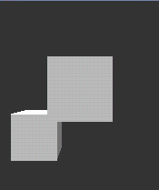
Draw Object
static const GLbyte
cubeVertices[] =
{
-15, -5, -5,
-5, -15, -5,
-5, -5, -5,
-15, -15, -5,
-15, -5, -15,
-5, -15, -15,
-5, -5, -15,
-15, -15, -15
};
static const Glubyte
cubeIndices[] =
{
0, 3, 1, 2, 0, 1,
6, 5, 4, 5, 7, 4,
4, 7, 3, 0, 4, 3,
2, 1, 5, 6, 2, 5,
4, 0, 2, 6, 4, 2,
3, 7, 1, 7, 5, 1
};
glEnableClientState (GL_VERTEX_ARRAY);
glVertexPointer (3, GL_BYTE, 0, cubeVertices);
glDrawElements(GL_TRIANGLES, 36, GL_UNSIGNED_BYTE,
cubeIndices);
This code fragment
draws this object.
Notes:
Made text bigger – too hard to see from back of room

Slide 16


Draw Object
3
!!
1
2
1
Order of drawing element（vertex） is important…
3
????
2
See what is happening on sample
application.
Notes:
Made text bigger – too hard to see from back of room

Slide 17
Draw Object
static const GLbyte
cubeVertices[] =
{
-15, -5, -5, // 0
-5, -15, -5, // 1
-5, -5, -5, // 2
-15, -15, -5, // 3
-15, -5, -15, // 4
-5, -15, -15, // 5
-5, -5, -15, // 6
-15, -15, -15 // 7
};
static const Glubyte
cubeIndices[] =
{
0, 3, 1, 2, 0, 1,
6, 5, 4, 5, 7, 4,
4, 7, 3, 0, 4, 3,
2, 1, 5, 6, 2, 5,
4, 0, 2, 6, 4, 2,
3, 7, 1, 7, 5, 1
};
y
x
4
6
Z=－15
7
5
y
x
0
2
Z=－5
3
1
Notes:
Made text bigger – too hard to see from back of room

Slide 18
Affine Transformation
Object handling is achieved by Affine Transformation
Typical transformation is provided by some functions
  e.g. glRotatex, glTranslatex, etc
Notes:
Made text bigger – too hard to see from back of room

Slide 19
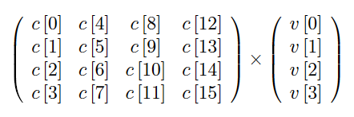
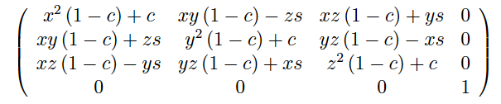
Affine Transformation
Affine Transformation is described as follow
E.g. Rotate the object
Notes:
Made text bigger – too hard to see from back of room

Slide 20
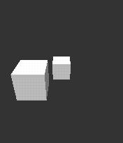
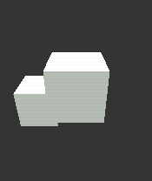
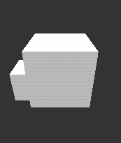
How to Handle Object
Object handling is achieved by Affine Transformation
glLoadIdentity();
// Load identity matrix
………
GLfloat sizeMatrix[] =
{
size,0 ,0 ,0,
0 ,size,0 ,0,
0 ,0 ,size,0,
0 ,0 ,0 ,1
};
glMultMatrixf( sizeMatrix );
Smaller
// Multiply the matrix
Larger
This transformation can be also done by
glScalef() function
Notes:
Made text bigger – too hard to see from back of room

Slide 21
Camera and Perspective projection
Initial camera position is set at (0,0,0)
  Need to move camera
  Instead of moving camera, move all other objects
Perspective projection is done by glFrustumf() function
  With no GLU functions on OpenGL ES, you cannot use gluLookat() function
// projection
glMatrixMode(GL_PROJECTION);
glLoadIdentity();
perspective(60.f, (float)width/(float)height, 0.1f, 100.f);
glTranslatef(ymove*10.f, xmove*10.f, -30.f*zmove);
Notes:
Made text bigger – too hard to see from back of room

Slide 22
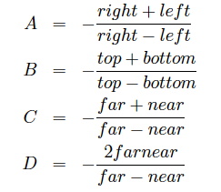
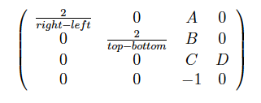
Perspective projection
GLfloat left, right, bottom, top;
top = zNear * (GLfloat)tan(fovy * 3.1415962f / 360.0);
bottom = -top;
left = bottom * aspect;
right = top * aspect;
glFrustumf(left, right, bottom, top, zNear, zFar);
glFrustnumf function provides projection
matrix. Projection matrix is as follow.
Notes:
Made text bigger – too hard to see from back of room

Slide 23
Lightning
Eight lights are supported in OpenGL ES 1.0 and OpenGL ES 1.1
Enabling light is done by glEnable(GL_LIGHTING ) and
glEnable( GL_LIGHT?) [? = 0 – 7]
Position of light is specified in coordinate array
Notes:
Made text bigger – too hard to see from back of room

Slide 24
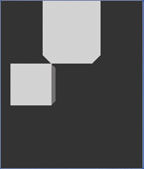
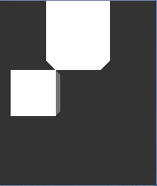
Lightning
static const Glfloat
light_position[] = { -50.f, 50.f, 300.f, 0.f };
//static const Glfloat
// light_position[] = { 50.f, 50.f, 300.f, 0.f };
static const Glfloat
light_ambient[] = { 0.25f, 0.25f, 0.25f, 1.f };
static const Glfloat
light_diffuse[] = { 0.5f, 0.5f, 0.5f, 1.f };
……
glEnable(GL_LIGHTING);
glEnable(GL_LIGHT0);
……
glLightfv(GL_LIGHT0, GL_POSITION, light_position);
glLightfv(GL_LIGHT0, GL_AMBIENT, light_ambient);
glLightfv(GL_LIGHT0, GL_DIFFUSE, light_diffuse);
glLightfv(GL_LIGHT0, GL_SPECULAR, light_diffuse);
Specify the position of light and else
Enable light #0
Notes:
Made text bigger – too hard to see from back of room

Slide 25
Swap Buffer
After all object are drawn, then swap surface to native window. eglSwapBuffer() function posts buffer to associated native window
m_display = eglGetDisplay(EGL_DEFAULT_DISPLAY);
m_surface = eglCreateWindowSurface(m_display,
m_config, m_window, NULL);
……
eglSwapBuffers(m_display, m_surface);
Notes:
Made text bigger – too hard to see from back of room

Slide 26
Agenda
What is OpenGL ES
Check the sample
Walk through the source code
Information source
Notes:
Made text bigger – too hard to see from back of room

Slide 27
Information Source of OpenGL ES
You can get everything you need to start OpenGL ES from
  http://www.khronos.org/devu/opengles_challenge/gettingstarted.html
http://www.khronos.org/opengles/index.html
  OpenGL ES specification
  EGL specification
  Header files
  Reference Manual
Notes:
Made text bigger – too hard to see from back of room

Slide 28
Tools
OpenGL ES 1.0/1.1 implementations are available for following platforms:
  Windows 2000/XP
  Linux (OpenGL ES 1.0)
  Nokia Series 60/Symbian OS
  PocketPC 2003
  Microsoft Smartphone 2003
Nokia Series 60 SDK 2nd edition Feature Pack 2 provides good samples about OpenGL ES (OpenGL ES 1.1)
  http://www.forum.nokia.com/main.html
Notes:
Made text bigger – too hard to see from back of room

Slide 29
Any Questions?
Notes:
Made text bigger – too hard to see from back of room

