Slide 1




Building scalable 3D apps
Tips & tricks for developers
Janne Hellsten, Head of R&D
janne.hellsten@hybrid.fi

Slide 2
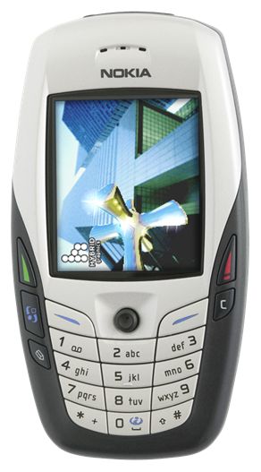


Three very good questions
Will there be low-end mass market 3D gaming?
  Are we going to evolve beyond simple 2D Java games?
  Technology done, it’s all about distribution models & customer interest
Are dedicated game phones going to be a success?
  Hey, I want to use my phone for talking!
  First attempt (N-Gage) interesting, but not financially viable... yet
    Practically all games with serious budgets were subsidized
And will individual gaming devices be important enough?
  Publishers & developers could target only a few select devices

Slide 3
Now, let me predict...
3D gaming will fly on ”regular” cell phones for a low-end market
  Retro-gaming
  New game genres taking into account special characteristics of cell phones
  Place for revolutions
Almost separate market for high-end game phones
  Console ports
  Still need to run popular ”low-end” games
  Place for evolution
A couple of game devices strong enough to form their own markets
  Launch titles still subsidized by device manufacturers (differentiation)
This means: much more variety than in PC or console space
  Like developing the same title for GBA and PS2...

Slide 4
What is this ”mobile platform”?
CPU speed and available memory varies wildly
  Starting generally from ~50Mhz, up to 600MHz on some PDAs
  Usually no floating-point units
Portability issues
  Different CPUs, operating systems, Java VMs, C compilers, ...
Different resolutions
  QCIF (176x144) to VGA (640x480), antialiasing on higher-end devices
  Color depths 4-8 bits per channel (12-32 bpp)
Different balancing between the CPU and GPU
  General-purpose multimedia hardware
    Pure software renderers (all done using CPU & integer ALU)
    Software + DSP / WMMX / FPU / VFPU
    Multimedia accelerators
  Dedicated 3D hardware
    Software T&L + HW tri setup / rasterization, Full HW
  Performance: 50K tris – 2M tris, 1M pixels – 100M pixels

Slide 5
Dealing with diversity
Problem: running the same game on 100+ different devices
  Must have same gameplay, but can scale video and audio
Solution: scalability through ”profiles” / quality settings
  Scalability built into game design
  Different profile combination for each device
    Performance profiles by operators / platform owners?
    Profiles pre-selected by developers
    If user can toggle features, controls must be high-level
3D content easy to scale
  Separate low and high poly 3D models
  Different texture resolutions & formats, compressed formats
  Scaling down special effects not critical to game play (particle systems, shadows)
    Important to realize what is a ”special effect”
  Rendering quality controls
    Texture filtering, perspective correction, blend functions, multi-texturing, antialiasing

Slide 6
Building scalable 3D applications
OpenGL ES was created to standardize the API and behavior
  ES does not attempt to standardize performance
  Two out of three ain’t bad
Understand differences between SW/HW configurations
  Trade-off between flexibility and performance
  Speed of querying derived state and reading back the frame buffer
  Are T&L and rasterization executed in parallel?
Scale upwards, not downwards
  Bad experiences of retro-fitting HW titles to run on SW
  Test during development on lowest-end platform
Both programmers and artists need education
  Artists can deal with almost anything as long as they know the rules
    .. And when they don’t, just force them (automatic checking in art pipeline)

Slide 7
Reducing state changes
Unnecessary state changes are the root of all evil
  Avoid changes affecting the vertex pipeline
  Avoid changes to the pixel pipeline
  Avoid changing textures
Combine state changes into blocks (”shaders”)
  Minimize number of shaders per frame
  Typical application needs only 3-10 ”pixel shaders”
    Different 3-10 shaders in every application
    Enforce this in artists’ tool chain
Sort objects by shaders every frame
  Split objects based on shaders
SW: Important to keep shaders as simple as possible
  Do even if introduces additional state changes
  Example: turn off fog & depth buffering when rendering overlays
HW: Usually more important to keep number of changes small

Slide 8
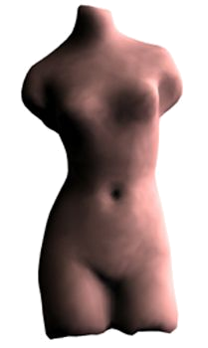
Of models and stripping
Use buffer objects of ES 1.1 for everything
  Only models changed manually every frame need vertex pointers
  Many LOD schemes can be done just by changing index buffers
Keep data formats short and simple
  Better cache coherence, less memory used
Minimize number of rendering calls
  Objectification: trade-off between no. of render calls & culling efficiency
  Combine strips using degenerate triangles
  Understanding vertex caching
    Automatically optimize vertex access order
    Triangle lists better than their reputation
Optimize data in your art pipeline
  Welding vertices with same attributes (with tolerance)
    Vertices/triangle ratio in good data 0.7-1.0
  Give artists as much automatic feedback as possible
SW: using constant attributes

Slide 9
Transformations and matrices
Minimize matrix changes (demo)
  Changing a matrix may involve many hidden costs
  Combine simple objects with same transformation
  Flatten and cache transformation hierarchies in scene graphs
ES 1.1: Matrix readbacks
  Use matrix stack machinery in setup and non-time-critical operations
ES 1.1: Skinning using matrix palettes (demo)
  CPU does not have to touch vertices in animated objects
  Character animation, natural motion: grass, trees, waves
ES 1.1: Point sprites (demo)
  Smoke, fire, explosions, water flow, stars, weather effects
  Scale controls through PointSizeArray, PointSizeAttenuation
  Expensive to do in ES 1.0
  Drawback: can’t rotate sprites or textures, fixed texture coordinates

Slide 10
Lighting and Materials
Fixed-function lighting pipelines are so 1990s
  Drivers implemented badly even in desktop space
  In practice only single directional light fast
  OpenGL’s attenuation model difficult to use
  Spot cutoff and specular model cause aliasing
  No secondary specular color
While we’re waiting for OpenGL ES 2.0...
  Pre-computed vertex illumination good for T&L bound devices
  Illumination using texturing
    Light mapping
    ES 1.1: dot3 bump mapping + texture combine
    Less tessellation required
Use color material tracking for changing materials
Flat shading is for flat models!

Slide 11
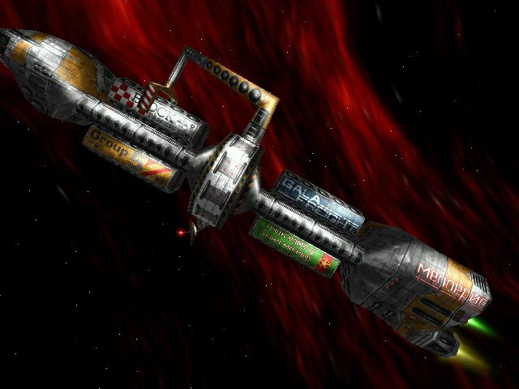
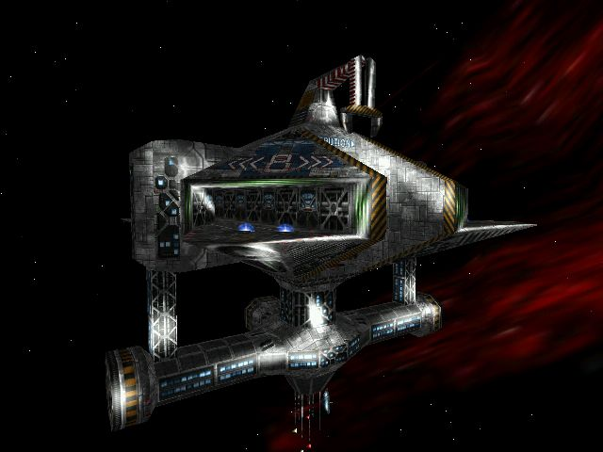
Illumination using multitexturing
  Classic ”fake phong shading”
  Images from Starlancer (Warthog/Microsoft)
  Software rendering, very few triangles in each model

Slide 12
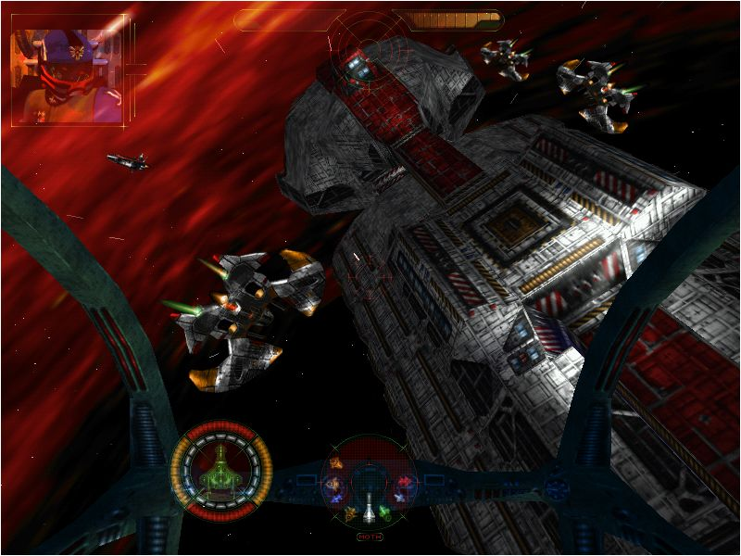

Slide 13
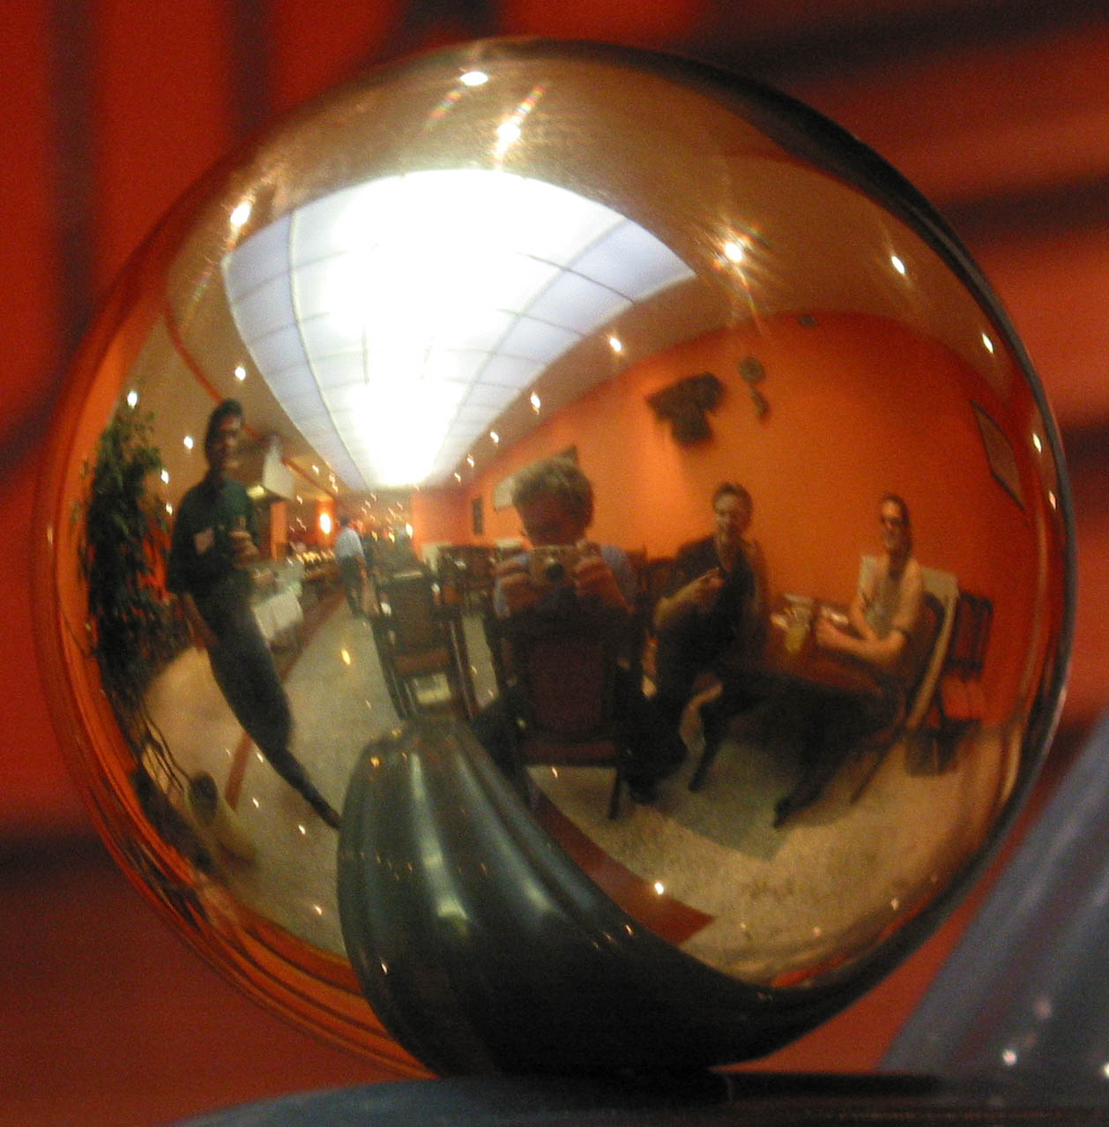

Slide 14
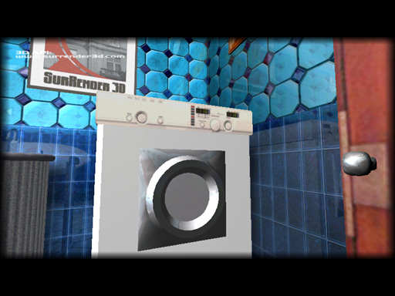
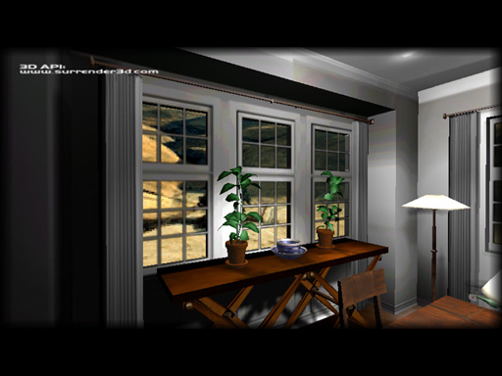
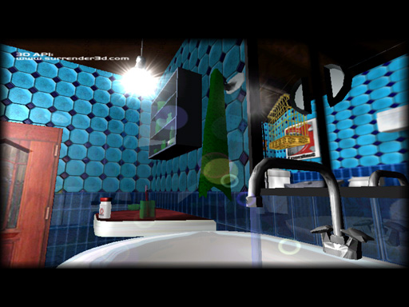
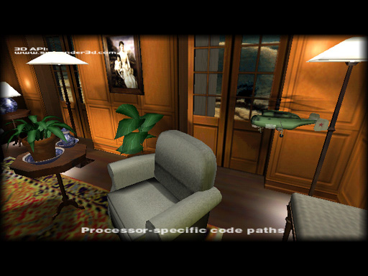

Slide 15
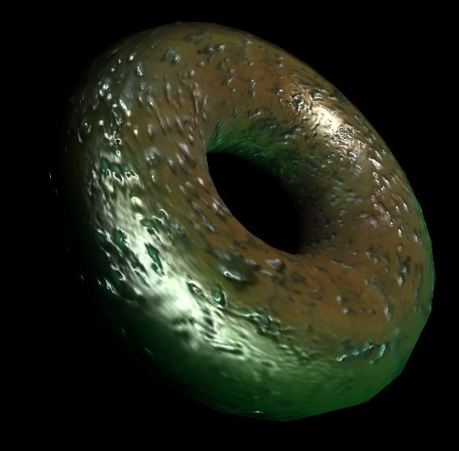
Textures
Mipmaps always a Good Thing™
  Improved cache coherence and visual quality
  ES 1.1 supports auto mipmap generation
Different strategies for texture filtering
  SW: Use nearest filtering, HW: Use high-quality filtering
Multitexturing - for texture-based lighting
  Always faster than doing multiple rendering passes
  ES 1.1: support at least two texturing units
  ES 1.1: TexEnvCombine neat toy
SW: Perspective correction not always needed
Modifying textures bad idea
Keep textures ”right size”, use compressed textures
Combine multiple textures into one
  Reduce number of texture state changes (for fonts, animations, light maps, ..)

Slide 16



Textures and shots from Kesmai’s Air Warrior 4 (never published)

Slide 17
The high-level pipeline
Organize objects hierarchically
  Triangles organized into spatially coherent ”objects”
  Conservative bounding volumes (spheres, boxes) computed for each object
Five-step program for fast rendering
  1. Render background and very distance objects
    Sky cubes, impostors (use sky box to clear the background)
  2. Remove quickly objects not contributing to final image (culling)
  3. Apply level of detail computations
    Cull-away sub-pixel-size objects (contribution culling)
  4. Optimize redundant lighting and fog operations
  5. Sort remaining objects into optimal order

Slide 18
Culling and sorting
Culling strategies
  Occlusion culling
    Potentially Visible Sets and Portals good low-cost solutions
    ES 1.1 provides user clip planes to help with portals
  Hierarchical view frustum culling with plane masks
  Back-face culling
    Are we inside our outside the object? Terrains and indoors don’t cull well
SW-only: Optimizing non-contributing light and fog
  Compute distance from light or camera to object’s BV
  If BV cannot be lit (due to light’s attenuation), disable the light
  If BV cannot be fogged (due to fog range), disable fogging
Sort remaining objects into optimal rendering order
  Minimize shader changes
  Keep objects in front-to-back order
    Improves Z-buffering efficiency
  Satisfying both goals: bucketize objects by shader, sort buckets by Z

Slide 19

Thank you for staying awake!
Any questions?
If there’s time, run ”Love is a Fix”,
otherwise say something witty

