Slide 1

Real-number abstraction Portability and performance for OpenGL ES
Phil Atkin
Imagination Technologies

Slide 2
About Imagination Technologies (IMG)
IP company, we license multimedia Intellectual Property cores
  Our customers are chip makers
  Our main markets are consumer and handheld devices
  3D, digital video, display, mobile TV, digital radio
Public company, listed on full London exchange
Technology divisions plus consumer electronics
  PowerVR – 3D, digital video encode/decode, display
  Ensigma – communications processors and tools
  Metagence – multithreaded CPUs
  IMGworks - IP to tape out full-service design consultancy for IMG licensees
  PURE Digital - leading digital radio brand in the UK
Today we will focus on PowerVR division
PowerVR MBX and MBX Lite
  De facto standard 3D cores for accelerated OpenGL ES
  Licensed to 6 of top 10 world semiconductor companies
    Freescale, Intel, Philips, Renesas, Samsung,TI
  Note to developers - if you tune for MBX / MBX Lite you hit virtually the entire market

Slide 3
The handheld 3D challenge
Handheld 3D chips / GPUs are pretty amazing
  Low power, long battery life, yet extraordinary performance
  > 1M tris/sec from low-end devices
  > 50M pixels/sec from low-end devices
  Hardware geometry acceleration
  Multitexturing, Dot3 bump-mapping
Everyone agrees. It’s amazing.
  So now the chipmakers have licensed the IP and made the 3D chip.
  And the handset manufacturers have designed it in.
  Now the developers have to make it sing. No pressure.
So what’s the problem?
  The platform has to keep the GPU busy
  Handheld platforms more constrained than desktop
The handheld 3D challenge is actually a handheld platform challenge
  Low clock rates on handheld CPUs compared to desktop – couple of hundred MHz
  Smaller caches, shorter pipelines, bigger miss penalties
  Relatively low overall memory bandwidth compared to desktop
  Unified memory systems - CPU shares bandwidth with media processors
And the single biggest issue – typically no FPU

Slide 4
Is the lack of FPU really such a problem?
Simple fix #1 - Code in fixed-point always
  Some CPUs (including very high volume parts) will have an FPU
  It was included for a reason
  On systems with an FPU, floating-point maths is typically
    higher performance
    lower power-consumption than fixed-point
  We have established that handheld platforms are constrained
    hence demand high coding efficiency
  To operate efficiently you must use floating-point if the FPU is present
Simple fix #2 - Code in floating-point always
  Clearly, this is fine if we have an FPU - but many platforms will not
  Issue now is overall performance rather than efficiency
  Performance of emulated floating-point on handheld CPUs is poor
    Typically 1/10 that of fixed-point, or worse
    Really bad relative case - FPADD
      Fixed-point add is a single-cycle register-to-register add
      Floating-point add could be as high as 100 cycles
  Hence to keep the 3D engine busy you must use fixed-point if FPU is absent
How to manage a common code base and address both cases?

Slide 5
Proposal - real-number abstraction
2 C++ real-number classes
  Floating-point class – example ‘PVRFloat’
  Fixed-point class – example ‘PVRFix’
Provide identical functionality for fixed and floating-point classes
Compile-time switch to select one of these as default ‘real number’
  Platform by platform, class ‘PVRReal’ is just a #define or typedef
Intended usage is the following –
  Majority of application coding uses PVRReal
    e.g. Matrix manipulation and accumulation
    Application lighting
    Frustum culling
    Intersection, collision and lots of physics code
  This ensures best performance on target platform
  But if floating-point precision or range is definitely needed, use float explicitly

Slide 6
Floating-point class
class PVRFloat {
public:
float value;
PVRFloat(float v) { value = v; }
PVRFloat(int v) { value = (float) v; }
PVRFloat() : value((float)0) {}
void operator+=(const PVRFloat& rhs) { value+=rhs.value; }
void operator-=(const PVRFloat& rhs) { value-=rhs.value; }
void operator*=(const PVRFloat& rhs) { value*=rhs.value; }
void operator/=(const PVRFloat& rhs) { value/=rhs.value; }
operator float() const { return value; }
operator int() const { return (int) value; }
etc.

Slide 7
Fixed-point class
class PVRFix {
public:
int value;
PVRFix(float v) : value((int) (v*65536.0f)) {}
PVRFix(int v) : value( v<<16 ) {}
PVRFix() : value(0) {}
void operator+=(const PVRFix& rhs) { value+=rhs.value; }
void operator-=(const PVRFix& rhs) { value-=rhs.value; }
void operator*=(const PVRFix& rhs) {
fix_value = (int) ((value*(int64)rhs.value) >> 16);
}
void operator/=(const PVRFix& rhs) { PVRdivby(rhs); }
operator float() const { return value*(1.0f / 65536.0f); }
operator int() const { return value >> 16; }
etc.

Slide 8
Platform-specific optimizations
Fixed-point multiply demands consideration for ‘native’ implementation
  Note that the function we need is not expressible in C++ without promotion
    32x32 => 32 with 16-bit shift
    Demands 64-bit intermediate result
  Generic C++ version requires a promotion of one operand to long long
  Implemented as
    c = (a * (long long) b) >> 16;
  Likely to compile into a 64x64 bit multiply using at least 2, possibly 4 multiply operations
Dell Axim X50V (Intel 2700G)
  No floating-point unit in XScale CPU
  But very fast CPU for a handheld - 624MHz
  Generic PVRFix multiply implementation has been sufficient to date
Renesas SHMobile-3 and SH-MobileA
  No floating-point unit
  216MHz CPU in SH-Mobile3
  Architecture provides exactly the multiply we needed, but not available directly in C++
  Required a 5-line assembly-coded multiply operator
TI OMAP 2420
  Has floating-point unit, use floating-point class

Slide 9
Approaches to implementing division
Firstly, do you divide often enough to care?
  Would very much care if we owned perspective projection in 3D pipeline
  Definitely a secondary issue most of the time
  But worth understanding
1 - Trust the compiler
  c = (int) ((((long long) a) * 0x10000) / b);
  But you never know what will get compiled in by this – multiple library calls?
  And if the target CPU does not have a divider, this version really will crawl
2 – Do it yourself
  Newton iteration driven by a short table is the approach taken
  Normalize – shift n until in range 0.5f <= n < 1.0f
  Reciprocate approximation – short(ish) table
  Newton step
  Denormalize – de-shift by amount we first shifted by
  PVRReal reciprocation will only yield 16 good bits of reciprocal
  If you need better accuracy, do it in explicit floats
Similar approach used for PVRsqrt()
  Normalize, approximate, iterate, denormalize

Slide 10
Approaches to trig
Trig can be very expensive
  And often only available in double precision
Approach used is piecewise quadratic approximations
  Split 90º into 16ths of 5.625º
  Fit a quadratic to each of these short segments of sine wave
  This can form part of a supplementary library coded entirely with PVRReal
    i.e. the floating-point version is the same source as the fixed-point
  It’s much more like how apps look
PVRReal
PVRsin(PVRReal pangle)
{
// first isolate into a quadrant ...
// then determine desired sign of result ...
// compute index into quadratic coefficient table
PVRReal t=angle * (PVRReal) (1.0f / 5.625f);
ret=quadCoeff[ix]+(t*(quadCoeff[ix+1] + (t*quadCoeff[ix+2])));
if (neg) ret=-ret;
return ret;
}

Slide 11
Negative aspects of abstraction
False sense of security – feels like floats
  Never forget - you may be on a fixed-point platform
  So be careful what you multiply – intermediate results get unrepresentable very quickly
  e.g. Pythagoras to find radius – it will blow up on you
The abstraction simplifies application coding …
  No ugly macros to provide multiply functionality
  Readability is much improved
    d = ((a*b)+(c*d)+(e*f))*(PVRReal) (1.0f / 3.0f);
  Compared with
    d = fixedAdd(fixedMul(a,b),fixedMul(c,d))etc.
… but complexity re-emerges at interface to OpenGL ES
  OpenGL ES requires simple integers
  Interactions with OpenGL ES are at
    Transfer of matrices and material properties
    Transfer of geometry
  Need to ‘de-class’ at these points, which is unfortunate and ugly
  Example – passing modelView matrix to driver
    Rather hideous use of ‘address of first element of array of class’ -
      glLoadMatrixx (&matrix[0][0].value);
    Alternative – promote to floats – but not available on Common Lite profile
Leads to a desire to hide OpenGL ES interactions
  To hide the ugliness
  To make coding generally safer – less likely to see accidental type conversions
  Best use of this kind of abstraction is within a more general abstraction layer

Slide 12
Demos
Coded with in-house 3D framework
  Collection of small C++ classes for 3D rapid application prototyping and development
  Abstracts out OpenGL ES and numeric format
  PVR-TC 4-bit and 2-bit per texel compressed textures
  Very thin veneer over directly coding to PowerVR MBX hardware
  Aim is to have no performance disadvantage associated with coding to the framework
Implemented atop PowerVR OpenGL ES SDK
  SDK now available, open and free from PowerVR Developer Relations
Cross-platform demos
  Dell Axim X50V, Windows Mobile 2nd Edition – no FPU
  Renesas SH-Mobile3, uITRON and Linux – no FPU
  Renesas SH-MobileA, uITRON and Linux – no FPU
  Texas Instruments OMAP 2420, Linux – vector floating-point unit
Live demo platform – Dell Axim X50V
  Fixed-point platform
  Intel XScale CPU, 624MHz
  Intel 2700G multimedia coprocessor
  VGA resolution display

Slide 13
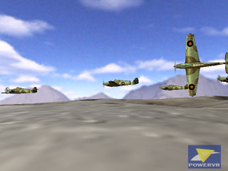
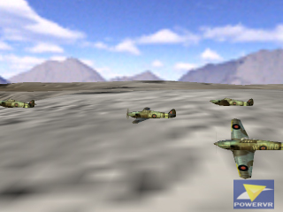
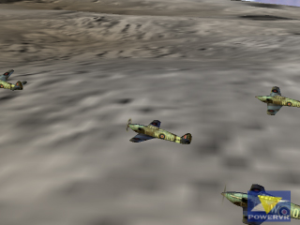
PowerVR Hurricanes
Frustum-culling exercise
  Skybox
  Hierarchical terrain and planes
No physics
  Just splines being followed
Entire app coded in PVRReal
  Application executes zero floating-point operations
  Although framework performs floating-point operations on frustum setup and matrix inversion

Slide 14

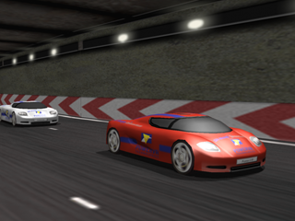
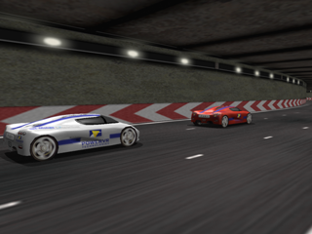
PowerVR Racer
‘Game-like’ cross-platform demo
  20+ track segments containing 25k+ triangles
  Multiple LODs per car, peaking at 1,500 triangles
  CPU reflection-mapping
  No frustum culling, just track section disabling
  PVR-TC everywhere
Suspension physics
  But driven by car bodies following spline paths – still not ‘real game code’
Entire app coded in PVRReal
  Suspension, banking, braking

Slide 15
Conclusions
Real number abstraction works
  At least for demos!
    Next step, a much more significant application
  You’ll probably be surprised how much can be done in fixed-point
  Use with wisdom – know what the variable represents and how big / small it will be
  It doesn’t solve everything – you will have to use floats
    Examples – matrix inversion, frustum plane equations
And we care about real number abstraction because
  There will be handheld gaming platforms with and without floating-point units
  They demand to be treated differently
    Coding to floats too slow on FPU-less platforms
    Coding to fixed-point inefficient on FPU-accelerated platforms
  Directly conflicting this is the desire to code once and to hit all bases with one development
Hence a real number abstraction
  Delivers platform-tuned executables from a single codebase
  Is highly intuitive
  d = c+((a*b)*(PVRReal) 0.53f);
Downside – makes interaction with OpenGL ES more complex
  But since most apps will be coded to a middleware layer, just include abstraction in middleware

