Slide 1
Migration: Porting a Game from PC to handheld
Jeff Rous
Intel Corporation

Slide 2
Overview
Introduction to Cube*
The Project
Device Considerations
Performance Considerations
Challenges & Optimizations
Summary

Slide 3
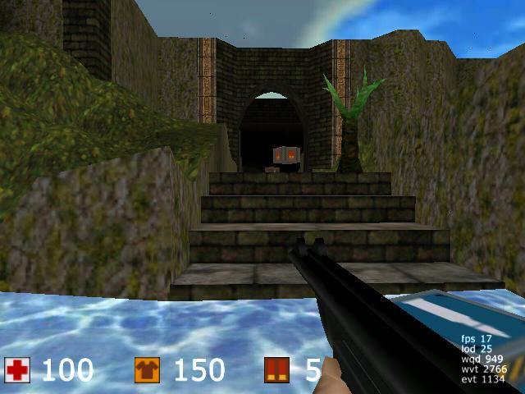
Introduction to Cube*
First person shooter genre (QUAKE*-like)
Open source code and art work
Win32* and Unix* platforms
OpenGL rendering engine
Dynamic occlusion testing
Multiplayer via TCP/IP
Dynamic lighting
Physics
Permission from Wouter van Oortmerssen

Slide 4
The Project
OS Target: PocketPC* 2003 Second Edition
Port rendering engine to OpenGL* ES 1.0 Common-Lite
  Convert math from floating to fixed point
  Emulate unsupported desktop functions
Replace unsupported Win32* calls
Optimize for hardware target
  Intel XScale® PXA270 processor
  Intel® 2700G Multimedia Accelerator
Cross-architecture multiplayer (PC vs. PDA)
Proof of Concept for 3D game ports

Slide 5
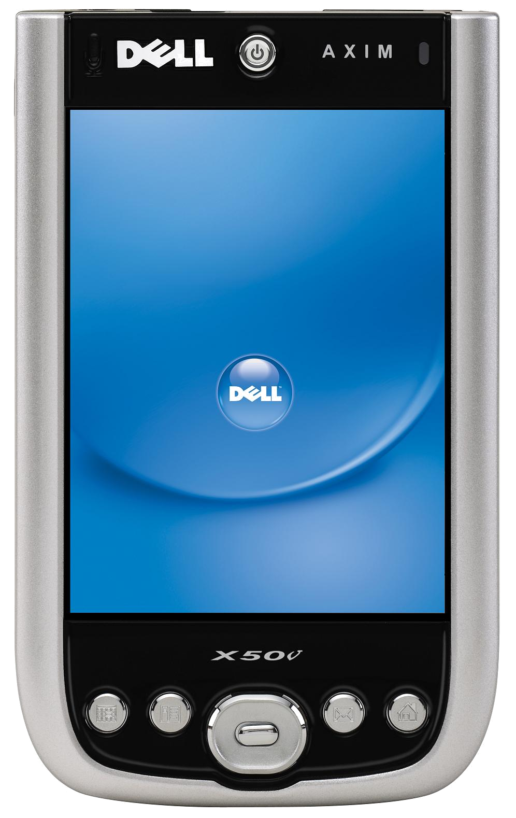
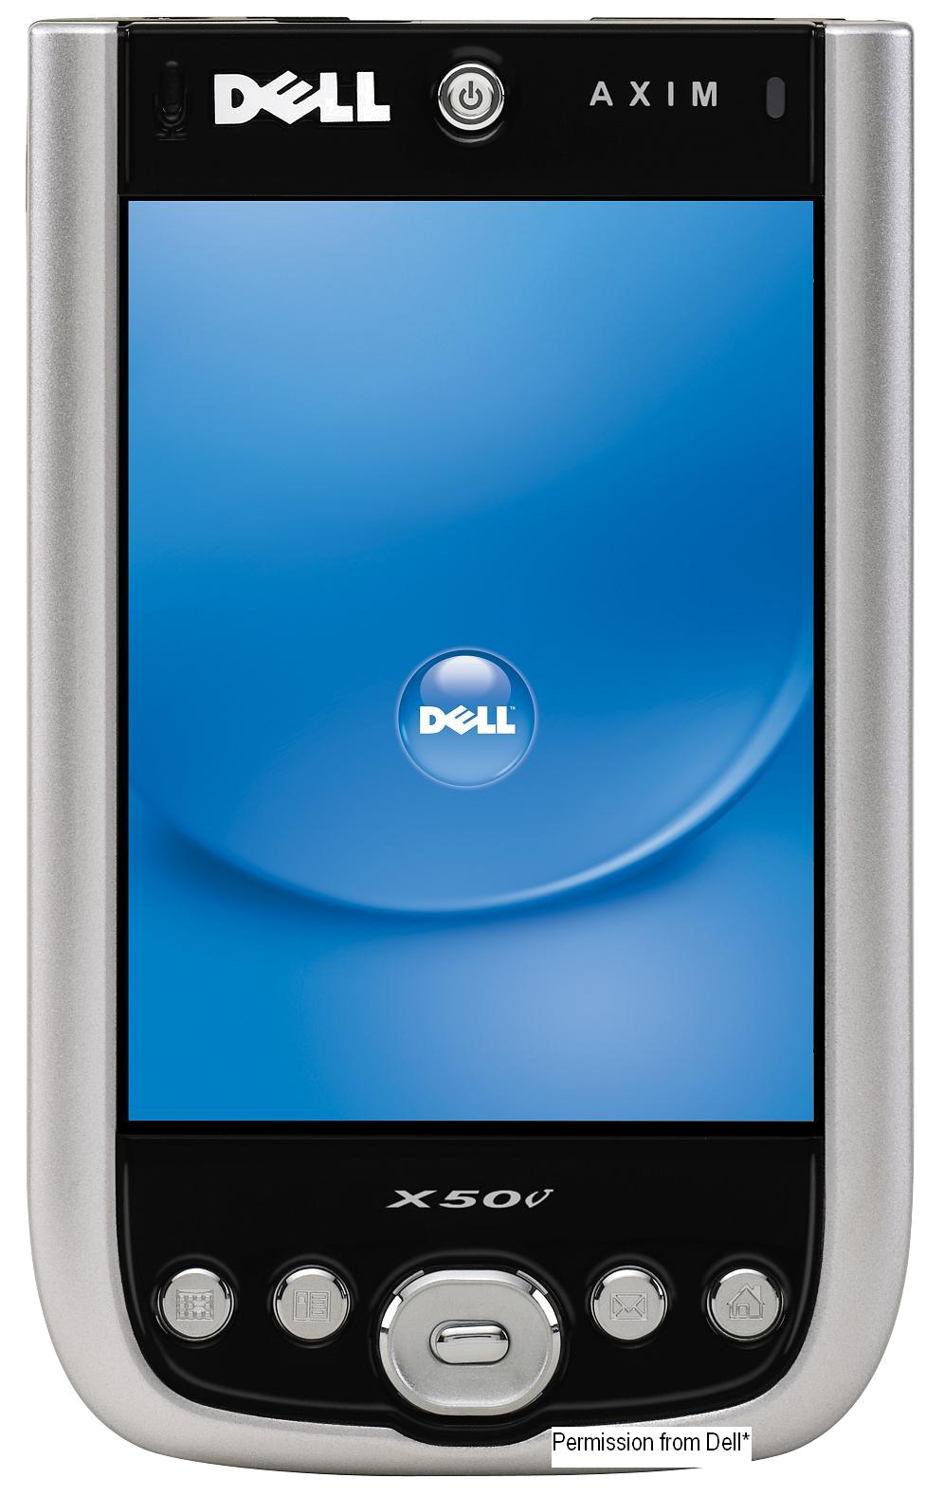
Device Considerations
Power Management
Sleep
Resolution
  Window sizing & scaling
  Font size
Hardware capabilities
  Integer or FP math preferred
  OpenGL* ES implementation
  CPU, memory
Ergonomics
  Stylus
  Button placement
  Screen orientation

Slide 6
Performance Considerations
Tradeoffs
  Field of view
  Far plane
  Less precise division
Art assets
  Powers of two
  Compression
  Pre-generated mipmaps
Optimizations
  Frequently used routines in fixed point
  Pre-built performance libraries
  Profile guided
Tip: Test game on an older PC to gauge relative performance

Slide 7
Geometry
Challenges:
  Eliminating immediate mode
  Eliminating function lists
  Converting vertices from floating to fixed point
Recommendations:
  Native fixed point vertices
  Draw call reduction
    Geometry sorting by texture
    Primitive combining
    Triangle lists
QueryMatrix
Challenges:
  Not part of 1.0 spec
  Developers implement transform stack
  Often unanticipated in development cycle
Recommendations:
  Don’t rely on GL matrices
  If a stack must be written:
    Use LoadMatrix to test functions
    Don’t forget PushMatrix and PopMatrix!

Slide 8
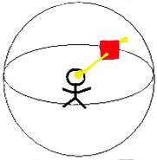
Line of Sight
No get depth component in ReadPixels
Used for shooting and AI
To emulate:
  Use camera position and orientation
  Cast a ray along this line
  Search for bounds of objects that cross ray
  Determine distance to closest object

Slide 9
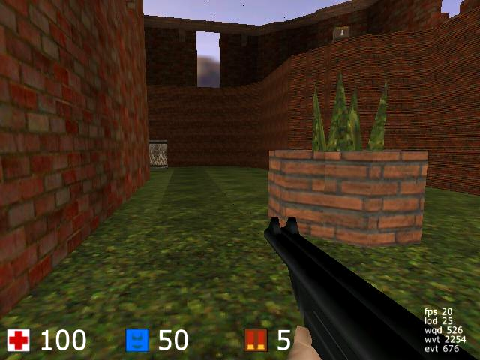
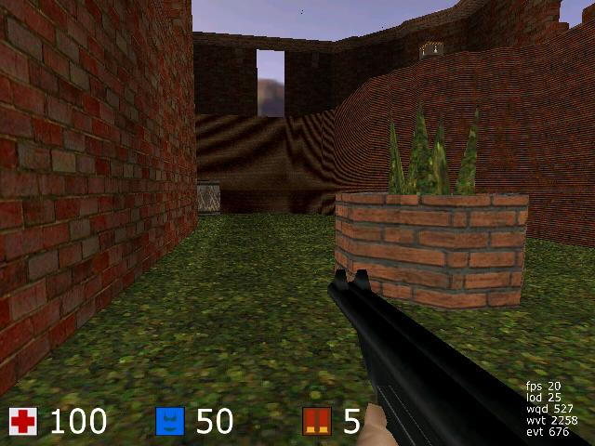
Mipmap Generation
Not part of OpenGL* ES 1.0 spec
Average of four pixels method
Permission from Wouter van Oortmerssen
Permission from Wouter van Oortmerssen

Slide 10
Mipmap Generation Algorithm
glTexImage2D(GL_TEXTURE_2D, 0, GL_RGB, width, height, 0, GL_RGB, GL_UNSIGNED_BYTE, texture);
while (width > 1 || height > 1)
{ width = width >> 1;
height = height >> 1;
++level;
for(unsigned int row = 0; row < height; ++row)
{ for(unsigned int col = 0; col < width; ++col)
{
Texel p00 = GetTexel(texture, (2 * row * (width * 2) + 2 * col) * 3);
Texel p01 = GetTexel(texture, (2 * row * (width * 2) + 2 * col + 1) * 3);
Texel p10 = GetTexel(texture, ((2 * row + 1) * (width * 2) + 2 * col) * 3);
Texel p11 = GetTexel(texture, ((2 * row + 1) * (width * 2) + 2 * col + 1) *3);
Texel result =Texel((p00.r + p01.r + p10.r + p11.r) / 4,
(p00.g + p01.g + p10.g + p11.g) / 4,
(p00.b + p01.b + p10.b + p11.b) / 4);
    texture[(row * width + col)*3] = result.r;
  texture[(row * width + col)*3+1] = result.g;
  texture[(row * width + col)*3+2] = result.b;
  }
  }
  glTexImage2D(GL_TEXTURE_2D, level, GL_RGB, width, height, 0, GL_RGB, GL_UNSIGNED_BYTE, texture);
}
Copyright © 2004, Hans-Martin Will. All rights reserved. Portions
copyright © 2005 Intel Corporation. This software program is licensed subject to the open source License, available at ogl-es.sourceforge.net/legal.htm

Slide 11
Summary
3D game ports from PC now a reality
Know your target platform
Optimization techniques
Challenges of porting a game
Usable code is in your packets!

Slide 12
Demo

