Slide 1
OpenGL ES development on
Series 60 & Symbian
Jani Vaarala
Graphics Architect, Nokia

Slide 2

Outline
Devices
SDKs
Developer forums
Nokia Series60 FP2 SDK Tour
Symbian basics
Example build & run walkthrough
Symbian OS tips’n’tricks
Notes:
Devices == on the market, you can immediately target to
Libraries == different SW libraries (multi-platform)

Slide 3
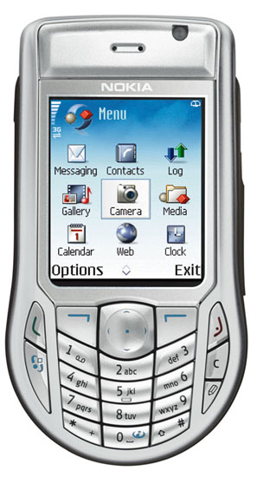
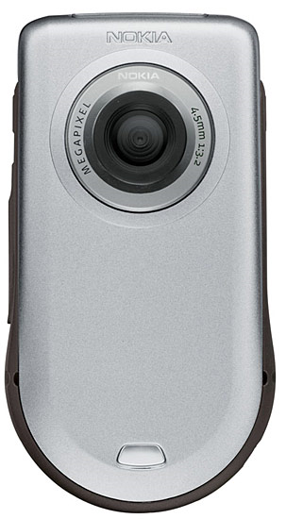
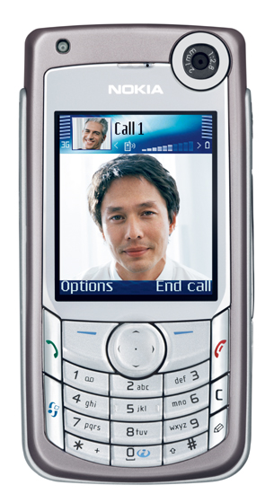
Nokia Devices with OpenGL ES (1)
Nokia 6630
  Comes with built-in OpenGL ES 1.0 Common support
  Supports also M3G for J2ME developers
  Available now
Nokia 6680
  262144 color display
  Supports also M3G
  Availability 1Q/05
  Expected to be OpenGL ES 1.0 CM conformant

Slide 4
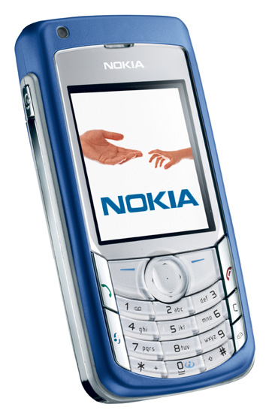
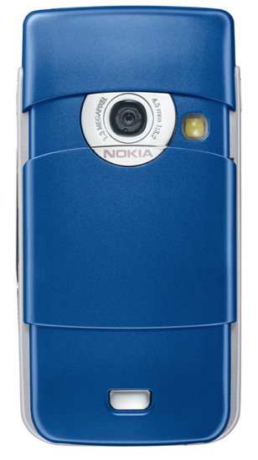
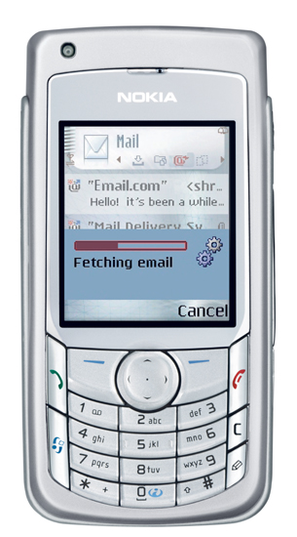
Nokia Devices with OpenGL ES (2)
Nokia 6681
  262144 color display
  Supports also M3G
  Availability 1Q/05
  Expected to be OpenGL ES 1.0 CM conformant
Nokia 6682
  262144 color display
  Supports also M3G
  Available 2Q/05
  Phone for Americas market
  Expected to be OpenGL ES 1.0 CM conformant
All 4 phones should have roughly the same 3D performance

Slide 5
Developer forums
Forum Nokia Discussion boards: http://discussion.forum.nokia.com/forum/
  Ask questions about development on Nokia devices here (including OpenGL ES)
  E.g., Nokia 6630, 6880, 6881, 6882 (once released)
Khronos developer forums:
http://www.kronos.org -> OpenGL ES -> OpenGL ES forum
  Ask any generic OpenGL ES questions here (development, coding contest, …)

Slide 6
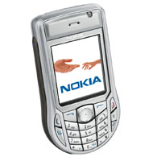
Nokia Series60 SDK FP2 / FP3
Support for OpenGL ES
  12 code examples with documentation
  SDK documentation about OpenGL ES
  Performance tips’n’tricks
  New examples coming to Forum Nokia
Supports Nokia 6630, 6880, 6881
SDK documentation
  VC6 & .NET:
    Start -> Programs -> Series 60 Developer tools -> 2nd Edition SDK Feature Pack 2 -> 1.0 -> SDK Help
  Metrowerks:
    Start -> Programs -> Series 60 Developer tools -> 2nd Edition SDK Feature Pack 2 -> Metrowerks -> SDK Help
  Type “OpenGL ES” into search box and select “OpenGL ES” link

Slide 7
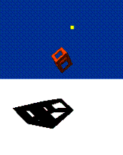
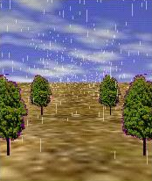


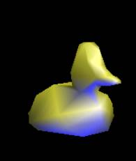
Examples (in SDK)

Slide 8
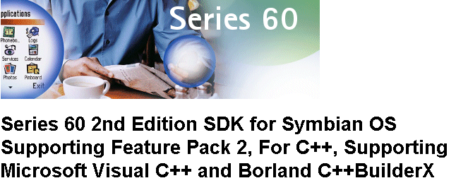
SDK Tour

Slide 9
Symbian basics
C++ API and programming model
MVC Application Architecture
Three flavors of multitasking:
  Processes, can contain multiple
  Threads, can contain multiple
  Active Objects (form of co-operative multi-tasking)
No C++ exceptions
Multiple inheritance not recommended
Coding Conventions: Naming scheme, CleanupStack, …

Slide 10
Application Classes
DATA
EXAMPLE.APP (.DLL)
Application
Document
AppUI
Container
VIEW
Handle Commands (Events, Keys)
Handle Application views

Slide 11
Build Process
OGLExample.MMP
BLD.INF
PLATFORM INDEPENDENT
OGLExample2.MMP
BLDMAKE.BAT
MAKMAKE.BAT
“Import MMP file”
ABLD.BAT
OGLExample.DSW
COMPILER / IDE DEPENDENT
UREL
WINS
ARMI
WINSCW
WINS
UDEB
THUMB
EABI

Slide 12
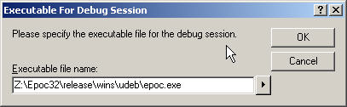
Building & Running
Just press F5 to build’n’run (Visual Studio)
Emulator can be launched from the debugger OR
It can be launched independently

Slide 13
Target build & deployment
Target build is done in the group folder:
  bldmake.bat bldfiles
  ./abld.bat build thumb urel
Installation file (oglexample.sis) is created (in ‘install’ folder):
  makesis.bat OGLEXAMPLE.PKG
  PKG-file contains a list of files to be included in the installation package
  This file can be sent to phone via Bluetooth, Infrared, or installed from a wap/web page (installed to phone via browser)
Application UIDs
  Allocated by Symbian
  See SDK for more info
  mailto: UID@symbiandevnet.com to allocate

Slide 14
OpenGL ES linkage in Symbian / S60
OpenGL ES and EGL are provided in a single DLL
There are two DLLs that can exist (one or both):
  libGLES_cm.dll (Common profile)
  libGLES_cl.dll (Common-lite profile)
Series 60 provides only the Common profile DLL
  If you want to port your common-lite application to Series 60, just link it against libGLES_cm.dll
  Common profile DLL includes all Common-lite entry points
  Common is supported, but use only integer vertex data

Slide 15
Projective Shadow example
Location: c:\Symbian\8.0a\S60_2nd_FP2\Series60Ex\openglex\shadows
Example code that is presented can be found from the SDK

Slide 16
Tips & tricks, window & focus
Avoid clipping, track the application focus
  EGL can be implemented in different ways
  Many implementations probably use direct screen access (6630)
  If direct screen region (render window) is clipped by a dialog, implementation may halt rendering or render slower (clipping)
  Track the application focus ! (MCoeForegroundObserver)
Use full-screen windows when possible
  Some OS fast paths may be in use for full-screen windows (6630)
  Also, tearing-free updates may only work in full-screen mode

Slide 17
Mixing native rendering (1)
Rendering native graphics is not allowed for configs that are not marked as EGL_NATIVE_RENDERABLE
  Doing so will make results UNDEFINED
Alternatives:
  Use EGLPixmapSurface (if supported) // mix: many times
    Make pixmap surface current, render GL stuff
    Call eglWaitGL( )
    Use the native pixmap
    Call eglWaitNative( EGL_CORE_NATIVE_ENGINE )
  Use eglPbufferSurface (if supported) with eglCopyBuffers( ) // mix:once
    Make pbuffer surface current, render GL stuff
    Call eglCopyBuffers( ) to copy the the data to Symbian bitmap
    Blit the bitmap to display

Slide 18
Mixing native rendering (2)
Use EGLPbufferSurface (if supported) with glReadPixels( ) // mix: once
  Make pbuffer surface current, render GL stuff
  Call glReadPixels to get the pixel data
  Lock the Symbian bitmap
  Get the pointer to the bitmap data ( bitmap->DataAddress( ) )
  Copy that data to Symbian bitmap
  Unlock the bitmap
  Use Symbian bitmap
Use textures // mix: many times
  Render native graphics to a Symbian bitmap
  Lock the bitmap (bitmap heap is locked -> address can’t change)
  Get the pointer to the bitmap data ( bitmap->DataAddress( ) )
  Create a texture from the bitmap ( glTexSubImage2D )
  Unlock the bitmap
  Use the texture to overlay the native graphics to display

Slide 19
Tips & tricks, portability (1)
How to get maximum portability across Symbian and S60 devices?
If possible, don’t use extensions
  If extensions are used, have alternate code paths
Use OpenGL ES 1.0 (for now)
To support older devices, integrate a fallback SW engine
  But, do it in proper way so that you get also HW acceleration
  Apps then work just on newer devices with (pre-)installed OpenGL ES
  If this is not strictly a requirement, don’t integrate at all (smaller app)

Slide 20
Tips & tricks, portability (2)
How to properly integrate the fallback SW engine ?
Use dynamic link-loading (RLibrary):
If loading succeeds, use this
Renderhw.DLL
libGLES_cm.dll
Application
Rendersw.DLL
libSWGLES.dll
OR
If loading fails, use this
Rendersw.DLL
3D ENGINE

Slide 21
Tips & tricks, portability (3)
What about OpenGL ES 1.1 ?
  No official 1.1 .LIB files exist yet
  Apps written against current 1.1 SW implementations may not work when 1.1 .LIB comes
How to work with OpenGL ES 1.0 and 1.1 inside the same app?
  Use case: use 1.1 features if 1.1 available, else use 1.0
  This can be achieved with same trick as in previous slide
  There may be something to help working with 1.0 and 1.1 in future SDKs

Slide 22
Tips & tricks, miscellaneous
Work with minimum requirements if possible
  E.g., don’t require more than 15 bits of depth buffer (or use stencil)
Do not use fixed config IDs
  IDs may change
Match config with color depth of the surface (Pixmap, Window)
  Matching config guarantees best performance
Use lower bit-depth textures if possible
  Implementation can choose the best performing texture format
Do not install OpenGL ES DLL to system libs folder
  May prevent other apps to get HW acceleration
FPS may be limited by the display system
  Double-buffered synchronized updates
  Do other processing between eglSwapbuffers and first eglClear/glDrawXYZ call
More tricks in the SDK (performance etc.)

Slide 23
SDK FAQ & Typical pitfalls
Don’t use global non-const data
  APPs are DLLs
  The only way to have global data in DLL is through TLS
Don’t use unaligned data accesses
  Target processor may not support unaligned data
Floating point exceptions
  On Windows typically floating point exceptions are disabled
  On a target device, floating point exceptions are enabled (can be disabled, see SDK)
Active Object Scheduler
  Don’t block the AOS with long-running tasks (“ViewSRV 11”)
3D in emulator is slow
  It is actually currently SLOWER than on the real HW
  No use when measuring performance

Slide 24
Want to learn more?
Download the SDK from www.forum.nokia.com
Join the webcast (Americas)
Forum Nokia Webcast: OpenGL ES, March 22, 10 A.M. CST
  This Webcast will cover the Khronos Group's Open Graphics Library for Embedded Systems (OpenGL ES) and OpenVG. The discussion will include a short comparison of ES with the OpenGL desktop version, along with Nokia device support information. Also covered with be performance-optimization tricks that really make a difference in performance
Register in:
http://americas.deviceprograms.forum.nokia.com/learningseries.asp

Slide 25





Any Questions?

