Slide 1
OpenVG Overview
April 8th, 2005
Daniel Rice
Senior Staff Engineer
Sun Microsystems, Inc.
Koichi Mori
Nokia

Slide 2
Agenda
Motivation
  Background, Use cases, Problems to be solved
OpenVG in a Nutshell
  Milestones & Deliverables
  Feature set
  How to work with other Khronos APIs
Technical Introduction

Slide 3
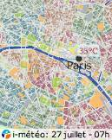
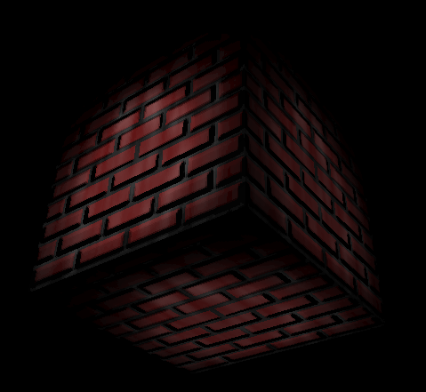
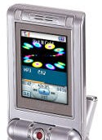
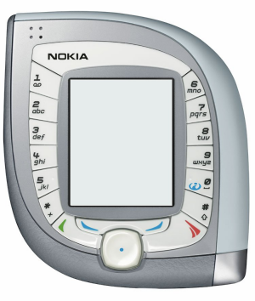
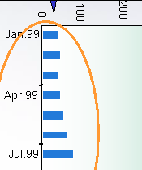
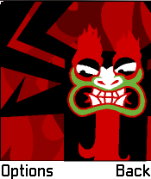
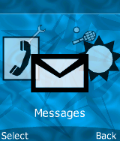
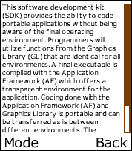
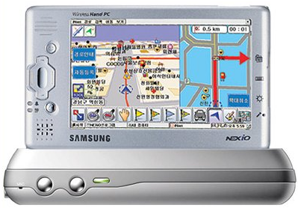
Strong Need for Vector Graphics
Many applications need low-level 2D vector graphics primitives
  Portable mapping and GPS applications, E-book readers and text packages
  Games
  Advanced user interfaces and screen savers, even GDIs
Many vector graphics formats in use
  Flash, SVG, PDF, Postscript, Vector fonts etc. etc.
Scalable graphics = Easier to port content

Slide 4
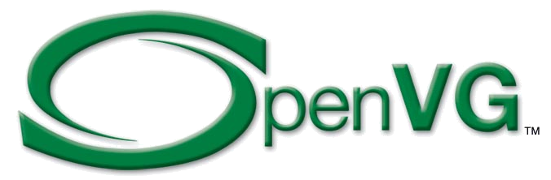
Why is New API Needed?
No existing API, including OpenGL ES, can cover all different requirements for handhelds
High-quality vector graphics rendering
Interactive performance
Low power consumption
Vector graphics acceleration brings high value to handheld devices
Code portability &
Seamless transition from SW implementation to HW implementation

Slide 5
OpenVG in a Nutshell
Open standard
Low-level API for 2D vector graphics
  With a focus on enabling hardware acceleration
  Should also allow efficient SW implementations
OpenVG ACCELERATES existing formats
  NOT a competitor to existing formats
Applications
SVG/Flash/
Font Package etc..
2D Hardware Acceleration
Fast Track Development Schedule
OpenVG working group started
1st OpenVG face-to-face meeting
Draft OpenVG1.0 specification completed
OpenVG 1.0 specification release
Samples and conformance tests
2Q04
3Q04
4Q04
1Q05
2Q05
3Q05

Slide 6



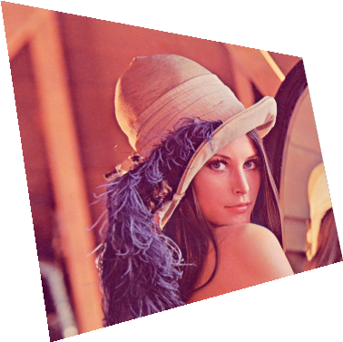


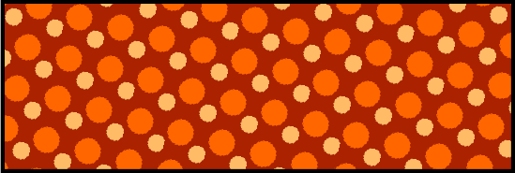
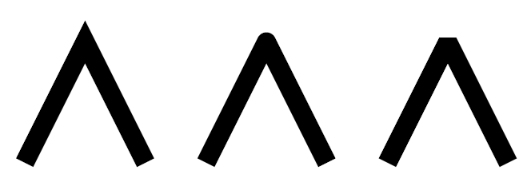
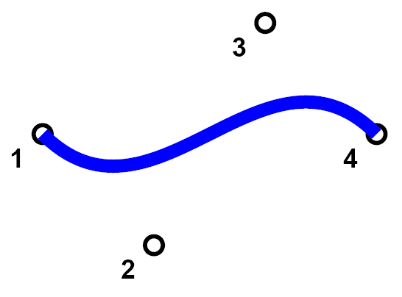
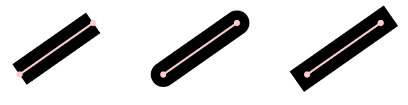
OpenVG Features
Design Philosophy
  Provide a low-level hardware acceleration abstraction layer
  Use OpenGL-style syntax where possible
  Allow flexibility in the way acceleration can be provided
  Enables hardware vendors to use their own preferred internal representations
Core API
  Coordinate Systems and Transformations
  (Image drawing uses a 3x3 perspective
  transformation matrix)
  Viewport Clipping, Scissoring and Alpha Masking
  Paths
  Images
  Image Filters
  Paint (gradient and pattern)
  Blending
The VGU Utility Library
  Higher-level Geometric Primitives
  Image Warping

Slide 7

Use with other Khronos APIs
EGL– portable layer for graphics resource management
  Graphics context management
  Surface/buffer binding
  Rendering synchronization
Use cases of OpenVG + OpenGL ES
  OpenVG renders front/back ground of OpenGL ES application (surface sharing)
  OpenVG renders on OpenGL ES texture buffer
  OpenGL ES renders on OpenVG image buffer
EGL
Graphics context
Surface/buffer

Slide 8
A Technical Introduction to OpenVG
The OpenVG Pipeline
Path Definition
Stroking
Transformation
Rasterization
Clipping
Masking
Paint Generation
Blending
Dithering
Images

Slide 9
The OpenVG Pipeline
OpenVG defines a hardware pipeline for paths and images
Path Definition
Stroking
  Line width, joins & caps, dashing, etc.
Transformation
  2x3 and 3x3 transformations
Rasterization
Clipping & Masking
  Scissor rectangles
Paint Generation
  Flat color, gradient, or pattern paint
Blending
  Multiple blend modes
Dithering
OpenVG also supports Image Filters
Path Definition &
Setting of API Parameters
Stroking
Transformation
Rasterization
Clipping and Masking
Paint Generation
Blending
Dithering

Slide 10
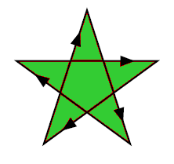
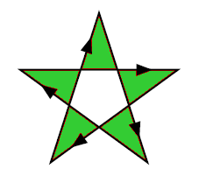
Path Definition
MOVE_TO, LINE_TO, QUAD_TO, CUBIC_TO, CLOSE_PATH
Elliptical Arcs
Absolute / Relative Coordinates
Smooth Curves
Path Interpolation
Path queries:
  Bounding Boxes
  Point along path
  Tangent along path
Non-Zero and Even-Odd fill rules
(px, py)
(sx, sy)
LINE_TO
CUBIC_TO
MOVE_TO
(ox, oy)

Slide 11
Stroking
Stroking takes a path and defines an outline around it based on:
  Line Width
  End cap style (butt, round or square)
  Line join style (bevel, round or miter)
  Miter limit (to convert long miters to bevels)
  Dash array and offset
Miter Length
Dash array = { 10, 20, 30, 40} / Dash Phase = 35
25
10
30
10
30
10
30
...

Slide 12
Transformation
Paths use 2x3 affine transformations
Images use 3x3 perspective transformations
Transformation functions are similar to OpenGL:
  vgLoadIdentity
  vgLoadMatrix
  vgGetMatrix
  vgMultMatrix
  vgScale
  vgRotate
  vgTranslate
$\left[\begin{matrix}1.080 & 0.101 & 0 \\ 0.209 & 0.691 & 0 \\ 1.28×{10}^{−3} & −1.19×{10}^{−3} & 1\end{matrix}\right]$

Slide 13
Rasterization
The goal of rasterization is to determine a filtered alpha value for each pixel, based on the geometry around that pixel
Filters may be up to 3 pixels in diameter
0
0
.1
.4
.5
.2
0
0
0
.3
.8
1
1
.9
.4
0
.4
.8
.9
1
1
1
1
.8
0
.6
.4
.3
.7
1
1
1
.3
0
0
0
.2
1
1
1
.5
0
0
0
.1
1
1
1
.5
0
0
0
.1
.9
1
.9
.2
0
0
0
0
.3
.5
.2
0

Slide 14
Clipping
Pixels outside a rectangular viewport are not drawn
Only pixels inside a set of scissor rectangles are drawn
Viewport
Scissor Rectangles
Pixels drawn
Pixels not drawn

Slide 15
Masking
In addition to clipping, a per-pixel mask may be applied
The mask has an alpha value at each pixel that is multiplied by the alpha from the rendering stage
May be used to “cut out” an area, create a transition between areas
Mask values may be modified using image data
  Fill, Clear, Set, Add, Subtract, Intersect
×
=
×
=

Slide 16
Masking (continued)
×
Alpha from Path Data
Mask Alpha
0
0
.1
.4
.5
.2
0
0
0
0
0
0
0
0
0
0
0
.3
.8
1
1
.9
.4
0
0
1
1
1
1
1
0
0
.4
.8
.9
1
1
1
1
.8
0
0
1
1
1
1
1
0
0
.6
.4
.3
.7
1
1
1
.3
×
0
1
1
1
1
1
1
1
0
0
0
.2
1
1
1
.5
0
0
0
1
1
1
1
1
0
0
0
.1
1
1
1
.5
0
0
0
0
0
1
0
0
0
0
0
.1
.9
1
.9
.2
0
0
0
0
0
.5
.5
.5
0
0
0
0
.3
.5
.2
0
0
0
0
0
0
.5
.5
.5

Slide 17
Masking (continued)
= Resulting Masked Alpha
0
0
0
0
0
0
0
0
0
.3
.8
1
1
.9
0
0
0
.8
.9
1
1
1
1
0
0
0
.4
.3
.7
1
1
1
.3
0
0
0
.2
1
1
1
.5
0
0
0
0
0
1
0
0
0
0
0
0
0
.5
.4
.1
0
0
0
0
0
.2
.1
0

Slide 18

Paint Generation
Paint is generated pixel-by-pixel and applied on top of geometry
The alpha from the previous stage (rendering + masking) is used to determine how much paint to apply
Separate paint objects for stroking, filling
Paint is applied through an affine transformation
Four types of paint are supported:
  Flat color paint
  Linear Gradient paint: Points (x1, y1) and (x2, y2), color ramp
  Radial Gradient paint: center (x, y), focus (x, y), radius, color ramp
  Pattern paint based on an image, tiling mode
(x1, y1)
r
(cx, cy)
(x2, y2)

Slide 19
Blending
Combine masked alpha from path with paint alpha
Blend the result onto the drawing surface
Blending is a function of:
  The paint (R, G, B) color
  The masked alpha value (path alpha × mask alpha × paint alpha)
  The destination (R, G, B) color
  The destination alpha value (1 if no stored alpha)
There are 8 blending functions:
  Porter-Duff “source” mode (copy source to destination)
  Porter-Duff “source over destination”/ “destination over source”
  Porter-Duff “source in destination”/ “destination in source”
  Lighten (choose lighter of source and destination)
  Darken (choose darker of source and destination)
  Multiply (black source pixel forces black, white leaves unchanged)
  “Screen”(white source pixel forces white, black leaves unchanged)
  Additive (add pixel values, add alpha up to 1)
Blending may occur in a linear or non-linear color space

Slide 20

Blending (continued)
Masked Alpha
Paint Colors
0
0
0
0
0
0
0
0
0
.3
.8
1
1
.9
0
0
0
.8
.9
1
1
1
1
0
0
0
.4
.3
.7
1
1
1
.3
0
0
0
.2
1
1
1
.5
0
0
0
0
0
1
0
0
0
0
0
0
0
.5
.4
.1
0
0
0
0
0
.2
.1
0

Slide 21
Blending (continued)
Masked Alpha
Final Blended Result
0
0
0
0
0
0
0
0
0
.3
.8
1
1
.9
0
0
0
.8
.9
1
1
1
1
0
0
0
.4
.3
.7
1
1
1
.3
0
0
0
.2
1
1
1
.5
0
0
0
0
0
1
0
0
0
0
0
0
0
.5
.4
.1
0
0
0
0
0
.2
.1
0

Slide 22




Dithering
As a final stage, the bit depth of pixels may be reduced using dithering
The details of dithering are platform-specific
8/8/8 RGB
+
Dither Values
8/8/8 RGB + Dither
Extract Upper Bits
5/6/5 RGB

Slide 23
Images
Images are defined using one of 15 pixel formats
  Linear or non-linear (sRGB) color spaces
  Linear or non-linear grayscale
  Pre-multiplied or non-premultiplied alpha
  8/8/8, 5/6/5 or 5/5/5 bit depths
  1-bit Black & White (e.g., for Fax applications)
Images may be stored in accelerated memory
Image filters may be applied:
  Color Matrix
  Convolve, Separable Convolve, Gaussian Blur
  Lookup, LookupSingle
  Dither
Images may be drawn in perspective
Image may be used as a stencil to apply paint
  Very useful for drawing anti-aliased text

Slide 24
Any Questions?

Slide 25
Thank you, and See demos by members!

