Slide 1
OpenGL ES Developer Perspectives
Your Company Logo Here
Chris Wynn
NVIDIA Developer Technical Relations

Slide 2

Developer Perspectives: Warthog and Lavastorm
Chris Wynn
NVIDIA

Slide 3


NVIDIA Handheld Technology
World leader in graphics technology
10+ Million graphics chips shipped in handheld devices
  Mobile phones
  PDAs
  Handheld game consoles
GoForce 3D is brand new architecture
  Performance
  Features
  Power consumption
  Licensable IP and discrete chips

Slide 4
Handheld Product Offerings
GoForce 2100/2150
GoForce 3000/4000
GoForce 3D 4500/4800
GoForce 3D Licensable IP core
Shipping in several devices
  Gizmondo (3D), Mitsubishi 341i/342, LG SC8000, Motorola E1000/V1000/v975/c975/V980/C980, Samsung M500, Sendo X, HP iPAQ 2200/5000, more...
More products and devices soon

Slide 5
NVIDIA Khronos Group Activities
Contributing member since 2002
Participation in OpenGL ES 1.1, 2.0 WG
Increasing Ievel of contribution for OpenVG, OpenML, and OpenMAX

Slide 6
NVIDIA’s Handheld Developer Program
Designed to promote multimedia content for handheld devices
  Quality and Quantity of 3D and other applications
Content Team working with developers, publishers, manufacturers, and carriers
  Marketing/Publisher Programs
  Developer Support

Slide 7
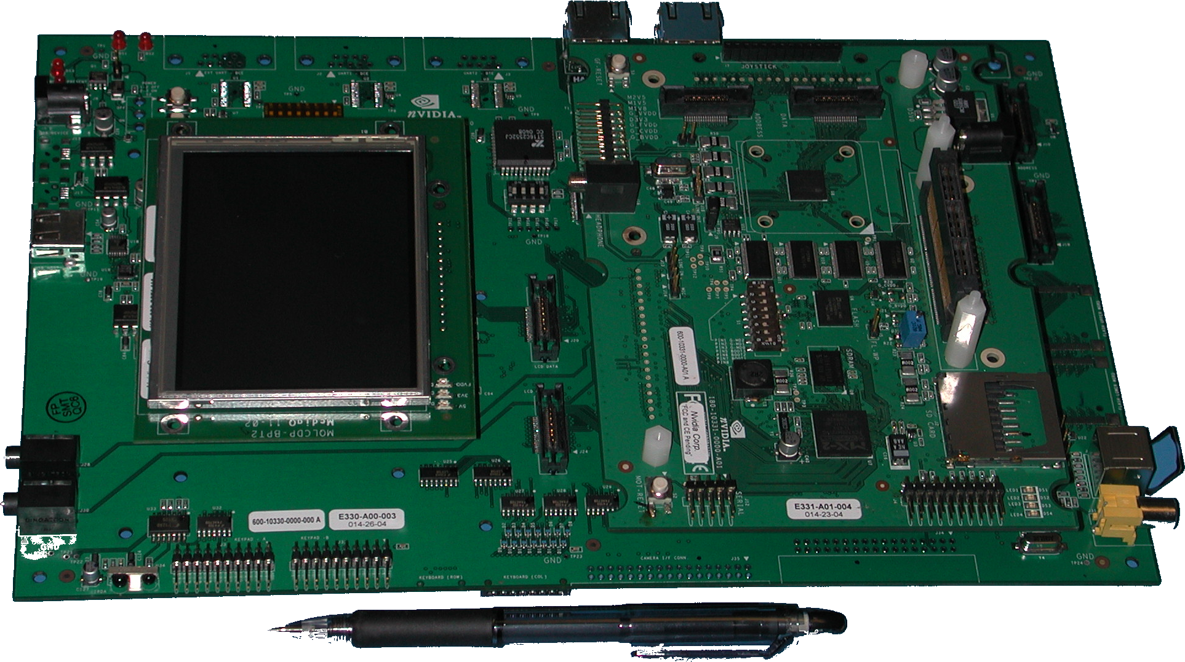
GoForce 3D Development Kit

Slide 8
What’s Included?
Handset Hardware Environment
  Freescale i.MX21 (ARM926EJ-S™ core)
  GoForce 3D 4500 / 4800
  2.2” or 3.5” QVGA LCD
  Joypad Input Device
  Audio, SD, USB
Multi-OS capable (currently WinCE and Linux)
Software (drivers, tools, libraries, sample code)
Documentation (2D/3D)
3rd party support (Java VM w/ JSR184 available)

Slide 9
What to Expect?
Null Modem Cable – boot sequence
Crossover Ethernet Cable – console / remote debug
  GNU Tools
  eMbedded Visual C++ 4.0 Tools
Host
Development
PC
GoForce
DevKit

Slide 10
Development Kits
Available now!
Register for NVIDIA Handheld Developer Program
http://developer.nvidia.com
Email
handset-dev@nvidia.com

Slide 11
Mobile 3D Graphics Challenges
Diversity of Devices
  Different OSes
  Varying performance characteristics
Limited System Resources
  Video/System Memory
  CPU Processing
  Limited System Bandwidth and Contention

Slide 12
Common Performance Pitfalls
CPU Workload
Vertex Data Bandwidth
Texture Memory Consumption and Bandwidth

Slide 13
Pitfall #1: CPU Workload
Often a problem for 1st port to handheld device
Application
  Complex Physics, AI, Game Logic
  CPU lacks native floating point math and integer division
Driver
  SW emulated driver paths
  Data conversion

Slide 14
Pitfall #1: CPU Workload (Solutions)
Use “stubbed” driver to analyze perf
  Example:
  15 fps w/ stub driver
  10 fps w/ real driver
  → 66% of total time in CPU app processing
Application
  simplify and optimize
Driver
  avoid GLES lighting and non-identity texture matrix

Slide 15
Pitfall #2: Vertex Data Bandwidth
Many devices have low system memory bandwidth
  Too much traffic → bus-limited performance
GoForce 3D 4500/4800
  1280K of vidmem (on chip)
  GPU only pulls geometry data from on-chip vertex cache (small)
Impact
  Draw calls consume bandwidth

Slide 16
Pitfall #2: Vertex Data Bandwidth (Solutions)
Use only the amount of geometry required (LODs)
Minimize the vertex format
  packed ARGB
  don’t specify Z or W if you don’t need to
Use multi-texturing instead of multi-pass
Optimize for vertex reuse
  glDrawArrays – Use strips/fans optimized for maximal length
  glDrawElements – Can optimize for vertex cache
    1. Must use GL_TRIANGLES
    2. Optimize for 16/32 entry LRU cache
    3. Make sure perf is helping by comparing vs. long strips and fans

Slide 17
Pitfall #3: Texture Data Bandwidth
GoForce 3D 4500/4800
  1280K of vidmem (on chip)
  On-chip texture memory is: 1280K – Frame Buffer
QVGA (320x240) 16-bit color double buffered w/ Z:
  450K Frame buffer
  830K Texture memory available
Impact:
  Exceeding available texture memory can cause texture thrashing

Slide 18
Pitfall #3: Texture Bandwidth (Solutions)
Make sure all texture in a “scene” fit within the texture memory budget
Use minimum size possible
Use compact texture formats (DXT1/1a, palletized)
If thrashing occurs, sort by texture
Use light mapping or detail mapping to conserve space.
  Multi-texturing: common high res base texture w/ low res differentiating texture
If possible, avoid allocating full-screen buffers
  Can use Pixmap with Blit to Front Buffer for some classes of apps

Slide 19





Any Questions?

