Slide 1


OpenGL ES getting started
January 14th, Amsterdam
Jani Vaarala, Nokia
jani.vaarala@nokia.com

Slide 2

Outline
Specification
Devices
Libraries
SDKs
Developer forums
Nokia Series60 FP2 SDK Tour
Symbian basics
Example build & run walkthrough
Symbian OS tips’n’tricks
Notes:
Devices == on the market, you can immediately target to
Libraries == different SW libraries (multi-platform)

Slide 3
Specification
OpenGL ES specification: http://www.khronos.org/opengles/spec.html
  OpenGL ES 1.0 and 1.1 specs
  EGL 1.0 and 1.1 specs
  Reference manuals
  Reference header files (use the OS specific ones from SDK, if available)
OpenGL ES 1.1 Coding Challenge: http://www.khronos.org/devu/opengles_challenge

Slide 4
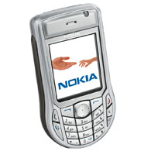
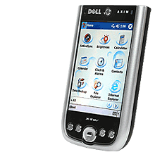
Devices
Nokia 6630
  Comes with built-in OpenGL ES 1.0 Common support
  Supports also M3G for J2ME developers
  SDK from http://www.forum.nokia.com
Dell Axim X50v
  Comes with OpenGL ES support
Toshiba W21T
Other devices
  Get a SW implementation
  Can be statically linked to the application (or provided in the installation package)

Slide 5


Cross-platform SW Libraries
Gerbera from Hybrid
  Supports many operating systems and devices (including Nokia S60 devices, Linux, Windows)
  Free version for non-commercial use, License for commercial use
  http://www.hybrid.fi
Vincent
  Open-source OpenGL ES library
  http://sourceforge.net/projects/ogl-es
Reference implementation
  Wraps on top of OpenGL to provide OpenGL ES API
  Works in Linux and Windows
  Can be ported to other platforms as well
  http://www.khronos.org/opengles/documentation/gles-1.0c.tgz

Slide 6
SDKs & Example code
Nokia Series60 FP2 SDK
  Example code & documentation
  http://www.forum.nokia.com
Vincent
  Comes with OpenGL red book examples converted to OpenGL ES
  http://sourceforge.net/projects/ogl-es
NVIDIA handheld SDK
  http://www.nvidia.com/object/hhsdk_home.html
Brew SDK & documentation
  http://brew.qualcomm.com
Intel (e.g., Dell Axim X50v)
  Closed SDK
  Also some discussion in OpenGL ES forums at www.khronos.org

Slide 7
Developer forums
Khronos developer forums:
http://www.kronos.org -> OpenGL ES -> OpenGL ES forum
  Ask any generic OpenGL ES questions here (development, coding contest, …)
Forum Nokia Discussion boards: http://discussion.forum.nokia.com/forum/
  Ask questions about development on Nokia devices here (including OpenGL ES)
  E.g., Nokia 6630
Hybrid Graphics support forums: http://forum.hybrid.fi/
  Ask Gerbera related questions here
Brew developer forums: http://brewforums.qualcomm.com/

Slide 8
Nokia Series60 SDK FP2
Support for OpenGL ES
  12 code examples with documentation
  SDK documentation about OpenGL ES
  Performance tips’n’tricks
Supports Nokia 6630
SDK documentation
  VC6 & .NET:
    Start -> Programs -> Series 60 Developer tools -> 2nd Edition SDK Feature Pack 2 -> 1.0 -> SDK Help
  Metrowerks:
    Start -> Programs -> Series 60 Developer tools -> 2nd Edition SDK Feature Pack 2 -> Metrowerks -> SDK Help
  Type “OpenGL ES” into search box and select “OpenGL ES” link

Slide 9
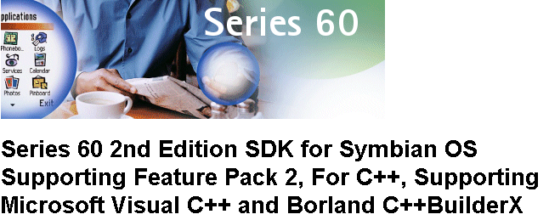
SDK Tour

Slide 10
Symbian basics
C++ API and programming model
MVC Application Architecture
Three flavors of multitasking:
  Processes, can contain multiple
  Threads, can contain multiple
  Active Objects (form of co-operative multi-tasking)
No C++ exceptions
Multiple inheritance not recommended
Coding Conventions: Naming scheme, CleanupStack, …

Slide 11
Application Classes
DATA
EXAMPLE.APP (.DLL)
Application
Document
AppUI
Container
VIEW
Handle Commands (Events, Keys)
Handle Application views

Slide 12
Build Process
OGLExample.MMP
BLD.INF
PLATFORM INDEPENDENT
OGLExample2.MMP
BLDMAKE.BAT
MAKMAKE.BAT
“Import MMP file”
ABLD.BAT
OGLExample.DSW
COMPILER / IDE DEPENDENT
UREL
WINS
ARMI
WINSCW
WINS
UDEB
THUMB
EABI

Slide 13
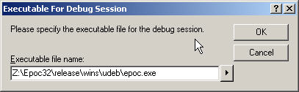
Building & Running
Just press F5 to build’n’run (Visual Studio)
Emulator can be launched from the debugger OR
It can be launched independently

Slide 14
Target build & deployment
Target build is done in the group folder:
  bldmake.bat bldfiles
  ./abld.bat build thumb urel
Installation file (oglexample.sis) is created (in ‘install’ folder):
  makesis.bat OGLEXAMPLE.PKG
  PKG-file contains a list of files to be included in the installation package
  This file can be sent to phone via Bluetooth, Infrared, or installed from a wap/web page (installed to phone via browser)
Application UIDs
  Allocated by Symbian
  See SDK for more info
  mailto: UID@symbiandevnet.com to allocate

Slide 15
OpenGL ES linkage in Symbian / S60
OpenGL ES and EGL are provided in a single DLL
There are two DLLs that can exist (one or both):
  libGLES_cm.dll (Common profile)
  libGLES_cl.dll (Common-lite profile)
Series 60 provides only the Common profile DLL
  If you want to port your common-lite application to Series 60, just link it against libGLES_cm.dll
  Common profile DLL includes all Common-lite entry points
  Common is supported, but use only integer vertex data

Slide 16
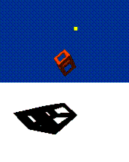
Projective Shadow example
Location: c:\Symbian\8.0a\S60_2nd_FP2\Series60Ex\openglex\shadows
Example code that was presented can be found from the SDK

Slide 17
Tips & tricks, window & focus
Avoid clipping, track the application focus
  EGL can be implemented in different ways
  Many implementations probably use direct screen access (6630)
  If direct screen region (render window) is clipped by a dialog, implementation may halt rendering or render slower (clipping)
  Track the application focus !
Use full-screen windows when possible
  Some OS fast paths may be in use for full-screen windows (6630)

Slide 18
Mixing native rendering (1)
Rendering native graphics is not allowed for configs that are not marked as EGL_NATIVE_RENDERABLE
  Doing so will make results UNDEFINED
Alternatives:
  - Use EGLPixmapSurface (if supported) // mix: many times
    Make pixmap surface current, render GL stuff
    Call eglWaitGL( )
    Use the native pixmap
    Call eglWaitNative( EGL_CORE_NATIVE_ENGINE )
  - Use EGLPbufferSurface (if supported) with glReadPixels( ) // mix: once
    Make pbuffer surface current, render GL stuff
    Call glReadPixels to get the pixel data
    Copy that data to Symbian bitmap
    Use Symbian bitmap

Slide 19
Mixing native rendering (2)
  - Use eglPbufferSurface (if supported) with eglCopyBuffers( ) // mix:once
    Make pbuffer surface current, render GL stuff
    Call eglCopyBuffers( ) to copy the the data to Symbian bitmap
    Blit the bitmap to display
  - Use textures // mix: many times
    Render native graphics to a Symbian bitmap
    Lock the bitmap (bitmap heap is locked -> address can’t change)
    Get the pointer to the bitmap data ( bitmap->DataAddress( ) )
    Create a texture from the bitmap ( glTexSubImage2D )
    Unlock the bitmap
    Use the texture to overlay the native graphics to display

Slide 20
Tips & tricks, portability (1)
Problem: How to get maximum portability across Symbian and S60 devices?
If possible, don’t use extensions
  If extensions are used, have alternate code paths
Use OpenGL ES 1.0
To support older devices, integrate a fallback SW engine
  But, do it in proper way so that you get also HW acceleration
  Apps then work just on newer devices with (pre-)installed OpenGL ES
  If this is not strictly a requirement, don’t integrate at all (smaller app)

Slide 21
Tips & tricks, portability (2)
How to properly integrate the fallback SW engine ?
Use dynamic link-loading (RLibrary):
If loading succeeds, use this
Renderhw.DLL
libGLES_cm.dll
Application
Rendersw.DLL
libSWGLES.dll
OR
If loading fails, use this
Rendersw.DLL
3D ENGINE

Slide 22
Tips & tricks, misc
Work with minimum requirements if possible
  E.g., don’t require more than 15 bits of depth buffer
Do not use fixed config IDs
  IDs may change
Match config with color depth of the surface (Pixmap, Window)
  Matching config guarantees best performance
Do not install OpenGL ES DLL to system libs folder
  May prevent other apps to get HW acceleration
FPS may be limited by the display system
  double-buffered synchronized updates
More tricks in the SDK

Slide 23
Typical Symbian pitfalls
Don’t use global non-const data
  APPs are DLLs
  The only way to have global data in DLL is through TLS
Don’t use unaligned data accesses
  Target processor may not support unaligned data
Floating point exceptions
  On Windows typically floating point exceptions are disabled
  On a target device, floating point exceptions are enabled
Active Object Scheduler
  Don’t block the AOS with long-running tasks

Slide 24
What was left out ?
GDI
Memory handling
Descriptors
Cleanup
File Server
Active Objects
Exceptions
Processes & Threads
Building UIs
…
Resource files
On-Target debugging
Window Server

Slide 25



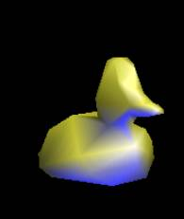
Questions ?

