Slide 1





Hybrid Graphics, Ltd.
Mobile Graphics Technology
Khronos Developer University
December 8, 2004 Seoul

Slide 2

Facts…
Ten years of experience in 3D technology
  HQ in Helsinki, Finland
Millions of shipped products & devices with Hybrid technology (games, mobile phones, handhelds, …)
Stable and growing
Extensive partner network

Slide 3
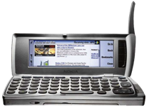
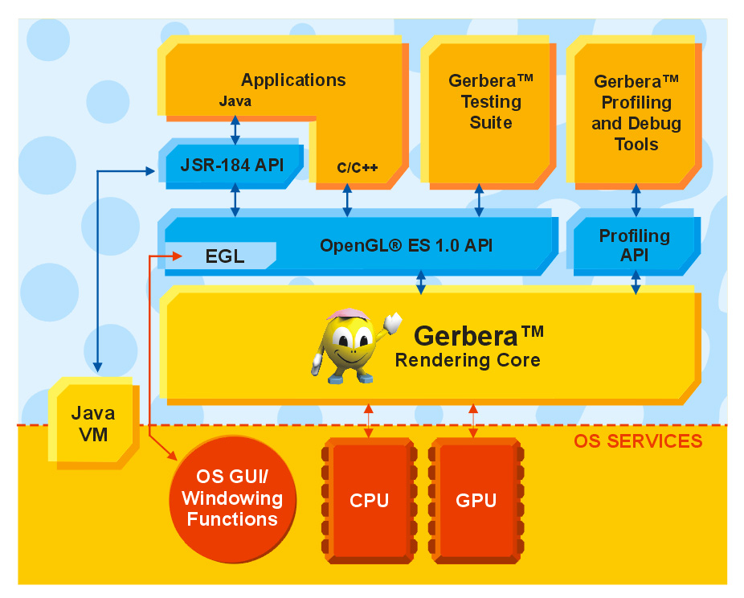
Software infra for embedded graphics
Graphics technology for enabling a rich content market
Technology shipped within devices
Open standard APIs
  OpenGL ES, OpenVG, Java JSRs, MPEG-J, …
  Supports all engines
Active standardization work
  Khronos Promoters
Partnerships with leading
engine & middleware vendors
  Fathammer, Criterion,
  Synergenix, Discreet, …

Slide 4
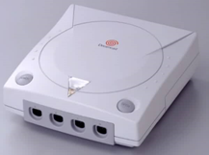
How things used to be
New features every 4 years
~Millions of devices, hundreds of developers
HW driven
Completely stable and simple environment (OS, HW, ...)
Applications
Middleware
Proprietary 3D API
Proprietary 3D hardware
OS

Slide 5

How things are now
API driven
New features every year
100 million devices, thousands of developers
A dozen OSs, a dozen JVMs, a couple of CPU families, half a dozen architectures, ...
Applications
Middleware
Java VM
Standard Java 3D APIs
(JSR 184, 239)
Standard native 3D API (OpenGL ES)
OS
Prop. Low level API
Proprietary 3D HW
No 3D HW

Slide 6
How things are in 2005
Industry standard 3D API
(ISO/IEC MPEG-4 3D)
Java VM
Standard Java 2D API (JSR 226)
SVG players
Standard Java 3D APIs
(JSR 184, 239)
Standard native 3D API (OpenGL ES)
Standard native 2D API (OpenVG)
OS
Prop. Low level API
Prop. Low level API
Proprietary 3D HW
No 3D HW
Proprietary 2D HW
No 2D HW
Every software component has a roadmap of its own

Slide 7
Content emphasis
Game phones, managed content programs, high budget development
Evolutionary
User interfaces, Java games, bubblegum content, hobbyists
Revolutionary

Slide 8
Hybrid's offering
Hardware driver framework
Graphics support for multimedia hardware
Standard implementations on general purpose HW

Slide 9




In Practice:
Modeling Tools
Game Development Tools
Game Engine Content Tools
Game developers create games financed by publishers
Packaged Game Content
Game Engine; licensed or custom built
Distributors distribute games to end users
Enabling technology with standard
interfaces:
OpenGL ES,
Java M3G
Multimedia/3D accelerators
Chipsets, processors

Slide 11
Conclusions
Importance of the software layer is increasing dramatically
  It is critical for getting the full benefit of HW
  Operators mandate standard APIs
  (they are not interested in low-level details)
The requirements for the software layer are an order of magnitude more demanding than on PC or game consoles
Hybrid will:
  Drive the standardization of the sw layer
  Deliver the sw layer
  Support the sw layer for all parties involved
  Deliver the roadmap for the sw layer

Slide 12

Status
OpenGL ES implementations: Shipping
  ES 1.0 Common profile shipped 1Q04
  Licensees: Nokia, Ericsson, Symbian, Khronos, Discreet...
  ES 1.1: Reference implementation shipped to Khronos
  ES 2.0, MPEG-J: Standardization work in progress
  ARM (v4, v5), SH-3, TI OMAP, XScale, x86 + half a dozen OSs
OpenGL ES hardware driver kit: Shipping
  Licensees: NEC/Bitboys Acceleon hardware accelerators
  DSP support from several vendors underway
  Additional HW support TBA 4Q04
Java interfaces: Shipping
  JSR184 (M3G): Ericsson, Symbian, Discreet
  JSR239: Released as soon as spec finished:
SVG: Tiny/Basic rasterizer shipped
  Work for OpenVG standard started, player ready 4Q04

Slide 13
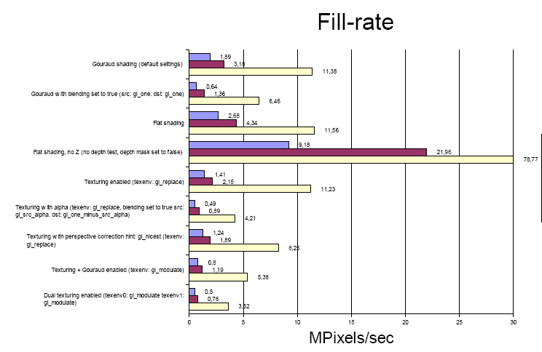

Slide 14
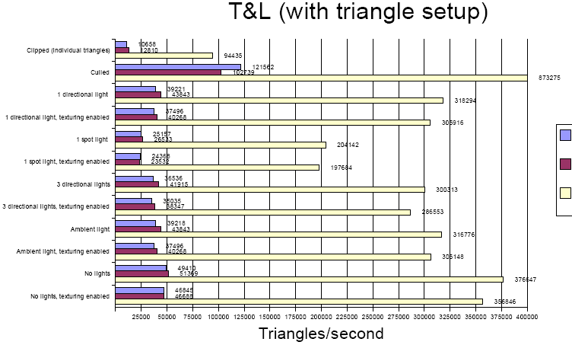

Slide 15
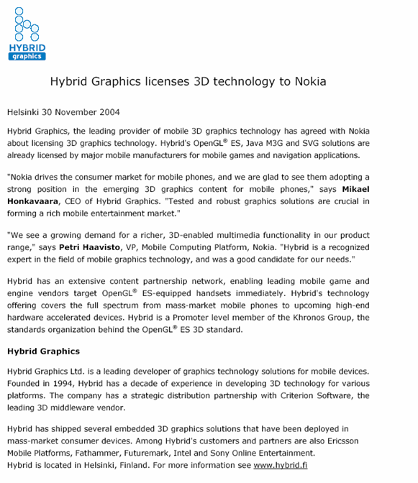

Slide 16
Contact
Commercial:
  Mr. Panu Wilska, VP of Sales
  panu@hybrid.fi
  +358 400 155 951
Technical:
  Mr. Harri Holopainen, Exec. VP
  harri@hybrid.fi
  +358 40 504 2544

