Slide 1



Harnessing the Horsepower of OpenGL ES Hardware Acceleration
Seoul, December 2004
Alan Tsai, Deputy Director

Slide 2
Why Graphics H/W Acceleration
Least Power Consumption
  Save amazing power (almost 90%)
Best Performance
  Software can only achieve around 35K pixels/s (StrongARM 200MHz )
    QVGA 30fps need at least 9M pixels/s, assume depth complexity 3
  HW can reach 10X~1000X performance than general CPU of mobile-phone
  Offload CPU for doing other more important tasks (game play, phone)
  CPU/GPU parallelism
Better Quality
  PC level quality for real-time rendering
  Advanced rasterization capability

Slide 3
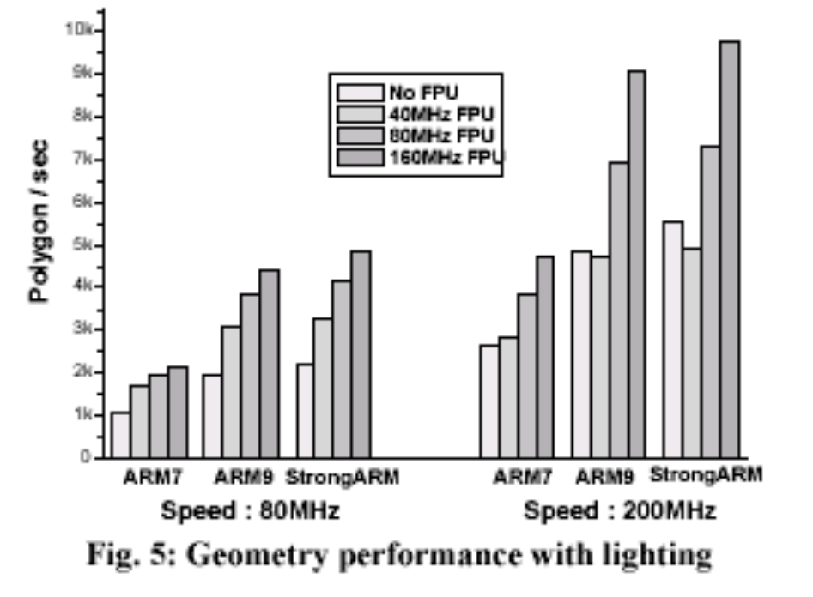
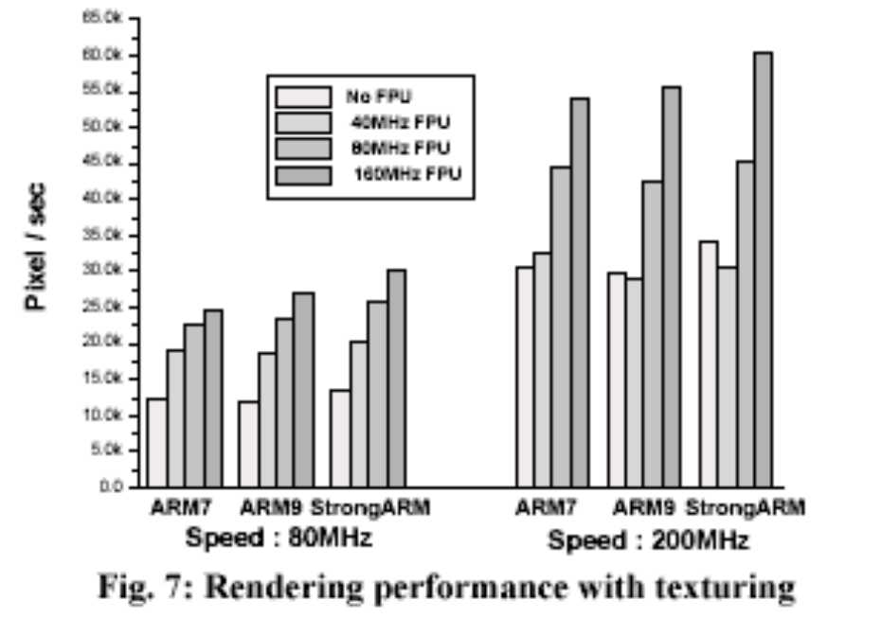
SW solution performance is limited
“Optimization of Portable System Architecture for Real-Time 3D Graphics”, page 2490, ISCAS 2002

Slide 4
3D HW solution Case Study
(SMEDIA 3360)
Target depth complexity of 10+ for QVGA screen at 30fps
Performance Specifications
  1.28M polygons/sec
  33M pixels/sec
Performance Characteristics
  Pure HW solution
  CPU is freed up for game play, physics, AI
  Predictable complex rendering performance
  Less system impact on graphics performance
Power Consumption
  About 1mW per MHZ, core can clock down accordingly to save even more power
    16MHZ is already capable for most application
  Fully support TnL and rasterization with lower frequency than CPU

Slide 5
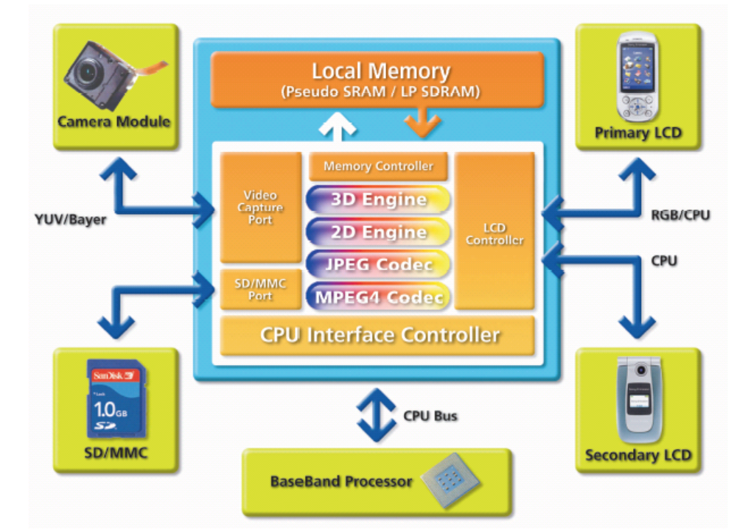
Mobile Multi-media HW Case Study
(SMEDIA 3360)

Slide 6

Architectural View of HW Acceleration
Vertex Processing
Pixel Processing
Raster Operation
Glamo3360
core
Operating System
OpenGL ES driver
Game Control
Game Engine(AI, Physics, ..)
Base Band
ARM CPU
Video memory
AHB
Color buffer
Depth buffer
Stencil buffer
Texture
Host
Memory
LCD Display

Slide 7
Where the bottleneck might be ?
Glamo3360
core
Base Band
CPU
Video memory
AHB
Host
Memory
LCD Display

Slide 8
Locate Bottleneck
Suspect, Experiment, See any difference ?
  Adjust each stage’s workload or clock down
Experiment:
  CPU
    Adjust CPU frequency
      Application bound or driver bound ?
  Host Memory Bandwidth
    Adjust host memory frequency
  Bus Bandwidth
    Adjust system bus frequency
    Reduce vertex size
  Vertex Processing
    Unload vertex processing load(ex:disable lighting,)
  Pixel Processing
    Adjust resolution
  Video Memory Bandwidth
    Adjust video memory frequency
    Change texture size
    Change texture filter mode

Slide 9
CPU
Use profiling tool
Offload CPU load to GPU
  All 3D function
  All 2D function
  Do not over-analyze level-of-detail, culling occlusion
Use OpenGL ES Common Lite profile, if possible
  Most embedded CPU do not have floating point unit, emulation is slow

Slide 10
Bus bandwidth
Use small vertex format, if possible
  GL_BYTE, GL_SHORT
Eliminate unnecessary vertex attribute
Enable client state only when necessary
  Use glDisableClientState to reduce unnecessary vertex stream
Multi-texture instead of multi-pass
Triangle strip instead of triangle list
Use Vertex Buffer Object

Slide 11
Vertex Buffer Object (OpenGL ES 1.1)
Base Band
Glamo3360
CPU
AHB
Video
memory
VBO
Host
Memory
Vertex data
glGenBuffer, glBindBuffer
glBuffer[Sub]Data

Slide 12
Vertex Processing
Use triangle strip
Use indexed primitive
  Leverage HW vertex cache
  DrawElement instead of DrawArray
Low polygon art design
  Polygon reduction
  Per pixel lighting with lightmap or Dot3
  Use texture to represent fine detail
Use lighting efficiently
  Light is not free
    Spot light > Point light > Directional light
  Use the fewest light to obtain the same effect
Pre-compute lighted vertex color, if possible
  Static model with static light

Slide 13
Pixel Processing
Disable unused state and watch out default OpenGL ES state
Use GL_LINEAR_MIPMAP_NEAREST
  Use nearest mipmap for better cache efficiency
  Use trilinear filter only when necessary
Reduce depth complexity
  Roughly sort object front to back
  Use occlusion culling technique

Slide 14
Video Memory Bandwidth
Use alpha test instead of alpha blending, if possible
Use color mask only when necessary
Avoid redundant color/depth clear
Turn off depth test/write when it is unnecessary
Save texture bandwidth
  Use small texture or mipmap texture to leverage HW’s texture cache
  Use palette texture

Slide 15
CPU/GPU Balancing
Do not try to access color buffer directly
  glReadPixels
  CPU will be idle waiting for GPU to finish all rendering task
Avoid texture recycle
  In some implementation, driver will wait for GPU to finish
Reduce render state/texture change
  State change will lead to driver overhead
  State change might flush HW rendering pipeline
  Group object by render state and texture
Increase batch size aggressively

Slide 16
Conclusion
Mobile Gaming is progressing at 10X speed of PC-industry
  Application driving the demand: Contents already match performance and quality level of PC games released only a few years ago
  Pioneer pushing the implementation: Carriers concern ARPU; Phone markers concern unique features
3D Application will be implemented in any UI & content
  3D will be the standard feature in handhelds, like current Notebook
  Personalization driving MMI enhancement
OpenGL ES API is ideal to harness HW capability
  Cross-platform standard, Official subset of OpenGL for embedded systems
  Enough feature-set for handhelds to perform high-quality application
  An open, royalty-free API standard for advanced 2D & 3D graphics
  Strong Industry Momentum
H/W Acceleration is the trend
  Less power and cutting-edge visual experience
  Easily implement into current phone architecture (replace backend IC)

Slide 17
Questions ?

