Slide 1
A Walk Through the API
Kari Pulli, Nokia Research Center & MIT
kari.pulli@nokia.com, kapu@csail.mit.edu

Slide 2
Agenda
Background: OpenGL & OpenGL ES
OpenGL ES 1.0 functionality
OpenGL ES profiles and beyond 1.0
EGL: the glue between OS and OpenGL ES
How can I get it and learn more?

Slide 3
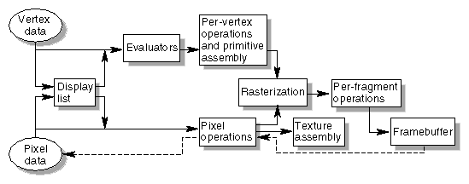
What is OpenGL?
The most widely adopted graphics standard
  Most operating systems, thousands of applications
Abstracts the graphics process into a pipeline
  Good match to hardware
  Operates on both graphics primitives as well as image data
A foundation for higher level APIs
  Open Inventor; VRML / X3D; Java3D; game engines
modeling
⇩
projecting
⇩
clipping
⇩
lighting & shading
⇩
texturing
⇩
hidden surface
⇩
blending
⇩
pixels to screen

Slide 4

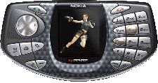
What is OpenGL ES?
OpenGL is just too big for Embedded Systems with limited resources
  Mobile phones, with no floating point hardware
  PDAs and Personal Media Centers
  Avionics / Automotive displays
  Consumer appliances
Make OpenGL smaller mostly by removing:
  Redundant functionality
  Unused functionality
  Expensive functionality
Result
  A compact API that can still do almost everything that full OpenGL can

Slide 5
OpenGL ES 1.0 Design Targets
Preserve OpenGL’s goodness
  Don’t try to fix it, it isn’t broken
Keep it compact and efficient
  Pure software implementation possible within 50 KB, without floating point hardware
  Hardware implementations possible as well
Enable innovation and implementation competition
  Allow extensions, just like on the desktop
  Try to harmonize any extensions – which may become part of the core in the future
Align with other mobile 3D APIs if possible
  M3G / JSR-184

Slide 6
Outline
Background: OpenGL & OpenGL ES
OpenGL ES 1.0 functionality
OpenGL ES profiles and beyond 1.0
EGL: the glue between OS and OpenGL ES
How can I get it and learn more?

Slide 7
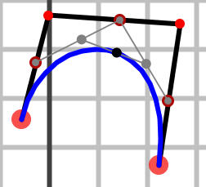
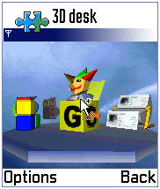
Functionality: In / Out? (1/4)
Convenience functionality usually implemented in SW on desktop is OUT
  GLU (utility library)
  Evaluators (for splines)
  Feedback mode (tell what would draw without drawing)
  Selection mode (for picking, easily emulated)
  Display lists (collecting and preprocessing commands)
gluOrtho2D(0,1,0,1)
vs.
glOrtho(0,1,0,1,-1,1)
glNewList(1, GL_COMPILE)
myFuncThatCallsOpenGL()
glEndList()
…
glCallList(1)

Slide 8
Functionality: In / Out? (2/4)
Remove old or complex functionality
  OUT: glBegin – glEnd specifies geometry a vertex at a time - complex and inefficient
  IN: vertex arrays (introduced in OpenGL 1.1)
  new: coordinates can be given as bytes
static const GLbyte verts[4 * 3] =
{
-1, 1, 1, 1, 1, 1,
1, -1, 1, -1, -1, 1
};
static const GLubyte colors[4 * 3] =
{
255, 0, 0, 255, 0, 0,
0,255, 0, 0,255, 0
};
glVertexPointer( 3,GL_BYTE,0, verts );
glColorPointerf( 3,GL_UNSIGNED_BYTE,
0, colors );
glDrawArrays( GL_TRIANGLES, 0, 4 );
glBegin(GL_POLYGON);
glColor3f (1, 0, 0);
glVertex3f(-.5, .5, .5);
glVertex3f( .5, .5, .5);
glColor3f (0, 1, 0);
glVertex3f( .5,-.5, .5);
glVertex3f(-.5,-.5, .5);
glEnd();

Slide 9
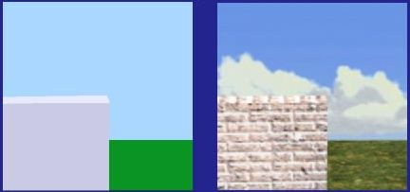

Functionality: In / Out? (3/4)
Simplify rendering modes
  IN ONLY: double buffering, RGBA colors, access to back buffer
Full fragment processing is IN:
  Expensive or impossible to emulate
  Alpha/depth/scissor/stencil tests, multisampling, dithering, blending, logic ops
Simplify Raster processing
  ReadPixels IN, DrawPixels and Bitmap OUT
2D texture maps IN
  1D, 3D, cube maps OUT
  Borders, proxies, priorities, LOD clamps OUT
  Multi-texturing, texture compression IN (optional)
  Paletted textures IN
  Texture filtering (including mipmaps) IN

Slide 10
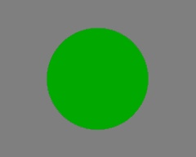
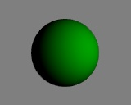
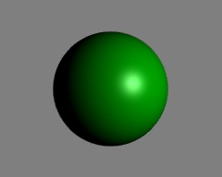
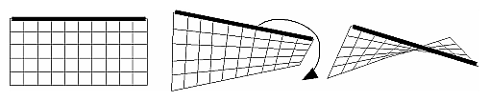
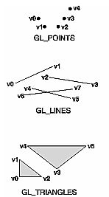
Functionality: In / Out? (4/4)
Almost full OpenGL light model IN
  Back materials, local viewer, separate specular OUT
Primitives
  IN: points, lines, triangles
  OUT: polygons and quads
Vertex processing
  IN: transformations
  OUT: user clip planes, texcoord generation
Rasterization
  OUT: PolygonMode, PolygonSmooth, Stipple
Support only static queries
  OUT: dynamic queries, attribute stacks
  Application can usually keep track of its own state
  Querying matrices an optional extension

Slide 11
Outline
Background: OpenGL & OpenGL ES
OpenGL ES 1.0 functionality
OpenGL ES profiles and beyond 1.0
EGL: the glue between OS and OpenGL ES
How can I get it and learn more?

Slide 12

Fixed and Float Profiles
Support for high-volume devices systems with no floating point is key
  But need to prevent fragmentation between fixed and float applications
Common-Lite profile replaces all floating point calls with fixed point
  Enabling applications to use just 16.16 integer math
  For extremely limited systems - reduced range requirements
Common Profile is a proper superset of Common-Lite
  Has BOTH fixed and float versions of all entry points
  Requires desktop OpenGL range and accuracy - “Forward-looking” and “Programmer-friendly”
Common-Lite applications run without modification on Common Profile
Full functionality – with both float and fixed point entry points for code portability between profiles
Full functionality – but just fixed point entry points to API for integer-only platforms
Common
Profile
Common-Lite
Profile

Slide 13
Floating Point vs. Fixed-point
OpenGL is strongly based on floats
  Recently even define floating point frame buffers
Floats provide ease-of-use and are future-proof
  But doubles are OUT
16.16 fixed-point: pretend an integer has a decimal point
  2^16 == 1 << 16
  Float to fixed: x = int( f * (1<<16) );
  Int to fixed: x = i << 16;
  Fixed to float: f = float(x) / (1<<16);
  Sum (fixed): a = b + c;
  Mul (fixed): a = (b * c) >> 16;
glRotatef( 0.5f, 0.f , 1.f, 0.f );
vs.
glRotatex( 1 << 15, 0 , 1 << 16, 0 );

Slide 14
OpenGL ES Roadmap
Update OpenGL ES every year by default
  To expose rapidly developing handheld platforms capabilities
BUT ONLY introduce features with proven demand
  Guarding against unnecessary bloat
Track and adapt developments in desktop OpenGL
Full high-level shading language capability to harness the power of programmable hardware
State-of-the-art shader programmability for embedded devices
OpenGL 2.0
Widely available cross-platform 3D graphics API
OpenGL ES 2.0
OpenGL 1.5
OpenGL ES 1.1
Increasing emphasis on enabling emerging fixed function 3D hardware
OpenGL 1.3
OpenGL ES 1.0
Enabling software AND hardware implementations – including small-footprint, low-end fixed point platforms
Mid-03
Mid-04
Mid-05

Slide 15
OpenGL ES and EGL 1.1
OpenGL ES 1.1 more oriented to hardware implementations
  Enabling the feature of new generation OpenGL ES silicon
Backwards compatible with OpenGL ES 1.0
  A superset of OpenGL ES 1.0 - Common and Common-Lite profiles maintained
Enhanced Effects
Multi-texture
Skinning
Particle effects
Enhanced Power Efficiency
Buffer Objects
Swap Interval
Power Events
OpenGL ES 1.1
Enhanced Flexibility
Dynamic State Queries so layered software can use OpenGL ES.
Not just games anymore!
Enhanced JSR 184 Support
Sprite and background handling

Slide 16
OpenGL ES 1.1
Buffer Objects
  Enable caching of vertex data
Better Textures
  >= 2 tex units, combine (+,-,interp), dot3 bumps, auto mipmap generation
User Clip Planes
  Portal culling (>= 1)
Point Sprites
  Particles as points not quads, attenuate size with distance
State Queries
  Enables state save / restore, good for middleware
Draw Texture
  Fast drawing of pixel rectangles using texturing units so data can be cached
  constant Z, scaling [optional]
Matrix Palette
  Vertex skinning (>= 3 M / vtx, palette >= 9) [optional]

Slide 17
OpenGL ES 1.2
Work ongoing
Evolving the fixed-functionality API functionality
Reduce variability of implementations
  Require stencil bits, make some optional extensions mandatory

Slide 18
OpenGL ES 2.0
Work ongoing
  Targeted for released in summer 2005
Introduce shader programmability to embedded markets
  Vertex and pixel shaders
  OpenGL Shading Language
Possible directions
  Really stripped-down version of OpenGL 2.0
  No fixed functionality
  Backwards compatibility through shaders
  Enabling source and binary shader distributions
Mobile 3D feature set is catching up to the desktop very fast!

Slide 19
Outline
Background: OpenGL & OpenGL ES
OpenGL ES 1.0 functionality
OpenGL ES profiles and beyond 1.0
EGL: the glue between OS and OpenGL ES
How can I get it and learn more?

Slide 20

EGL – Increasing 3D Code Portability
But operating system calls access platform resources - memory, processor threads etc. makes code non-portable
Application
Code
Native Operating System
OpenGL ES provides portable, cross platform, abstracted access to the 3D pipeline
EGL
EGL abstracts graphics-related system resource calls – such as accessing screen windows. Makes 3D-related code cross-platform portable. Similar to GLX/AGL/WGL
3D Hardware Acceleration

Slide 21
EGL glues OpenGL ES to OS
Division of labor
  EGL gets resources (windows, etc.) and displays images created by OpenGL ES commands
  OpenGL ES does the 3D graphics part once the resources have been obtained
Various drawing surfaces, targets for rendering
  windows – on-screen rendering
  pbuffers – off-screen rendering (user memory)
  pixmaps – off-screen rendering (OS native images)

Slide 22
Main EGL 1.0 functions
Getting started
  eglGetDisplay(), eglInitialize() / eglTerminate(), eglGetConfigs() / eglChooseConfig(), eglCreateXSurface() (X=Window|Pbuffer|Pixmap)
eglMakeCurrent( display, drawsurf, readsurf, context )
  binds context to current thread, surfaces, display
eglSwapBuffers( display, surface )
  posts the color buffer to a window
eglWaitGL( ), eglWaitNative( engine )
  provides synchronization between OpenGL ES and native (2D) graphics libraries
eglCopyBuffer( display, surface, target )
  copy color buffer to a native color pixmap

Slide 23
EGL 1.1 enhancements
Swap interval control
  specify # of video frames between buffer swaps
  default is 1; 0 means unlocked swaps, >1 can be used to save power
Power management events
  PM event => all Context lost
  Displays and Surfaces remain, but Surface contents unspecified
Render-to-texture [optional]
  flexible use of texture memory
  based on the desktop WGL_ARB_render_texture extension

Slide 24
Outline
Background: OpenGL & OpenGL ES
OpenGL ES 1.0 functionality
OpenGL ES profiles and beyond 1.0
EGL: the glue between OS and OpenGL ES
How can I get it and learn more?

Slide 25

When can I use it?
It’s shipping already
  Nokia 6630 has a SW implementation of OpenGL ES 1.0 Common Profile
Several hardware vendors have announced compatible HW
  ATI, Bitboys, Falanx, Imagination Technologies, Mitsubishi, Nvidia, Renesas, SMEDIA,Toshiba
Hybrid Graphics has downloadable SDK’s for 1.0 and 1.1
  Symbian OS, PocketPC, Desktop Windows

Slide 26
Learning More
OpenGL ES website:
  www.opengles.org or www.khronos.org
DevU presentations
  http://www.khronos.org/devu/library/
Series 60 SDK 2.2: emulator, documents, examples
  http://www.forum.nokia.com
Hybrid Graphics OpenGL ES binaries, demos, docs
  http://www.hybrid.fi/main/download/
Book: OpenGL ES Game Development (Astle, Durnil)

Slide 27
Questions?

