Slide 1


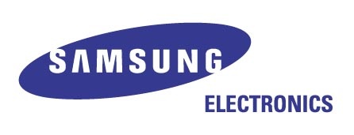
Vector Graphics for Digital Media Devices
Samsung Electronics
Seoul, Dec 2004

Slide 2

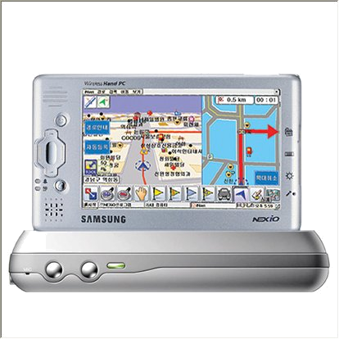
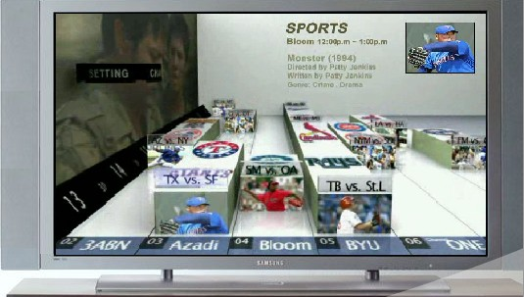
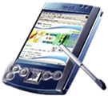
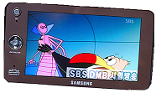
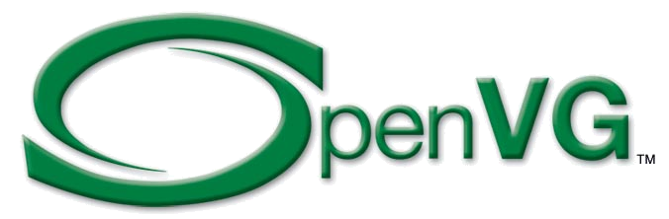
Vector Graphics for Digital Media Devices
Application
Game
GUI
GIS
MMS
…
Vector Graphics Library
Low-Level Vector Graphics API
CPU
HW Accelerator

Slide 3
Benefits of OpenVG for Digital Media Devices
General benefits
  Royalty & Licensing Free
  Seamless Hardware Acceleration
  Small footprint
High-quality Vector Graphics
  Highly readable graphics and texts leveraged by Anti-aliasing and Scalability
Cross Platform API
  Small digital media devices as well as High-end devices
  Developers do not have to re-write code for each different platform.
Easy Integration with 3D API
  OpenVG and OpenGL-ES can be utilized in one application using EGL.
  OpenVG API resembles OpenGL-ES API in Style.

Slide 4
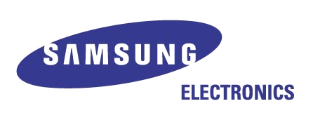
Samsung’s Solution (1/2)
Dynamic Vector Graphics Library
  Dynamic Graphics Toolkit based on 2D Vector Graphics
  Currently based on Proprietary 2D API
  Feature Set
    Advanced Geometric Primitives
    Shape / Motion Tweening
    Time-based Animation
    Motion Widget : Dynamic UI Components
Application
Dynamic Vector Graphics Library
?
Vector Graphics Library
Motion Graphics Library
Motion Widget Library
H/W 3D Graphics Engine
Low-Level Vector Graphics API
Proprietary 2D API
OpenVG

Slide 5
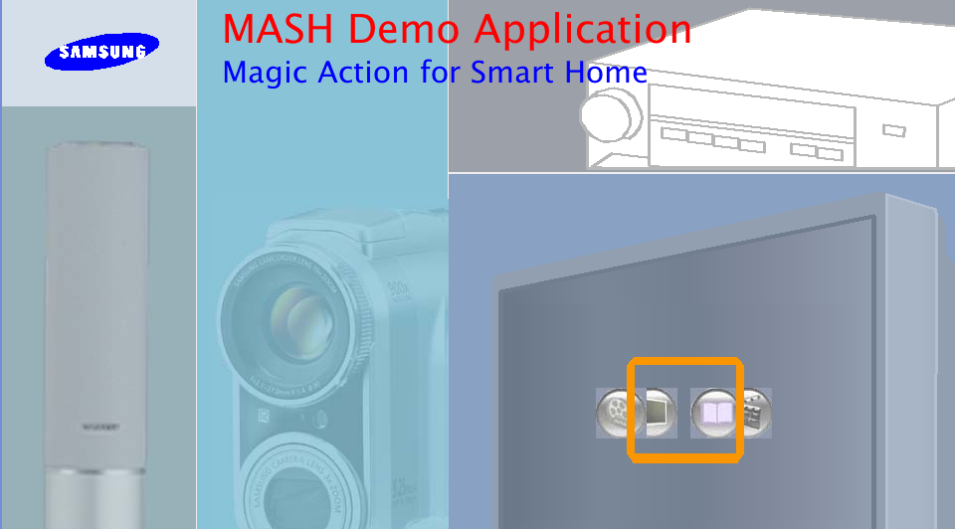
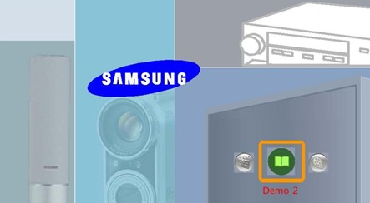
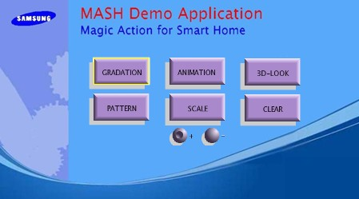
Samsung’s Solution (2/2)
Dynamic Vector Graphics Library
  Primary Targets : Digital TV / STB
  Main Applications : Dynamic GUI and Interactive Applications
Application ( Dynamic GUI / Interactive TV Appls.)
Dynamic Vector Graphics Library
Low-Level 2D Vector Graphics API
CPU
HW Accelerator

Slide 6
Thank you!

