Slide 1
OpenVG Introduction
January 14th, 2005
Tero Pihlajakoski
Nokia

Slide 2
Agenda
Motivation
OpenVG in a Nutshell
  Use Cases
  Milestone & Deliverables
OpenVG Technical Brief
  API Design Philosophy
  OpenVG Drawing Pipeline and Feature Set

Slide 3
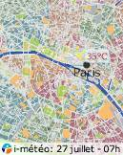
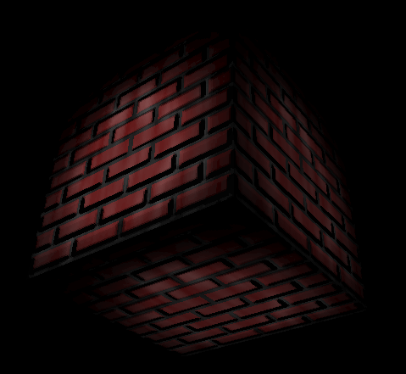
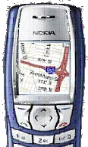


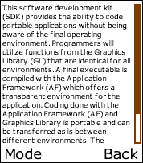
Strong Need for Vector Graphics
Many applications need low-level vector graphics primitives
  Portable Mapping and GPS applications, E-book Readers and text packages
  Games
  Advanced user interfaces and screen savers, even GDIs
Many vector graphics formats in use
  Flash, SVG, PDF, Postscript, Vector fonts etc. etc.
OpenVG ACCELERATES existing formats – for the first time
  NOT a competitor to existing formats
Applications
SVG/Flash/
Font Package etc..
OpenVG can be called directly by 2D applications or by existing vector graphics packages
2D Hardware Acceleration

Slide 4
OpenVG – Accelerating 2D Graphics
OpenVG is a low-level API for 2D vector graphics
  With a focus on enabling hardware acceleration
Vector graphics acceleration brings high value to handheld devices:
High-quality anti-aliasing for ultra-high-quality 2D graphics and text on small-screen devices
Accelerate vector 2D graphics for
interactive performance
2D graphics on hardware accelerators saves 90% of power
Hardware Acceleration for Vector Graphics
Provide SCALABLE 2D graphics for easy porting of content to different screen sizes

Slide 5
OpenVG Design Philosophy
Provide a low-level hardware acceleration abstraction layer
Allow flexibility in the way acceleration needs to be provided
Use OpenGL-style syntax where possible to make learning OpenVG as easy as possible for OpenGL developers
Reference Path and Image objects by opaque handles - enabling hardware vendors to use their own preferred representations
OpenVG working group started
1st OpenVG face-to-face meeting
Draft OpenVG1.0 specification completed
Target date for OpenVG 1.0 release – with samples and conformance tests
2Q04
3Q04
4Q04
1Q05
2Q05
Fast Track Development Schedule

Slide 6
OpenVG Feature Set
Core API
  Coordinate Systems and Transformations
  (Image drawing uses a 3x3 perspective
  transformation matrix)
  Paths
  Images
  Image Filters
  Paint (gradient and pattern)
  Blending and Masking
The VGU Utility Library
  Higher-level Geometric Primitives
  Image Warping
  Animations
Definition of path, transformation, stroke and paint
Stroked path generation
Transformation
Clipping
Rasterization
Masking
Paint Generation
Blending

Slide 7
1 Path and Image Definitions
Handle-based types
  Create the handles before adding data
Just like textures or buffer objects in OpenGL
  VGPath myPaths[num];
  VGImage myImages[num];
  vgGenHandles(VG_IMAGE_HANDLE / VG_PATH_HANDLE,
  ..., myPaths / myImages);
Append data into the object designated by the handle
  Path creation: vgCreatePath(…), vgAppendPath(…), vgPathSubData(…)
  Path external definitions made with a set of C macros
  Image creation: vgCreateImage(…), vgImageSubData(…)
Other types of object management
  Copying: vgCopyImage/Path(…)
  Child images can be used to, e.g., save memory

Slide 8


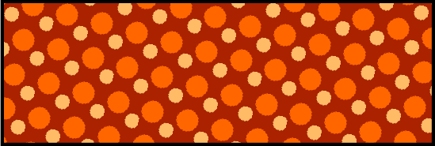

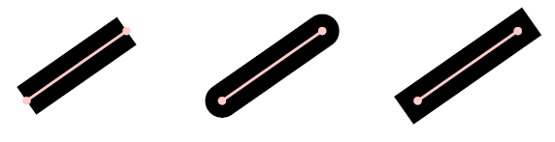
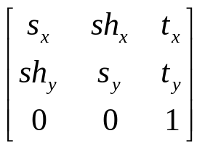
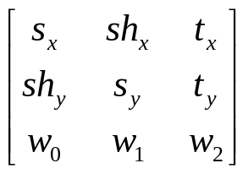
1 Stroke and Paint Properties
Other parameters
  Simple enough to set up on-demand using the appropriate vgSet(…) calls
  Fill and stroke paint can be set up separately and support the same three modes: solid, gradient, and patterned
  Stroke parameters reflect the SVG specification of dashes, joins, caps
Transformations
  “2D” OpenGL paradigm in use
    vgLoadMatrix(…), vgMultMatrix(…), …
  2x3 matrices for affine geometry transforms
  3x3 matrices for images for perspective transforms (warping effects, basic texture mapping)

Slide 9


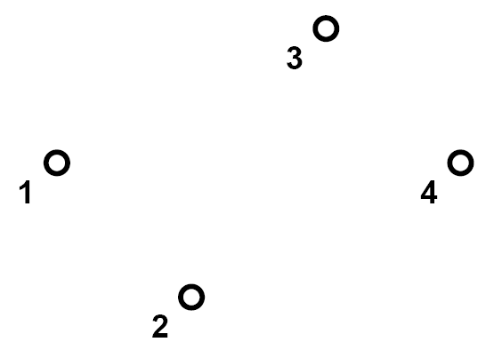
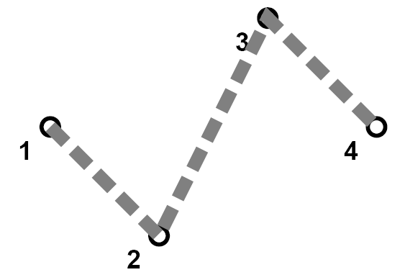
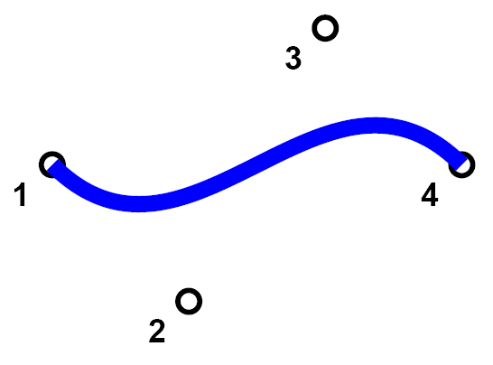
2 Stroked Path Generation
User input for paths is control data and coordinates
Rasterizer must generate extra geometry to create curves, lines, joins, and caps. The winding rule is reduced to “non-zero” at this stage
Approximately:
  Move a pen along the curve defined by the control commands and data
  Take join styles into account at points where the curve is discontinuous
  Take cap styles into account at the beginning and end of the curve
  Break curve into pieces according to dashing
A rectangular path is implicitly generated for images (vgDrawImage)
Self-intersection

Slide 10
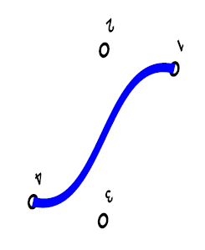
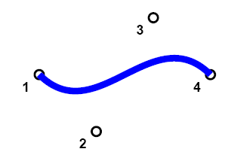
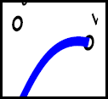
3 Transformation, 4 Clipping
Transform all the generated geometry into surface space
Different transforms
  User to viewport with the special case of “image-user to viewport”
  Viewport to surface (using a matrix derived from the viewport and surface setup)
Other transforms are relevant in the following pipeline stages
Next, clip the transformed geometry against the drawing surface. And/or you can use scissoring. The idea is just to remove excess graphics

Slide 11

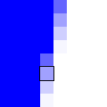




5 Rasterization, 6 Masking
The geometry is scan-converted
Determine pixel coverage
  Preliminary alpha value
  Anti-aliasing
Apply the current mask to the pixel alpha
  An alpha value is fetched from the VGImage that is set as the current mask
  If there is no mask set, this stage will be skipped
  A multiplication operation per coverage (pixel) value
  Determines the next-stage alpha value for the pixel:

Slide 12

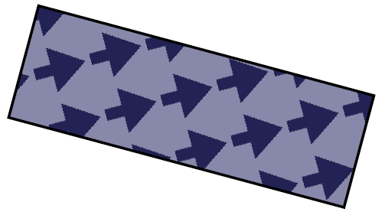
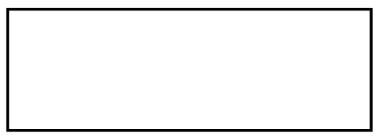
7 Paint Generation
Color and alpha is determined from stroke and/or fill settings
  If the paint mode is solid, the color remains constant
Gradient paint
  Transform gradient into screen space
  Apply spread mode and the rest of the parameters
Pattern paint
  Pattern data is read from the VGImage object
  Transform pattern into the screen space
  Take tiling mode into account
Rendering VGImages
  Uses 3x3 transform matrix that was used to transform the geometry
As a result, we have an rgba value
  The r, g, and b values now reflect the paint or image color
  Alpha is a combination of coverage, mask, and paint/image alpha
Paint
Geometry

Slide 13




8 Blending
OpenVG defines a few of the Porter-Duff blending modes
  SRC (blending off, replace)
  SRC_OVER_DST & DST_OVER_SRC
  SRC_IN_DST & DST_IN_SRC
Some useful additional modes
  Disjoint blending can be used when the primitives are going to be apart from each other
  Threshold blending is useful for picking & visual effects
Now the final pixel color has been determined
  The r, g, b, and alpha are now the same as after the previous step + a possible blend to the destination surface
  Write it to the framebuffer
A
B
A over B
A in B

Slide 14
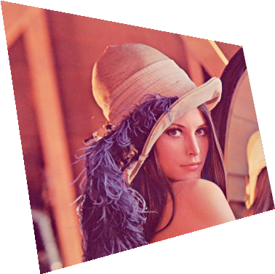
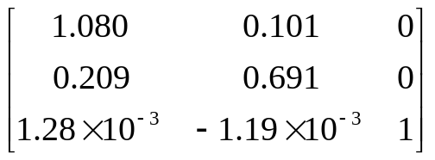
Other Features
SVG-style filters
  More blending operations
  Color matrices
  Convolution filters
  Blurring
  Rendering initiated with a separate
  call
VGU library
  Utility library
  Functions to set up image warp matrices
  Provide higher-order primitives
    Polygons
    Rectangles (rounded)
    …
Others…
vguComputeWarpQuadToQuad

Slide 15
Any Questions?

