Slide 1
OpenVG Introduction
December 8th, 2004
Jitaek Lim
Samsung Electronics Ltd., Co.

Slide 2
Agenda
Motivation
OpenVG in Nutshell
  Use Cases
  Milestone & Deliverables
OpenVG Technical Brief
  API Design Philosophy
  OpenVG Drawing Pipeline
  OpenVG Feature Set

Slide 3
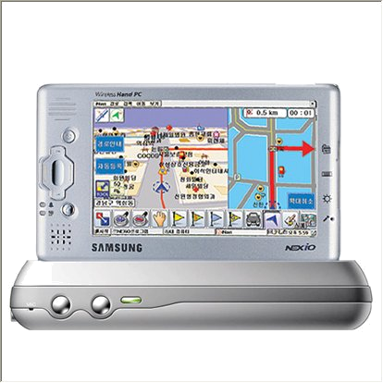
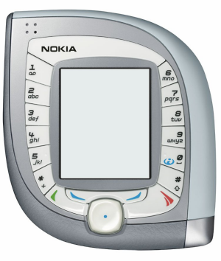
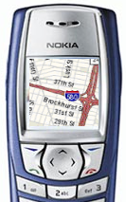
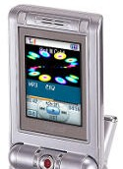
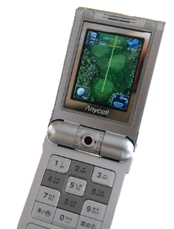
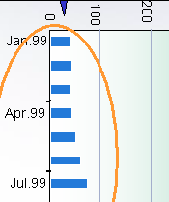

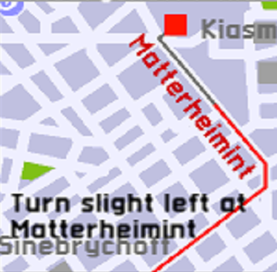
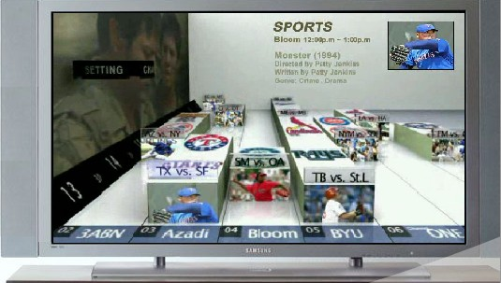
2D Vector Graphics
Vector graphics are already used everywhere
  File format (e.g. Flash (swf), SVG, PDF), Vector font, Character animation
Will also appear in new applications soon
  Browser, user interface, Multimedia messaging, and more!
Vector graphics are extremely high-quality - perfect for small-screens
  Sophisticated anti-aliasing and easy scalability

Slide 4

Need Accelerated Vector Graphics
An Enabling Technology for Small Screen Devices
A CPU-based solution is not optimal for handheld devices
  CPU is underpowered compared to desktop
  Running graphics algorithms on a CPU cycles memory and uses too much power
2D Vector graphics API has been proprietary
  Developer has to re-write code for each platform
Need to offload 2D vector graphics operation from the CPU
Need to save power when running 2D vector graphics
Need of open standard API
Open Standard for Vector Graphics Hardware Acceleration

Slide 5
OpenVG in Nutshell
Royalty-free open standard API
Low-level 2D vector graphics rendering API
Advanced feature set to enable SVG, Flash, etc.
Enables smooth evolution towards hardware accelerated vector graphics
Application
Application
Vector graphics Lib
Vector graphics Lib
Proprietary 2D API
CPU
HW Accelerator
2D Vector Graphics Today
2D Vector Graphics with OpenVG

Slide 6
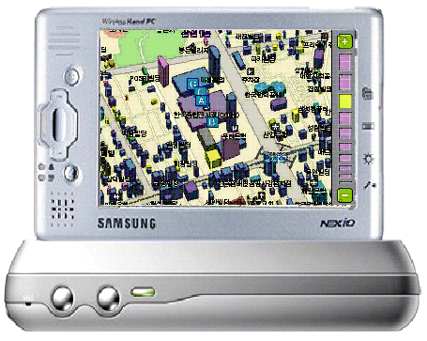
Use Cases
Target Applications
  Vector Graphics Format Viewers
  Portable Mapping Applications
  E-book Readers
  Games
  User Interfaces
  Low-Level Graphics Device Interface
Target Devices
  Wrist watches to desktop PC!
    Main focus is embedded devices like mobile phone, PDA, game console, DVR, DVD, car navigation, etc.
    Graphics accelerator is expected
    Should be implement-able on any device that is capable enough to support OpenGL ES 1.1

Slide 7
Milestone & Deliverables
OpenVG 1.0 Released
  API Specification
  Sample code
  Conformance test suite
External review
  Draft API specification
2Q04
3Q04
4Q04
1Q05
2Q05
We are here
WG started

Slide 8
API Design Philosophy
OpenVG is intended to provide a hardware abstraction layer that will allow accelerated performance on a variety of application platforms
Functions that are not expected to be accelerated in hardware in the near future were either not included, or included as part of the optional VGU utility library
Where possible, the syntax of OpenVG is intended to be reminiscent of that of OpenGL, in order to make learning OpenVG as easy as possible for OpenGL developers
Path and Image objects in OpenVG are referenced by opaque handles, for allowing that hardware vendors can implement these objects using their own preferred representations

Slide 9
OpenVG Drawing Pipeline
Definition of path, transformation, stroke and paint
Stroked path generation
Transformation
Clipping
Rasterization
Masking
Paint Generation
Blending

Slide 10
OpenVG Feature Set
Core API
  Coordinate Systems and Transformations
    Image drawing uses a 3x3 perspective (or projective) transformation matrix
  Paths
  Images
  Image Filters
  Paint (gradient and pattern)
  Blending and Masking
The VGU Utility Library
  Higher-level Geometric Primitives
  Image Warping
  Animations
* TOC of draft spec is available at http://www.khronos.org/openvg/

Slide 11
http://www.khronos.org/openvg/
Thank you!
Any Questions?

