Slide 1

Programming OpenGL® ES In a BREW Environment
Maurya Shah
3D Apps Research, Qualcomm Inc

Slide 2
Overview
Introduction to BREW
Sample games developed using BREW with OpenGL ES APIs
Application handling in BREW
The BREW OpenGL ES and EGL architecture
Setup steps for OpenGL ES and EGL
The Qualcomm Development Platform
Links to more information

Slide 3
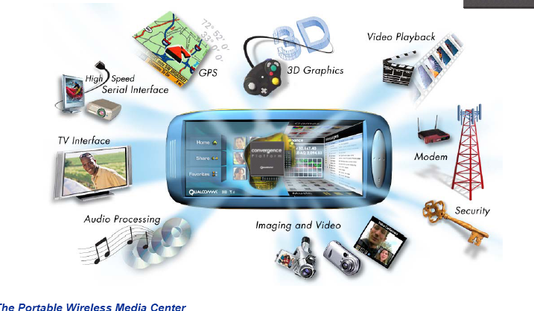
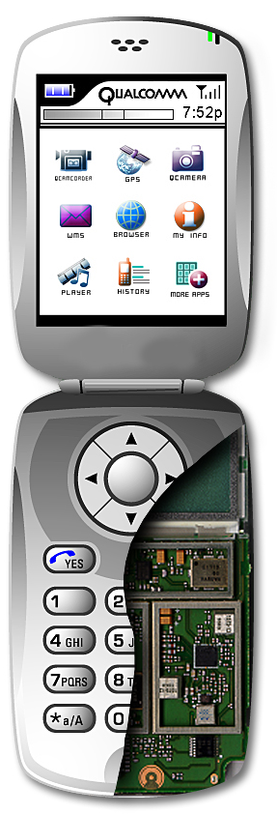


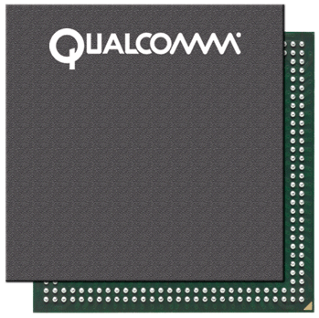

MSM: Integrated Wireless and Multimedia Solution
Multimedia Integration
Qualcomm providing many OpenGL ES platforms
  World’s largest fabless manufacturer of semiconductors
  Shipped cumulative total of more than 1.5B chipsets
PLATFORMS
Dual CPU
VGA video (640x480)
6M pixel camera support
802.11, TV-out
OpenGL ES with ATI 2300+
QVGA (320x240)
Multimedia, data-centric
Integrated Launchpad features:
Qcamera, CMX, Qtv, gpsOne,
OpenGL ES with HW GRP
Video ASIC
Apps Co-proc.
Ringer Chip
Camera Module with DSP
QCIF+ (176x180)
Multimedia
Integrated Launchpad features:
Qcamera, CMX, Qtv, gpsOne
OpenGL ES with DSP acceleration
3D Gaming
ASIC
LBS
ASIC
Audio ASIC

Slide 4
BREWTM Is ….
Binary Runtime Environment for Wireless
A Software Technology
  Able to write apps for wireless phone
A Distribution Technology
  Able to download applications over the air
  Developers get paid for each app downloaded

Slide 5
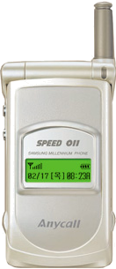
BREW Changes Wireless Application Development
Out with the Old In with the BREW
Application
Application
OEM 1
OEM 2
OEM 3
OEM 1
OEM 2
OEM 3
10 integration tasks:
One for each phone
1 integration task
task
task
BREW
task
task
task
task
task
task
task
task
Sw
Sw
Sw
Sw
Sw
Sw
Sw
Sw
Sw
Sw
Handset Software

Slide 6

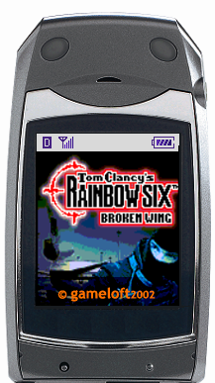

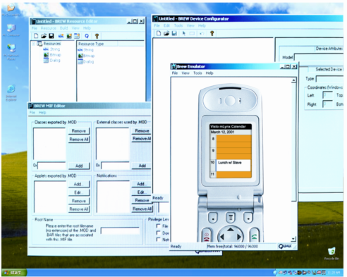








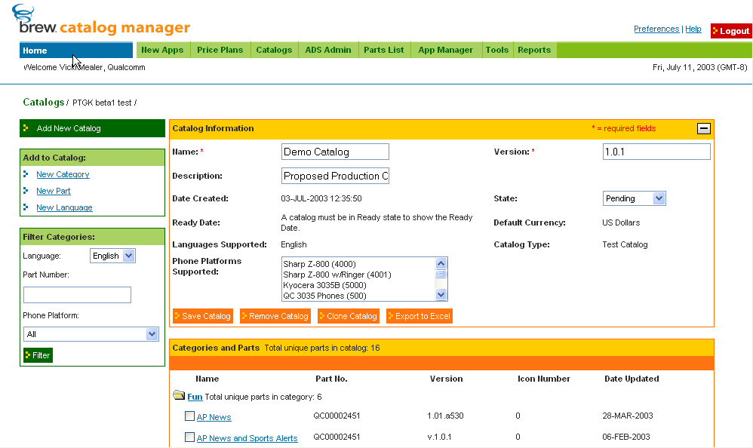

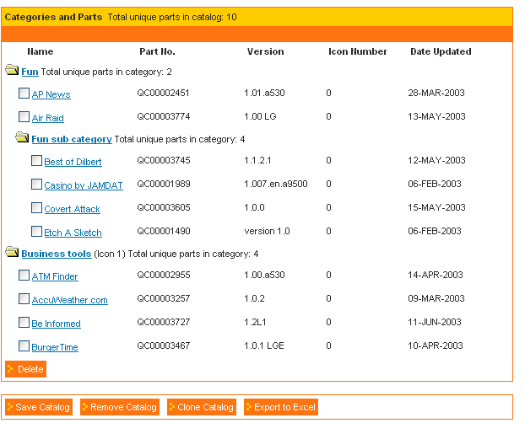
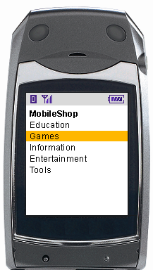
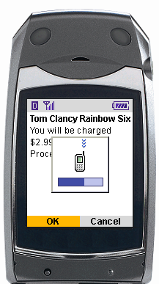
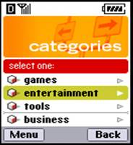
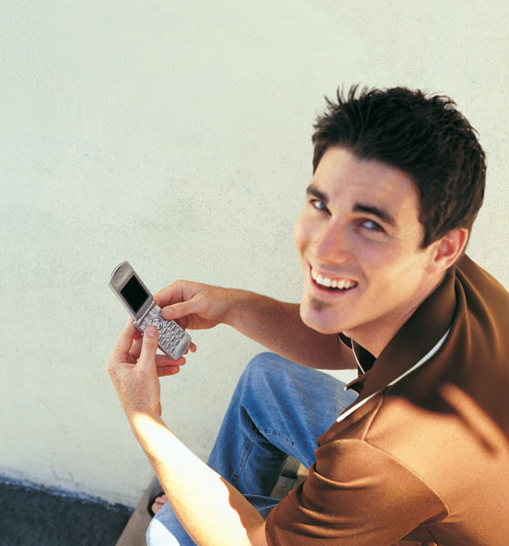



Creating a self-sustaining marketplace
3. Operator selects application & negotiates price
2. Application tested (at operator discretion)
TBT
4. Operator creates user catalogs
The BREW Ecosystem
1. Developer creates
new application
5. Users select and purchases applications
8. Developers want to build new compelling BREW applications
7. Ecosystem parties get paid
6. Users pay
phone bill

Slide 7

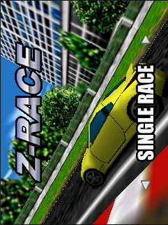

BREW Enables High Quality OpenGL ES Mobile Gaming
QUALCOMM enables the highest quality mobile games for handsets targeted for the mass market
  Asphalt (Gameloft), Brew3dRace (HudsonSoft) are examples of a high quality 3D BREW games
  Faster processors, better screen resolutions & the overall quality of BREW & MSM-enabled devices makes this possible
  CDMA2000 1xEV-DO enables the downloading of larger, graphically impressive games over-the-air, enabling impulse purchasing & reducing the need to purchase games via (physical) memory cards

Slide 8
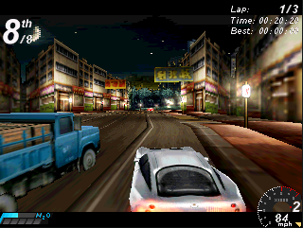
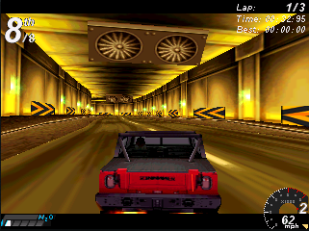
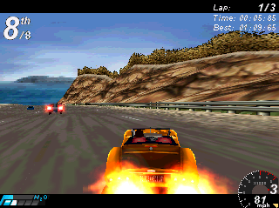
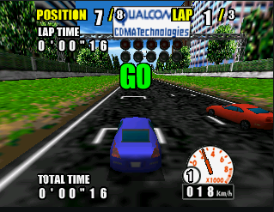
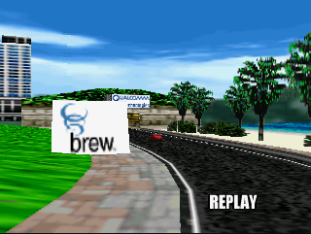
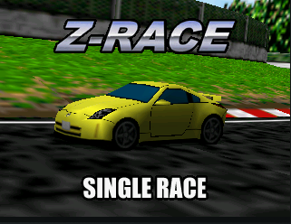
Screen Shots of some BREW™ OpenGL ES games
Gameloft (Asphalt - Urban GT)
Hudson (Z-Race)

Slide 9
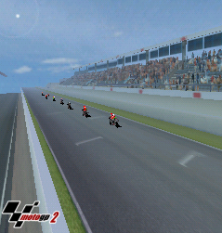
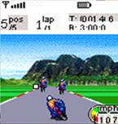



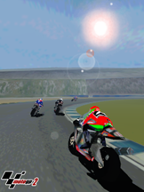
OpenGL® ES in Action (MotoGP: A simple case study)
Before OpenGL ES
Porting an Xbox console game
To OpenGL-ES
Java MIDP1.0
MotoGP2 on Accelerated OpenGL-ES
Nokia N-Gage
Increase in visual quality, visual effects, screen resolution and frame rate for less power!

Slide 10
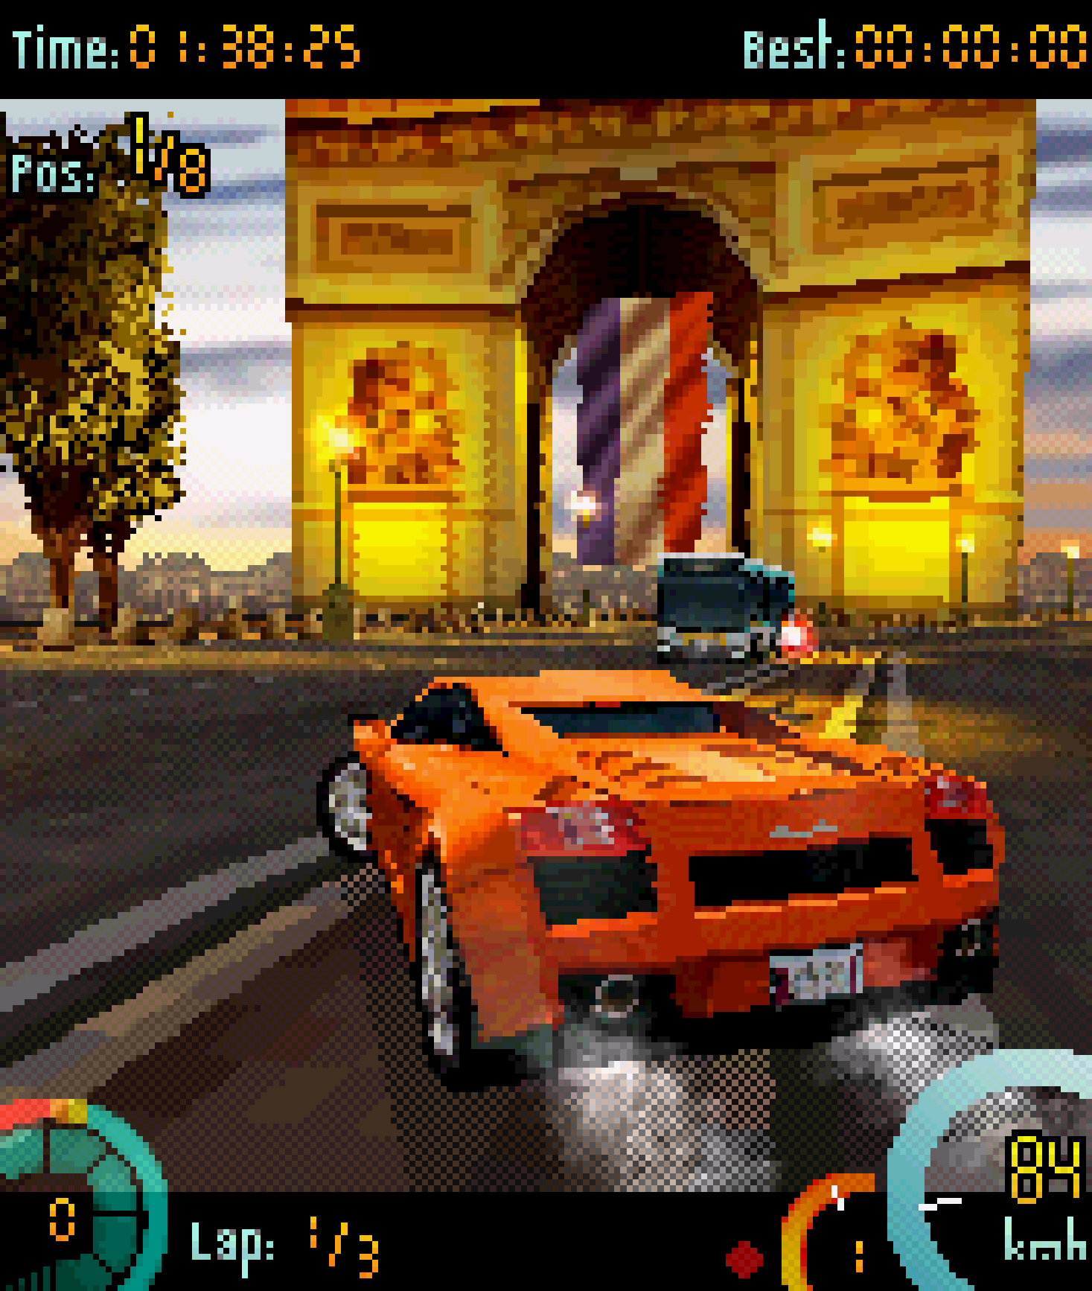

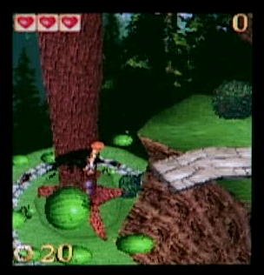
Application Model
BREW™ Interfaces
  Collection of functions related to a service
  IFileMgr, IDisplay, IShell etc.
AEECLSID
  Unique 32-bit ID that identifies an Interface
Applications
  Expose base IApplet Interface associated with AEECLSID
Extensions
  Custom Interface added by developer, OEM etc.
The BREW application model is based on an event-driven engine
Applications can be developed in C/C++
Each application module in the SDK is developed as a Windows DLL

Slide 11
BREW gaming APIs
Current graphics interfaces available:
  IGRAPHICS
  ISPRITE
  IFONT
  IIMAGE
  IBITMAP / IDIB
  ITRANSFORM
  IDISPLAY
  IGL (OpenGL ES APIs)
  IEGL (standard EGL)
Other useful APIs for gaming
  IMEDIA (video and audio)
  ISOUND
  IPOSDET (gps)
  ISOCKET
  ICAMERA
  IJOYSTICK

Slide 12
OpenGL ES API layer
OpenGL ES
(AEEGL.h/.c)
EGL
(AEEGL.h/.c)
BREW APIs
OEMgles
(OEMgles.h/.c)
OEMegl
(OEMegl.h/.c)
OEM lnterface
OpenGL-ES/EGL
(libGLES_CL.lib)
graphics driver
Phone Software
Graphics Processor
(enhanced series)
ARM
DSP
Hardware Interface

Slide 13
Steps for using IGL
Include the AEEGL.h header file
#include "AEEGL.h"
Create an instance of the IGL interface:
if (ISHELL_CreateInstance(pMe->a.m_pIShell, AEECLSID_GL,(void**)&pMe->m_pIGL) != SUCCESS)
return FALSE;
// you can now use the BREW IGL interface
// Eg. IGL_glGetError(pMe->m_pIGL);
When the application exits, release the IGL interface
IGL_Release(pMe->m_pIGL);

Slide 14
Steps for using IEGL
Include the AEEGL.h header file
#include "AEEGL.h"
Create an instance of the IEGL interface:
if (ISHELL_CreateInstance(pMe->a.m_pIShell, AEECLSID_EGL, (void**)&pMe->m_pIEGL) != SUCCESS)
return FALSE;
// you can now use the IEGL interface
Eg. IEGL_eglWaitGL(pMe->m_pIEGL);
When the application exits, release the IEGL interface:
IEGL_Release(pMe->m_pIEGL);

Slide 15
Steps for using IGL with gl wrappers
Include the IGL.h wrapper header file
#include "IGL.h"
Create an instance of the IGL interface and initialize the IGL wrappers
if (ISHELL_CreateInstance(pMe->a.m_pIShell, AEECLSID_GL, (void**)&pMe->m_pIGL) == SUCCESS)
IGL_Init(pMe->m_pIGL);
else
return FALSE;
Now the standard OpenGL ES functions can be called
// Eg. glGetError();
When the application exits, release the IGL interface
IGL_Release(pMe->m_pIGL);
Just add this one line

Slide 16
Steps for using IEGL with egl wrapper
Include the AEEGL.h header file
#include “IGL.h"
Create an instance of the IEGL interface:
if (ISHELL_CreateInstance(pMe->a.m_pIShell, AEECLID_EGL,
(void**)&pMe->m_pIEGL) != SUCCESS)
IEGL_Init(pMe->m_pIEGL);
else
return FALSE;
The standard EGL functions can now be called
Eg. eglWaitGL(pMe->m_pIEGL);
When the application exits, release the IEGL interface:
IEGL_Release(pMe->m_pIEGL);
Just add this one line

Slide 17
The GL.c file
Must build your application with GL.c file to use standard OpenGLES calls
Provides wrappers for the OpenGL®ES and EGL standard API functions
For example:
GLAPI void APIENTRY glActiveTexture(GLenum texture)
{
IGL_glActiveTexture(GPIGL,texture);
}
GLAPI void APIENTRY glDrawArrays(GLenum mode, GLint first, GLsizei count)
{
IGL_glDrawArrays(GPIGL,mode,first,count);
}

Slide 18
Setting up EGL Surface
Get the display device
  eglDisplay = eglGetDisplay(EGL_DEFAULT_DISPLAY )
Initialize the display
  eglInitialize(eglDisplay, NULL, NULL)
Obtain the first configuration with a depth buffer
  eglChooseConfig(eglDisplay,attrs,&eglConfig,1,&numConfig)
Create a surface for the main window
  eglCreateWindowSurface(eglDisplay,eglConfig,(NativeWindowType)&screen_surface, NULL)
Create an OpenGL ES context
  eglCreateContext(eglDisplay,eglConfig,EGL_NO_CONTEXT, NULL)
Make the context and surface current
  eglMakeCurrent(eglDisplay,eglSurface,eglSurface,
  eglContext)

Slide 19
Mixing 2D/3D Calls (only for enhanced series)
Qualcomm is planning to define an EGL extension which would return a pointer to the current color buffer
Typical usage of this extension will be
  combine 2D images on the color buffer, drawing skybox or HUD
  post process the image to add special effects like night vision, embossing etc.
The extension will likely be called “EGL_QUALCOMM_COLOR_BUFFER”
The extension should be called using eglGetProcAddress(“eglGetColorBufferQUALCOMM”)

Slide 20
Power Level Extension
Returns the % of battery life
This information can be used to turn on/off certain features of the game
The name will likely be called “EGL_QUALCOMM_POWER_LEVEL”
Used as eglGetProcAddress(“eglGetPowerLevelQUALCOMM”)

Slide 21
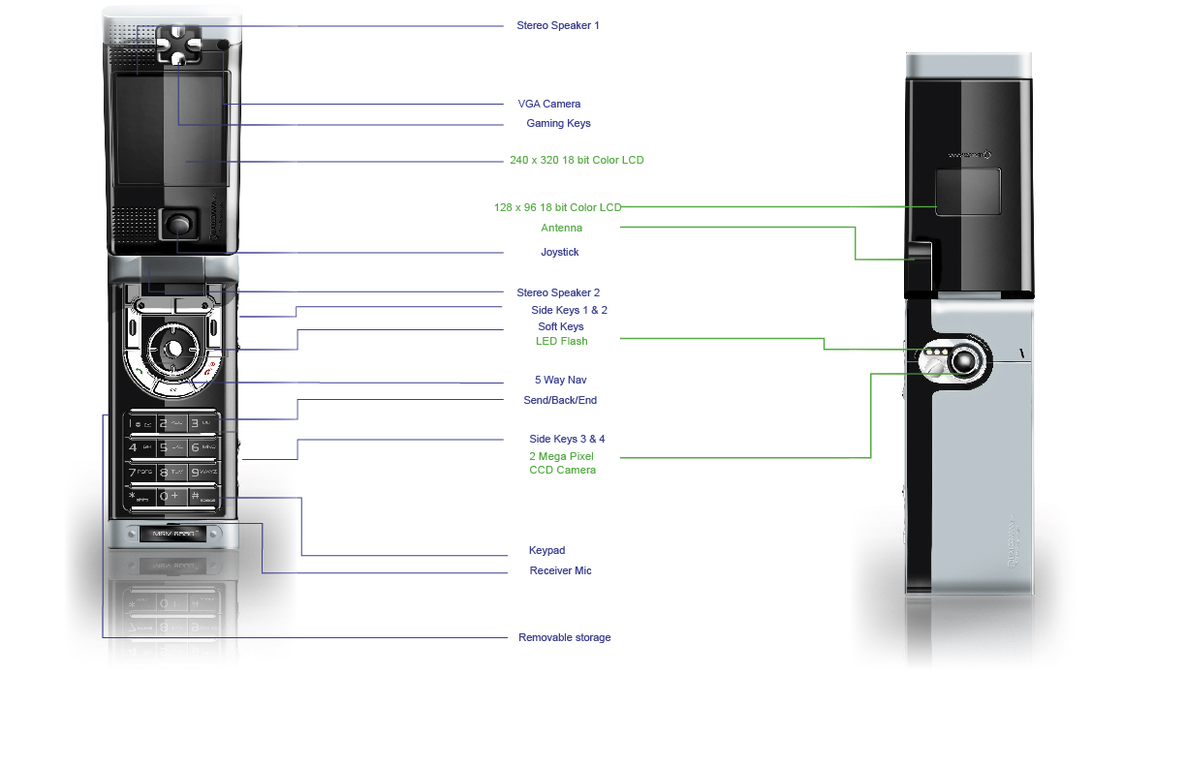
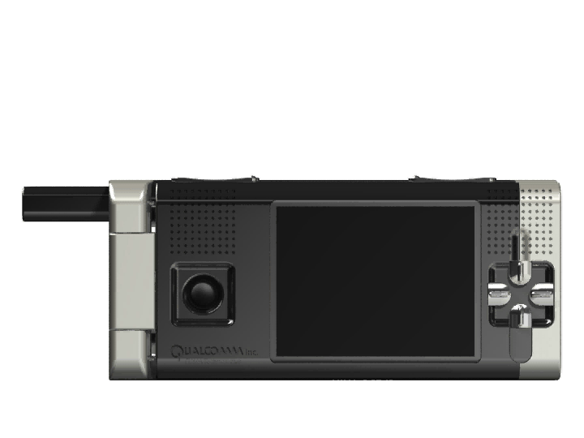
Enhanced Platform Development FFA
Stereo Speaker 1
VGA Camera
Rocker Buttons
320x240 18 bit Color Display
128x96 18 bit Color LCD
Antenna
Joystick
Stereo Speaker 2
Shoulder Buttons 1 & 2
Soft Keys
LED Flash
5 Way Navigator
Send/back/End
Shoulder Buttons 3 & 4
2 Mega Pixel CCD Camera
Open Mode
Keypad
Receiver Microphone
Removable Storage

Slide 22
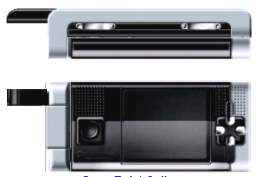
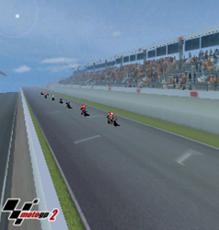
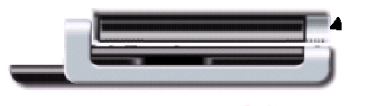
Enhanced Platform Development FFA
Shoulder Buttons 1, 2, 3 & 4
Stereo Speakers
Rocker Buttons
320x240 18 bit Color Display
Removable Storage
Gaming Mode
Joystick

Slide 23
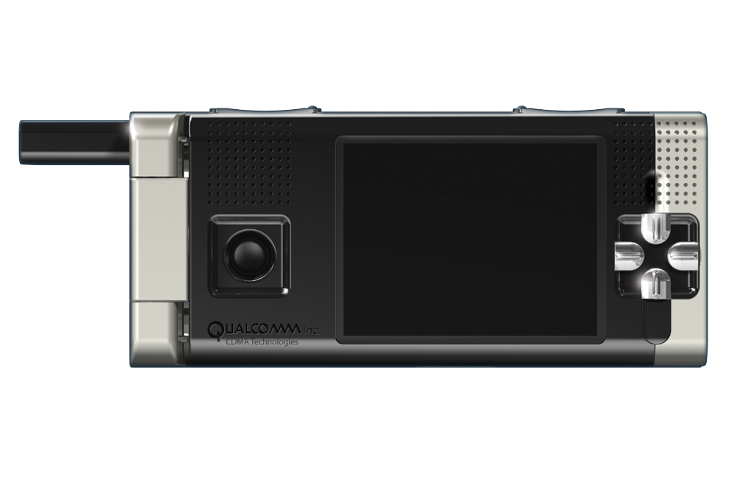

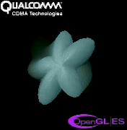

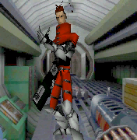
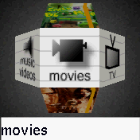
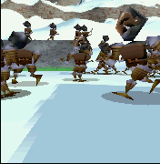

OpenGL ES demos on BREW
Motion Blur
Cloth Simulation
3D UI
MD2 Model Loader
3D UI

Slide 24

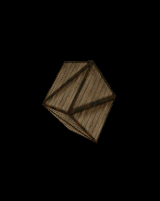

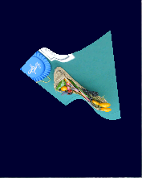
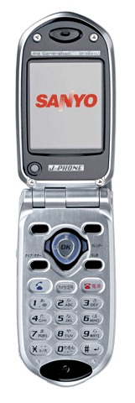
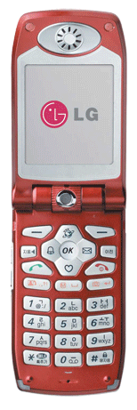
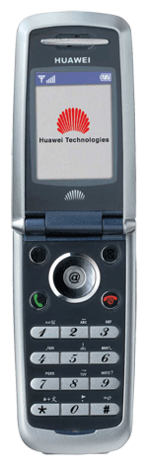
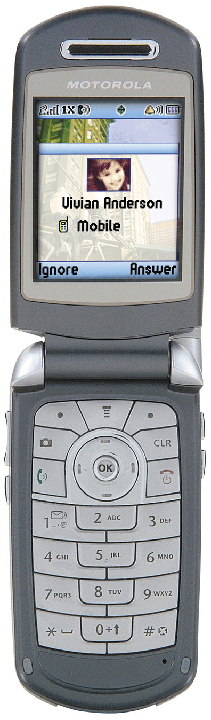
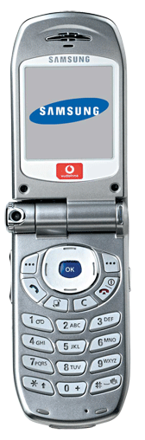
Getting started
Download the BREW SDK simulator: www.brewdeveloper.com
  Sample OpenGL ES BREW applications available
Demo 01
Demo 02
Demo 03
Demo 04
  Several pre-commercial phone skins/device files available
  …

Slide 25
Download OpenGL ES Extension
Download the BREW SDK extension for OpenGL ES at: https://brewx.qualcomm.com/brew/sdk/download.jsp?page=dx/devmisc
This dll is Qualcomm’s software implementation of OpenGL ES
Will work with Brew SDK 2.1 and above
This extension should reside in the Modules directory of the Brew SDK.
E.g. C:\Program Files\BREW SDK v2.1.0\Bin\Modules
It is important to match the extension with the Brew version
Need to make sure that the device skin supports at least 16-bit color depth

Slide 26
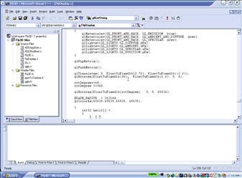
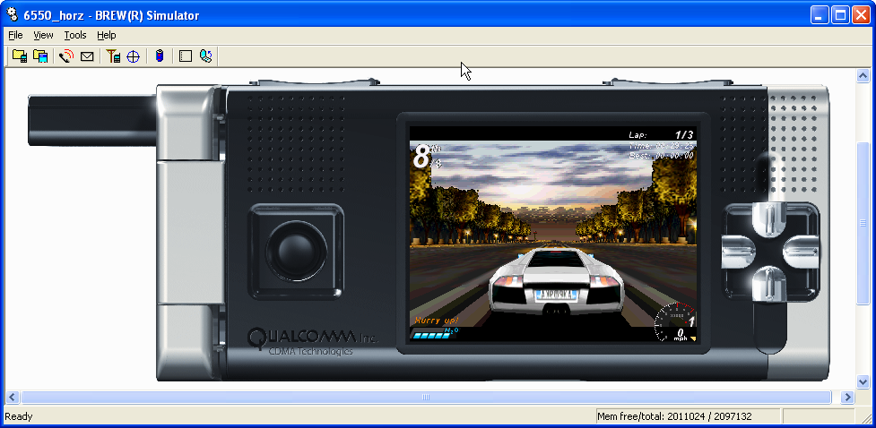
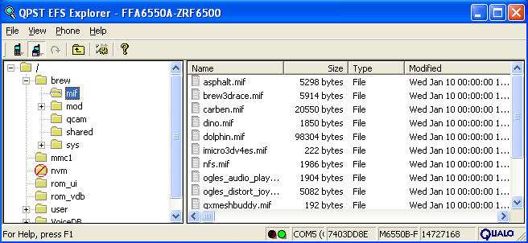
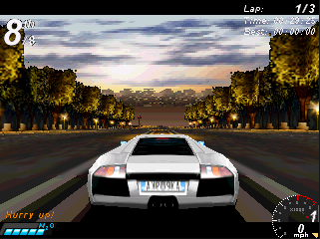
BREW™ OpenGL® ES Development Environment
Programming Environment
BREW SDK simulator
Application Loader
www.brewdeveloper.com

Slide 27

The OpenGL ES book
For complete information on the OpenGL ES spec and reference manual visit: www.opengles.org
For more information on programming using OpenGL ES:
Publisher: Premier Press/Course Technology PTR (September 21, 2004)
ISBN: 1592003702

Slide 28
Where to get more information
Learn more about developing BREW applications or to become an Authenticated BREW Developer visit: www.BREWdeveloper.com
Obtain the latest BREW market information at: www.BREWtoday.com
Contact BREW Developer Relations at: www.BREWdeveloperrelations.com
Obtain information about QUALCOMM’s product line for OpenGL ES at: www.cdmatech.com/Q3D

Slide 29
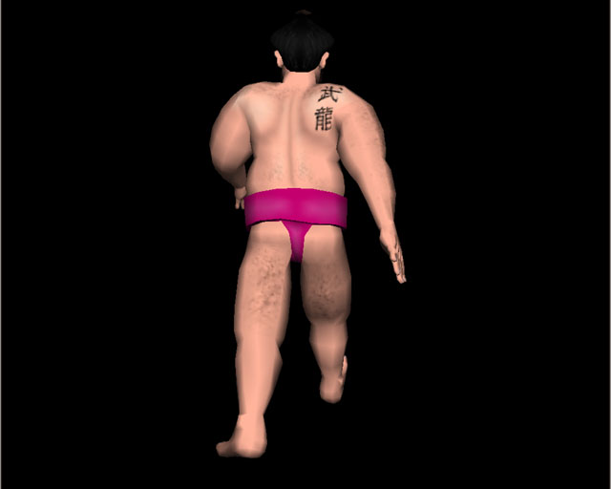
Questions?
The End

