Slide 1

OpenGL ES for Military and Security Applications
Mark Snyder
Mgr, Embedded Software Tools

Slide 2


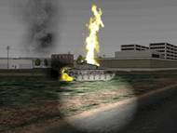


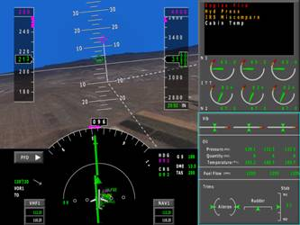
Quantum3D
  Markets – Visual Simulation and Training and Embedded Visual Computing
  Headquarters – San Jose
  Approx 100 employees
  Solutions (NVidia Based)
    Independence High Performance PC-Based Image Generator with optional Sensor Simulation
    Thermite Wearable Tactical Visual Computer
    Sentiris Embedded PMC Module
  Technology Directions
    Scalable HW/SW image generation
    Parallel Rendering Architectures
    Low Power/Low Cost Advanced Visual Computing
    Human Machine Interface Software Tools

Slide 3
OpenGL ES for Military and Security Applications
Mark Snyder
Mgr, Embedded Software Tools
www.quantum3d.com

Slide 4
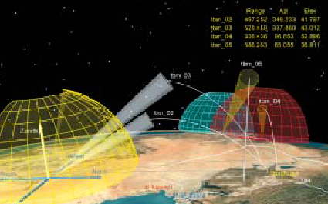

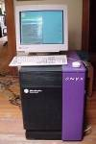
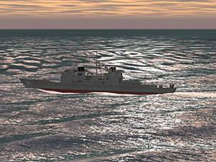

Open GL History in Military/Security Applications – ‘Big Iron’ Visualization
Full OpenGL Plus Extensions
Military Visualization
High End SGI
PC- Image Generator
Simulation and Training

Slide 5
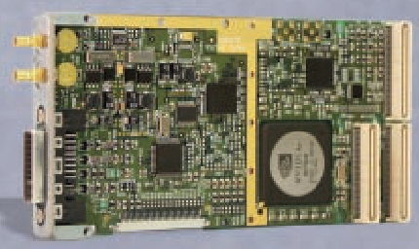
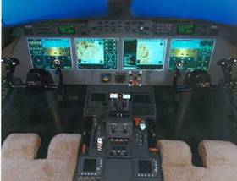
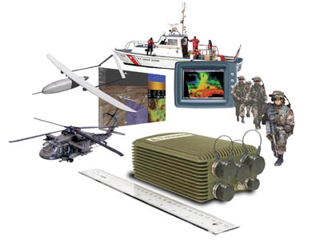
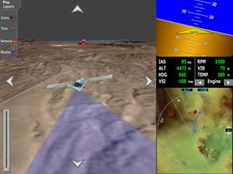
Open GL History in Military/Security Applications – Embedded Graphics
Open GL and/or Subsets – including OpenGL ES SC Profile
PMC for embedded SBC
Glass Flight Deck
Ruggedized mobile platforms
Portable 3D

Slide 6
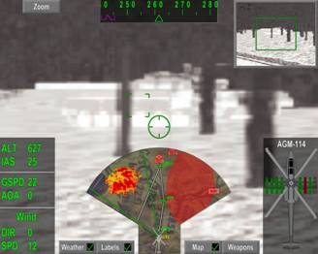
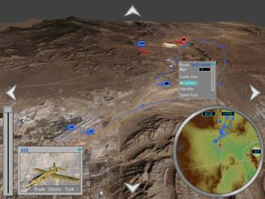
Mil/Security Uses of OpenGL – What are the Core Required Capabilities?
2D Graphics – Primarily Avionics
Fonts – extreme quality requirements
(Lines and/or textures)
Lines and multiple line widths
Layered transparent textures (Data Fusion)
Dynamic texturing (video, moving maps)
Safety criticality (small, subsetted drivers)
Scissor/stencil
Low power
Display flexibility
3D Graphics – Embedded Training and Visualization
All of 2D (except Safety Criticality) PLUS
3D geometry/lighting/transformation
Texture/geometry paging
3D clipping/culling
Shaders

Slide 7
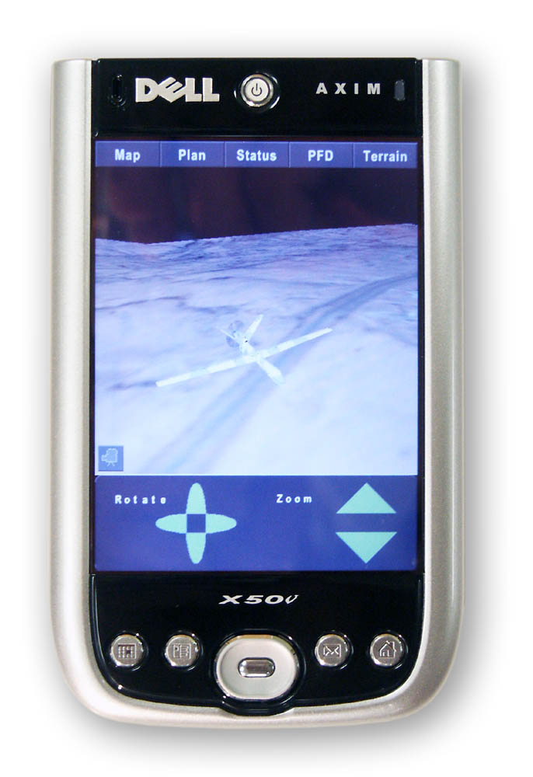
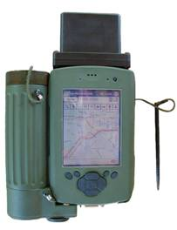
Why OpenGL ES for These Applications?
Power and Weight…
But this..
Is the incumbent technology
Is very limited graphically
Lots of weight given up for batteries
However, this..
Has some promise to change the
equation
But it has to bring more capability than
the incumbent!
Even This..
Is too hungry for some apps
Is too heavy for some apps

Slide 8
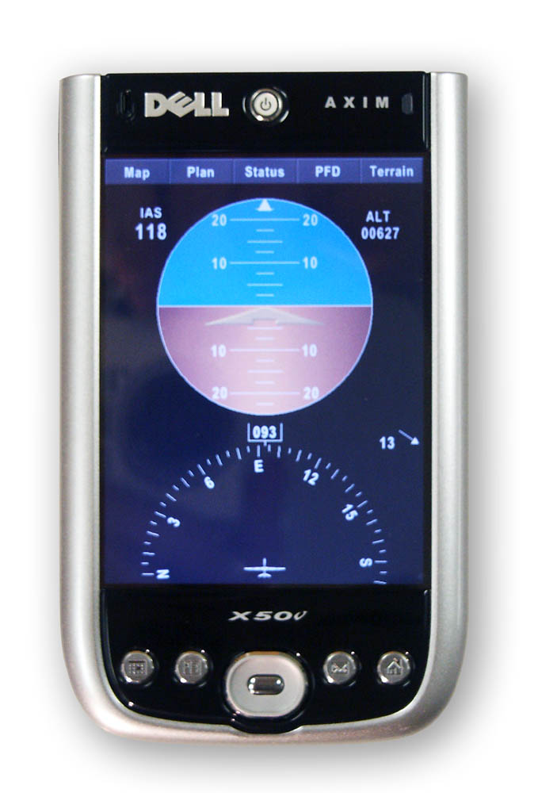
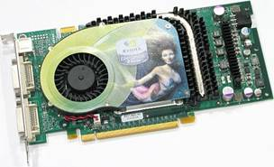
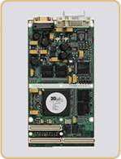
Why OpenGL ES for These Applications?
Driver Footprint
This…
Uses a full up driver plus many extensions
Maybe 3M SLOC??
Highly Optimized – many paths
Safety critical certification difficult/impossible
Or Huge NRE investment by avionics companies
However, this..
Driver probably <50K SLOC
Few Paths
Able to be certified
Deterministic

Slide 9
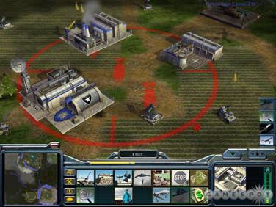
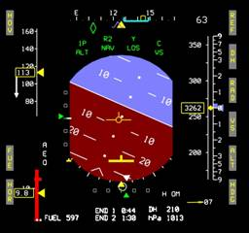
The Embedded Development Gap
Embedded Development Culture –
Code Driven
Tools (code generators) for routine things
Hand code for ‘advanced’ graphics
Slow to adopt new things
Game/Vis-sim development culture –
Data Driven
Use tools and SDKs (scene managers/game engines)
Many exist that bridge technologies (DirectX-OpenGL)
3D Model driven (Max, Creator, Maya, etc)
If done right – bridges consoles, desktop…
Faster to adopt latest – competitive reasons

Slide 10
What's the Matter With a Little Code, Anyway?
Sure, Lets Draw A Box
glColor4f(1.0f, 1.0f, 1.0f, 1.0f );
glBegin(GL_QUADS);
glVertex2f(1.0f, 0.0f);
glVertex2f(0.0f, 0.0f);
glVertex2f(0.0f, 1.0f);
glVertex2f(1.0f, 1.0f);
glEnd( );
OOPS! – Can’t run under some subsets now!
What if only packed colors supported?
What if no QUADS (only triangles)?
What if only vertex arrays?
What if we are fixed point?
While this may seem extreme…
It is the state of a lot of embedded code generators now
And don’t even think about looking at the hand code…

Slide 11
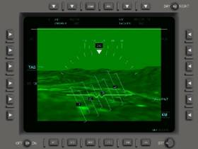
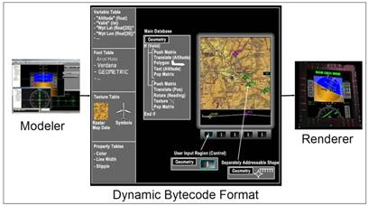
How About a Few Good Tools and APIs?
Move Beyond the Code Driven World…
Where geometry is represented as code
Where assumptions are made about the available
graphics
Into a Standards/Data Driven World
Lets get past the code and try data instead
Where the renderer/runtime adjusts to the available
graphics system

Slide 12
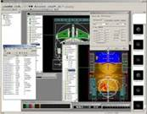
Q3D’s Experience with the Dell Axim
Our Starting Point
Quantum3D’s commercial cross-development HMI Authoring environment
Data driven technology supplies data, not source code, to renderer
Already running on multiple OS and Graphics implementations (all OpenGL)
IData Modeler HMI Tool Suite with Plug-Ins
New Target – Axim CL Subset
Develop Once
IData Application (Customer Developed)
IData Database(s)
IData Application (Customer Developed)
IData Database(s)
IData Application (Customer Developed)
IData Database(s)
IData Runtime 1
IData Runtime 2
IData Runtime 3
Operating System 1
Operating System 2
Operating System 3
Target/Embedded System 1
Target/Embedded System 2
Target/Embedded System 3
OpenGL
OpenGL2
OpenGL-ES Common Lite
Graphics Hardware 1
Graphics Hardware 2
Graphics Hardware 3

Slide 13
Some Things We Added (and Learned)
In our HMI Modeler/Database optimizer
  Vertex Arrays
  Take (even better) care of the OpenGL State
  Avoiding unsupported primitives while retaining capability
A few ways to do things differently in our renderer
  Fixed Point (up front, not every frame)
  Take good care of the vertex pointer
Some OS independence ‘features’ of Win/CE
Some ‘features’ of our pre-alpha driver
  We pushed it in ways not expected
  For instance – Scissoring didn’t work like we expected.
  Some things important to avionics/2D not important to games
But the good news was…
  The subset (even Common-Lite) was largely enough
  Enough that we have a launch customer
  We are pushing some advanced PDA-Like HMI capability into Army programs now

Slide 14
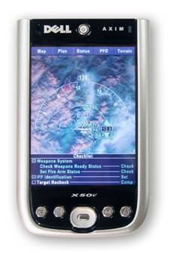
Our Axim X50V Demo Application
Features
2D Moving Map and 3D Terrain pages
Both Imagery and elevation-based map features
Geo-referenced 2D Data, including imagery
Pages for avionics-type screens and ‘advanced’ features
GUI
Portable GUI functions entirely atop ES
High quality fonts
Geographic picking in 2D

Slide 15

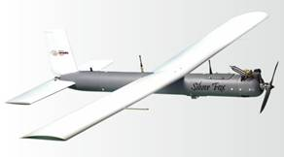
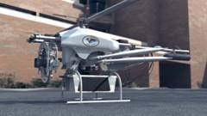
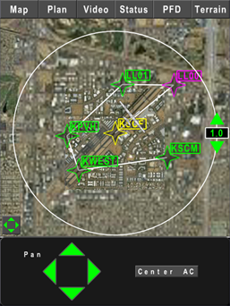
Real World OpenGL ES Usage
Kutta US Army Dismounted Associate (DA)
US Army Phase II Small Business Innovative Research (SBIR)
Handheld UAV controller/Flight planning device
2D/3D moving maps
Live video downlink
Advanced flight planning algorithms
Development platform – Axim X50V
Planned flight tests – this year
www.kutta.com
Challenges
Dynamic texture updates (Maps, Video)
User interactive frame rates
Minimize graphics power consumption (offload CPU)
Soldier friendly user interface
Leading edge drivers

Slide 16





Any Questions?

