Slide 1

Harnessing the Horsepower of OpenGL ES
Hardware Acceleration
이 진 언 (Jin-Aeon Lee)
수석, 삼성전자㈜

Slide 2
Organization – Samsung Electronics
Samsung Electronics Corp.
Corporate Technology Operation
Digital Media Business
Semiconductor Business
Telecommunication Network
LCD Business
Digital Appliance Business

Slide 3
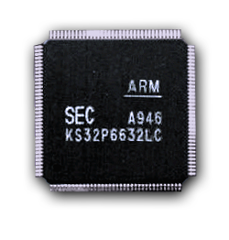
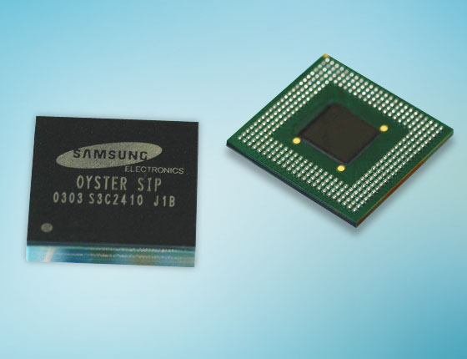
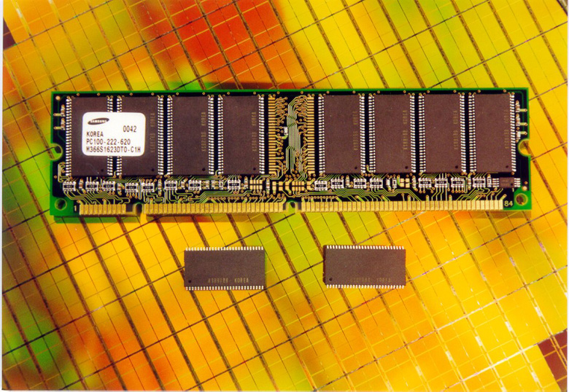
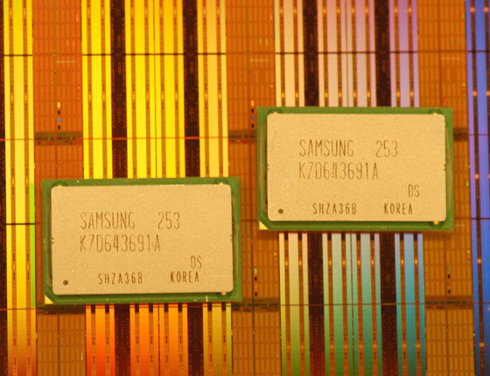
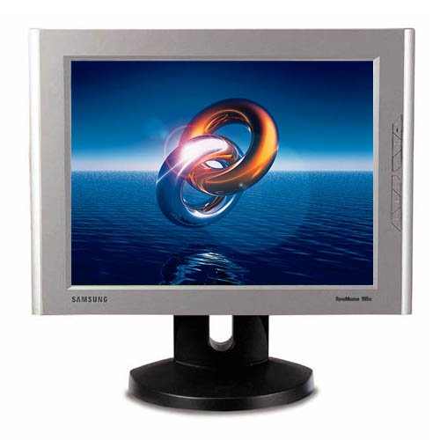
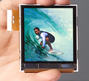
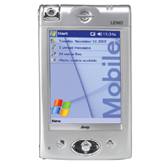
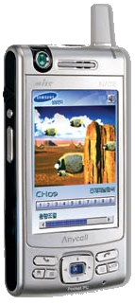
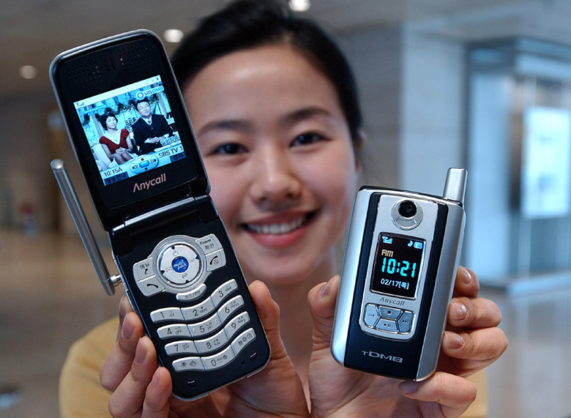
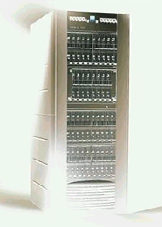
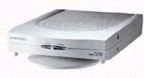
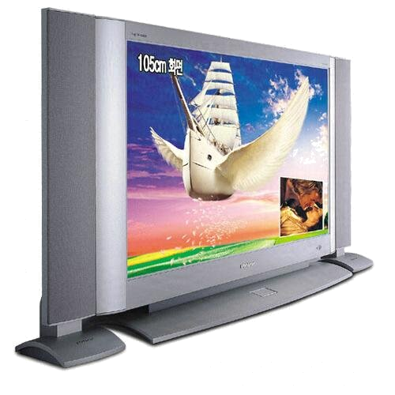
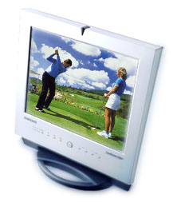
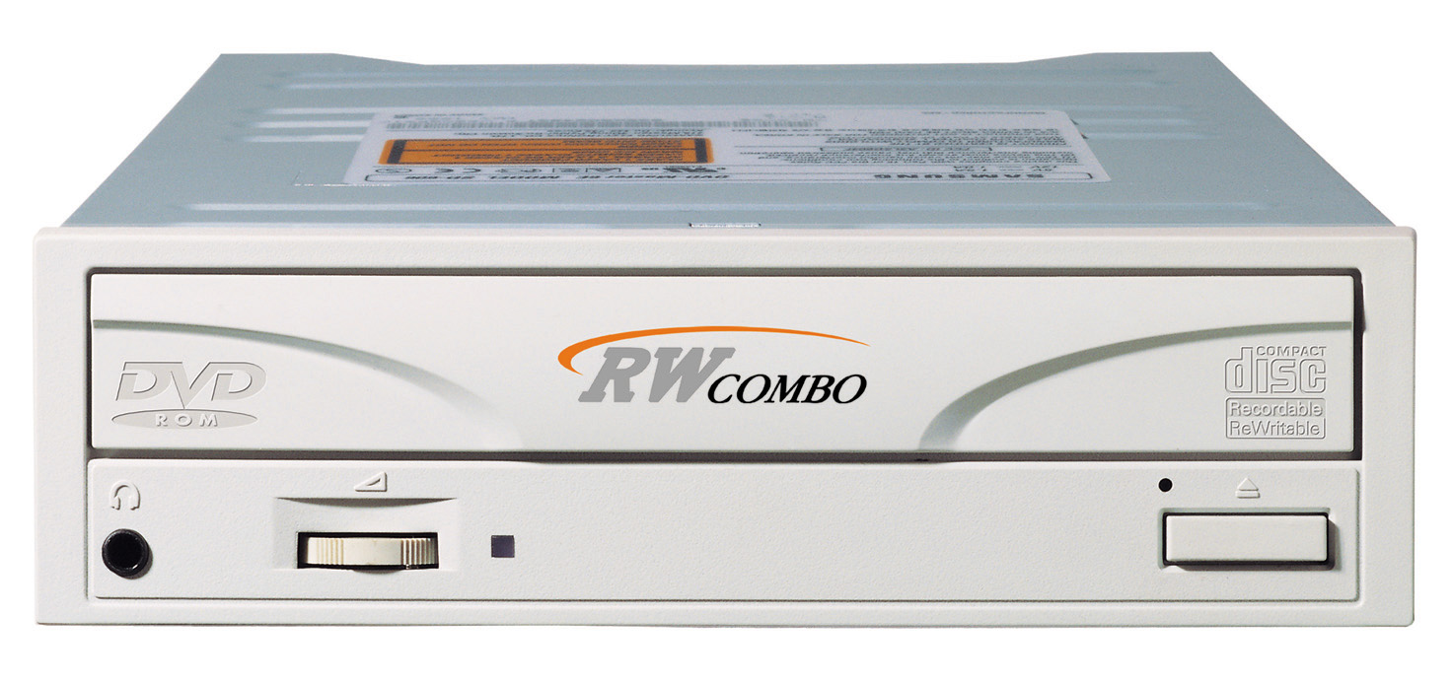

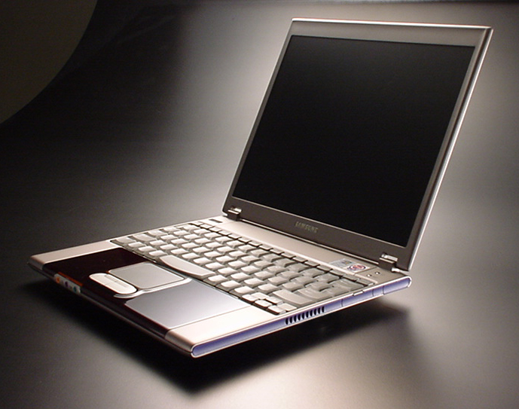
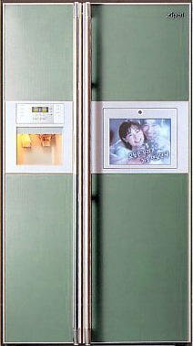
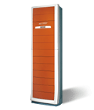

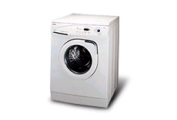
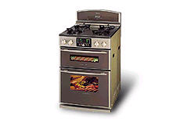
Business Area – Samsung Electronics
Semiconductor
Business
System LSI
Memory(DRAM, Flash, SRAM, Others)
LCD Business
Big Size-LCD
Mobile LCD
Telecommunication
Network Business
Cellular Phone
Smart Phone
ADSL Modem
Router
Digital Media
Business
Digital TV
(Home Theater)
ODD/HDD
DVDP / VCR
Monitor
PC
Digital Appliance
Business
Refrigerator
Air-Conditioner
Microwave Oven
Washing Machine
Gas Oven

Slide 4
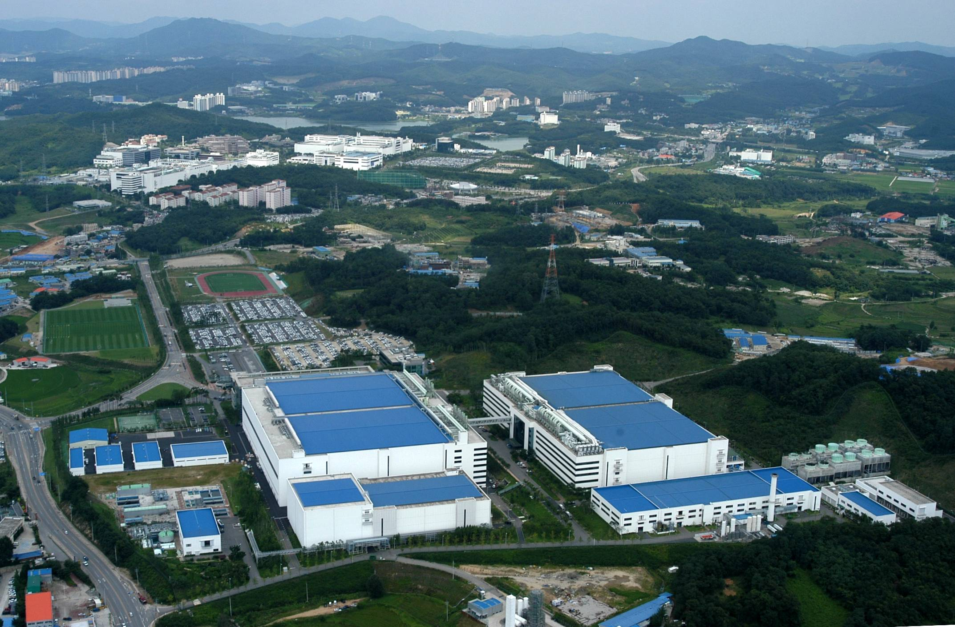
Giheung Semiconductor Complex
Since 2000
Gihung Plant
Whasung Plant

Slide 5




Business Area – System LSI Division
Mobile P/F SOC
Home P/F SOC
Platform
SOC
AP/MC
Modem/DMB
DTV/STB
Optical Disk SOC
Display SOC
Mass Storage SOC
SOC
DVDP/R
DVD R/W
LCD Monitor
HDD
Chip card & MCU
Display
Driver
Image
RF
LSI
MCU
S/Card
FCC
TFT
STN
PDP
CIS
CCD
CDMA/GSM
Connectivity
ASIC/Infra
IP Cores, Design Methodology, Process Technology

Slide 6


삼성 – Khronos Group 협력
Mobile & Home Multimedia SoC Platform을 위한 Open API 지원
  OpenGL ES Contributing Member : 2004 ~
  OpenGL ES 1.0/1.1 지원 AP (Application Processor) Sampling : S3C2460
  OpenGL ES 2.0 지원 3D Graphics Engine 개발 중
  OpenMax 표준화 참여
  OpenVG의 지원 검토
Mobile & Home SoC
with 3D Graphics & Multimedia
Open API 표준화

Slide 7


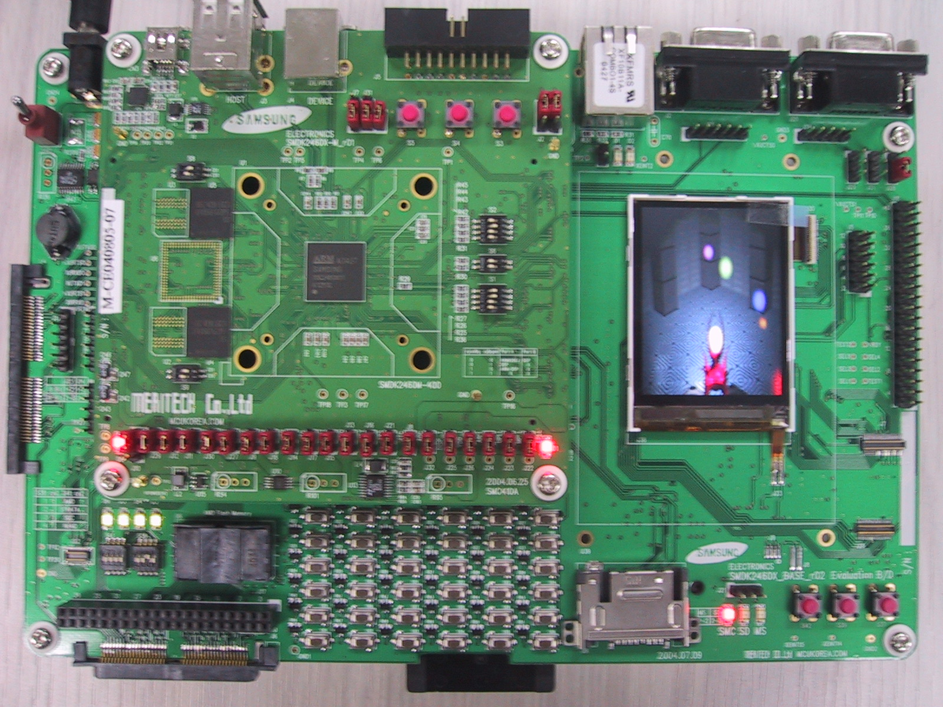
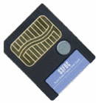
OpenGL ES 지원 AP – S3C2460
Silicon Sampling & 개발자용 Board Ready!
3D Graphics Engine powered by MBX R-S Core
OpenGL ES 1.0/1.1 compliant
AAC Audio
ARM926EJ_S (200~266MHz)
MBX R-S Core (1M tri./s)
Dual-MAC DSP
MPEG-4 CODEC (CIF 30fps)
16Mpixel Camera IF
NAND/NOR/SDRAM IF
USB/Serial
TFT-LCD IF
I2S/AC97 Audio IF
Mobile
DRAM
S3C2460
TFT Display
NAND
controller

Slide 8
3D Graphics H/W Acceleration for Mobile Applications?
Mobile Device에 3D Graphics H/W Acceleration이 필요한가?
Voice/Audio (Analog/Digital): 1970년 전후
Video/Image (Analog/Digital): 1990년 이후
3D Graphics: 2005년 ?
Commodity
Technology
Mobile
Gaming
Information
Visualization
3D GUI
Avatar
3D Clip

Slide 9
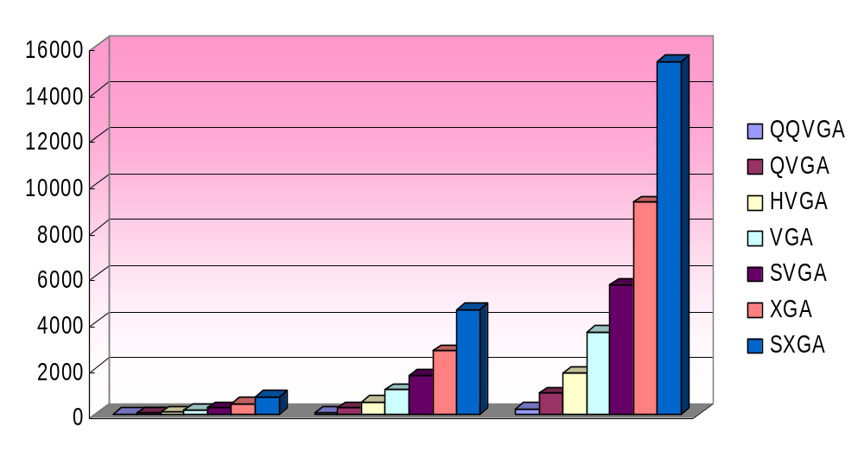
Rendering Performance vs. Display
3D Graphics Rendering Performance for Mobile Applications
  Low Quality: Entry-level gaming, 3D GUI
  Medium Quality: Moderate Mobile Gaming, Advanced GUI
  High Quality: Dynamic 3D Gaming, High Quality Animation
x K triangles/s
Low Quality
Medium Quality
High Quality

Slide 10
Constraints
End-user Requirements
  Performance/Image Quality/사용가능 시간 (Min. 2 hours)
Power Budget: 700 ~ 1400mAH battery
Cost (Silicon Area)
  3D Graphics H/W Acceleration에 얼마만큼의 Silicon Area를 허용할 수 있는가?
  130nm Technology: 0.5M ~ 2.0M gates
  90nm Technology: 1.0M ~ 4.0M gates
Memory Bandwidth
  mDDR I/O x16, x32: 100MHz ~ 166MHz (400MB/s ~ 1.3GB/s)
Host to 3D Engine Bandwidth
  On-chip SoC Bus (AHB, AXI, OCP or etc) x32, x64, x128: 100MHz ~ 200MHz (400MB/s ~ 2.0GB/s)
  High Speed Serial Link: 100Mbps ~ 1.2Gbps (12.5MB/s ~ 150MB/s)
Working Memory Size
  64MB/128MB/256MB (1Gb mDDR x 2)
Design Time / Software Solution

Slide 11
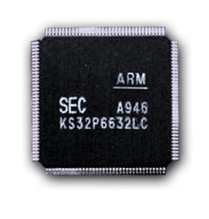
Samsung Mobile AP
Host Processor for the Mobile Application Processor
High-End PDA &
Smart Phone
1GHz
ARM12
667/800MHz
ARM11
400/533MHz
ARM11
Multimedia Handset,
Portable Media Player
2440
300/400MHz
667MHz
ARM11
2410
200/266MHz
400MHz
ARM11
266MHz
ARM9
2460
200MHz
24A0
200MHz
2004
2005
2006
2007

Slide 12
Mobile 3D Graphics Engine Roadmap
3D Graphics H/W Rendering Engine for Mobile SoCs
  5M triangles/s Engine (’05.Q4, OpenGL ES 1.0/1.1/2.0 support)
40M
GE/RE
M triangles/s
20M
GE/RE
VGA Display
(640 x 480)
10M
GE/RE
QVGA Display
(320 x 240)
5M GE/RE
(Programmable)
1M GE/RE
2004
2005
2006
2007

Slide 13
Development Environment
3D Graphics Rendering Engine & SoC 개발 Platform
  3D Engine 개발 & Early API Adaptation
ViP
RTL 설계
FPGA
Prototyping
Silicon
DB
API Porting
C Model
3D High-level
API

Slide 14



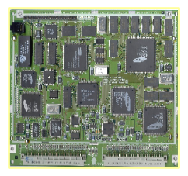
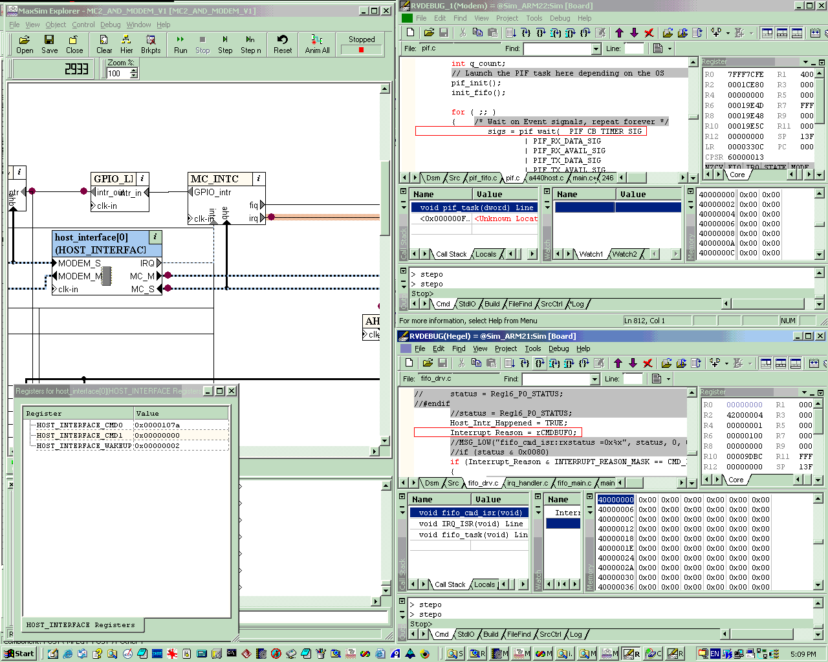
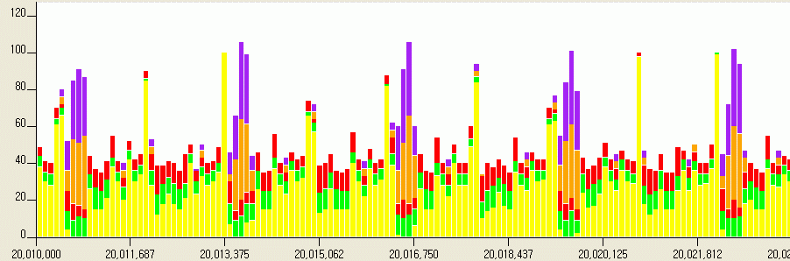
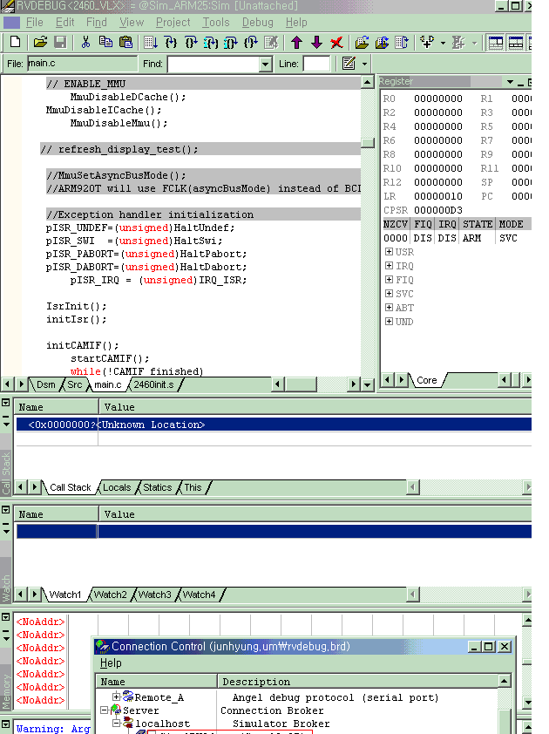
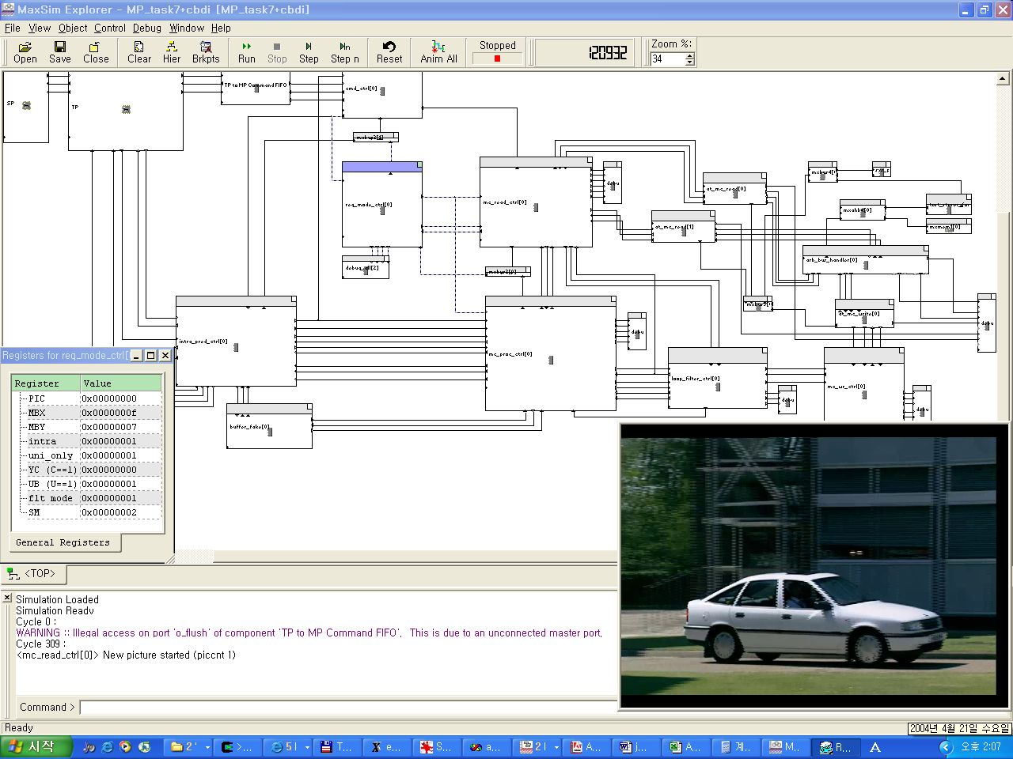
ViP (Virtual Platform)
Function-accurate and Cycle-approximate HW/SW System (Platform) Simulator
  Accuracy : > 90% (RTL Simulation 기준)
  High speed simulation with Transaction-level models: > 1000배 (RTL Simulation 대비)
C++/SystemC Models
DMAC
uC
Register File
Ports
Y
Bus Ctrl
Timers
MPEG
Video Decoder
Graphics
Engine
Bus Bridge
DSP
Bus/Cache Control
Pre-silicon SW development
and optimization
DRAM Ctrl
DSP Bus Control
On-Chip Ram
Y
D-Cache
I-Cache
SW debugger
Interplay effect analysis of HW and SW
→ Identify the performance bottleneck
Architecture Exploration
→ Predict IP performance in advance

Slide 15
FIMG (Fully Interactive Mobile Graphics)
Programmable (Vertex & Pixel) & Scalable Floating-point Architecture
  5M triangles/s ~ 40M triangles/s
Host
Interface
Vertex
Engine
Primitive
Engine
Raster
Engine
Pixel
Engine
Per-frag.
Engine
Texture
Engine
Control
Texture
Engine
FIMG
Mobile SoC On-chip Bus
CPU
Mobile DDR Memory

Slide 16
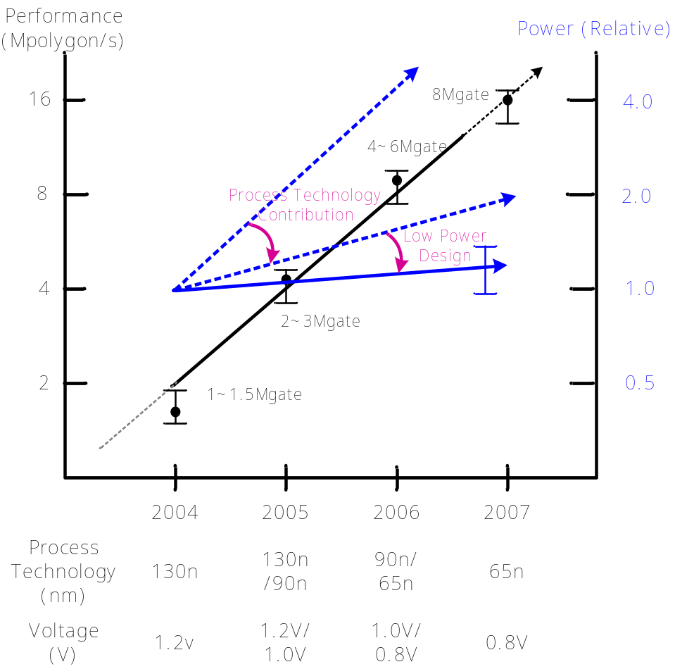
Low Power/Energy Consumption
고성능/고화질 Mobile 3D Graphics Engine은 저전력 설계가 필수
■ Power Consumption
Power = α × C × V²
HW Design Factor
Process Tech. Dependent Factor
■ Hardware Design Factor
- C : For more performance and functionality, H/W complexity is doubled in every new generation of Mobile 3D H/W Accelerator
- α (Switching Ratio)
Low Power 3D Architecture
Low Power HW Implementation
IDDP (Instantaneous Data-Driven Processing)

Slide 17
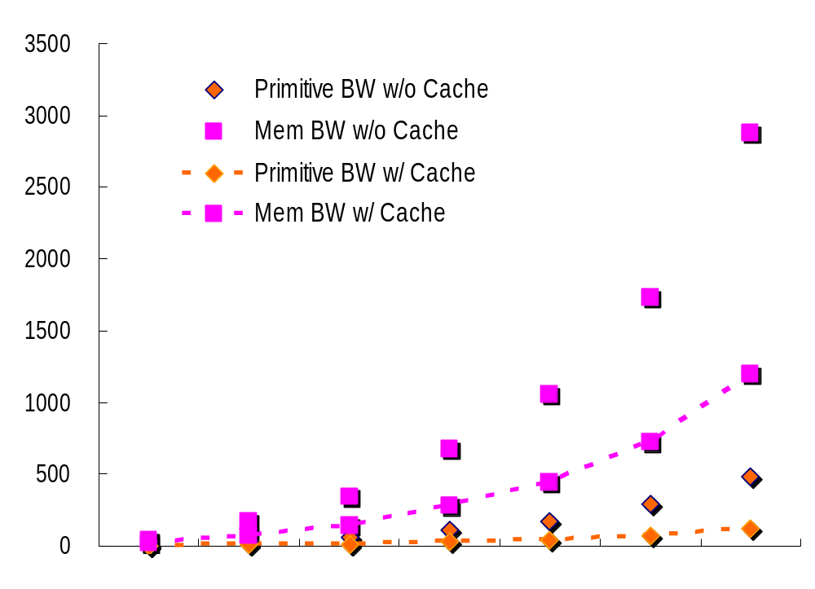
Primitive & Memory BW Problem
Mobile SoC Platform의 저전력/H/W Size 제약
  Primitive Write-path 및 Working Memory Interface에 효율적인 Cache가 필요
x MB/s
QQVGA
QVGA
HVGA
VGA
SVGA
XGA
SXGA

Slide 18
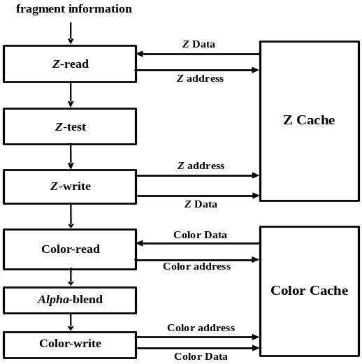
High Performance Z/Color/Texture Cache
Raster
Engine
Pixel
Engine
Per-frag.
Engine
Z/Color Cache Architecture
- Z/Color Prefetching
- Cache Parameter Optimization
- Memory Hierarchy Optimization
- Access-pattern Adaptive
Texture
Engine
FIMG
Z Cache
Mobile SoC On-chip Bus
Adaptive Texture Cache Architecture
Flexible Block-size based on Texture Format
Flexible Way-control for Multi-texturing
Texture Prefetching
L2 Texture Cache
→ Power Saving X Performance ↑
Color
Cache
Texture
Filtering Unit
Address
Generation Unit
Adaptive Texture Cache

Slide 19
Conclusion
Mobile 3D Graphics 기술의 범용화 시대 도래
Mobile Display의 고화질화
Mobile 사용 환경에 최적화된 Mobile용 3D Graphics Engine Architecture가 필요
  저전력/Compact/고화질
  Host to 3D Engine & Memory Access Efficiency 극대화
Open API에 최적화된 3D Graphics Engine & SoC Solution의 지속적 개발과 시장 공급
  OpenGL ES 1.0/1.1/2.0 Compliant
  Programmable & Scalable 3D Engine
Early-stage에서 S/W Solution을 개발할 수 있는 환경 제공
  ViP (Virtual Platform) & C Model

Slide 20




Any Questions?

