Slide 1

The reasoning behind the OpenGL ES SC subset specification
Chris Hall
Seaweed Systems Inc.

Slide 2
About Me
Seaweed Systems has been in the embedded graphics driver business for over 15 years
  Working with OpenGL since 1995
  Shipped our first certifiable OpenGL subset implementation in March of 2002
  Working on OpenGL ES since May 2002
  Have shipped 6 certifiable subset implementations since 2001
    Integrity DO178 , VMOS, vxWorks and vxWorks AE653 operating systems
    3 chipsets, 2 entire different hardware architectures
Chris Hall
  Involved with OpenGL since 1993
    Initially, on application side
    Later, driver and OpenGL implementation
  Architect for Seaweed System’s certifiable OpenGL subset implementations
    Began work in Oct 2001
  Initial Safety Critical contributor to the OpenGL ES effort
  Chairman of Safety Critical workgroup, from inception to just recently

Slide 3
The reasoning behind the OpenGL ES SC subset specification
Chris Hall
Seaweed Systems Inc.
cjh@seaweed.com

Slide 4
Safety Critical Graphics
Misleading information could result in loss of life and/or property
Must provide evidence that the software is safe
  Must follow rigorous development procedures, and prove that you did so
  Must prove that you have executed every code path
    At the highest level, must prove each combination of terms in conditional expression
  Must remove all unused code

Slide 5
Key Goals and Philosophies
A subset of OpenGL intended to address the needs of Safety-Critical markets should have the following properties:
  Meet the functional requirements of target applications
  Minimize Redundancy in functionality
  No unused functionality
  Simplified requirements for implementers
  Minimize dynamic allocation requirements
  Avoid recursion

Slide 6
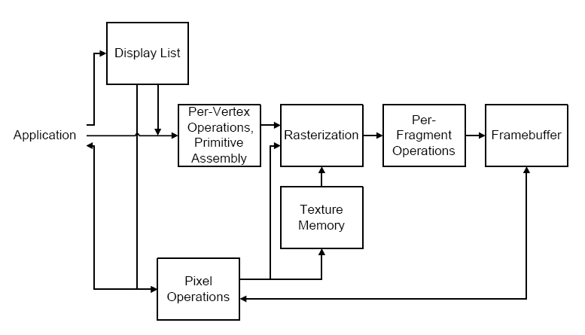
How OpenGL Works
Allows applications to draw visuals
  Unified approach to drawing 2D and 3D data
  Using multiple primitive elements (points, lines, triangles, line strips, triangle strips, etc.)
    These primitives are specified using a sequence of vertices
    Multiple data per vertex (position, color, surface normal, textures coordinates)
  Using raster operations
  Data can be specified in many different ways (24k ways to specify a colored, textured vertex)

Slide 7
How OpenGL Works
Operates as a pipeline
  Vertices are processed according to a set of switches (state) indicating operations such as lighting and clipping
  Vertices are assembled into primitives which are rasterized using operations which are controlled with another set of state.
  Fragments (pixels) produced by the rasterization step are subject to per-fragment operations

Slide 8
How OpenGL Works
Implications
  From the point on view of the application, most drawing operations are modified by most OpenGL state
  More than 40 independent functions which enable/set state, some of which have dozens of possible arguments
  Billions of possibilities!

Slide 9
Practical Guidelines
Where multiple functions could convey the same data to OpenGL ES, prefer functions which match native data types
Where a variety of data type sizes, for example – 8,16,24,32 bits - are available, balance simplicity, with the need to allow small footprint applications
Where input parameters to functions include a range of functionality, retain only commonly used inputs
Wherever possible, remove functionality which requires a decision by the implementation
Enable optimization of the entire graphics pipeline, without forcing complex logic on the application, or the OpenGL ES implementation
Avoid functionality which is not commonly use and/or supported in hardware

Slide 10
Aspects of the current draft specification

Slide 11
Vertex Specification and Primitive Assembly
Vertex Specification
  Choice of Vertex Arrays, or Begin/End
  Data Formats
    Color Specification
    Surface Normals
    Texture Coordinates
    Positional Data
  QUADS and QUAD_STRIP
    Implementation as triangles anyway
  POLYGON
    Triangle-fans

Slide 12
Rasterization
Anti-aliasing
  Critical functionality
  Multi-sample AA no good for 2D lines and points
  Support edge AA, not multi-sample
Points and Line Segments
  Many different modes which could be emulated with texturing, but…
  So - retain the full set of this functionality

Slide 13
Rasterization, continued
Polygons
  Remove QUAD, QUAD_STRIP and POLYGON
  Remove Point and line PolygonMode
    Useful for debugging
    Not the best way to render gridlines over terrain
Pixel Rectangles
  OpenGL provides support for a very large number of pixel rectangle formats and data types
  OpenGL provides support for data format conversion
  OpenGL provides support for color manipulation
  This advanced functionality is not typically supported in hardware, and we don’t want to write the complex software to implement it.

Slide 14
Rasterization, continued
Texturing
  OpenGL provides 1D, 2D, 3D textures, etc.
  1D texturing can be emulated using 2D textures
  2D texturing is an essential feature
  3D texturing has specialized uses, is often poorly supported in hardware, and requires substantial amounts of texture memory
  Include only 2D texturing
    Include Multi-texture – 2 texture units
    Color-index textures are useful for drawing map data
Texture management
  Applications must have ability to manage texture memory
  Create and Delete texture objects

Slide 15
Rasterization, continued
Fog
  OpenGL provides several fog modes
  Most common mentioned use is to hide pop-up
  Only need to support one mode – LINEAR

Slide 16
Per-Fragment Operations
Scissor
  Essential
Stencil, Depth Buffering
  Essential functionality
  Do we need all modes?
    Stencil – yes
    Depth – no
Alpha Test
  Important to keep, but cut down on combinations
Logic Ops
  Not important
Blending
  Important, but need to cut down on combinations
Masks (color, depth)
  Important
Dithering
  Not relevant

Slide 17





Any Questions?
Insert Your Company
Logo Here

Slide 18
Display Lists
Provide a mechanism to store large amount of data in the “server” to improve performance
  For implementations which completely isolate applications from anything which touches the hardware
Provide a mechanism to enable optimization of inefficient (but safe) application usage of OpenGL ES SC
  Optimization occurs once, and can run more slowly – easier to certify?
Provide a mechanism to allow implementation to store data in graphics memory
  Need to be careful – graphics memory can become corrupted
Good programming paradigm for fonts
  Very common in Avionics, and other applications

