Slide 1

A WALK THROUGH THE API
Jim Tan
SMedia Technology Corp.

Slide 2

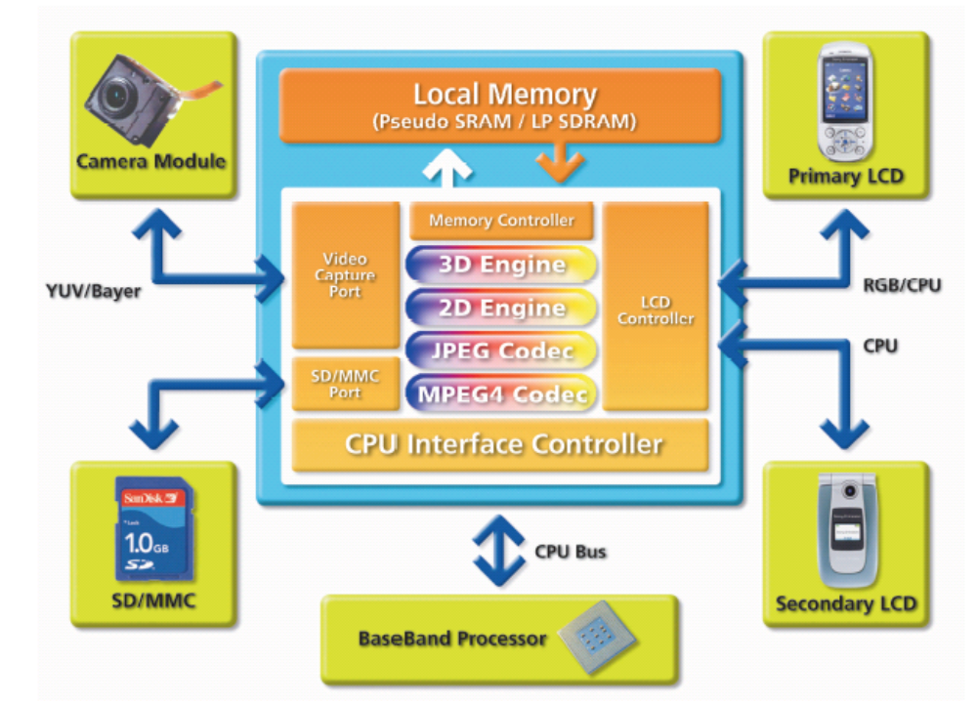
SMedia Solution
SMedia is integrating the interactive multimedia visual solution for handheld devices to enable new applications that enrich more enjoyment and quality to life.

Slide 3
Outline
What is OpenGL ES?
OpenGL and OpenGL ES
OpenGL ES Profiles
OpenGL ES Versions
How to write a program running on OpenGL and OpenGL ES?
OpenGL ES 1.1 New Functions
References

Slide 4
What is OpenGL ES?
A 2D/3D graphics API
Designed for embedded systems
Cross-platform
Royalty-free
Subset of OpenGL
  Keeps simple, small and efficiency as possible
  Keeps compatible with OpenGL as possible
Features beyond OpenGL
  Fixed-point
  EGL
  …
Similar projects
TinyGL
miniGL

Slide 5
OpenGL and OpenGL ES
OpenGL
  For workstations or PCs
  Different platform Interface layers like WGL, GLX and AGL
  Too many legacy, expensive, complicated functions
    Display List (glBegin / glEnd)
    Double precision floating
    1D, 3D textures
    Polygons and Quads
    Evaluators (curved surface functions)
    …
OpenGL ES
  For low-power, limited capability devices
  Standard platform Interface layer - EGL
  Keeps the most useful APIs from OpenGL
  New features
    Fixed-point
    Byte coordinates
    Paletted Textures

Slide 6
OpenGL ES Profiles
Common Profile
  For consumer entertainment
  Targets on High-end devices
  Covers all Common-Lite Profile functions
  Includes floating and fixed point functions
Common-Lite Profile
  For consumer entertainment
  Targets on Low-end devices
  Includes fixed point functions only
Safety Critical Profile
  For consumer and industrial applications
  Reliability and certifiability

Slide 7
OpenGL ES Versions
1.0
  Base on OpenGL 1.3
  Focuses on enabling software-only implementations
1.1
  Base on OpenGL 1.5
  Emphasizes hardware acceleration
  EGL
    Power management
    Swap control functionality
    Optional render-to-texture functionality
1.2
  Makes some optional extensions mandatory
  Adds new features
  Not finalized yet
2.0
  Defines OpenGL ES shading language to access programmable hardware
  Removal of Common Lite Profile
  Not finalized yet

Slide 8
How to write a program running on OpenGL and OpenGL ES?
Use a full functional OpenGL implementation
  Mesa3D
Use libraries to call OpenGL extension APIs as standard ones
  OpenGL SDK
  GLEW
Write macros to interface the standard APIs and constants
Write wrapper functions to implement some APIs
  glCompressedTexImage2D
  GLU
  GLUT

Slide 9
Macro Example
  #ifdef MGL_OPENGL
  #define GL_POINT_SPRITE GL_POINT_SPRITE_ARB
  #define MGL_GL_REAL GL_FLOAT
  #define mgl_glAlphaFunc glAlphaFunc
  #define mgl_glColor4 glColor4f
  #define mgl_glFogv glFogfv
  #define mgl_glCompressedTexImage2D mgl_oglCompressedTexImage2D
  #else
  #ifdef MGL_FLOATING
  #define MGL_GL_REAL GL_FLOAT
  #define mgl_glAlphaFunc glAlphaFunc
  #define mgl_glColor4 glColor4f
  #define mgl_glFogv glFogfv
  #define mgl_glCompressedTexImage2D glCompressedTexImage2D
  #else
  #define MGL_GL_REAL GL_FIXED
  #define mgl_glAlphaFunc glAlphaFuncx
  #define mgl_glColor4 glColor4x
  #define mgl_glFogv glFogxv
  #define mgl_glCompressedTexImage2D glCompressedTexImage2D
  #endif #endif #endif

Slide 10
Use Example
  glViewport(0, 0, (GLsizei) window_width, (GLsizei) window_height);
  glMatrixMode(GL_PROJECTION);
  glLoadIdentity();
  mgl_gluPerspective(MGL_F(45), // fov
  mgl_div(MGL_F(window_width), MGL_F(window_height)), // aspect
  MGL_F(1), // znear
  MGL_F(100)); // zfar
  glMatrixMode(GL_MODELVIEW);
  glLoadIdentity();
  mgl_gluLookAt(MGL_F(0), MGL_F(0), MGL_F(5), // eye
  MGL_F(0), MGL_F(0), MGL_F(0), // center
  MGL_F(0), MGL_F(1), MGL_F(0)); // up
  glVertexPointer(3, MGL_GL_REAL, 0, vertices);
  mgl_glColor4(MGL_F_ONE, MGL_F_ONE, MGL_F_ONE, MGL_F_ONE);
  glEnable(GL_CULL_FACE);
  glEnable(GL_DEPTH_TEST);
  glEnableClientState(GL_VERTEX_ARRAY);
  glClear(GL_COLOR_BUFFER_BIT | GL_DEPTH_BUFFER_BIT);
  glDrawArrays(GL_TRIANGLE_FAN, 0, 4);

Slide 11
OpenGL ES 1.1 New Functions
Vertex Buffer Objects
  Stores data to VRAM in advance
User Clip Planes
  Useful for portal culling
Texture Environment Combine / DOT3
  Bump-mapping and per-pixel-lighting effects
Static and Dynamic state queries
  Enables state save and restore, useful for 3rd-party libraries
Point Sprite / Point Size Array
  Used for particle system effects
Matrix Palette (Optional)
  Skin and bone animation
Draw Texture (Optional)
  Fast drawing background, font and 2D elements

Slide 12
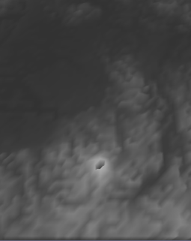
Vertex Buffer Objects
Stores frequently-used vertex data in video memory
// initialize
glGenBuffers(…);
glBindBuffer(…);
glBufferData(…);
// render
glEnableClientState(GL_VERTEX_ARRAY);
glBindBuffer(…);
glVertexPointer(…);
glDrawElements(…);
// destroy
glDisableClientState(…);
glDeleteBuffers(…);

Slide 13

Texture Environment Combine / DOT3
For effects such as bump-mapping and per-pixel lighting
glActiveTexture(GL_TEXTURE1);
glBindTexture(GL_TEXTURE_2D, …);
glEnable(GL_TEXTURE_2D);
glActiveTexture(GL_TEXTURE0);
glBindTexture(GL_TEXTURE_2D, …);
glEnable(GL_TEXTURE_2D);
mgl_glTexEnv(GL_TEXTURE_ENV, GL_TEXTURE_ENV_MODE, GL_COMBINE);
mgl_glTexEnv(GL_TEXTURE_ENV, GL_COMBINE_RGB, GL_DOT3_RGB);
mgl_glTexEnv(GL_TEXTURE_ENV, GL_SOURCE0_RGB, GL_TEXTURE);
mgl_glTexEnv(GL_TEXTURE_ENV, GL_OPERAND0_RGB, GL_SRC_COLOR);
mgl_glTexEnv(GL_TEXTURE_ENV, GL_SOURCE1_RGB, GL_CONSTANT);
mgl_glTexEnv(GL_TEXTURE_ENV, GL_OPERAND1_RGB, GL_SRC_COLOR);

Slide 14

Point Sprite / Point Size Array
Draws particles using points instead of quads
// enable & render
glDepthMask(GL_FALSE);
glEnable(GL_BLEND);
glBlendFunc(GL_DST_ALPHA, GL_ONE);
glBindTexture(…);
mgl_glTexEnv(GL_POINT_SPRITE, GL_COORD_REPLACE,
GL_TRUE);
glEnable(GL_POINT_SIZE_ARRAY);
glEnable(GL_POINT_SPRITE);
mgl_glPointSizePointer(…);
mgl_glColor4(…);
glVertexPointer(…);
glDrawArrays(GL_POINTS, …);
// disable
glDisable(GL_POINT_SPRITE);
glDisable(GL_POINT_SIZE_ARRAY);
glDisable(GL_BLEND);
glDepthMask(GL_TRUE);

Slide 15
References
OpenGL ES
  www.opengles.org
OpenGL
  www.opengl.org
Mesa 3D
  www.mesa3d.org
OpenGL SDK
  oss.sgi.com/projects/ogl-sample/sdk.html
GLEW
  glew.sourceforge.net
TinyGL
  fabrice.bellard.free.fr/TinyGL
miniGL
  www.dsbox.com/minigl.html
SMEDIA
  www.smediatech.com

Slide 16





Any Questions?

