Slide 1
Multimedia in Handhelds

Slide 2
Jon Peddie Research
Founded in 2001 - our 20th year
Focus and emphasis on Digital Technology, Multi Media, and Graphics
Consulting and market research - Advisor to industry leaders and financiers
Bi-weekly report, various Digital Technology Market Studies
The Business of Multimedia and Graphics

Slide 3
Refugees & Builders from PC Land
Valuable lessons learned the hard way
PC didn’t have stable APIs until 1995 – 15 years from introduction
Handhelds APIs in 2004 – 4 years from introduction
Common Open APIs enable growth – we proved that in PC Land

Slide 4
PC and HH Comparisons
Color bit-mapped screens empowered the PC, and did the same for handhelds
PCs screens grew quickly in size, resolution, and color depth
Handhelds are approaching asymptote on size, have some resolution growth left, problematic on color depth

Slide 5
PC and HH Comparisons
Cameras on HHs took off 36% today, 76% 2006, not so on PCs
SoCs widely used on HHs, less so on PCs
DSPs in most HHs, not in PCs
HDDs in PCs, just coming to HHs

Slide 6
Introduction into commercially available PCs
BitBLT
Anti-aliasing
Alpha blending
Gouraud Shading
Stencil Buffering
Mipmap
Transform & lighting
Cubic Mapping
Shaders
Hardware clipping
Chroma-key
Texture mapping
Back face culling
Bump Mapping
Shadows
Trilinear filtering
Perspective correct polygons
Depth cueing
Phong shading
occlusion culling (3D)
Anisotropic filtering
Perspective Correct Texturing
Z-buffering
(not needed in tiling architectures)
Open GL
3D AA
1987
1988
1991
1994
1995
1996
1998
2000
2003
Introduction into handheld chips or IP
BitBLT
Anti-aliasing
Mipmap
Cubic Mapping
Shadows
Hardware clipping
Alpha blending
3D AA
Depth cueing
occlusion culling (3D)
Transform & lighting
Chroma-key
Back face culling
Perspective correct polygons
Phong shading
Basic
Trilinear filtering
Shaders
3D
Anisotropic filtering
Advanced 3D
Z-buffering
(not needed in tiling architectures)
OpenVG-level vector
graphics acceleration
Gouraud Shading
Texture mapping
Stencil Buffering
Perspective Correct Texturing
Bump Mapping
2002
2003
2004
Open GL ES
2005 – 2006?
200?

Slide 7


Fast Moving
  The Mobile 3D industry is embryonic - and moving fast!
    Mobile phones are being transformed into personal compute devices
    Graphics will be a key ingredient – just as on the PC
  We are where PC graphics were in 1996 - but evolving 2-3 times faster!
    Just nine months since OpenGL ES 1.0 released
    Compliant graphics acceleration already on the market
  OpenGL ES has become the industry standard for embedded graphics
    We have avoided the two years of API indecision that occurred on the PC
Mobile 3D
API Confusion
3DR, Reality Lab, BRender, RenderWare
Four Years
1992
OpenGL 1.0
Created
1994
OpenGL on
Windows
1995
First OpenGL
HW on Windows
1996
OpenGL HW
Commonplace
< Two Years
Mid-2003
OpenGL ES 1.0
Created
2004
First OpenGL ES
hardware
Mid-2005
OpenGL ES HW
Commonplace

Slide 8
A New Definition for PC?
It’s not a desktop computer
It’s not a laptop computer
It’s a Personal Companion – a handheld device:
  A multi-function Mobile Phone
  A multi-function PDA
  A Handheld game machine
  A mobile media player
An Entertainment Machine

Slide 9
Entertainment includes:
Games, Local and on-line
TV & HDTV (widescreen)
DVR
Imaging (photos)
Video (creating & watching)
Web stuff
Presentations
Great audio
Jukebox
GPS
Translations
Most of this requires accelerators

Slide 10
31 - 3D & video Accelerator Suppliers
Agere Systems
Alphamosaic - Broadcom
ARM
ATI
Atsana media processor
Bitboys
Emblaze - Zoran
Emuzed
Epson
Falanx
Fujitsu
Imagination Technology
Intel
KAIST
MagicEyes
MegaChips LSI Solutions
Motorola - Freescale
Nazomi Communications
NeoMagic
NexusChips
Nvidia
Philips
Qualcomm
Renesas Technology
Samsung
Smedia
Sony
STMicroelectronics
Takumi
Texas Instruments
Toshiba

Slide 11

FACTS
&
Predictions

Slide 12
The Mobile Phone market is the fastest growing market
EVER !

Slide 13
Mobile Phone Market
It’s been compared to the other PC (Personal Computer) market in the early 90s – maybe
It more like the wild west
  Few rules (and the ones there are get broken)
  Biggest guy wins (a long as he can stay biggest)
  No one is compatible (or really wants to be)
  There’s gold in them hills

Slide 14
Democratization Opportunity
Will common APIs enable smaller platform vendors to tap into a bank of portable content?
A common API will enable a wider diversity of gaming platform suppliers
It is a democratization and provides a level playing field

Slide 15
Mobile Phone Market
MP3 introduced in phones – 2000
Color screens ushered in the MM phone – 2001
Camera phones accelerated the idea – 2002
528 million phones shipped in 2003
TV & DVR available in 2005
3D game accelerators available in phones 2005
FACTS

Slide 16
Beyond Games
Games get the headlines
Real graphics do the work
Video is the future
Audio is critical
It’s all about multimedia – and APIs

Slide 17
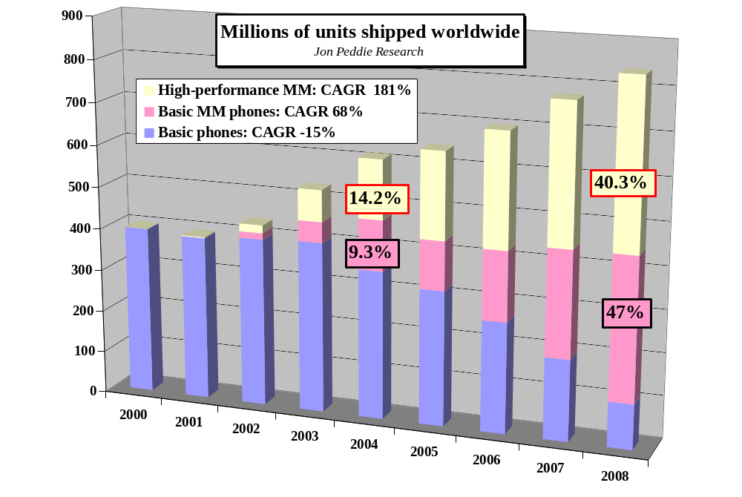
Mobile Phone Market
Predictions

Slide 18
PDAs
11.9 million PDAs shipped in 2003
4.2 million Pocket PCs in 2003
Market has slowed in growth
Adding phone capabilities
Offers the largest screen and highest resolution
FACTS

Slide 19
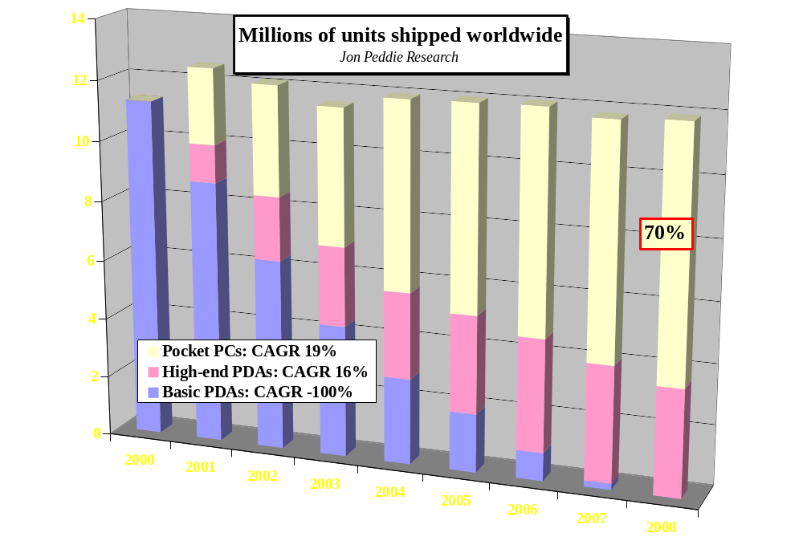
PDAs
Predictions

Slide 20
Portable Media Players
Concept design uses a 4-5" 320x240 to 704 x 480 display, 330 grams (11.5 ounces)
It is expected it will be used on a plane, train, car, or hotel room
DVR, PDA player, Docking station with TV tuner
Start shipping this year
FACTS

Slide 21
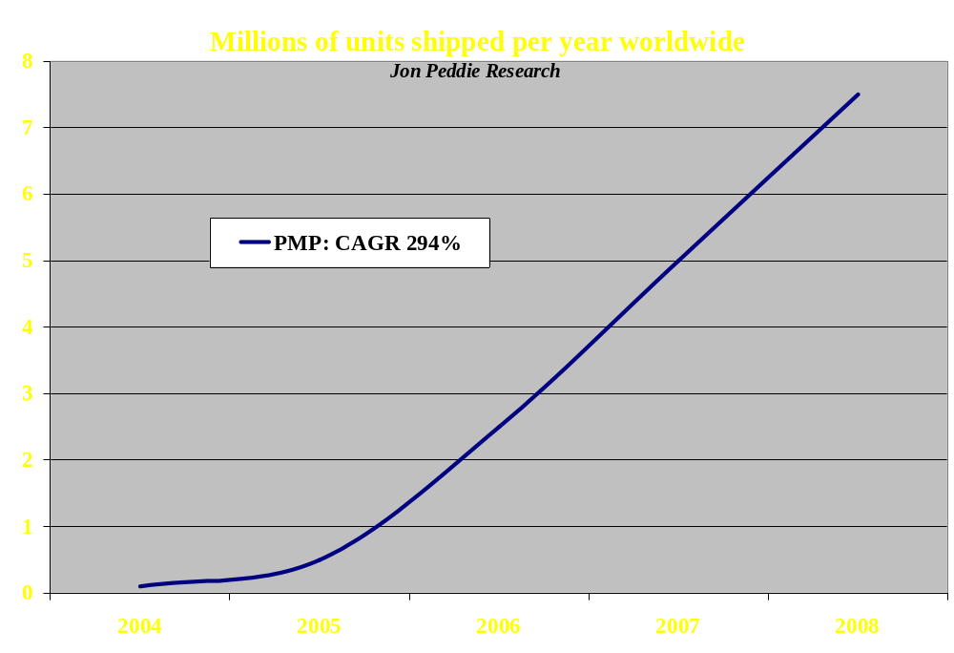
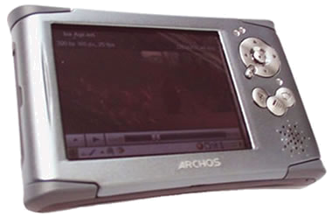
Portable Media Players
Predictions

Slide 22
Handheld Game Market
The most popular portable game machine today is the dedicated handheld: Gameboy, soon PSP
20 million users own a HH game machine today
By 2006 there will be 135 million 3D game capable phones
Mobile phone users will play and/or own several games
Mobile phone game market will reach $5 billion
FACTS
But how do you play?

Slide 23

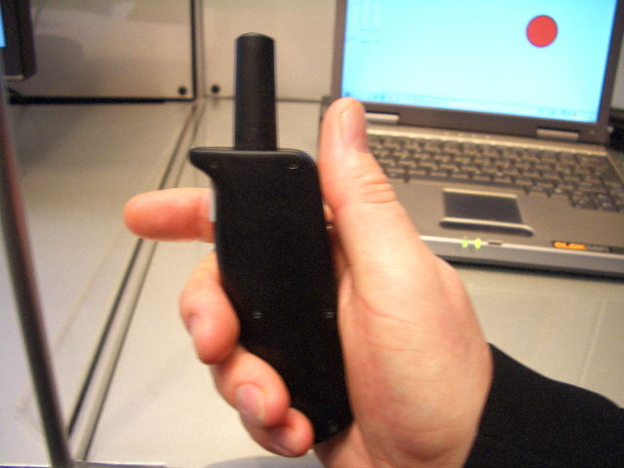
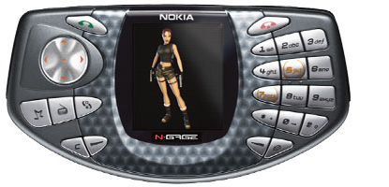
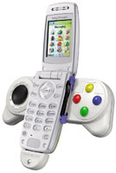
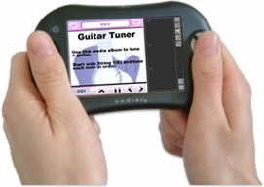
Playing games on a Handset

Slide 24
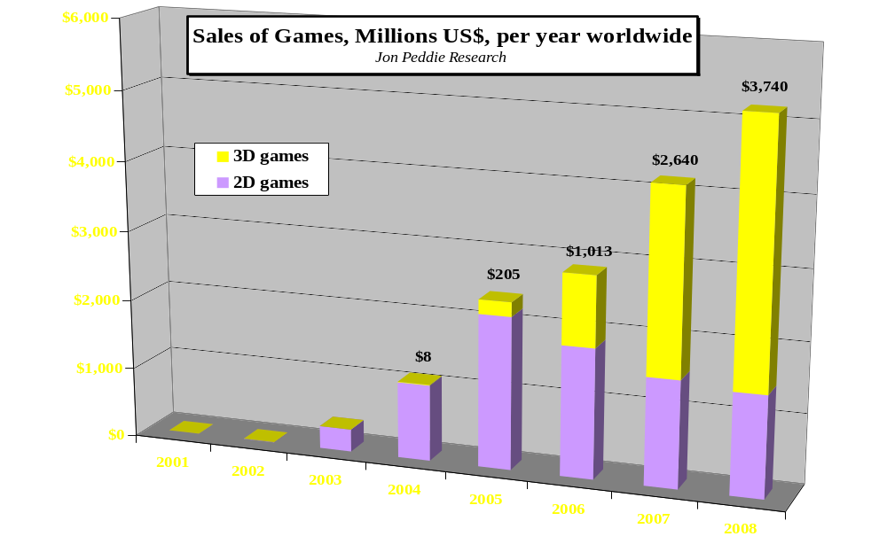
Handheld Game Market
Predictions

Slide 25
The Handheld Market
To Participate you need:
Summary
Great audio (24bit, 96kHz, 5.1 (sim), 3D)
Great video (HDTV)
DVR capability (UI, codecs, TV tuner)
Great graphics (games, web)
Great APIs to tie it all together

Slide 26

Thank you
Jon@jonpeddie.com

Slide 27
