Slide 1
OpenSL ES
Overview
Dr Nathan Charles
Creative Technology Ltd

Slide 2

The Embedded Audio Problem
Currently many closed proprietary audio APIs of varying functionality
  Playing a simple sound on different platform requires different code.
No standard way to access audio hardware acceleration
  Lots of work for developers to re-write code for every platform – no application/source level portability
Newer multimedia devices incorporating more advanced audio functionality
  Increases in audio quality & functionality further complicate the efforts of content developers aggravating the portability problem.
Solution - Open standard application level API for embedded audio !
Notes:
- Situation surprising considering audio is an integral part of mobile phones!

Slide 3

The Embedded Audio Solution
Diversified collection of embedded devices
  Target devices include “Mobile phones, personal media players & handheld gaming consoles”.
High performance, low latency access to audio
Application developer friendly
  Portability of native code form platform to platform
  Same interface for both hardware and software solutions
Support a diversified market space of embedded devices
High performance & low latency access to audio features
Open Standard API for application developers enabling application portability
Open standard for embedded audio

Slide 4



Part of Khronos Open Family
OpenSL ES compliments existing Khronos Standards
  Companion for 3D, Vector graphics, and multimedia
Applications or middleware libraries (Games, Media players, JSR’s etc.)
3D
Small footprint 3D for embedded systems
Vector 2D
Low-level vector
acceleration API
SOUND
Embedded audio
Multimedia
Embedded audio, video and imaging
EGL
Abstracted Access to OS Resources
Fast mixed mode 2D/3D rendering
Platform

Slide 5
Features
Playback of audio files
  Mandated audio format across platforms providing consistency for developers
    Support for additional optional formats in addition to mandated audio format
SP-MIDI, Mobile DLS, Mobile XMF
  For interactive music and ring-tones
Effects & Controls
  Music and media player effects
  Advanced environmental effects for gaming
3D Audio
  Provided for gaming as companion to OpenGL ES
Digital Audio
3D Audio
Controls
SP-MIDI
Effects
CODECs

Slide 6
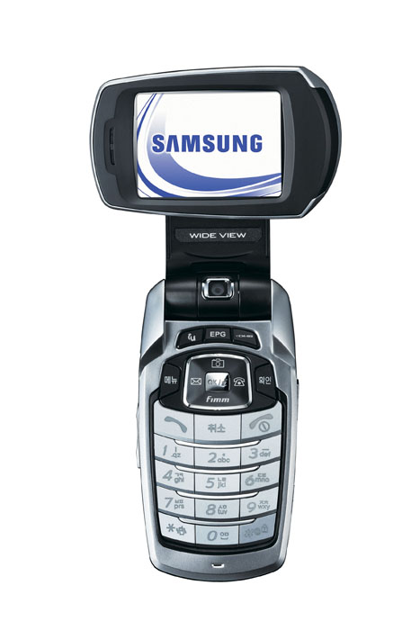
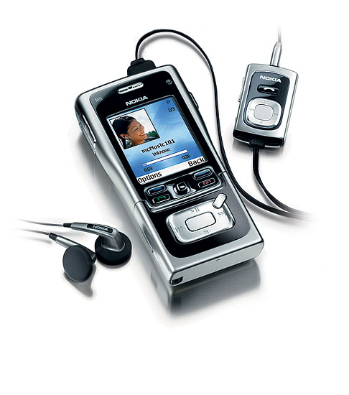
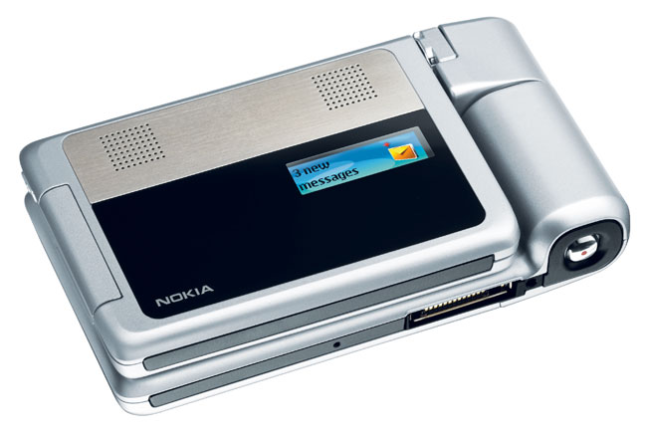
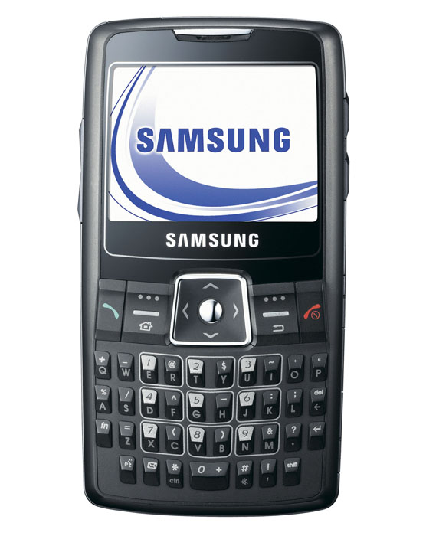
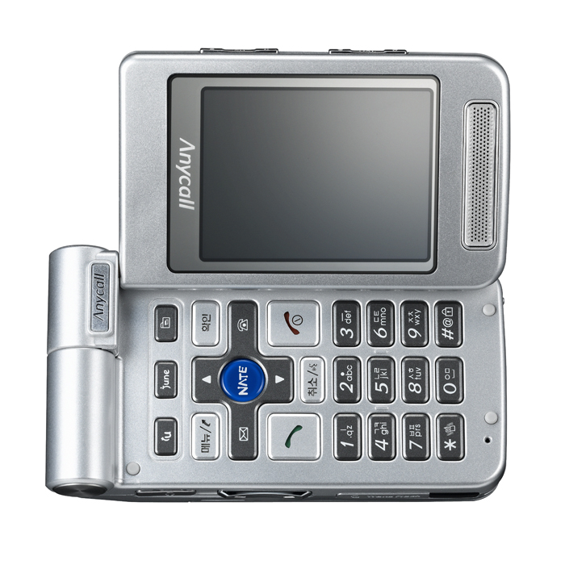
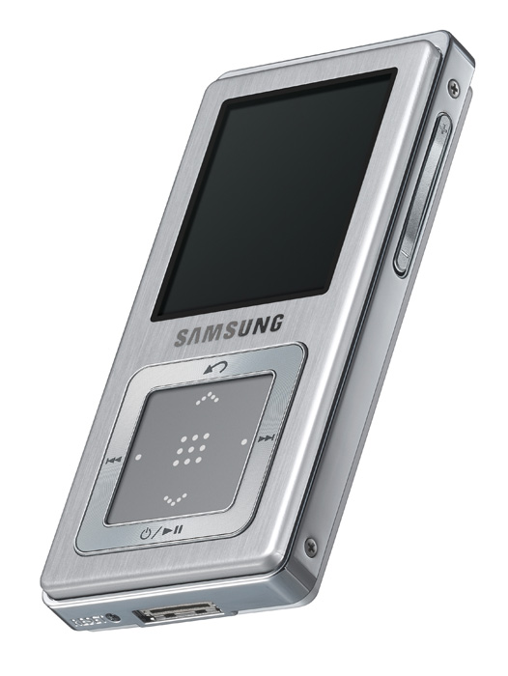
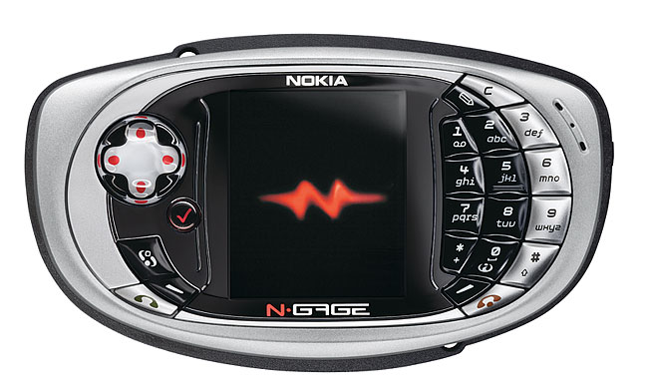
Target Devices
Examples of target devices include:
  Basic, Feature & Gaming mobile phones
  Personal Media Players & PDA’s
  Portable gaming consoles
Device requirements
  Minimum 8MB of RAM
  Minimum of 100MHz processor
  Battery powered portable handheld device.
  Audio output

Slide 7




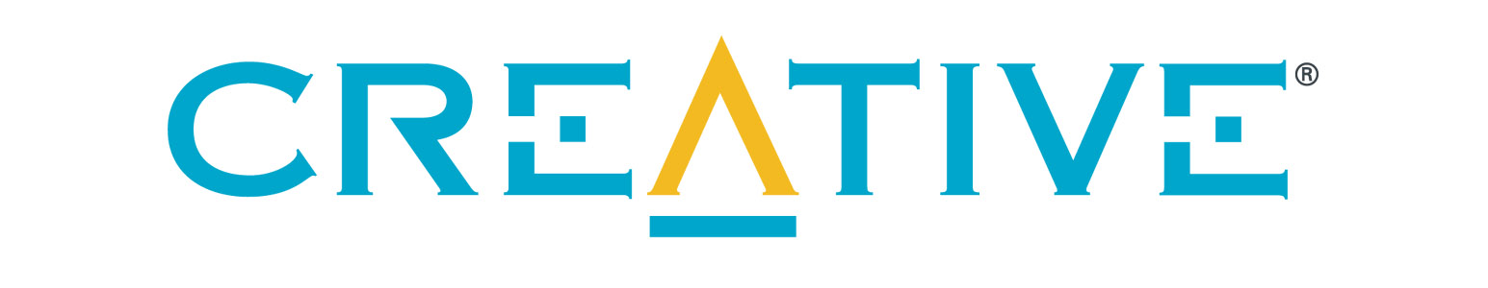


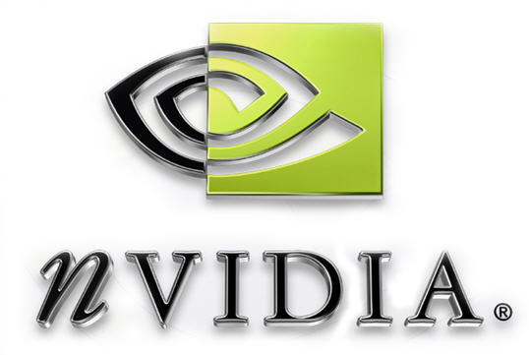










Working Group Members

Slide 8
Schedule
Khronos working group
  Started in Q4 2006
  Requirements for 1.0 release finalized
  Seeking developers to participate!
    Join Khronos working group and help shape the open standard for embedded audio.
Draft Specification for developer review
  Mid Q3 2006
  Requires signing Khronos reviewer agreement
    Provides opportunity for developers to specification issues
OpenSL ES 1.0 scheduled for release in Jan 2007
  Release includes specification & headers
OpenSL ES Started
Requirements finalized
Draft Specification Review
OpenSL ES 1.0 Released
Q4 05
Q1 06
Q2 06
Q3 06
Q4 06
Q1 07

Slide 9
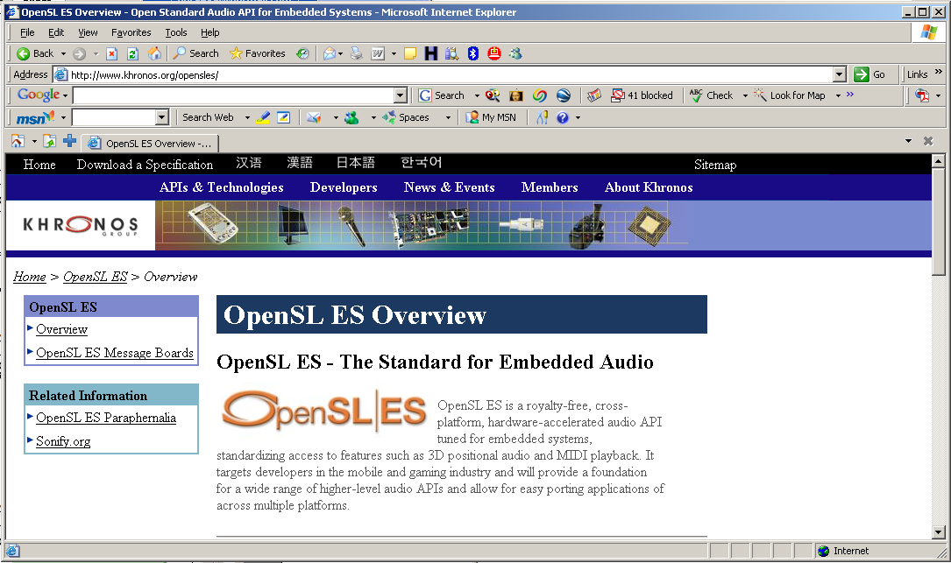
Contact information
OpenSL ES Home Page - http://www.khronos.org/opensles
  OpenSL ES Overview
  OpenSL ES Introduction Presentation
Contact us
  Marketing chair: Natan Linder <natan.linder@samsung.com>
  Technical chair: Nathan Charles <ncharles@sensaura.creative.com>

Slide 10
Thank You!

